Slide 1
BI 233 Laboratory Urinary System
Notes:
Saladin A&P: The Unity of Form and Function 6e

Slide 2
The Constituents of the Urinary System
2 Kidneys – produce urine.
2 ureters, urinary bladder, and urethra – eliminate urine.
Kidneys produce urine, which flows from…
Each kidney.
Through its ureter to the bladder.
Stored until voided by way of urethra.
Filter blood returning 99% of water and solutes.
Urination (micturition)
Elimination process.
Notes:
Martini Fundamentals of A&P 9e

Slide 3
Other Essential Homeostatic Functions of the Kidneys
Regulating blood volume and blood pressure.
Regulation of plasma.
Ionic composition (Na⁺, K⁺, Ca⁺², Cl¯ and phosphate ions).
Stabilization of pH (H⁺ and HCO₃¯).
Secretion of erythropoietin and calcitriol.
Conserving valuable nutrients.
Excretion of wastes and foreign substances.
Urea and uric acid.
Detoxifies free radicals and drugs.
Notes:
Retrieved from http://encyclopedia.lubopitko-bg.com/images/Regulation%20of%20blood%20pressure%20and%20volume.jpg, 2016

Slide 4
Surface Anatomy of Kidney
Paired kidney-bean-shaped organ.
~11.43 cm long, 6.35 cm wide, 2.54 cm thick.
Above waist between peritoneum and posterior wall of abdomen.
Retroperitoneal – situated behind peritoneum.
Protected by 11th and 12th ribs.
Right kidney positioned inferior to left.
Entering hilus (hilum) – depression on medial boarder.
Renal artery
Renal vein
Ureter
Include adrenal glands on superior pole.
Notes:
Saladin A&P Unity of Form and Function 6e

Slide 5
Connective Tissue Layers of Kidney
Renal (fibrous) capsule
Transparent membrane maintains organ shape.
Adipose capsule (perinephric fat)
Helps protect from trauma.
Renal fascia
Dense irregular CT holds against back body wall.
Notes:
Martini Fundamentals of A&P 9e

Slide 6
Internal Anatomy of the Kidneys
Kidney Structure
Renal cortex
Renal medulla
Drainage system fills renal sinus cavity.
Collect urine from papillary ducts of papilla
Minor and major calyces empty into renal pelvis
Renal pelvis empties into ureter.
Video on kidney anatomy.
Notes:
Martini Fundamentals of A&P 9e
lochness1. (2008). The Kidney by Dr. Fabian. Retrieved from https://www.youtube.com/watch?v=SVl81H7H5J4&index=2&list=PL1D3DBBCD903EC7B3

Slide 7
Blood Supply of the Kidneys
Notes:
Saladin A&P Unity of Form and Function 6e

Slide 9
The Nephron: Structural and Functional Unit of Kidney that Form Urine
Kidney has over 1 million nephrons.
Consists of a renal corpuscle and tubule.
Site of plasma filtration.
Renal corpuscle – collective term for glomerulus and surrounding capsule.
Glomerulus – tuft of capillaries.
Bowman’s capsule – enlarged end of renal tubule surrounding glomerulus.
Renal Tubule – tube into which fluid passes
Proximal convoluted tubule
Loop of Henle
Distal convoluted tubule
Two types of Nephrons
Cortical
Juxtamedullary
Notes:
Martini Fundamentals of A&P 9e

Slide 10
Cortical: Most Abundant
80-85% of nephrons are cortical nephrons.
Renal corpuscles are in outer cortex.
Short loop of Henle lie mainly in cortex.
Penetrate only into outer region of renal medulla.
Notes:
Saladin A&P Unity of Form and Function 6e

Slide 11
Juxtamedullary: Loop of Henle are Deep in Medulla
Make up 15-20% of nephrons.
Renal corpuscles near medulla.
Long loops of Henle deep into medulla.
Enable excretion of dilute or concentrated urine.
Vasa Recta capillaries around loops of Henle.
Notes:
Saladin A&P Unity of Form and Function 6e

Slide 12
Renal Corpuscle = Glomerulus + Bowman’s Capsule
Glomerular (Bowman’s) capsule surrounds capsular space.
Podocytes cover capillaries = visceral layer.
Simple squamous cells = parietal layer.
Pedicels, filtration slits, mesangial cells.
Glomerulus a knot of capillaries.
Arise from afferent arteriole (entering glomerulus).
Form a ball before emptying into efferent arteriole (exiting glomerulus).
Notes:
Saladin A&P Unity of Form and Function 6e

Slide 14
Filtration in the Renal Corpuscle
Water and dissolved substances forced out of capillaries.
Filtered through fenestrated endothelium into capsular space.
Capillaries contain ultramicroscopic pores of variable sizes
Effective and passive process – hydrostatic pressure
Podocytes are also involved in the regulation of the glomerular filtration rate, or GFR. By contracting, podocytes restrict the filtration slits and decrease GFR.
Produces protein free solution – glomerular filtrate.
Similar to blood plasma.
Except for larger protein molecules.
Useful compounds (glucose, fatty acids, amino acids and vitamins) entering capsular space will be reabsorbed at proximal convoluted tubule (PCT).
Notes:
Saladin A&P Unity of Form and Function 6e

Slide 15
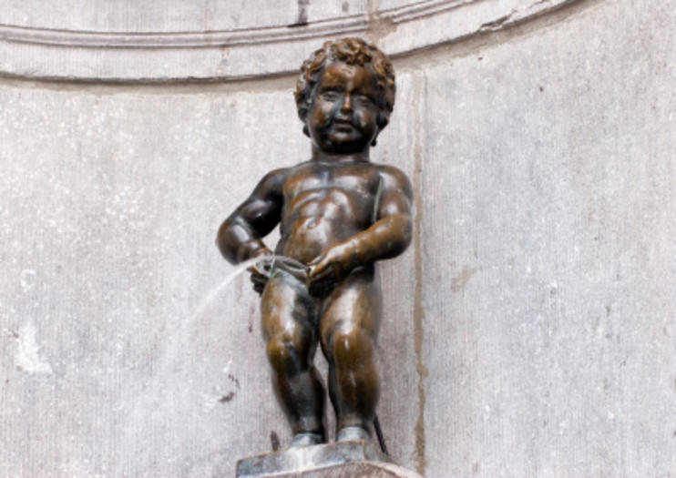
The typical kidneys filter approximately 180 liters of plasma/day
So a body’s 3 liters of plasma gets filtered about 60 times a day
To replace this much water you would have to drink a 12 ounce drink every 3 minutes
Fortunately 99% of the filtrate gets reabsorbed, leaving 1.5-2 liters of urine per day

Slide 16
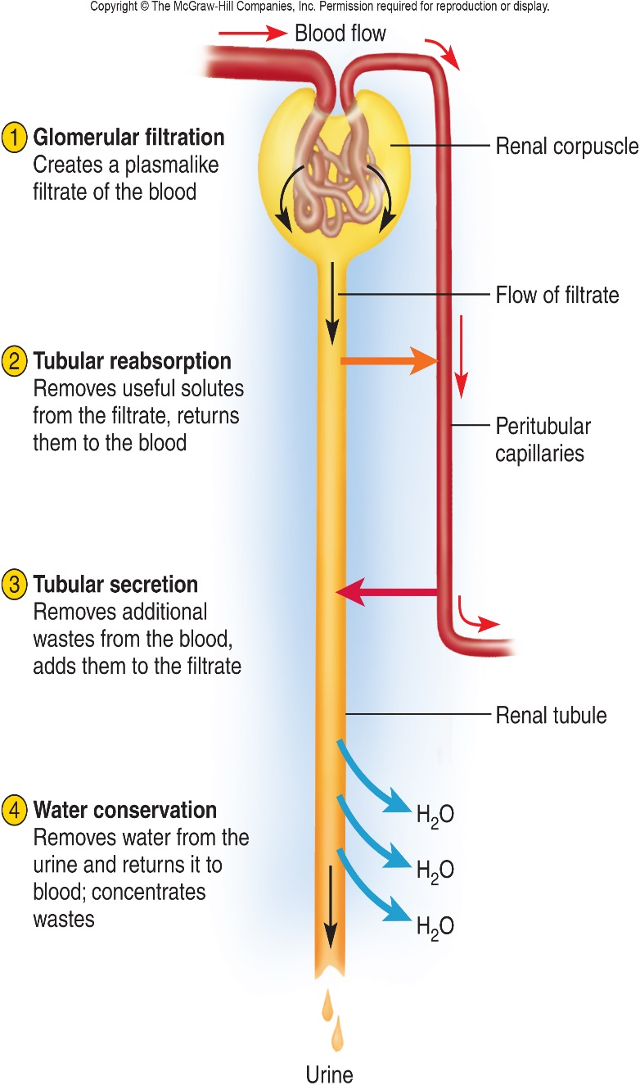
3 Basic Processes of Urine Formation
Nephrons and collecting ducts perform 3 basic processes.
Filtration
Blood pressure forces water/solutes across capillaries.
Small enough solutes pass through.
Filtrate – fluid pushed out consisting of everything except blood cells and large proteins.
Reabsorption
Removal of water and solutes from filtrate.
Solutes: diffusion or carrier proteins.
Water: osmosis.
Secretion
Process in which the renal tubule extracts chemicals from the capillary blood and secretes them into the tubular fluid.
Often primary way to get rid of some solutes (drugs).
Notes:
Saladin A&P Unity of Form and Function 6e

Slide 17
Renal Tubule
Convoluted tubules
Proximal convoluted tubule (PCT)
Distal convoluted tubule (DCT)
Nephron loop (Loop of Henle)
Empty into the collecting duct.
Three critical functions…
Reabsorption of useful organic nutrients.
Reabsorption of >90% of water.
Secretion of waste products.
Notes:
Proximal convoluted tubule: simple cuboidal with brush border of microvilli, increase surface area
Loop of Henle: dips down into medulla, descending limb of loop of Henle simple squamous, ascending limb of loop of Henle simple cuboidal to low columnar
Distal convoluted tubule: simple cuboidal epithelium, composed of principal and intercalated cells with microvilli.
Saladin A&P Unity of Form and Function 6e

Slide 18
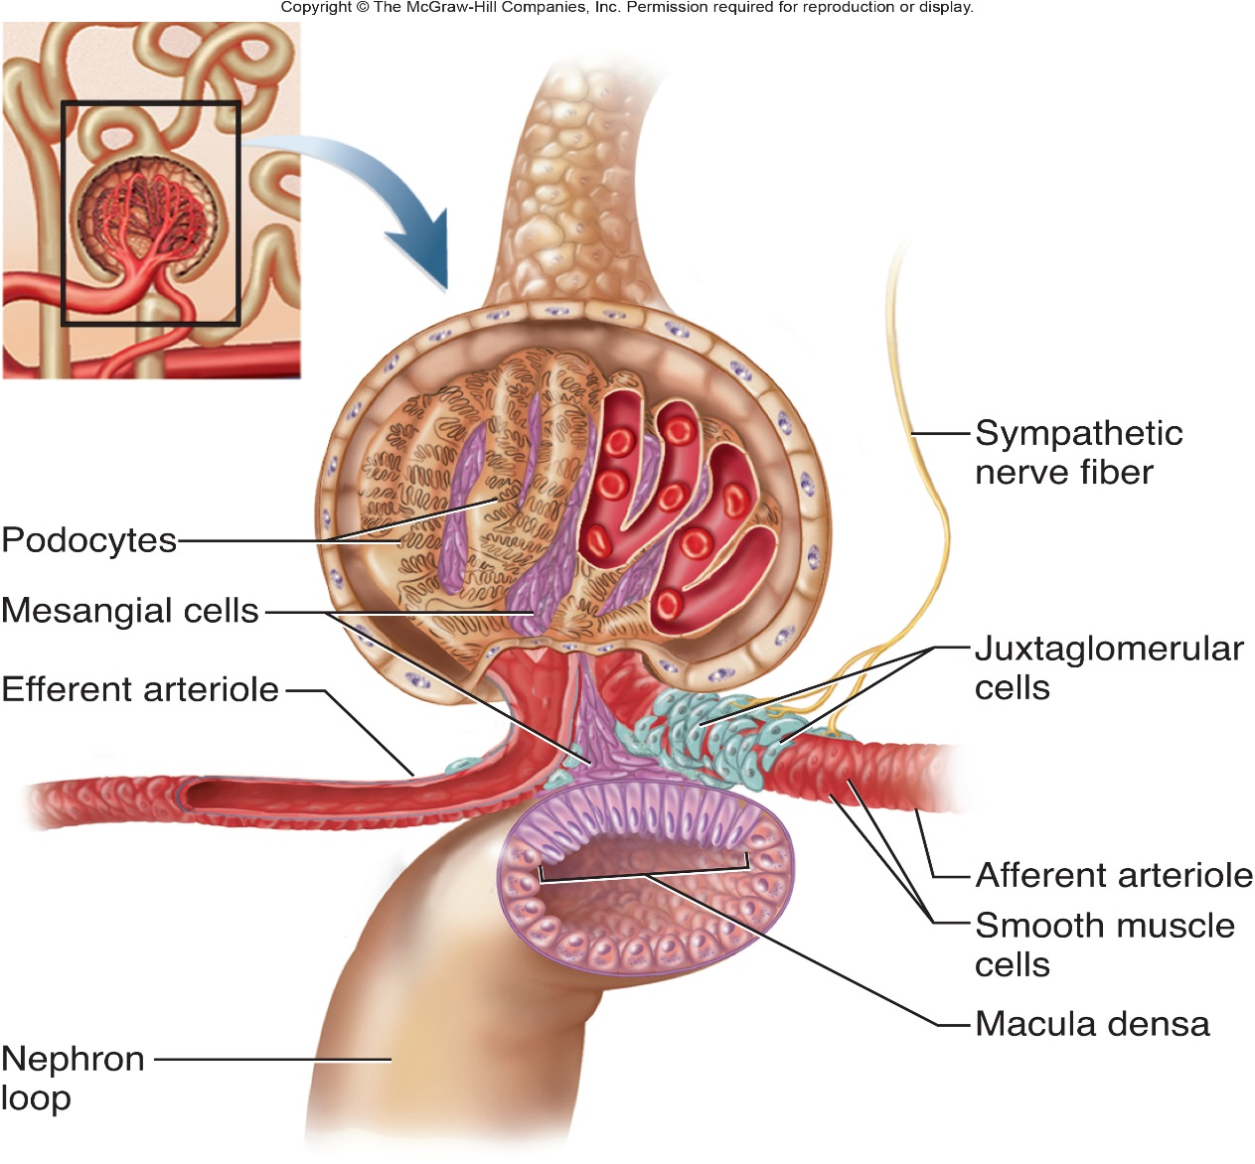
Juxtaglomerular Apparatus Consists of…
Macula densa
Part of DCT adjacent to afferent arteriole.
Sensitive to concentration of sodium.
Control release of renin.
Juxtaglomerular cells
Modified smooth muscle cells primarily in walls of afferent arteriole.
JG Cells synthesize and secrete renin…
In response to a drop in pressure detected by stretch receptors in vascular walls.
When stimulated by macula densa cells.
Notes:
Saladin A&P Unity of Form and Function 6e

Slide 19
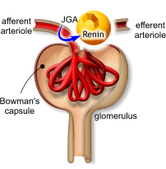
Restoring Critically Low Blood Pressure
Renin – secreted by afferent arterioles from specialized cells of juxtaglomerular apparatus (juxtaglomerular (JG) cells), in response to three stimuli:
Decrease in arterial blood pressure.
Decrease Na⁺ levels in ultra-filtrate of nephron measured by macula densa of the juxtaglomerular apparatus.
Sympathetic nervous system activity through beta1 adrenergic receptors.
Angiotensin I is produced by action of renin on the protein angiotensinogen (formed by liver).
Converted to angiotensin II (in lungs) by the action of angiotensin-converting enzyme (ACE).
Notes:
Retrieved from http://www.blobs.org/science/cells/reninsecretion.gif, 2016

Slide 20
Angiotensin II (liver)- Very potent vasoconstrictor.
Aldosterone (adrenal cortex) - Na⁺ and water retention by kidneys.
↑ blood volume and pressure.
Anti-diuretic hormone (ADH – post. pituitary) - Water retention.
Video on hormonal regulation of GFR.
Notes:
Retrieved from http://d6igaq6njxgjh.cloudfront.net/content/physrev/95/1/297/F5.large.jpg, 2016
NEState Biol. (2013). Hormonal Regulation of Glomerular Filtration Rate. Retrieved from https://www.youtube.com/watch?v=0lkXzfElwM4

Slide 21
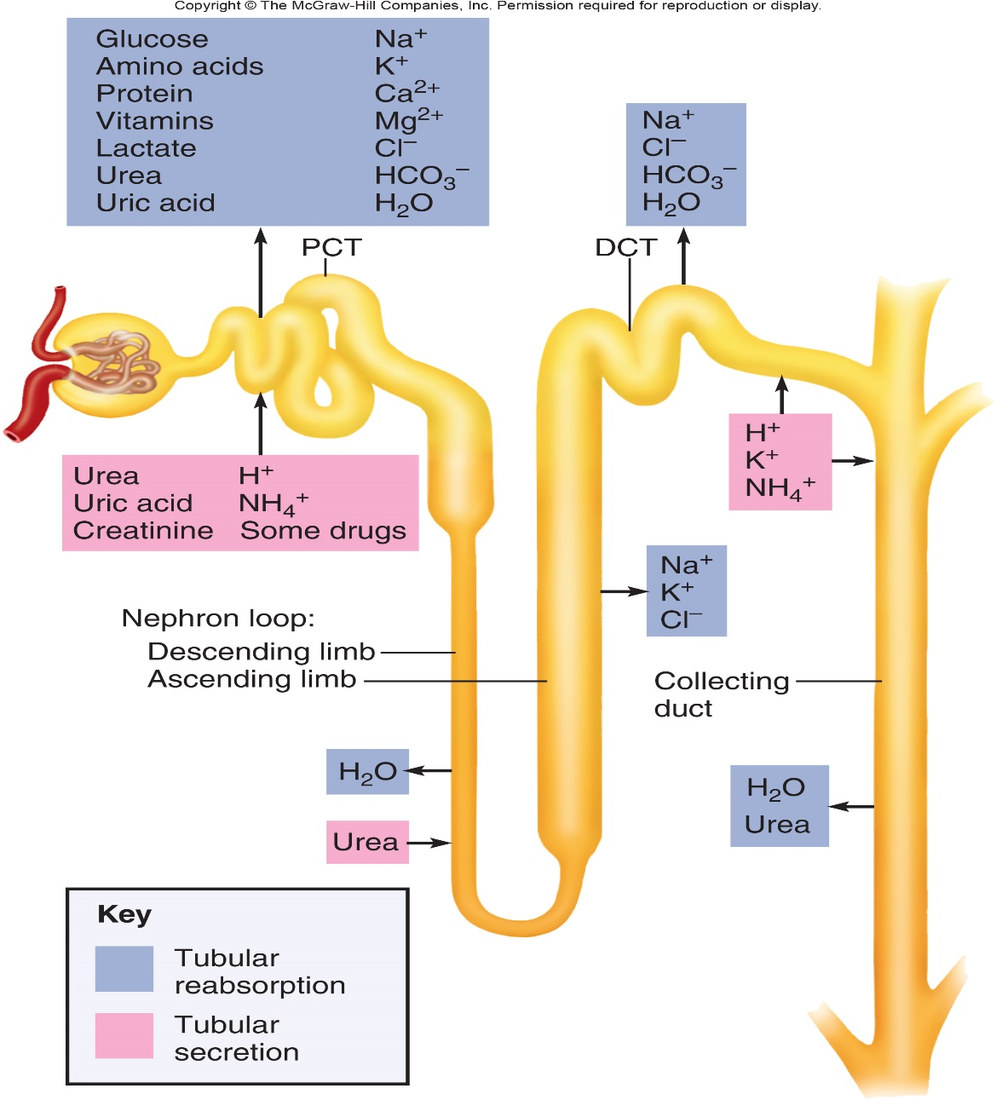
The Collecting System
Collecting duct and papillary duct
Drain urine to renal pelvis and ureter.
Papillary duct delivers to minor calyx.
Notes:
Saladin A&P Unity of Form and Function 6e
Histology image retrieved from http://faculty.une.edu/com/abell/histo/renalmedw.jpg, 2016

Slide 22
Histology - Identify
Macula Densa – on DCT adjacent to glomerulus
Parietal and Visceral layers (podycytes) of Bowmans capsule
PCT – low columnar with brush border, often stain darker
DCT – cuboidal without brush border
Collecting Duct – dense low cuboidal

Slide 24
Urine Transport, Storage, and Elimination
Consists of
Ureter (2)
Urinary bladder (1)
Urethra (1)
Pyelogram
X-ray of kidneys after intravenous administration of radiopaque contrast compound.
Notes:
Martini Fundamental of A&P 9e

Slide 25
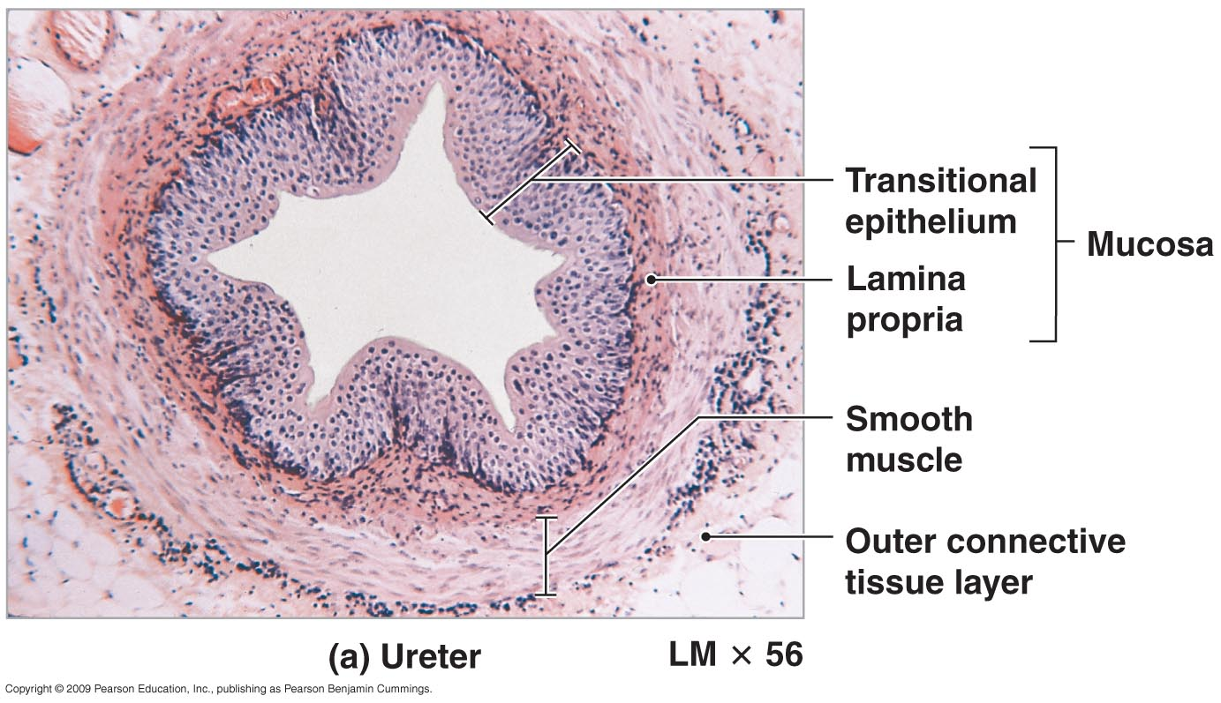
Ureters: Organs that Collect and Transport Urine
Retroperitoneal, ~30 cm long, paths differ between females and males
3 layers in wall
Mucosa is transitional epithelium and lamina propria.
Since organ must inflate and deflate.
Mucus prevents the cells from being contacted by urine.
No submucosa
Muscularis - smooth muscle
Inner longitudinal and outer circular smooth muscle layer.
Peristalsis contributes to urine flow.
Adventitia (retroperitoneal) layer of loose connective tissue anchors in place.
Contains lymphatics and blood vessels to supply ureter.
Notes:
Retrieved from http://anatomy.wikispaces.com/file/view/ureter_of_right_kidney.jpg/128049867/686x582/ureter_of_right_kidney.jpg, 2016

Slide 26
Nephrolithiasis – kidney stones

Slide 27
Urinary Bladder: Hollow, distensible muscular organ with capacity to stretch.
Posterior to pubic symphysis.
In females is anterior to vagina and inferior to uterus.
In males lies anterior to rectum.
Maximum capacity of 700 - 800 mL.
Rugae – conspicuous wrinkles in a relaxed bladder.
Trigone – 3!
Smooth flat area bordered by 2 ureteral openings and 1 urethral opening.
Transitional epithelium with capacity to stretch
Notes:
Saladin A&P Unity of Form and Function 6e

Slide 29
Bladder Histology
Mucosa
Transitional epithelium and lamina propria.
Submucosa - Some authorities do not include a submucosa in the wall of the urinary bladder--in their opinions, all of the connective tissue between the mucosa and the muscularis is part of the lamina propria of the mucosa
Muscularis
aka Detrusor muscle
3 layers of smooth muscle.
Adventitia
Layer of loose connective tissue anchors in place.
Superficial surface has serosa layer (visceral peritoneum).
Notes:
Retrieved from http://www.histology-world.com/photomicrographs/bladder1label.jpg, 2016

Slide 30
1. What is the name of the smooth muscle that makes up the bladder wall?
Detrussor
2. What type of muscle forms the internal urethral sphincter?
involuntary smooth
3. What type of muscle forms the external urethral sphincter?
voluntary striated
4. What part of the bladder or urethra is innervated by sympathetic neurons?
Detrussor relaxed, internal sphincter tight.
5. When are parasympathetic inputs to the bladder inhibited and when activated?
Detrussor activated, internal sphincter relaxed.

Slide 31
Position of the Urinary Bladder: Females
Urethra – 3-4 cm long
Bound to anterior wall of vagina by fibrous connective tissue and inferior to uterus.
External urethral orifice lies between vaginal orifice and clitoris.
Due to shorter length and relative position of external urethral orifice, when are more susceptible to urethritis and cystitis.
Other relative structures – rectum.
Notes:
Martini Fundamental of A&P 9e

Slide 32
Position of the Urinary Bladder: Males
Urethra – 18 cm long
Lies anterior to rectum.
Travels through prostate and length of penis.
3 distinct regions…
Prostatic urethra
Membranous urethra
Spongy (penile) urethra
Notes:
Martini Fundamental of A&P 9e

Slide 33
Histology of the Urethra
Transitional epithelium changing to non-keratinized stratified squamous epithelium.
Lamina propria with elastic fibers and circular smooth muscle.
Notes:
Martini Fundamental of A&P 9e

Slide 34
Overview: Renal Function
Notes:
Martini Fundamentals of A&P 9e

Slide 35
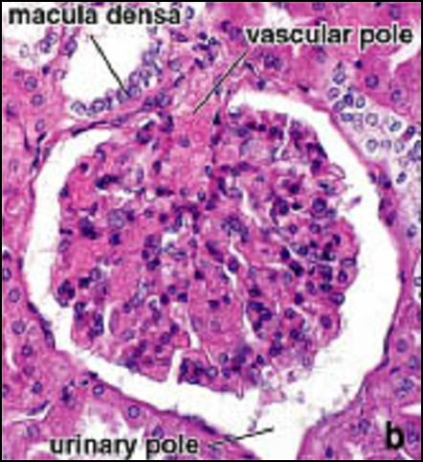
Activities
Review all models relating to the urinary system.
Histology of the kidney: microscopic observation.
Kidney dissection.
Complete all questions presented in Survival Guide (pgs. 226-232)
Notes:
Retrieved from https://classconnection.s3.amazonaws.com/595/flashcards/1500595/png/picture11352169042354.png, 2016

Slide 37
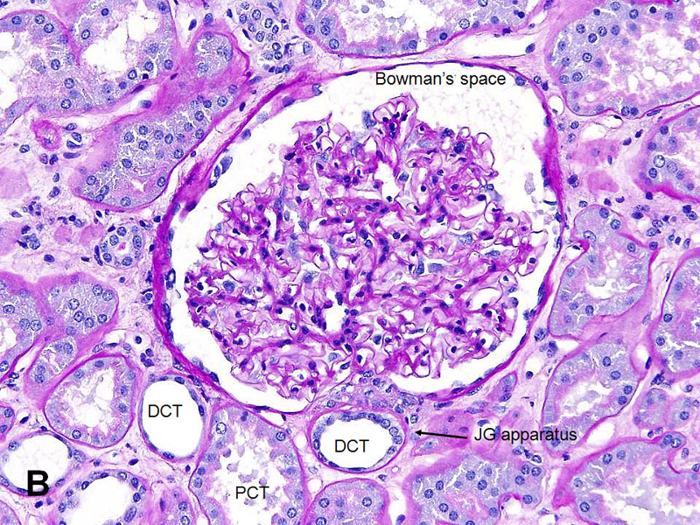

Slide 38
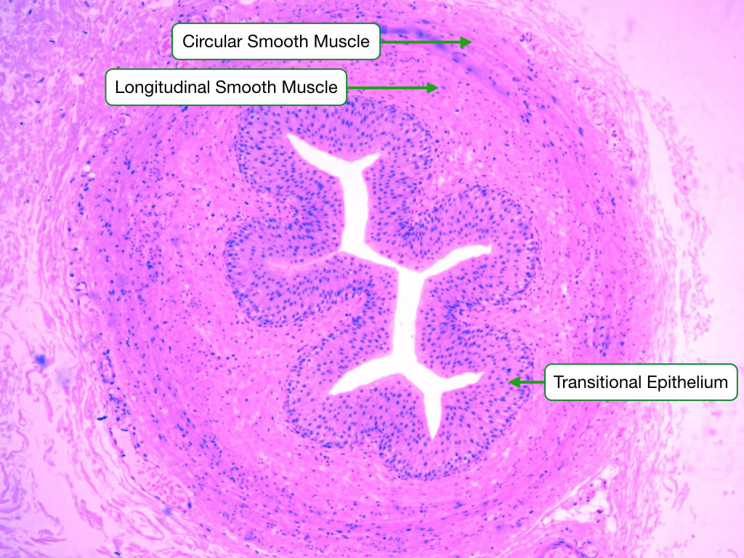

Slide 40
References
Marieb, E. N. (2012). Essentials of human anatomy & physiology
(6th ed.). Boston: Pearson Education, Inc.
Marieb, E.N., Mitchell, S.J. & Smith, L.A. (2012). Human anatomy and physiology laboratory manual (10th ed.). Boston: Pearson Education, Inc.
Martini, F., Nath, J. & Bartholomew, E.F. (2012). Fundamentals of anatomy & physiology (9th ed.). Boston: Pearson Education, Inc.
McPhee, J. & Papadakis, M. (2012) Current medical diagnosis & treatment (51st ed.). New York: McGraw Hill.
Patton, T. & Thibodeau, G. (2013). Anatomy & physiology (8th ed.).
St. Louis:Mosby Elsevier.
Saladin, K. S. (2012). Anatomy & physiology: The unity of form and function (6th ed.). New York: McGraw Hill.
Tortora, G.J. & Derrickson, B.H. (2012). Principles of anatomy and physiology (13th ed.). Hoboken, NJ: Wiley

