Slide 1
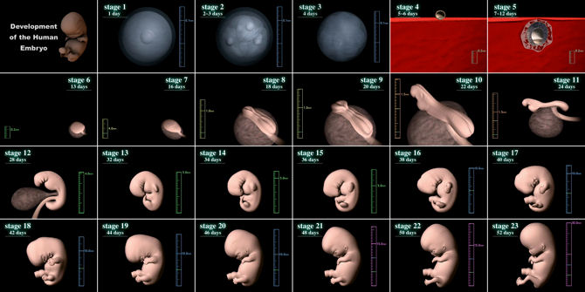
BI 233 Laboratory
Human
Development
Notes:
Retrieved from http://www.exploringnature.org/graphics/anatomy/Header_genetics.jpg, 2016

Slide 2
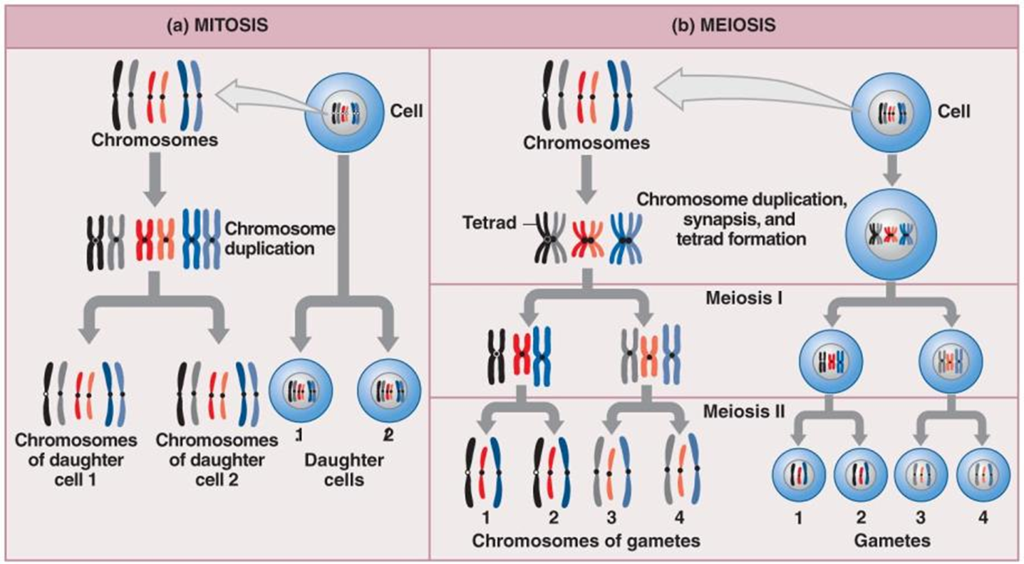
Spermatogenesis Involves:
Mitosis, Meiosis and Spermiogenesis
Video on spermatogenesis
Notes:
Mitosis
Part of somatic cell division
Produces two diploid daughter cells
Both have identical pairs of chromosomes
Meiosis
Specialized form of cell division only in production of gametes
Spermatozoa in males
Oocytes in females
Gametes contain 23 chromosomes, half the normal amount
Fusion of male and female gametes produces zygote with 46 chromosomes
Martini Fundamentals of A&P 9e
Janux. (2015, Jan 10). Human physiology – reproduction: Spermatogenesis. Retrieved from https://www.youtube.com/watch?v=krSMZDsjLuU

Slide 3
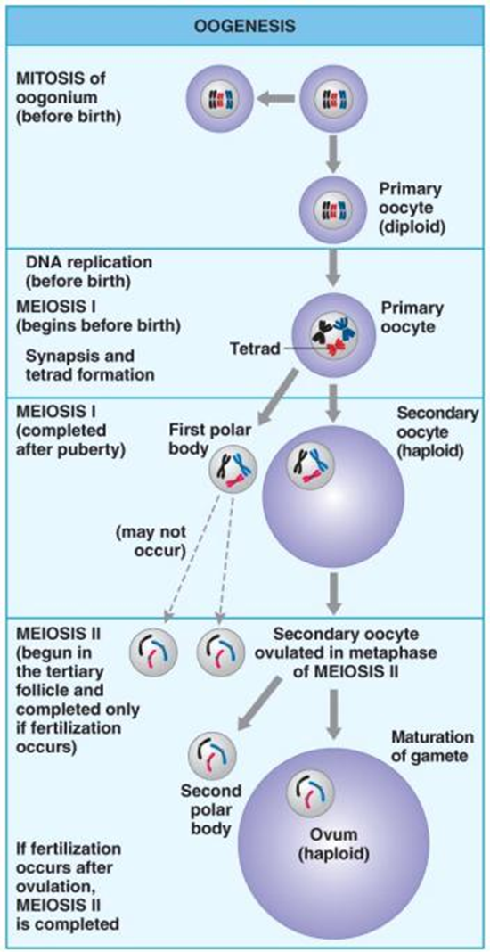
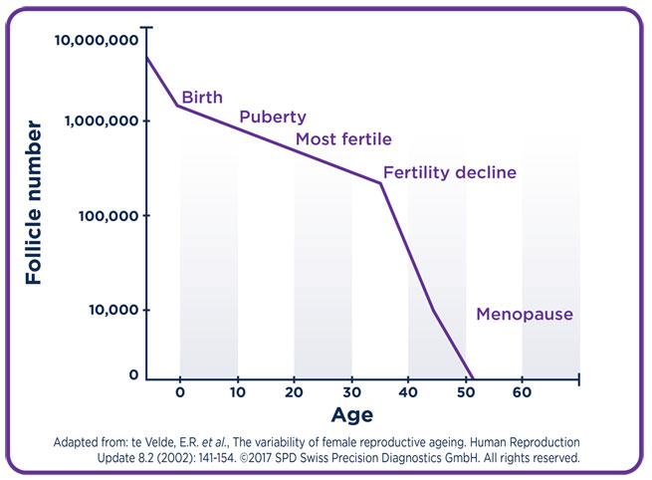
The Process of Oogenesis
  AKA: ovum production – before birth
  2 million at birth
  11,000 die every month.
  Accelerates at & after puberty.
  Ends at menopause.
Notes:
Mitosis
As a fetus, oogonia divide to produce millions by mitosis with most degenerating (atresia)
Meiosis occurs between 3rd -7th month (fetus) producing primary oocyte suspended in prophase of meiosis I
~2 million primary oocytes in primordial follicles at birth
At puberty: 400,000
Meiosis I
At puberty, FSH triggers ovarian cycle
Each month after ovarian cycle begins, some of the primary oocytes are stimulated and undergo further development
Meiosis I is then completed yielding a secondary oocyte and a polar body
Meiosis II
Each month ovarian cycle begins releasing one or more secondary oocytes suspended in metaphase of meiosis II and will be completed only if fertilization occurs
Polar body produced in meiosis I may or may not undergo meiosis II
In either case the polar body soon degenerates
Martini Fundamentals of A&P 7e
Sanghvi, S. (2014, Dec 18). Oogenesis Animation 2. Retrieved from https://www.youtube.com/watch?v=0-Q4V9tJ_18

Slide 4
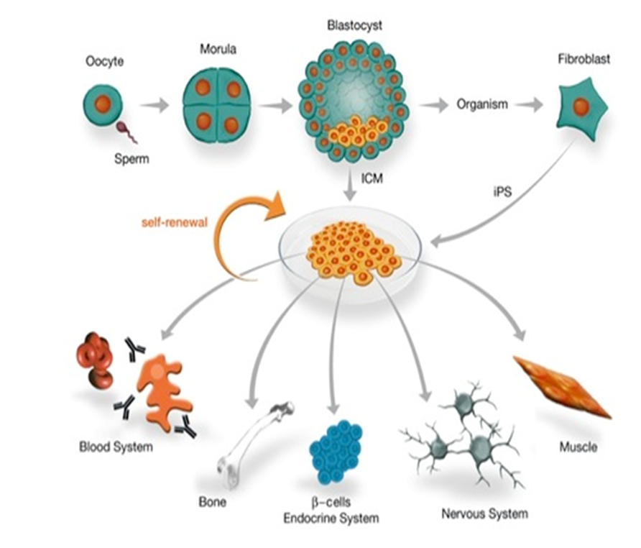
From Start of a Single Cell…
Becomes the Being Containing Trillions
Fertilization
  AKA: conception
  Marks beginning of development
Differentiation
  Formation of different types of cells
  Selective changes in genetic activity
    Genes are turned off, while others are turned on
Notes:
Retrieved form https://www.mdc-berlin.de/37695335/ve_disorders/Research_topics/Stem_cells__transcription_factors_and_epigenetic_regulation/ES_cell_regulation.jpg, 2016
Medicine forever. (2014, Jul 1). Life in the womb (9 months in 4 minutes) [video file]. Retrieved from https://www.youtube.com/watch?v=-jlPdMKPyZY

Slide 5
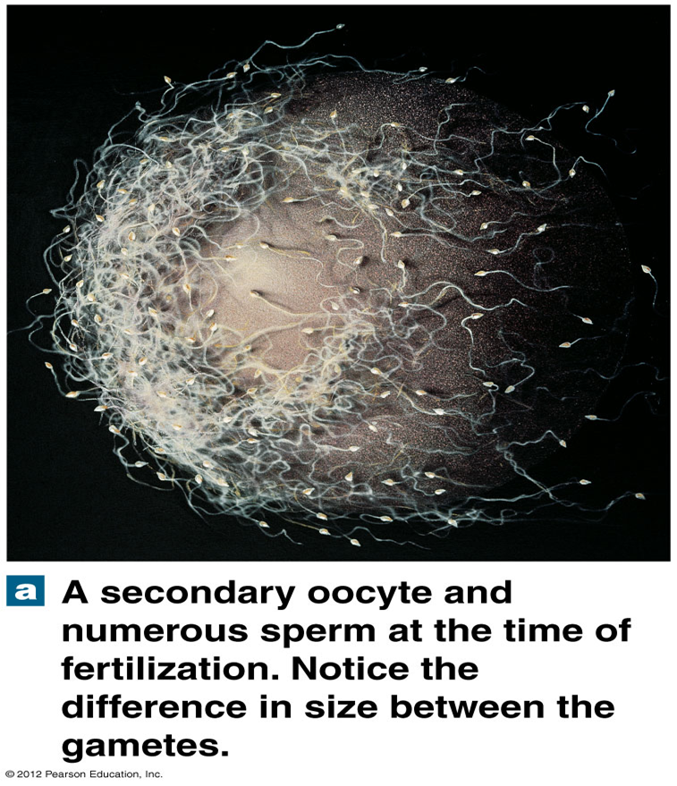
Fertilization Defined
Fusion of two haploid gametes each containing 23 chromosomes
Produces zygote containing 46 chromosomes
2000:1 size ration
Typically occurring in uterine tube.
  Junction of ampulla and isthmus.
Sperm reach uterine tube from 30 – 120 min.
Notes:
Martini Fundamentals of A&P 9e

Slide 6
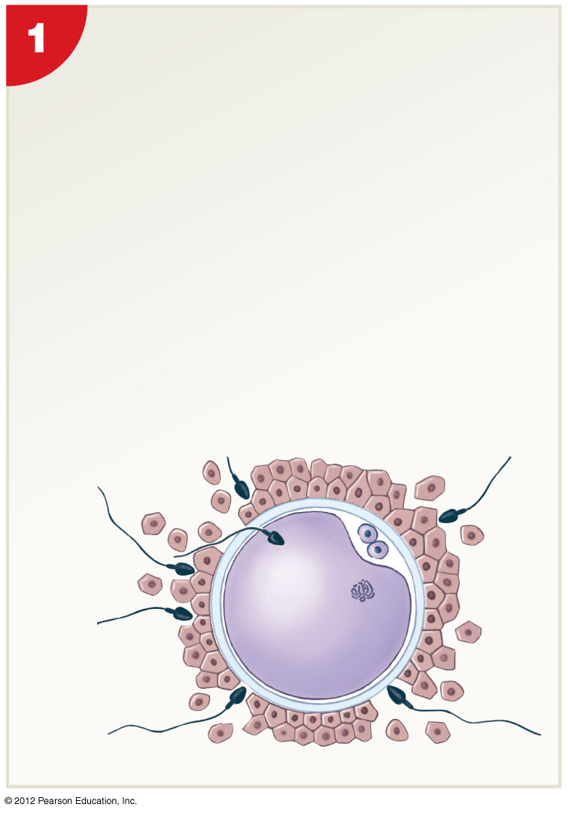
Activation of the Oocyte
~ 200 sperm reach isthmus. (from 100 million)
Hyaluronidase released from acrosomal cap.
1 sperm pushes through corona radiata.
Binding sperm triggers rupture of acrosome.
Acrosin digests path through zona pellucida.
Sperm and oocyte membranes fuse.
Activation of oocyte triggered.
Completion of meiosis II
Fertilizing
spermatozoon
Second polar
body
Notes:
Trigger for activation is contact and fusion of plasma membranes of sperm and oocyte
Includes depolarization of oocyte membrane du to ↑ permeability to NaCl and a release of Ca⁺² ions from smooth ER. This rise in Ca⁺² has important effects and includes a series of changes in metabolic activity of oocyte:
Cortical reaction – releases enzymes that inactivate sperm receptors and harden zona pellucida preventing polyspermy (fertilization by multiple sperm)
Completion of meiosis II and formation of 2nd polar body
Activation of enzymes that cause a rapid ↑ in cell’s metabolic rate – mRNA strands activated accelerating protein synthesis required for development to proceed
Martini Fundamentals of A&P 9e

Slide 7
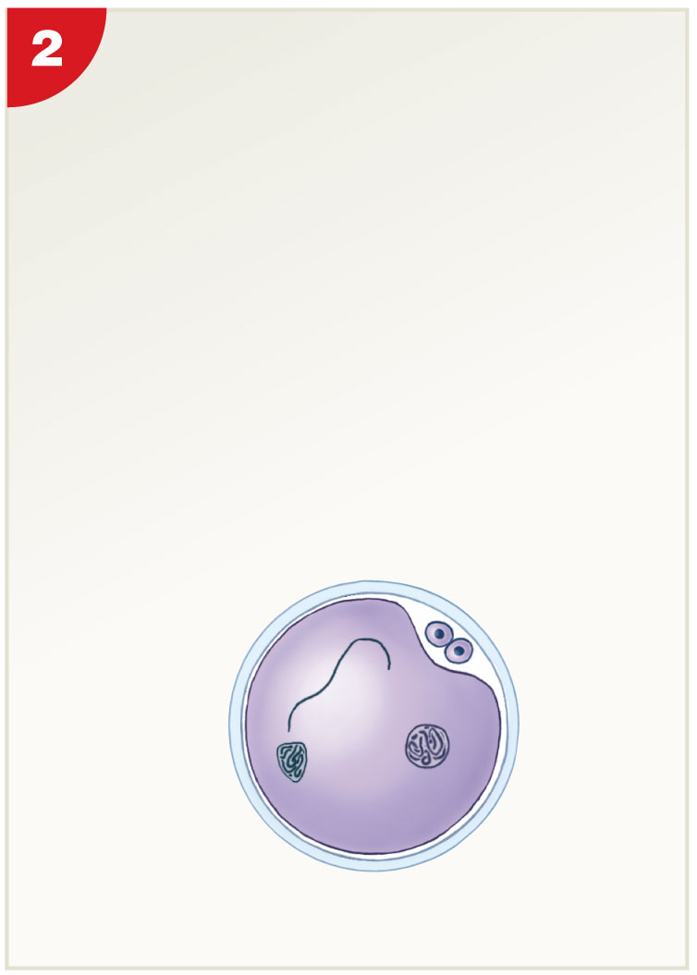
Pronucleus Formation Begins
Cortical reaction…
  Inactivation of sperm receptors.
Completion of meiosis II, 2nd polar body forms.
Activation of metabolic enzymes.
  mRNA activation for protein synthesis.
Sperm is absorbed into cytoplasm.
Female pronucleus develops.
Female
pronucleus
Nucleus of fertilizing
spermatozoon
Notes:
7
Martini Fundamentals of A&P 9e

Slide 8
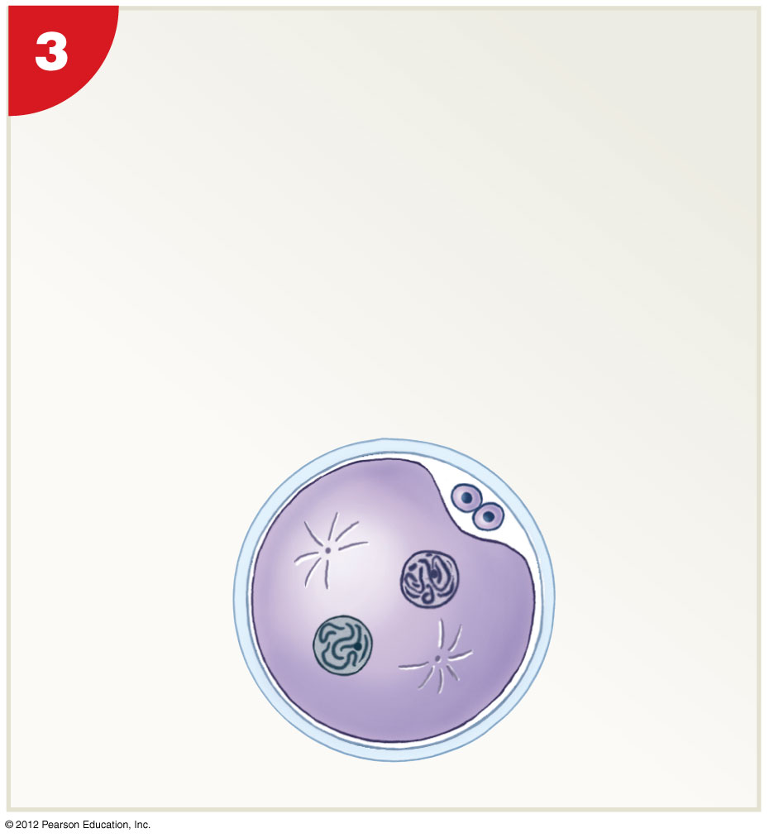
Spindle Formation and Cleavage Preparation
Male pronucleus migrates to center of cell.
Spindle fibers form.
Mark preparation for first cleavage division.
Female
pronucleus
Male
pronucleus
Notes:
8
Martini Fundamentals of A&P 9e

Slide 9
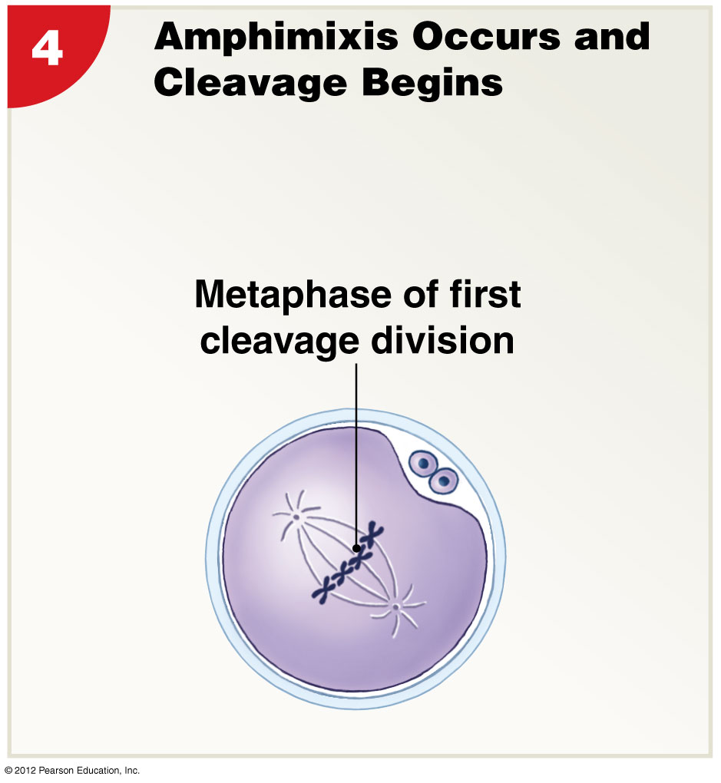
Fusion of Pronuclei = Amphimixis = Conception
Fusion of female and male pronuclei.
Moment of conception.
Now a zygote with 46 chromosomes.
Fertilization is officially complete.
First cleavage division begins.
Notes:
Martini Fundamentals of A&P 9e

Slide 10
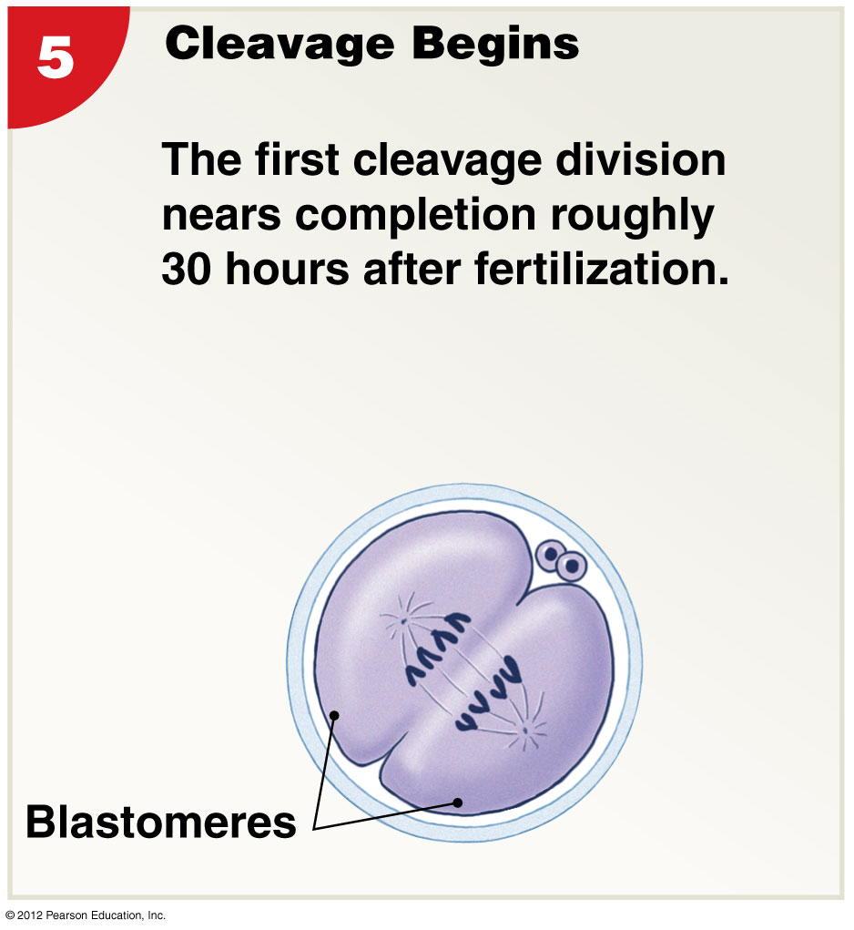
First Cleavage Forms Blastomeres
First cleavage division
  Completion ~30 hours after fertilization.
  Yields two daughter cells.
  Each half the size of original zygote.
  Known as blastomeres.
Notes:
Cleavage – a series of cell divisions producing an ever-increasing number of smaller and smaller daughter cells
Martini Fundamentals of A&P 9e

Slide 11
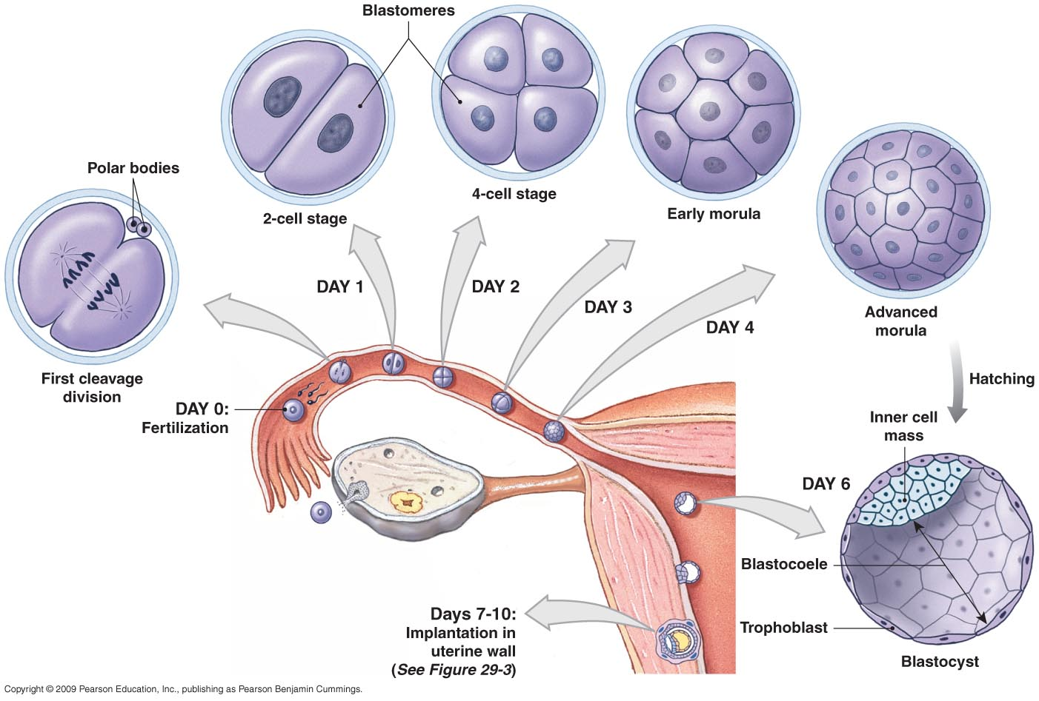
Cleavage and Blastocyst Formation
The inner cell mass will form the embryo
Notes:
Blastomeres
Identical cells produced by cleavage divisions
First division completed in ~30 hours
Subsequent divisions occurring at intervals of 10-12 hours
Morula
Presents with three days of cleavage
Pre-embryo – solid ball of cells, resembles mulberry
Reaches uterus on day 4
Blastocyst
Formed by blastomeres
Hollow ball with an inner cavity known as blastocoele
Trophoblast
Outer layer of cells separating outside world from blastocoele
Cells providing nutrients to developing embryo
Inner cell mass
Clustered at end of blastocyst and exposed to blastocoele
Trophoblasts provide protection from outside environment
Ultimately forms embryo
Martini Fundamentals of A&P 9e

Slide 12
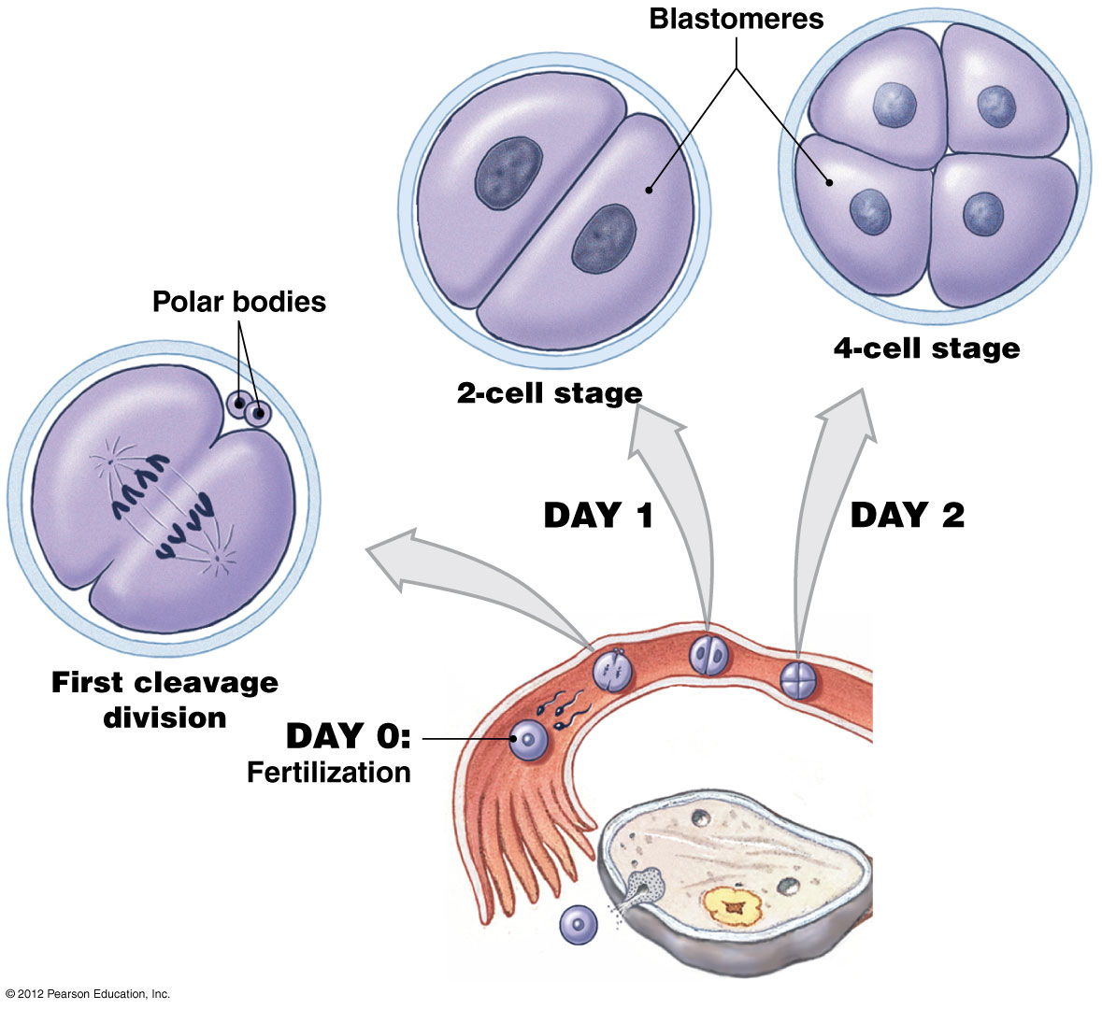
Fertilization to Day 2
Blastomeres
  Identical cells produced by cleavage divisions.
  First division completed in ~30 hours.
  Subsequent divisions occurring at intervals of 10-12 hours.
Notes:
Martini Fundamentals of A&P 9e

Slide 13
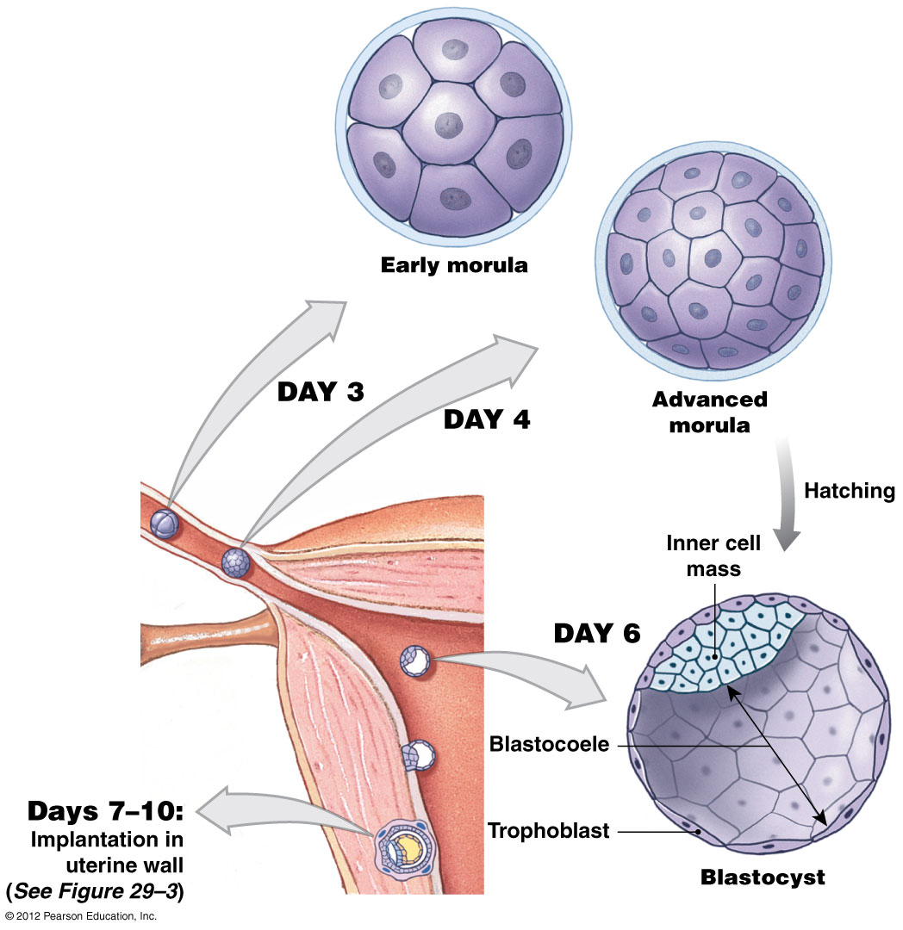
Day 3 to Blastocyst Formation
Morula (pre-embryo)
  Solid ball of cells, “mulberry”
Blastocyst
  Hollow ball containing 3 parts.
  1. Blastocoele
  2. Trophoblast
    Outer layer of cells.
    Provides nutrients to embryo.
    Takes part in placental formation.
  3. Inner cell mass
    Ultimately forms embryo.
Notes:
Morula
Presents with three days of cleavage
Pre-embryo – solid ball of cells, resembles mulberry
Reaches uterus on day 4
Blastocyst
Formed by blastomeres
Hollow ball with an inner cavity known as blastocoele
Trophoblast
Outer layer of cells separating outside world from blastocoele
Cells providing nutrients to developing embryo
Inner cell mass
Clustered at end of blastocyst and exposed to blastocoele
Trophoblasts provide protection from outside environment
Ultimately forms embryo
Martini Fundamentals of A&P 9e

Slide 14
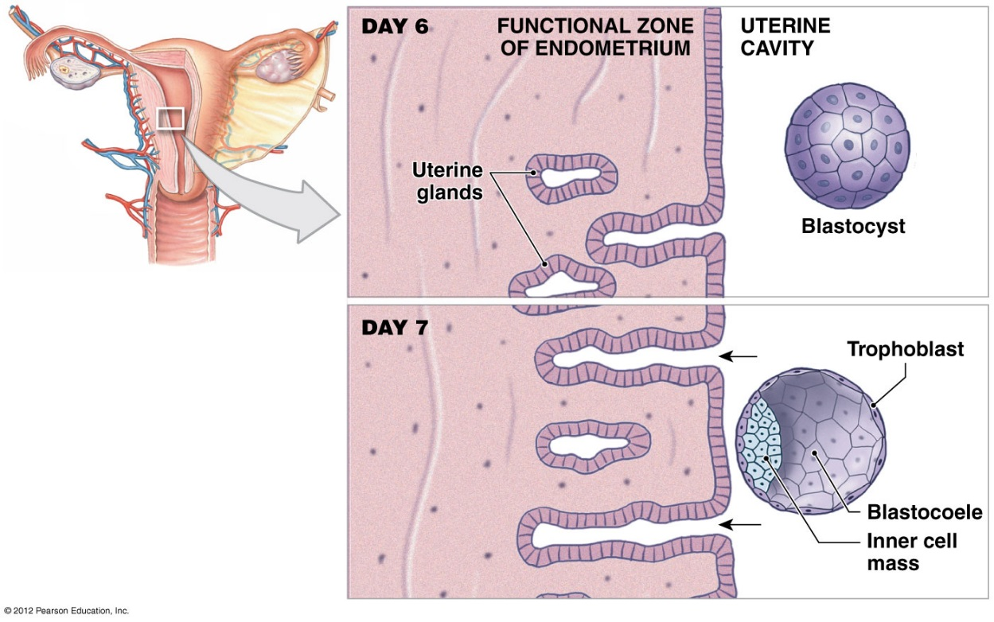
Stages in Implantation: Days 6 and 7
Implantation occurs seven days after fertilization.
Blastocyst attaches to endometrium.
Trophoblast will adhere to the endometrium.
Inner cell mass side facing the uterine wall.
Uterine glands secrete glycogen-rich fluid
Notes:
Martini Fundamentals of A&P 9e

Slide 15
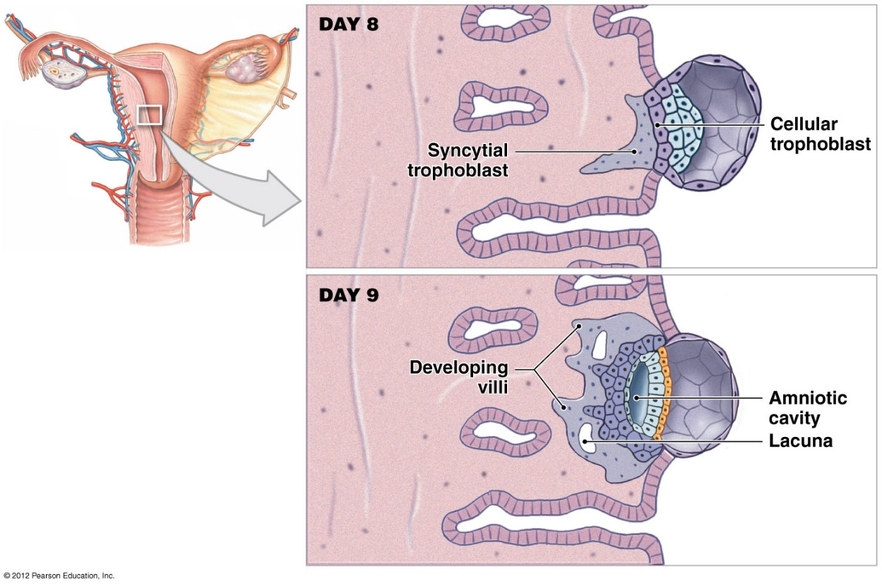
Stages in Implantation: Days 8 and 9
Trophoblast cells proliferate forms 2 layers.
Syncytiotrophoblast
  Perimeter touching endometrium.
Cytotrophoblast
  Interior of trophoblast retaining cell boundaries.
Creates syncytium
Syncytiotrophoblast erodes path.
  Hyaluronidase enzyme
Ectopic pregnancy (aka tubal pregnancy)
  https://www.youtube.com/watch?v=bIdJOiXpp9g
Notes:
Rapidly dividing trophoblast cells create several layers
Cellular trophoblast - closest to interior of blastocyst
Syncytial trophoblast - provides outer layer, cells secrete hyaluronidase, which erodes path through epithelium of uterus
By day 10 blastocyst loses contact with uterine cavity and all future development occurs with functional zone
Lacunae - trophoblastic channels carrying maternal blood
Villi - extend away from trophoblasts gradually increasing in size and complexity until day 21
Syncytial trophoblast spread breaking down larger endometrial veins and arteries accelerating blood flow through lacunae
Formation of the Amniotic Cavity
Amniotic cavity - fluid-filled chamber
Inner cell mass is organized into an oval sheet two layers thick
Superficial layer faces amniotic cavity
Ectopic Pregnancy
Implantation occurs outside uterus
Does not produce viable embryo
Can be life threatening
Martini Fundamentals of A&P 9e

Slide 16
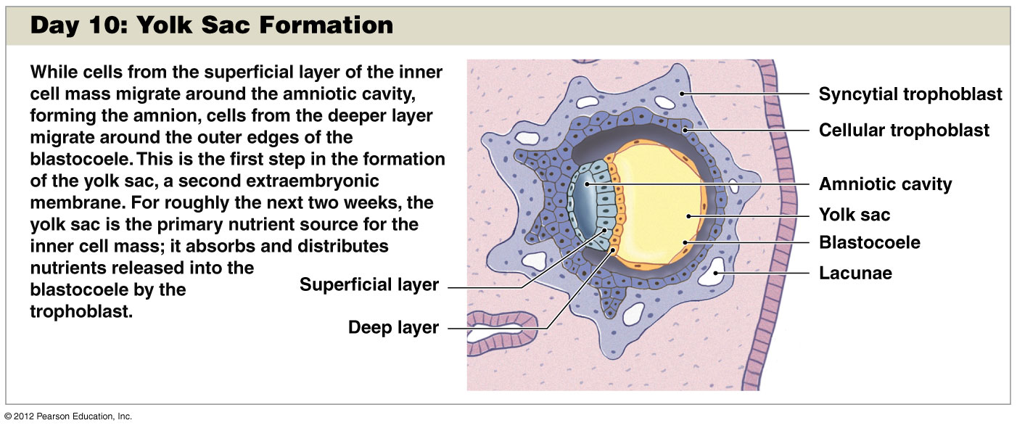
Amniotic Cavity and Yolk Sac Formation
Implanted blastocyst covered by endometrial cells.
Chorionic villi
  Extend into maternal blood filled lacunae.
Inner cell mass (ICM)
  Organizes to become embryonic disc.
  Ectoderm layer
    Forms amniotic cavity.
  Endoderm layer
    Forms yolk sac.
Amnion
  Cushions developing embryo and fetus.
Yolk sac primary nutrient source ICM.
Notes:
By day 10 blastocyst loses contact with uterine cavity and all future development occurs with functional zone
Lacunae - trophoblastic channels carrying maternal blood
Chorionic villi - extend away from trophoblasts gradually increasing in size and complexity until day 21
Extensions of cytotrophoblast covered by Syncytiotrophoblast extending into maternal blood filled spaces (lacunae)
Maternal blood exchange nutrients through villi that will eventually contain embryonic vessels
Syncytial trophoblast spread breaking down larger endometrial veins and arteries accelerating blood flow through lacunae
Formation of the Amniotic Cavity
Amniotic cavity - fluid-filled chamber
Inner cell mass is organized into an oval sheet two layers thick
Superficial layer faces amniotic cavity (ectoderm)
Deeper layer exposed to fluid contents of blastocoele (endoderm)
Ectoderm cells migrate around amniotic cavity forming amnion
Fluid and membranes will surround and cushion the developing embryo and fetus
Yolk sac formation
Cells from endoderm migrate around blastocoele being first step in formation of yolk sac
Primary nutrient source for ICM for ~ 2 weeks
Absorbs and distributes nutrients released into blastocoele by trophoblast
Martini Fundamentals of A&P 9e

Slide 17
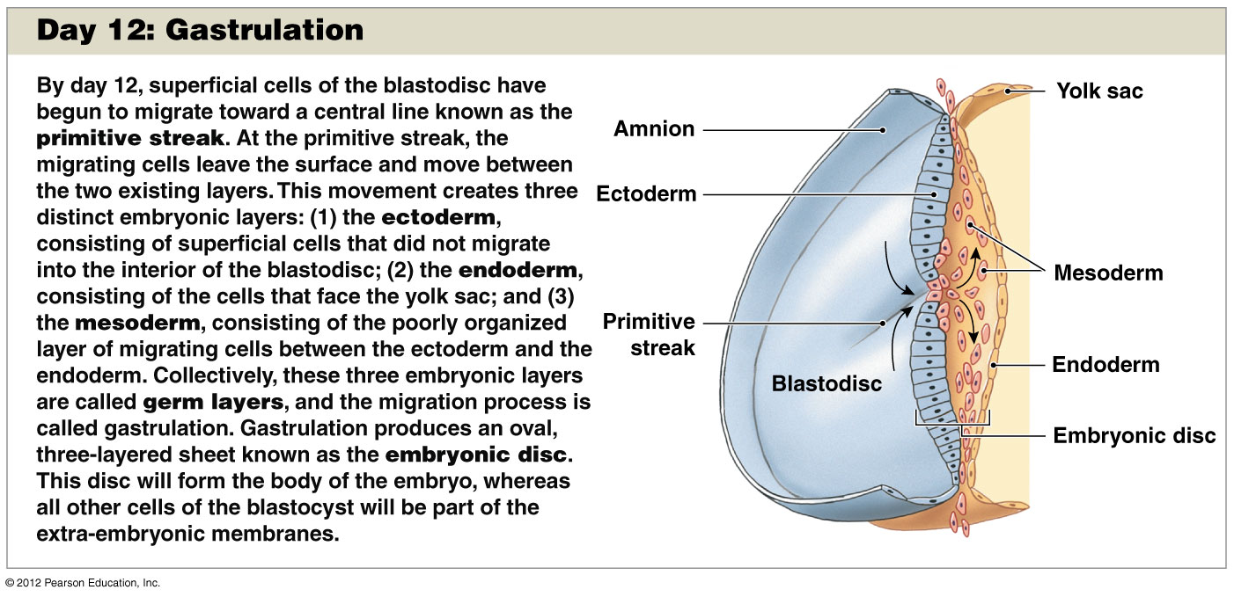
Gastrulation: Migration of cell to interior forming layer between ectoderm and endoderm.
Creates primitive streak.
  Raised dorsal groove establishes longitudinal axis of embryo.
Results in formation of 3rd germ layer.
  Endoderm
  Mesoderm
  Ectoderm
Gastrulation sets the stage for organogenesis.
https://www.youtube.com/watch?v=3AOoikTEfeo
Notes:
Serve as primitive tissues from which all body organs will be derived
Endoderm
Epithelial lining of GI & lower respiratory tract
All ducts entering the GI tract
Urinary bladder
Ectoderm
Nervous system
Epidermis
Lining of mouth, and anus
Sense organs such as eyes
Mesoderm
Muscle
Bone
Cartilage
Blood
Dermis and hypodermis
Kidneys, ovaries, testes
Lining of body cavities
Martini Fundamentals of A&P 9e

Slide 18
Primary Germ Layers
Serve as primitive tissues from which all body organs will be derived
Endoderm:
  Epithelial lining of GI & lower respiratory tract
  All ducts entering the GI tract
  Lung, Liver, Pancreas
  Urinary bladder
Ectoderm:
  Brain & Nervous system
  Epidermis
  Lining of mouth, and anus
  Sense organs such as eyes

Slide 19
Primary Germ Layers
Mesoderm:
  Muscle
  Bone
  Cartilage
  Cardiovascular
  Dermis and hypodermis
  Kidneys,
  ovaries, testes
  Lining of body cavities

Slide 20
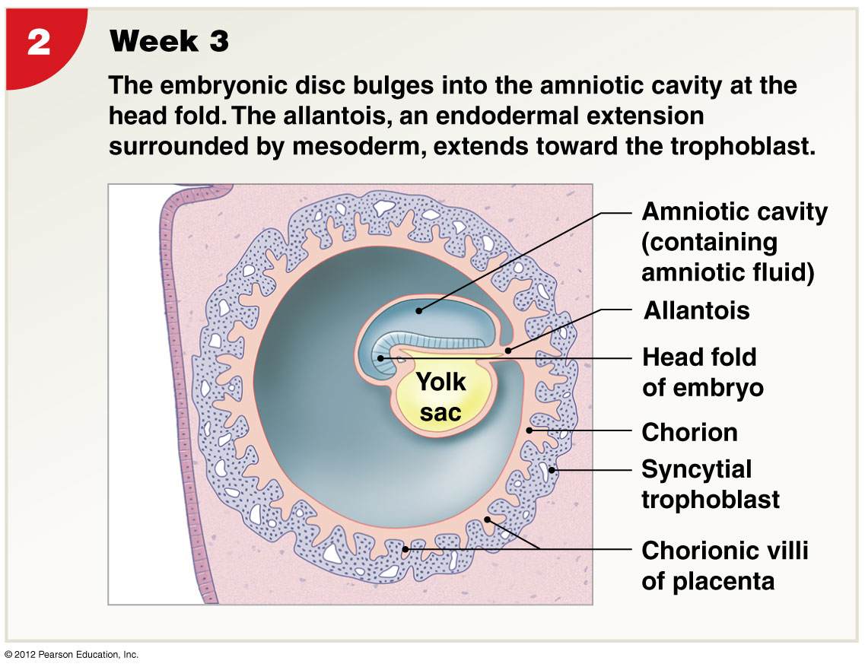
Formation of Extraembryonic Membranes
Yolk sac
  Blood cell formation.
Amnion
  Contains amniotic fluid.
Allantois
  Gives rise to urinary bladder.
Chorion
  Transit system for blood and nutrients.
Chorionic villi
  Becomes placenta.
Notes:
Yolk sac (endoderm + mesoderm): blood cell formation
Amnion (ectoderm + mesoderm = amnion): contains amniotic fluid which cushions embryo/fetus
Allantois (sac of endoderm + mesoderm): gives rise to the urinary bladder
Chorion (mesoderm + trophoblast): transit system for blood and nutrients
Chorionic villi (endometrial capillary network), becomes placenta
Martini Fundamentals of A&P 9e

Slide 21
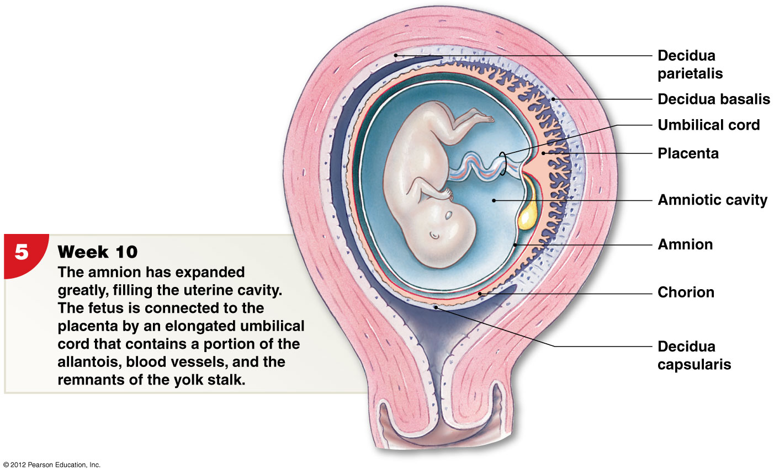
Placentation
Body stalk
Yolk stalk
Decidua capsularis
Decidua basalis
Decidua parietalis
Umbilical cord
Notes:
Body stalk
Connection between embryo and chorion
Yolk stalk
Connection between endoderm of embryo and yolk sac
Decidua capsularis
No longer participates in nutrient exchange
Decidua basalis
Where placental functions are concentrated
Decidua parietalis
Rest of the uterine endometrium
Umbilical cord
Connects fetus and placenta
Forms from allantois, yolk stalk, and placental blood vessels
Martini Fundamentals of A&P 9e

Slide 22
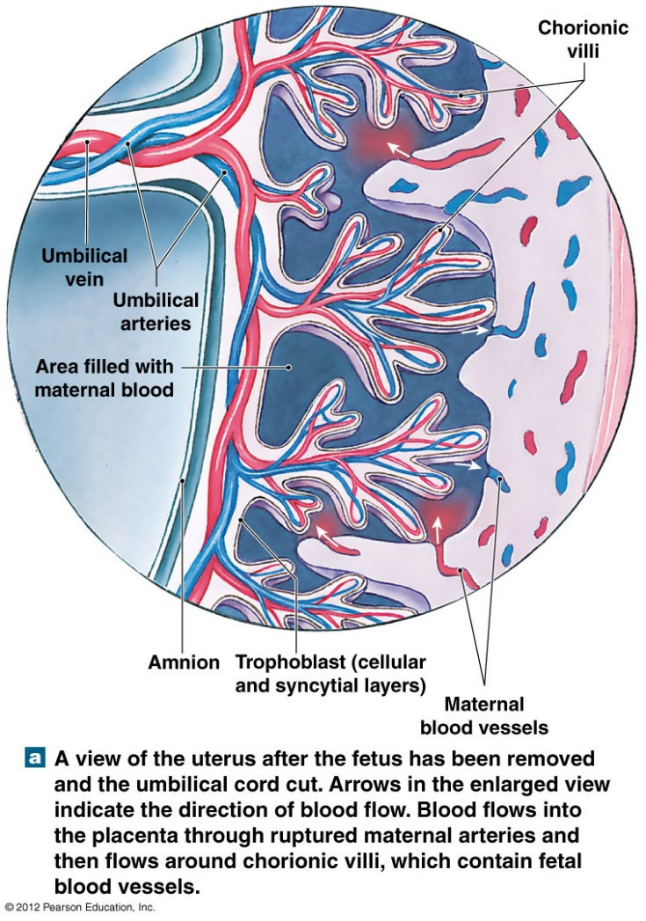
Placenta
Chorion of embryo and stratum functionalis layer of uterus.
Fully functional by 3rd month of pregnancy.
No union of maternal/fetal blood vessels.
Blood does not mix.
Diffusion of O2, nutrients, wastes, stores nutrients
produces hormones.
Barrier to microorganisms, except some viruses.
Notes:
Chorion – becomes embryonic contribution to placenta
Derived from trophoblast with mesoderm lining containing chorionic villi
Fully formed and functional by 3rd month of pregnancy
Chorion of embryo and stratum functionalis layer of uterus
Chorionic villi extend into maternal blood filled intervillous spaces
Maternal & fetal blood vessels do not join an blood does not mix
Diffusion of O2, nutrients, wastes, stores nutrients and produces hormones
Barrier to microorganisms, except some viruses: AIDS, measles, chickenpox, poliomyelitis, encephalitis
Martini Fundamentals of A&P 9e

Slide 23
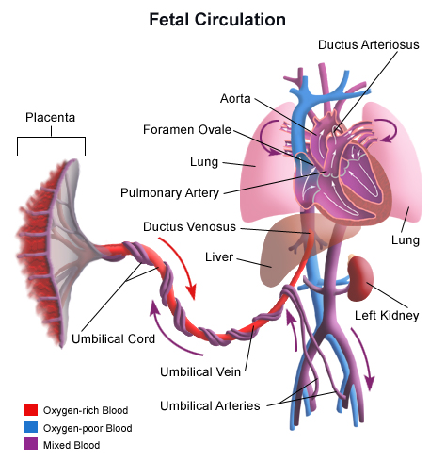
Fetal Circulation
Lungs are non-functional.
Oxygen and nutrients move from…
  Maternal side of placenta.
  To fetal bloodstream.
  Via umbilical vein
CO₂ and wastes move from…
  Fetal blood.
  To placenta.
  Via umbilical arteries
Notes:
Retrieved from http://www.urmc.rochester.edu/Encyclopedia/GetImage.aspx?ImageID=281867, 2014

Slide 24
Fetal Circulation
Placental blood flows from umbilical cord
  Through umbilical vein
  To ductus venosus & inferior vena cava
  To right atrium or through foramen ovale (shunt from R to L atrium)
  From right ventricle flows to pulmonary trunk
  Ductus arteriosus shunts blood flow from pulmonary trunk to aortic arch (bypassing lungs)
  Flow continues via aorta to internal iliac arteries
  Umbilical arteries branch from internal iliac arteries
  Returning deoxygenated blood and waste to placenta and maternal circulation
Simulation of fetal circulation
Notes:
Adé-Damilano, M. (2006). Human Embryology: Embryo-Fetal Circulation System [video file]. Retrieved from http://www.embryology.ch/images/pimgcardio/09umstellung/p9a_KreislaufvorA.gif
Retrieved from http://www.urmc.rochester.edu/Encyclopedia/GetImage.aspx?ImageID=281867, 2014

Slide 25
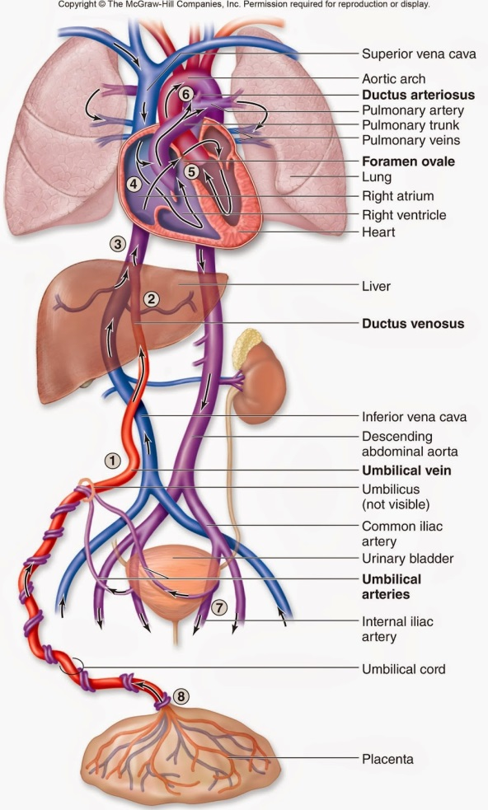

Slide 26
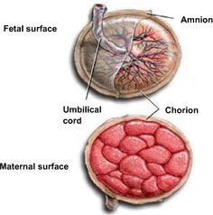
The Endocrine Placenta - 6
Human Chorionic Gonadotropin (hCG):
    Maintenance of Corpus luteum (progesterone).
    Prevents further uterine cycles.
    Detected by some pregnancy tests
Human Placental Lactogen (hPL)
placental Prolactin
    Prepares mammary glands for milk production.
Relaxin
    Increases flexibility of pubis, cervix, vaginal canal.
    Suppresses release of oxytocin until labor.
Progesterone
(later) Estrogen
    Maintenance of endometrial lining.
Notes:
Retrieved from https://s-media-cache-ak0.pinimg.com/236x/43/5b/72/435b72b8135a9b82ef8331f0b2f7277c.jpg, 2016

Slide 27
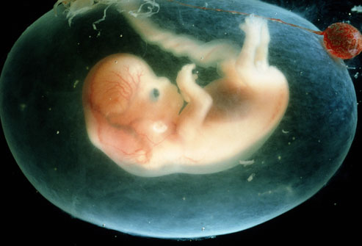
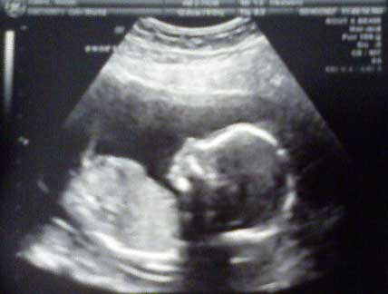
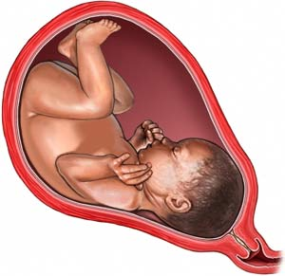
Gestation…..
Time Spent in Prenatal Development
First trimester
    Embryological and early fetal development, rudiments of organs appear.
Second trimester
    Development of organs and organ systems, fetus starts to look human.
Third trimester
    Rapid fetal growth, deposition of adipose tissue, organs become functional.
Notes:
Retrieved from http://img.webmd.com/dtmcms/live/webmd/consumer_assets/site_images/articles/health_tools/conception_slideshow/PRinc_rm_photo_of_7-8_week_embryo.jpg, 2016
Retrieved from http://www.babymed.com/sites/default/files/US_Fetus_14_weeks%20%281%29.jpg, 2016
Retrieved from http://www.everybody.co.nz/admin/UserImages/a1c7818a-ffff-4cab-b852-3a7750f3c73c.jpg, 2016

Slide 28
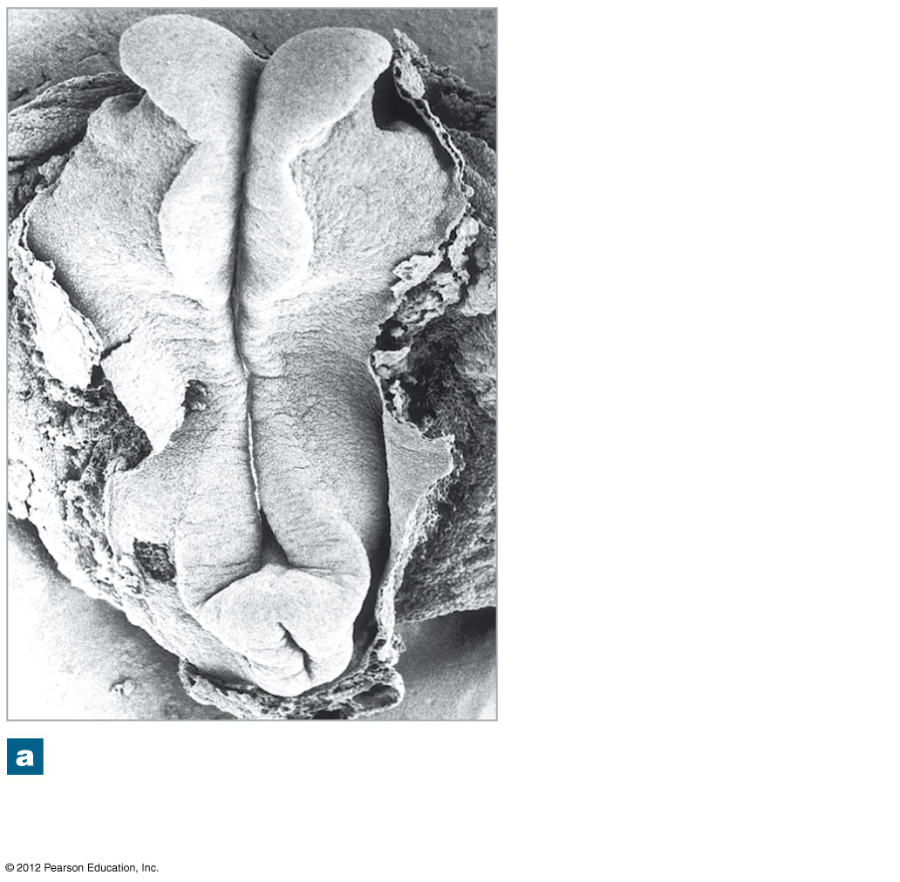
Embryogenesis
.
Begins shortly after gastrulation. ->PRIMARY GERM LAYERS
Embryo body begins to separate from embryonic disc.
Embryo body and internal organs start to form.
Folding, differential growth of disc form bulge projecting into amniotic cavity.
  Head fold
  Tail fold
First 12 weeks critical in establishing basis for organogenesis.
  Process of organ formation.
Week 2
Notes:
Martini Fundamentals of A&P 9e

Slide 29
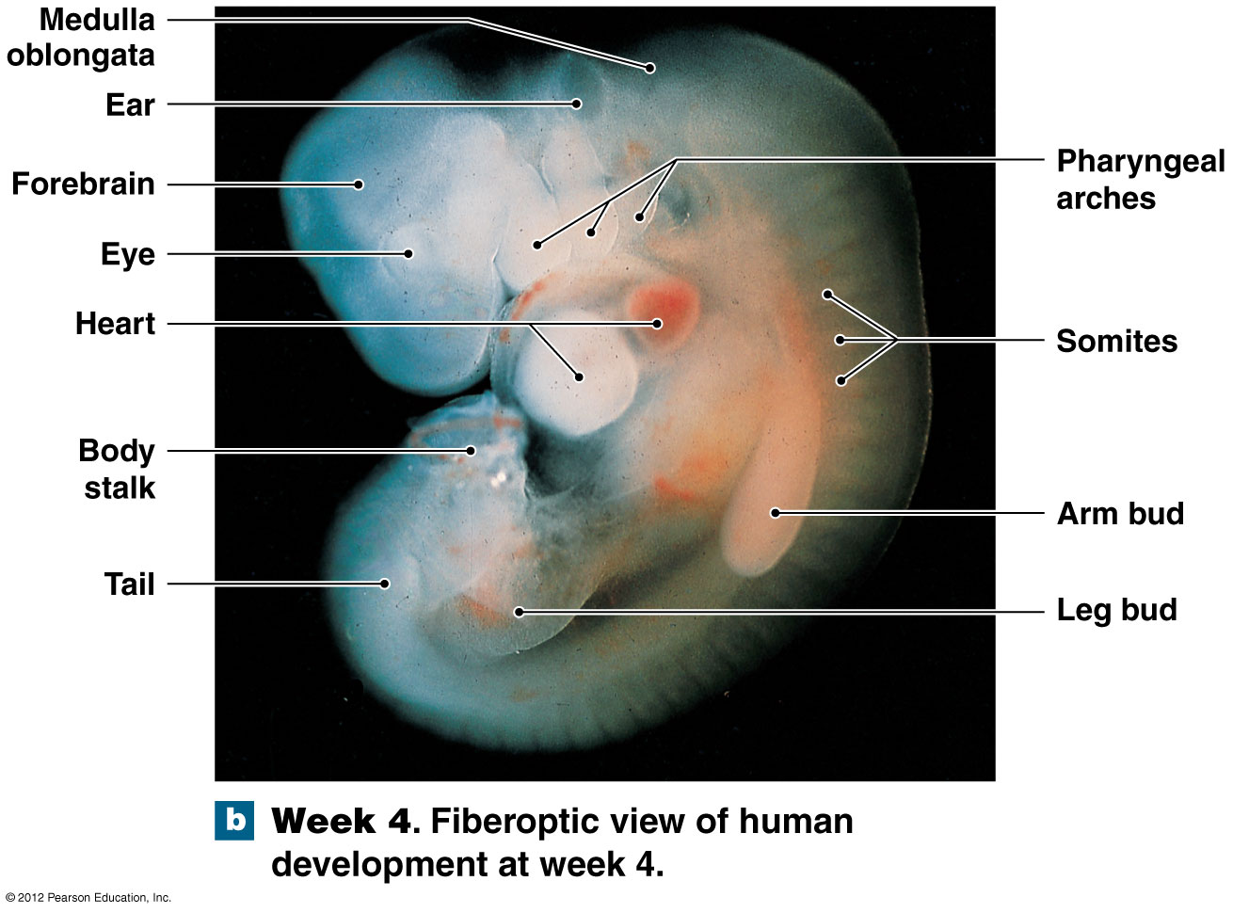
First Trimester: Week 4
Notes:
Martini Fundamentals of A&P 9e

Slide 30
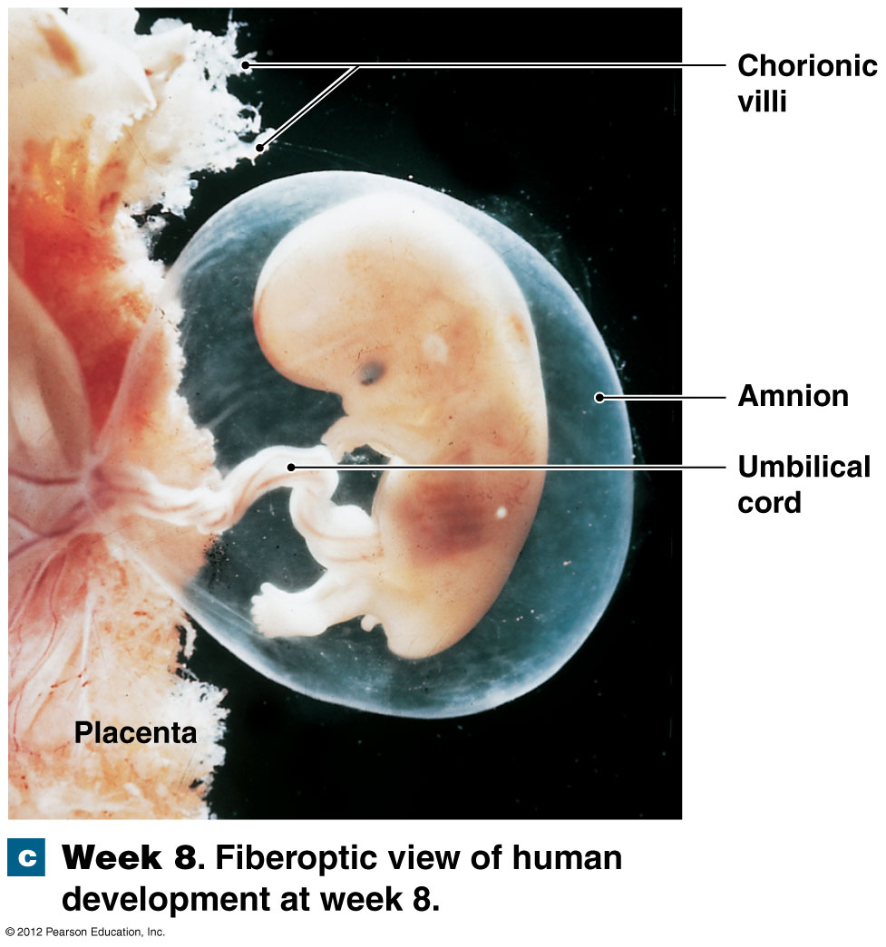
First Trimester: Week 8
Notes:
Martini Fundamentals of A&P 9e

Slide 31
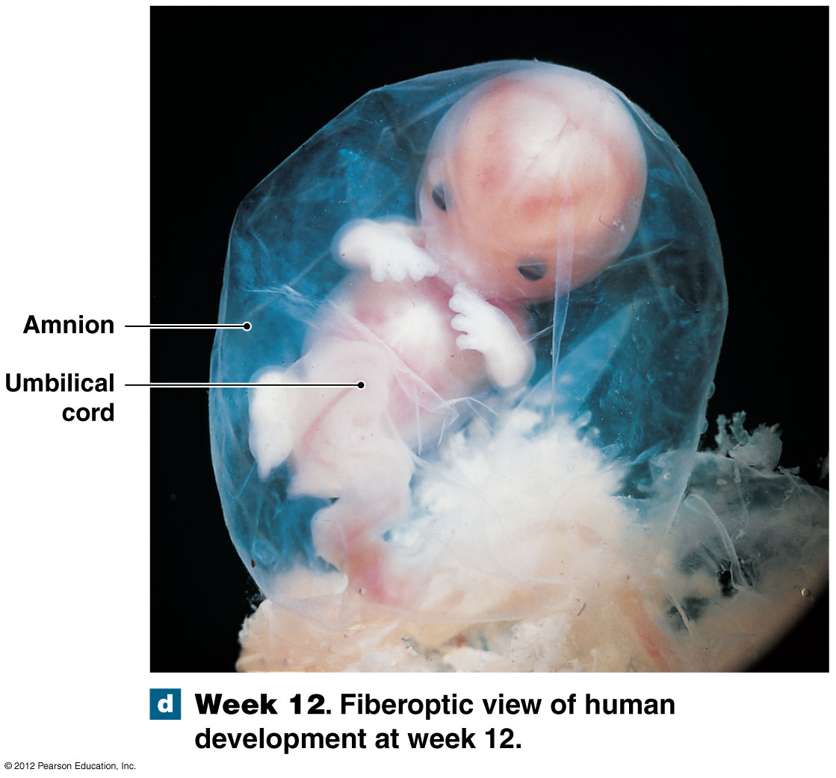
First Trimester: Week 12
Notes:
Martini Fundamentals of A&P 9e

Slide 32
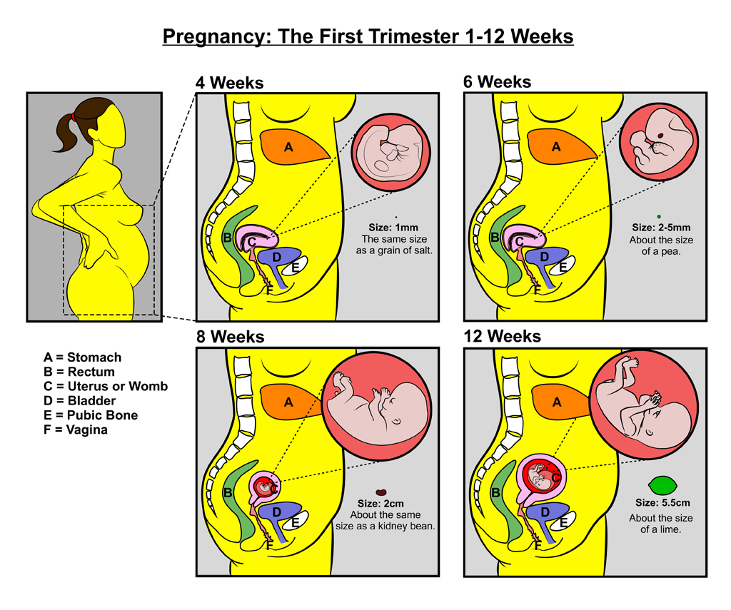
First Trimester
4 distinct processes…
  Cleavage
  Implantation
  Placentation
  Embryogenesis
Most dangerous period in prenatal life.
40% of conceptions survive past first trimester.
Notes:
Cleavage
Sequence of cell divisions begins immediately after fertilization
Zygote becomes a pre-embryo developing into multicellular blastocyst
Ends with blastocyst contacting uterine wall
Implantation
Begins with attachment of blastocyst to endometrium
Sets stage for formation of vital embryonic structures
Placentation
Occurs as blood vessels form around periphery of blastocyst and placenta develops
Embryogenesis
Formation of viable embryo
Establishes foundations for all major organ systems
40% chance success
Retrieved from http://gdhr.wa.gov.au/documents/10184/129074/Preg_First+Tri_Teachers+Sheet.jpg/666cf7be-e55b-4111-982e-5daca6199284?t=1405522038418/, 2015

Slide 33
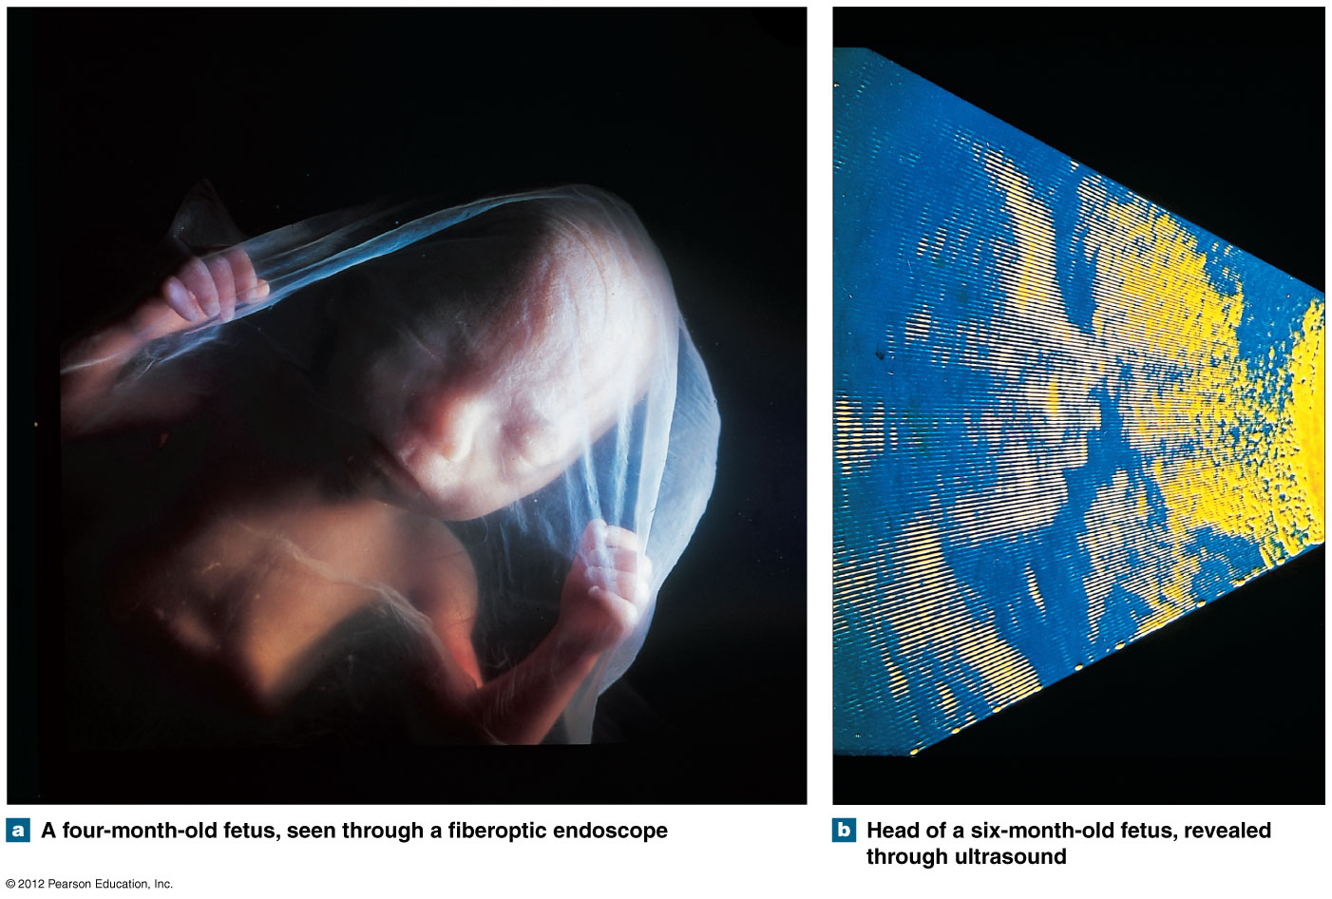
The Fetus: Second and Third Trimesters
Fetus grows faster that surrounding placenta during second trimester.
Organ systems ready to perform normal functions independently in third trimester.
Notes:
Martini Fundamentals of A&P 9e

Slide 34
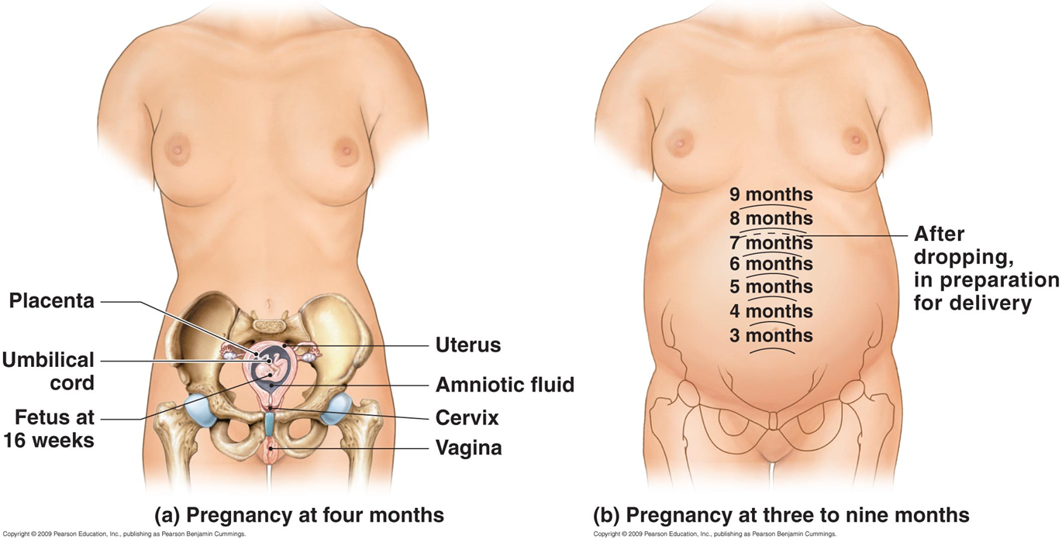
The Mother: Second and Third Trimesters
Growth of the Uterus and Fetus
Notes:
Martini Fundamentals of A&P 7e

Slide 35
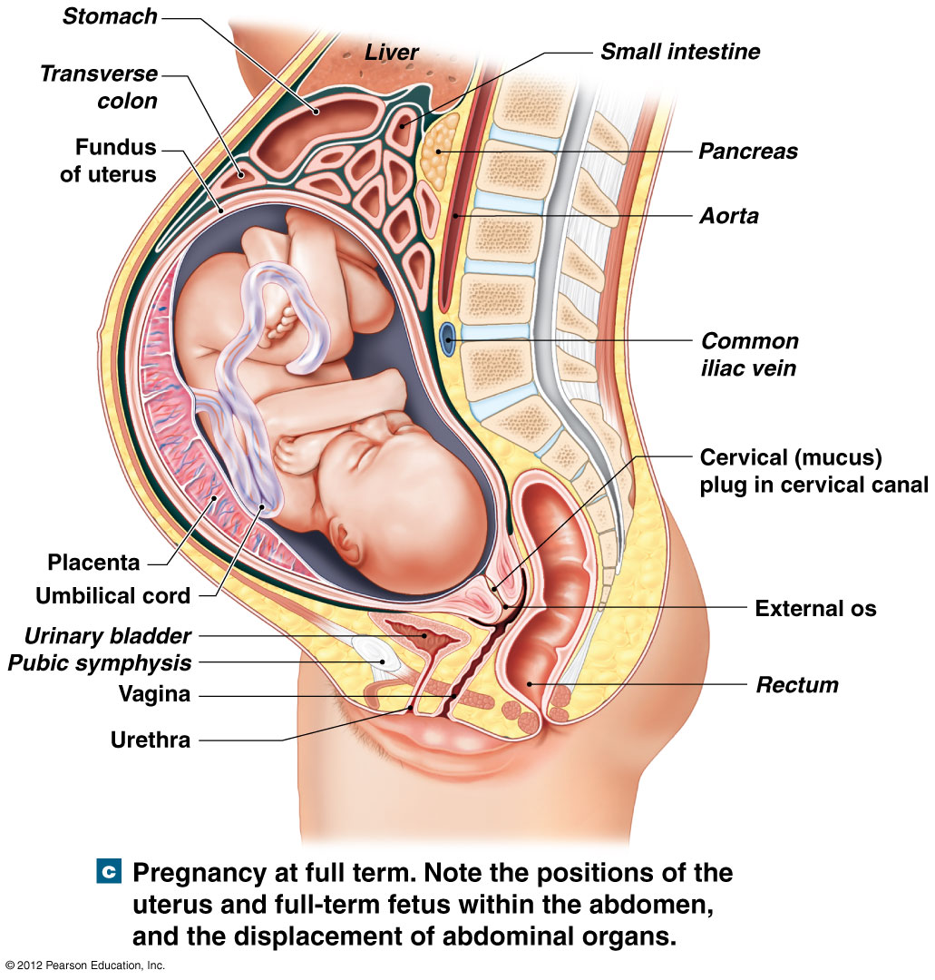
Changes in Maternal System
↑ Respiratory Rate, TV.
↑ Maternal blood volume (up to 50%).
↑ Maternal nutrient requirements (climb 10-30%).
↑ Maternal GFR (increases by ~ 50%).
↑ Size of uterus (7.5 cm, 30 g – 30 cm 1,100 g).
↑ Mammary glands, breasts.
True labor.
False labor.
Labor contractions.
Notes:
False labor
Occasional spasms in uterine musculature
Contractions not regular or persistent
True labor
Results from biochemical and mechanical factors
Continues due to positive feedback
Labor contractions
Begin in myometrium
Martini Fundamentals of A&P

Slide 36
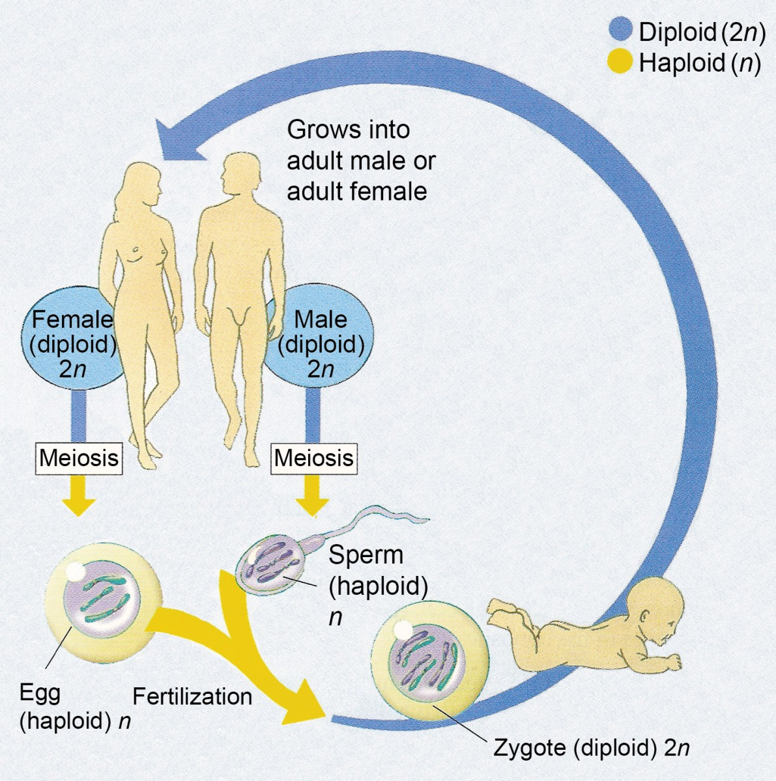
Development…..Gradual and Continuous Process From Fertilization to Maturity
Embryological Development
  Occurs first 2 months after fertilization.
  Study of events known as embryology.
Fetal Development
  Begins at the ninth week.
  Continues until birth.
Notes:
Retrieved from https://online.science.psu.edu/sites/default/files/biol011/Fig-5-14-Human-Life-Cycle.jpg, 2016

Slide 37
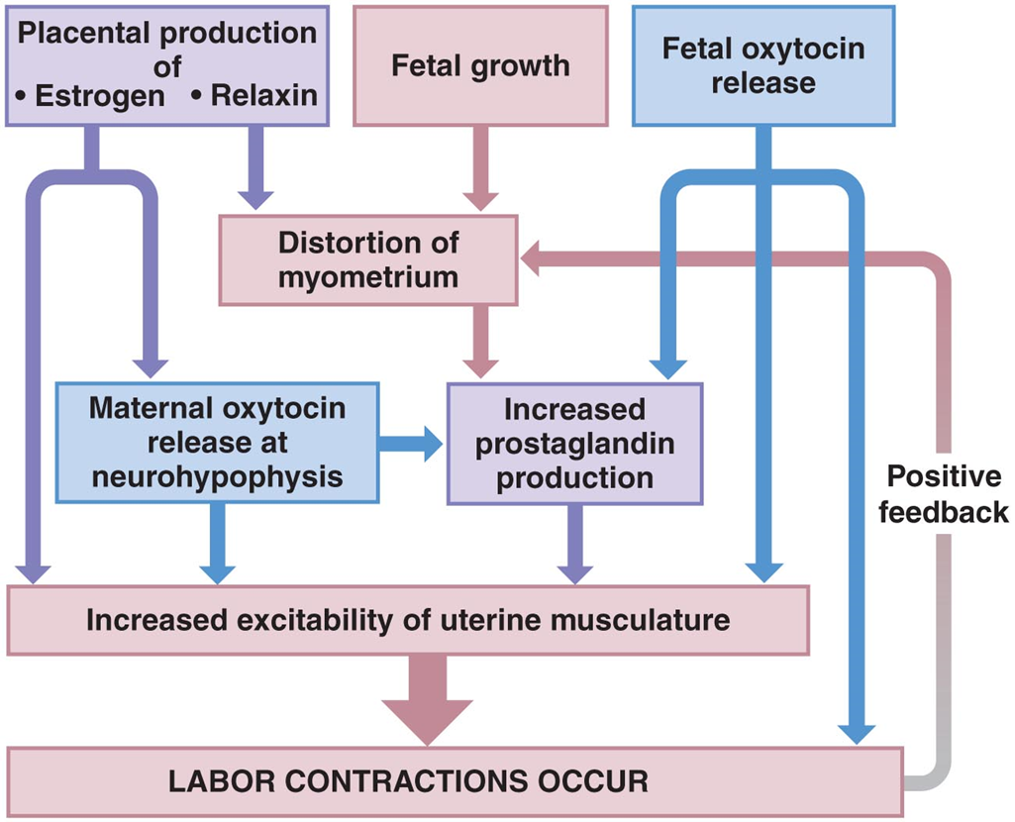
Factors Involved in Initiation of Labor and Delivery
Notes:
Hormones opposing progesterone leading to labor
Rising estrogen levels – initiate smooth muscle contractions toward labor
Rising Oxytocin levels – increase force and frequency of uterine contractions
Prostaglandin production – further stimulate muscle contractions
Martini Fundamentals of A&P 7e

Slide 38
Lifes Greatest Miracle
http://www.pbs.org/wgbh/nova/body/life-greatest-miracle.html
:41
6:50
15.10
26.48
40.24
43.49
50:17

Slide 39
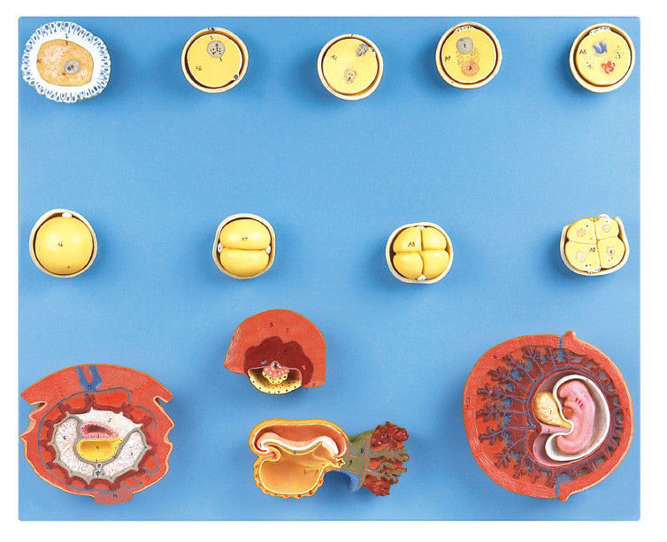
Activities
Study and review all models of human development for structure identification.
Answer all associated questions in Survival Guide.
Notes:
Retrieved from http://www.medicaltrainingsimulators.com/photo/pl10665490-human_fertilization_and_intermediate_embryogeny_human_anatomy_model_with_stander.jpg, 2016

Slide 40
Works Cited
Marieb, E. N. (2012). Essentials of human anatomy & physiology
(6th ed.). Boston: Pearson Education, Inc.
Marieb, E.N., Mitchell, S.J. & Smith, L.A. (2012). Human anatomy and physiology laboratory manual (10th ed.). Boston: Pearson Education, Inc.
Martini, F., Nath, J. & Bartholomew, E.F. (2012). Fundamentals of anatomy & physiology (9th ed.). Boston: Pearson Education, Inc.
McPhee, J. & Papadakis, M. (2012) Current medical diagnosis & treatment (51st ed.). New York: McGraw Hill.
Patton, T. & Thibodeau, G. (2013). Anatomy & physiology (8th ed.).
St. Louis:Mosby Elsevier.
Saladin, K. S. (2012). Anatomy & physiology: The unity of form and function (6th ed.). New York: McGraw Hill.
Tortora, G.J. & Derrickson, B.H. (2012). Principles of anatomy and physiology (13th ed.). Hoboken, NJ: Wiley

