Slide 1
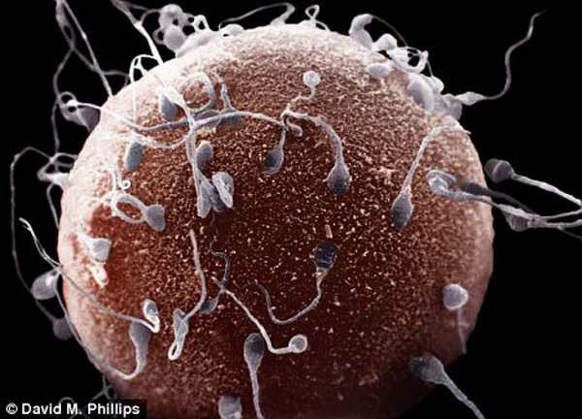
BI 233 Laboratory
Reproductive System:
Male and Female
Notes:
Retrieved from http://creatiwittyblog.com/wp-content/uploads/2013/01/world-microscopic-wonders-sperms-on-female-egg.jpg, 2015

Slide 2
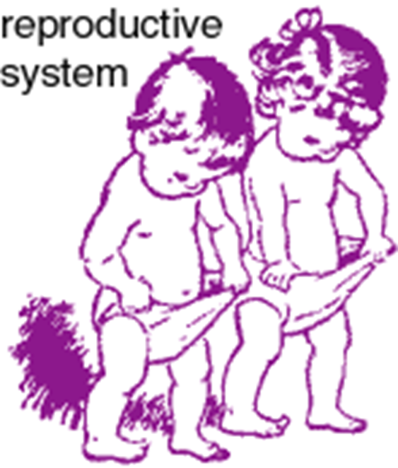
Reproductive System Defined
Ensures continued existence of human species.
Not an essential system to the life of the individual.
Activities of system affects other systems.
Consists of…
  Gonads – Gametes & Endocrine glands
  Ducts
  Accessory Glands
  Perineal structures - Genitalia
Notes:
Retrieved from http://images.clipartof.com/Cartoon-Of-A-Happy-Toddler-Boy-And-Girl-Jumping-Royalty-Free-Vector-Clipart-10241212408.jpg, 2016

Slide 3
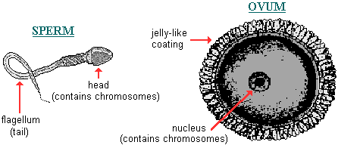
Terminology
Gametes
  Male and female reproductive cells.
Basic components…
  Gonads
    Reproductive organs, produce gametes.
  Ducts
    For transportation of gametes.
  Accessory glands and organs.
    Secrete fluids.
  Perineal structures (external genitalia).
Notes:
Retrieved from http://anthro.palomar.edu/biobasis/images/sperm_and_ovum.gif, 2016

Slide 4
Gonads
Male
Female
Testes
  Secrete androgens - testosterone
  Produce ca. 0.5 billion spermatozoa/day
    Male gametes.
Semen
    Spermatozoa and other fluids.
Ovaries
  Release one oocyte per month
    Immature gamete.
  Ovum
    Mature (capable of fertilization) female gamete.

Slide 5
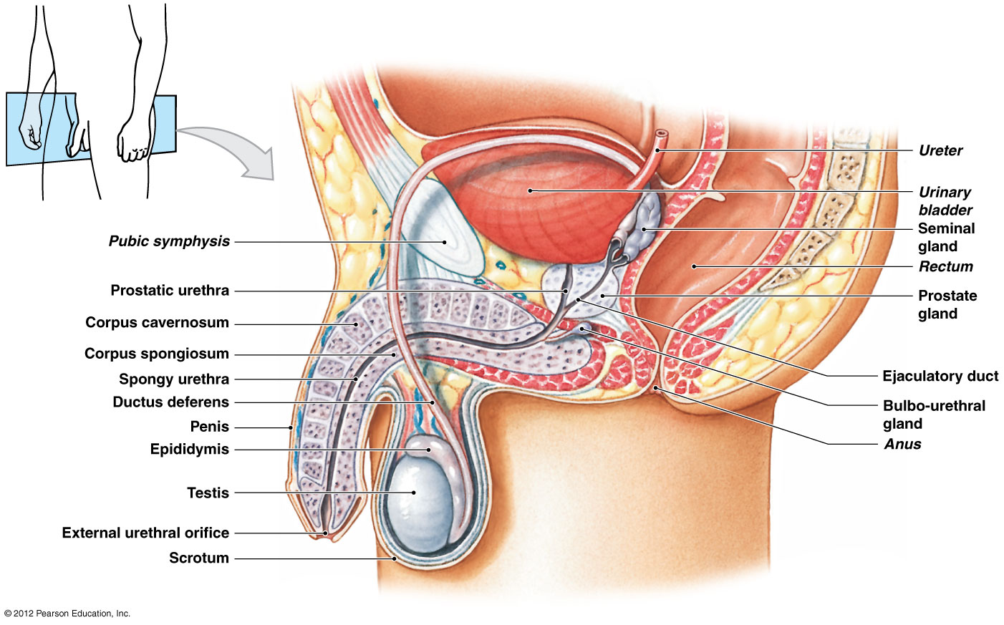
Male Reproductive System
Urethra
Notes:
Main structures of the male reproductive tract
Testis
Epididymis
Ductus deferens (vas deferens)
Ejaculatory duct
Urethra
Seminal glands
Prostate gland
Bulbo-urethral (Cowper’s) glands
Scrotum
Penis
Martini Fundamentals of A&P 9e

Slide 6
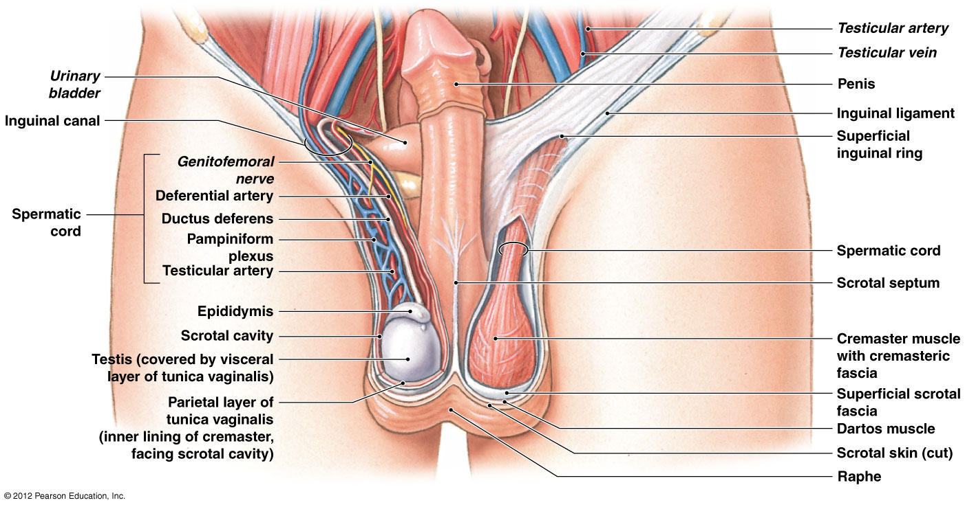
Testes: Male Gonads
Notes:
Paired oval glands measuring 5 cm (2 in.) x 3 cm (1.2 in.)
Surrounded by tunica albuginea
Filled with 2 or 3 seminiferous tubules = sperm formation
Martini Fundamentals of A&P 9e

Slide 7
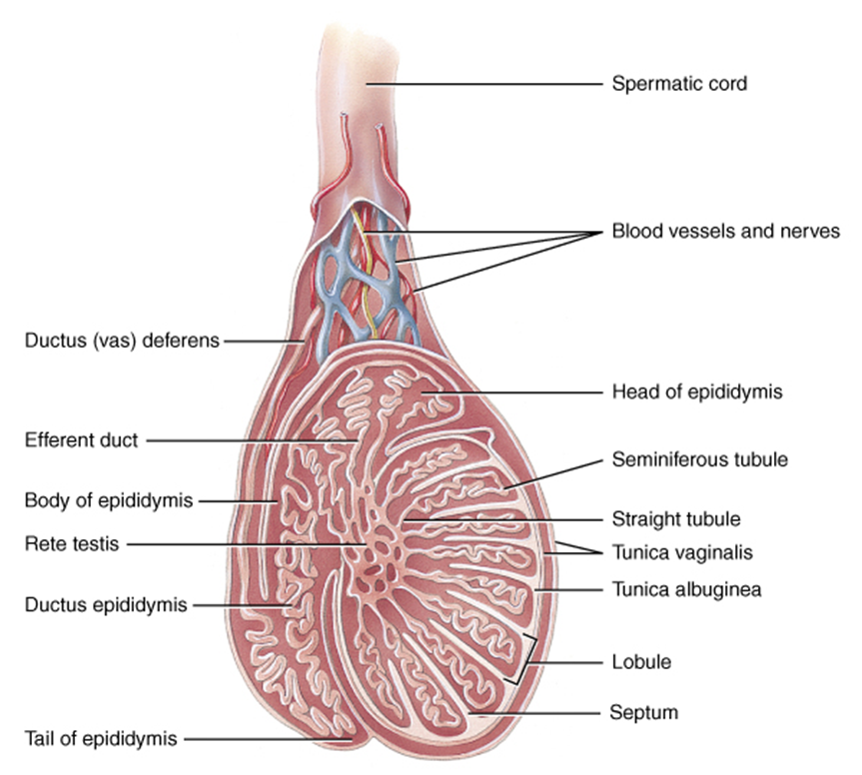
Ductal Pathway of Sperm Through Testis
Seminiferous tubules
Straight tubules
Rete testis
Efferent ducts
Ductus epididymis
Ductus (vas) deferens
Notes:
Martini Fundamentals of A&P 7e

Slide 8
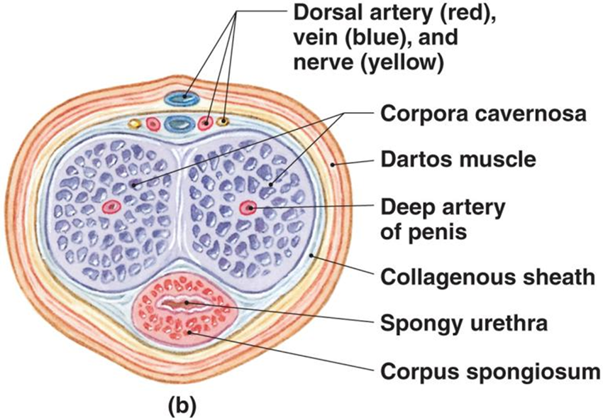
Anatomy of the Penis: Transverse Section
Corpora cavernosa
  Upper paired, erectile tissue masses.
  Begins as crura of the penis.
  Covered by ischiocavernosus muscle.
Corpus spongiosum
  Lower erectile tissue mass.
  Surrounds urethra.
  Begins as bulb of penis.
  Covered by bulbospongiosus muscle.
  Ends as glans penis.
Notes:
Erectile Tissue
In body of penis located deep to areolar tissue in dense network of elastic fibers that encircles internal structures of penis
Consists of network of vascular channels incompletely separated by partitions of elastic connective tissue and smooth muscle fibers
In resting state, arterial branches are constricted, muscular partitions are tense, and blood flow into erectile tissue is restricted
Martini Fundamentals of A&P 7e

Slide 9
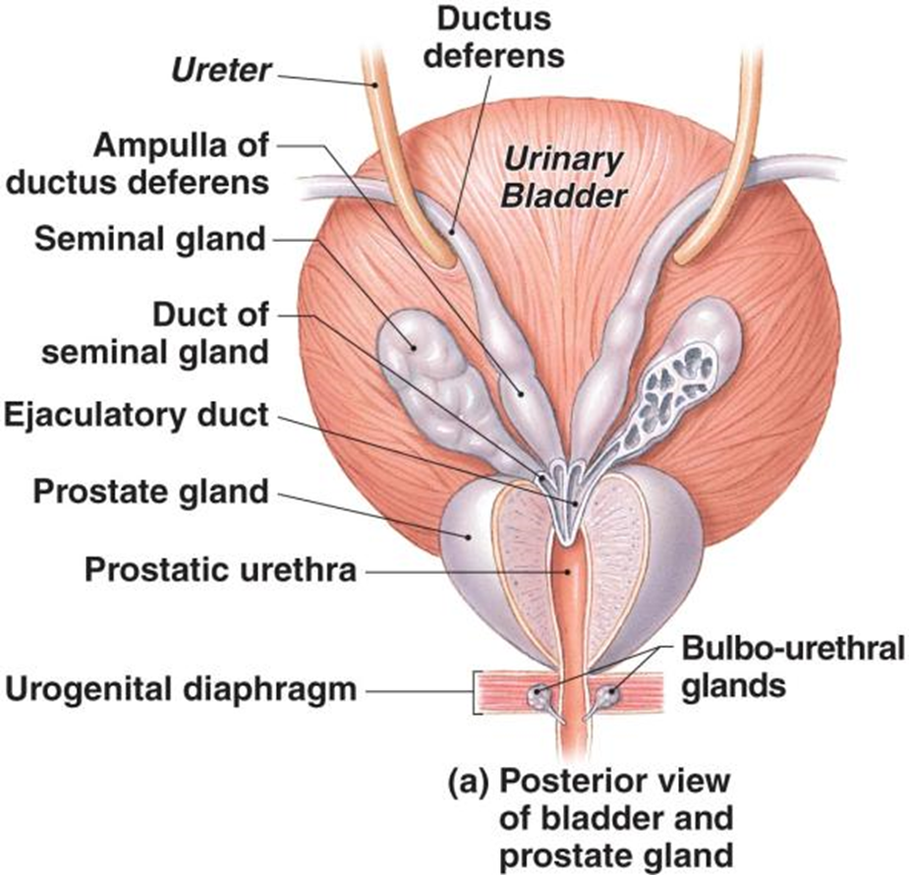
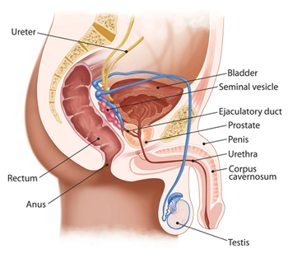
Ductus Deferens and Accessory Glands
Notes:
Martini Fundamentals of A&P 7e

Slide 10
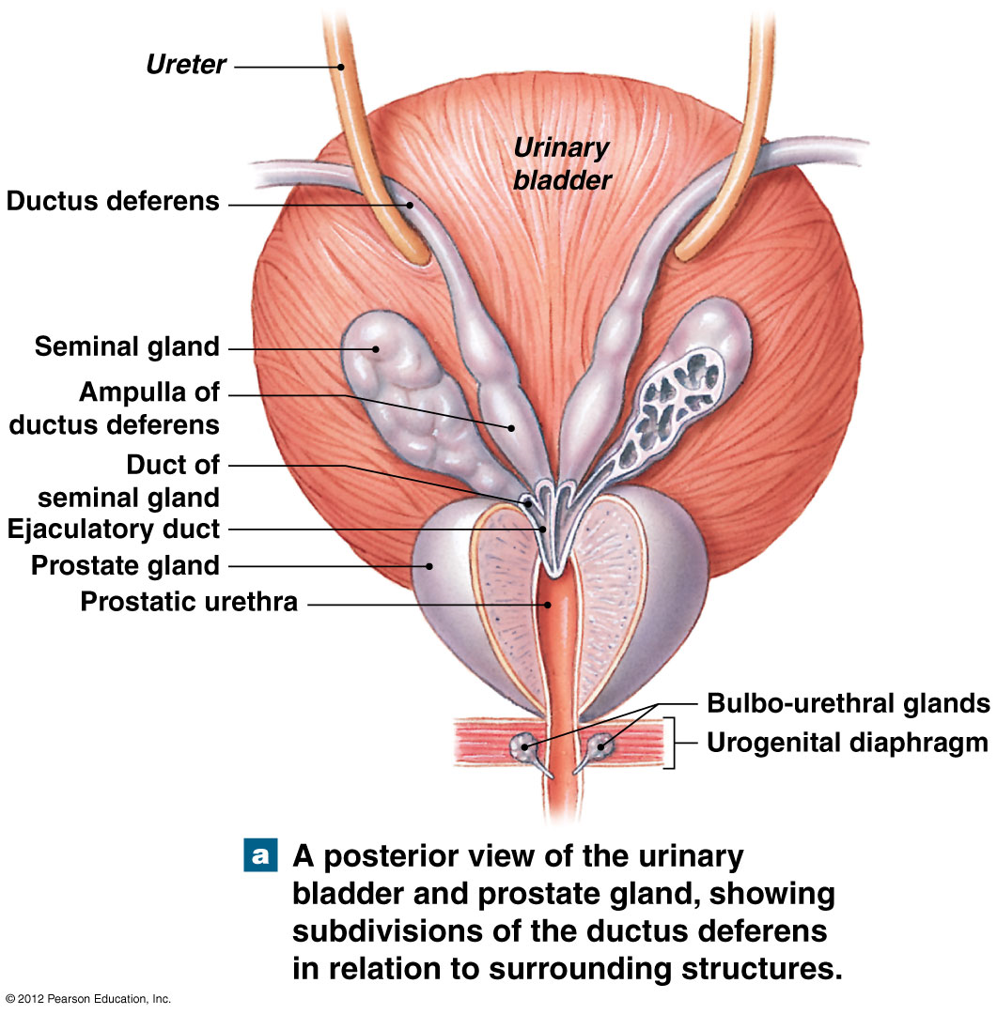
Ejaculatory Duct:
Formed from duct of seminal vesicle and ampulla
2 cm (< 1 in.) long.
Penetrates muscular wall of prostate gland emptying into urethra.
Adds fluid to prostatic urethra prior to ejaculation.
Notes:
Martini Fundamentals of A&P 9e

Slide 11
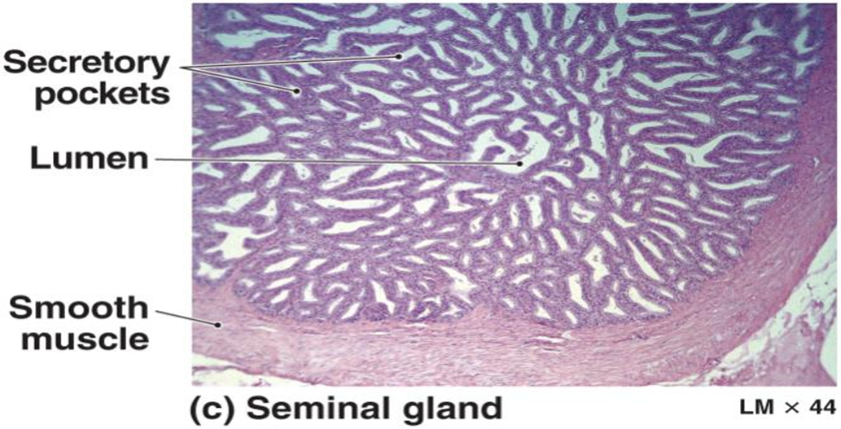
Seminal Glands
AKA: seminal vesicles
Pair of pouch-like organs found posterior to base of bladder.
Alkaline, viscous fluid = aprox 65-75% of semen volume
  Neutralizes vaginal acid and male urethra.
  Fructose for ATP production.
  Prostaglandins stimulate sperm motility and viability (capacitation).
  Clotting proteins for coagulation of semen.
Notes:
Martini Fundamentals of A&P 7e

Slide 12
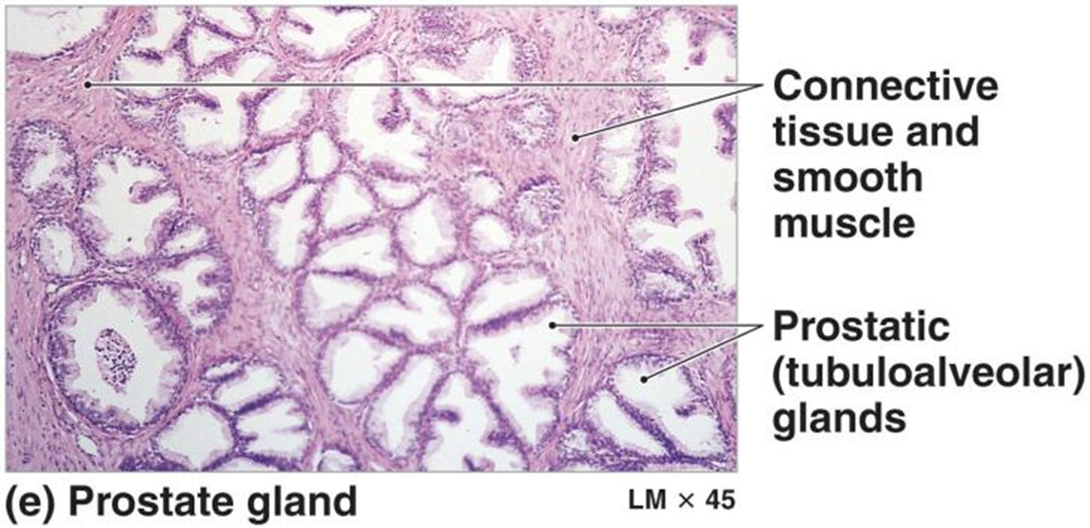
Prostate Gland
4 cm, small, muscular, round organ.
30-50 tubuloalveolar glands and smooth muscle.
Produce a thin, milky white fluid of semen
containing simple sugars (such as fructose and glucose), enzymes, and alkaline chemicals.
  The sugars secreted by the prostate function as nutrition for sperm as they pass into the female body to fertilize ova.
  Enzymes work to break down proteins in semen after ejaculation to free sperm cells from the viscous semen.
  The alkaline chemicals in prostatic secretions neutralize acidic vaginal secretions to promote the survival of sperm in the female body.
20-30% of semen volume.
Notes:
Martini Fundamentals of A&P 7e

Slide 13
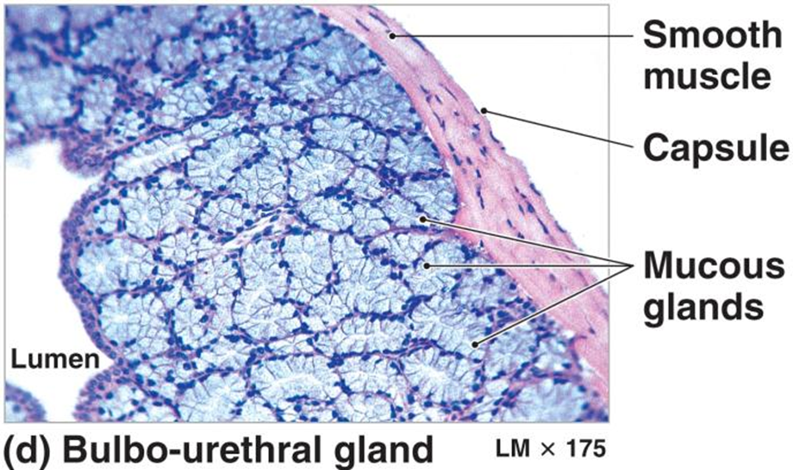
Bulbourethral Gland
AKA: Cowper’s gland
10 mm wide, round, at base of penis.
Compound tubular mucous glands.
Pre-ejaculate = mucus is thick and alkaline.
  Neutralizes urethra acids from urine
  Lubricates for sperm passage
Notes:
Martini Fundamentals of A&P 7e

Slide 14
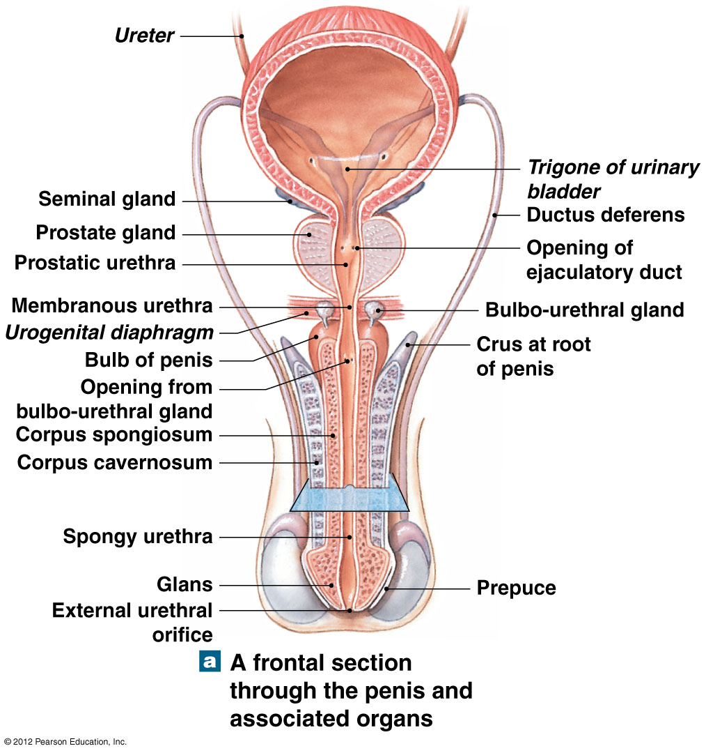
Urethra
Passageway for urine and semen
Prostatic urethra
Membranous urethra
  Passes through UG diaphragm
Penile (spongy) urethra
  Passes through corpus spongiosum
Notes:
Martini Fundamentals of A&P 9e

Slide 15
Spermatic Cord…….
Extends Between Abdominopelvic Cavity and Testes
5 structures passing to and from testes.
  Testicular artery
  Pampiniform plexus of veins
  Autonomic nerves
  Lymphatic vessels
  Ductus (vas) deferens
Notes:
Spermatic cord consists of layers of fascia and muscle enclosing ductus deferens, blood vessels, nerves, and lymphatic vessels supplying the testes.
Martini Fundamentals of A&P 7e

Slide 16


Slide 17
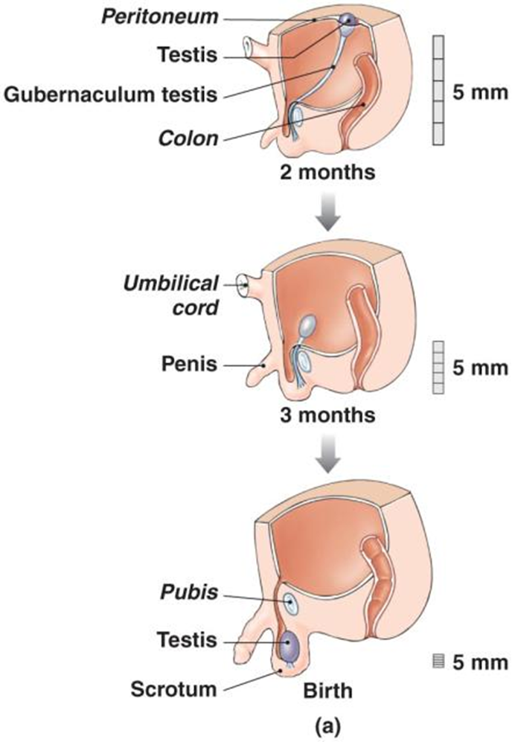
Testes Form Inside Abdominal Cavity
Testes form inside abdominal cavity adjacent kidneys.
Gubernaculum testis
  Bundle of connective tissue.
  Lock testes in positon.
Month 7-8 sees rapid growth.
Hormones trigger contraction of gubernaculum testis.
Testes moves through abdominal musculature.
Descend into scrotum.
Notes:
Martini Fundamentals of A&P 9e

Slide 18
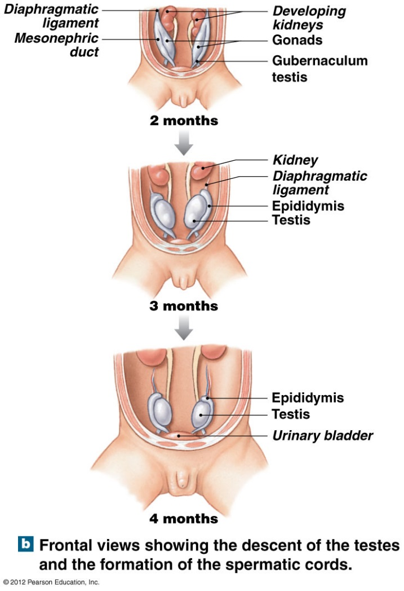
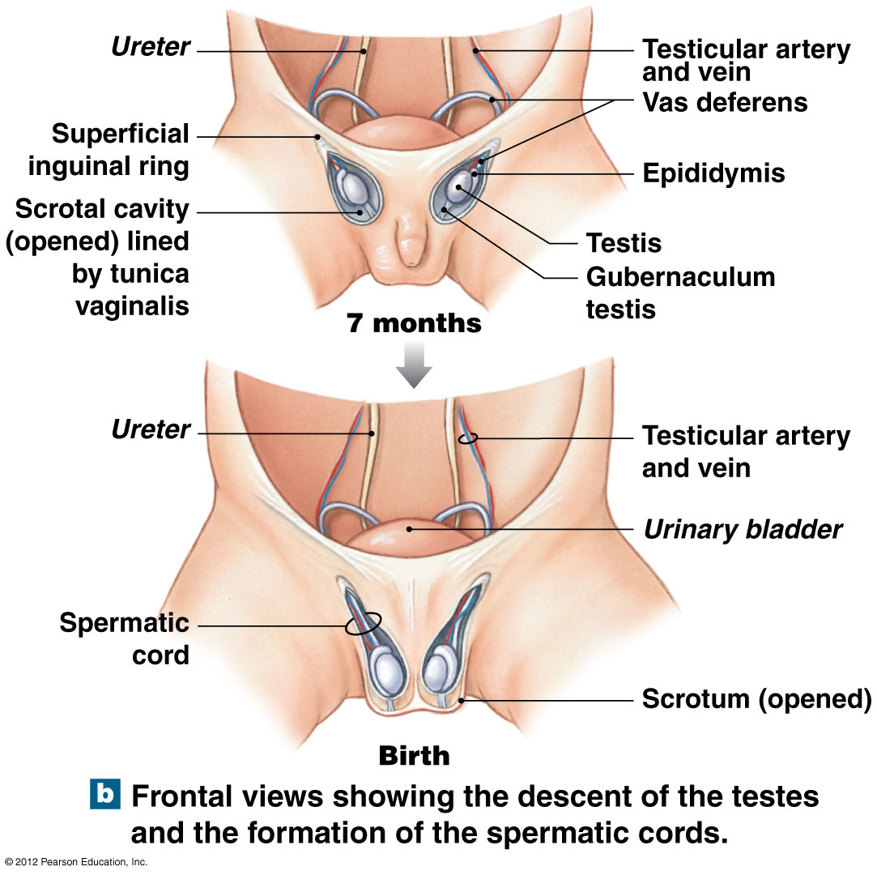
Descent of the Testes
Video on the descent of the testes
Notes:
Martini Fundamentals of A&P 9e
Clinical Anatomy Explained. (2013, Jul 22). Embryology & gross anatomy – testicular descent and layers of the spermatic cord. Retrieved from https://www.youtube.com/watch?v=qjpzfFsnr10

Slide 19
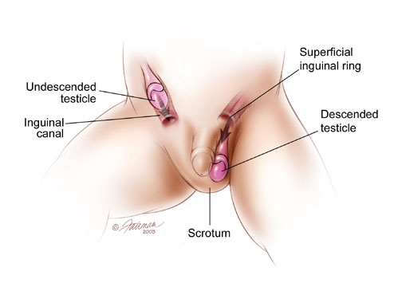
Cryptorchidism: Non-descended Testes
Rate of occurrence…
  3% of full-term and 30% of premature infants.
Untreated bilateral cryptorchidism.
  Results in sterility and ↑risk of testicular cancer.
  Surgical treatment necessary before 18 months.
Descend spontaneously during first year of life.
Notes:
Retrieved from http://www.urologyhealth.org/urology/articles/images/anatomy_Undescended_Testicle.jpg, 2015

Slide 20
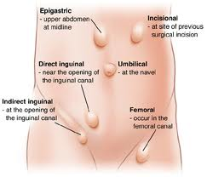
Inguinal Canal
Inguinal canal is a 2” long tunnel.
Passes through muscles of anterior abdominal wall.
Weakens wall.
Direct and indirect hernias.
More common in males.
Notes:
Indirect hernia
Loop of intestine protruding through deep ring
Direct hernia
Loop of intestine pushes through posterior wall of inguinal canal
More common in males
Retrieved from http://www.primesurgicalaffiliates.com/images/hernia.jpg, 2015

Slide 21
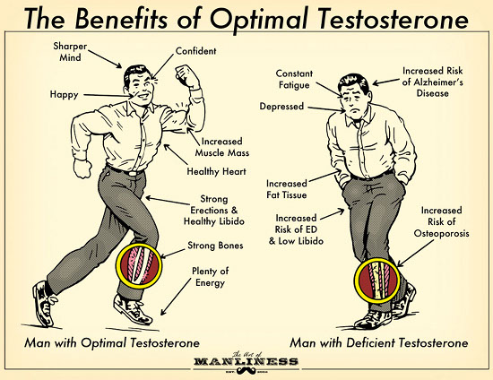
Testosterone
Circulates while bound to…
  Gonadal steroid-binding globulin (GBG)
  Albumin
Hormone-Hormone-receptor complex-DNA
Conversion to dihydrotestosterone (DHT).
10% DHT circulates in blood.
Production begins in 7th week of fetal development.
Responsible for secondary sex characteristics.
Sustains libido, spermatogenesis, reproductive tract.
Notes:
Retrieved from http://content.artofmanliness.com/uploads//2013/01/Testosterone-21.jpg, 2015

Slide 22
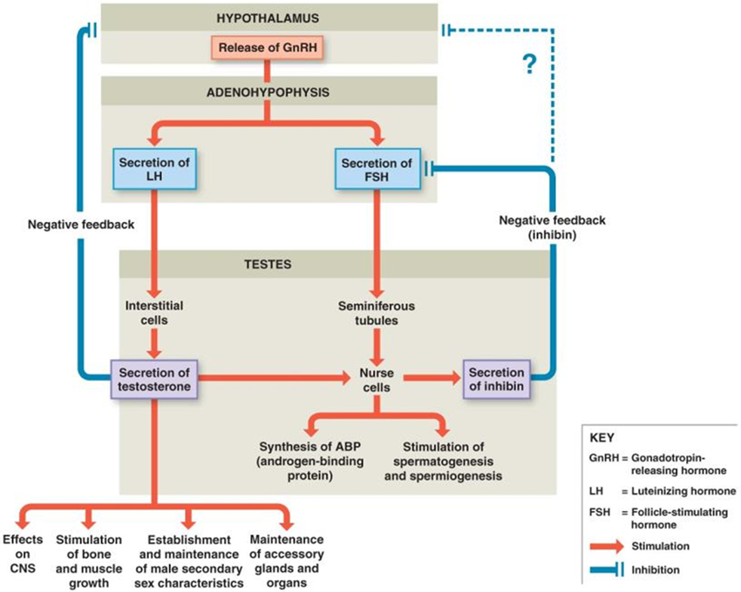
Regulation of Male Reproduction
Video on regulation of male reproduction
Notes:
Mature hypothalamus produces GnRH
Secretion of FSH and LH
Stimulation of gonadotroph cells in anterior pituitary
FSH stimulates spermatogenesis
LH stimulates testosterone production
Inhibin
Released by Sertoli cells
Inhibits FSH secretion
↓ sperm production
Martini Fundamentals of A&P 9e
Janux. (2015, Jan 10). Human physiology – hormonal regulation of male reproduction. Retrieved from https://www.youtube.com/watch?v=GC58kOcsx9U

Slide 23
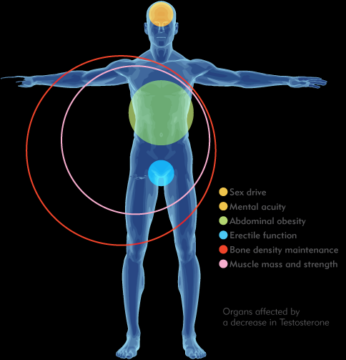
  Changes Associated with Male Climacteric Occur Gradually and Over a Longer Time Period
Male Climacteric = andropause
  The period of declining reproductive function.
  ↓ circulating testosterone.
  Typically begins between 50 and 60 years of age.
  ↑ circulating FSH and LH.
  Sperm production continues.
  ↓ testosterone levels leads to ↓ in sexual activity.
Notes:
Retrieved from http://www.procreacliniques.com/images/uploaded/men/andropause_en.png, 2016

Slide 24
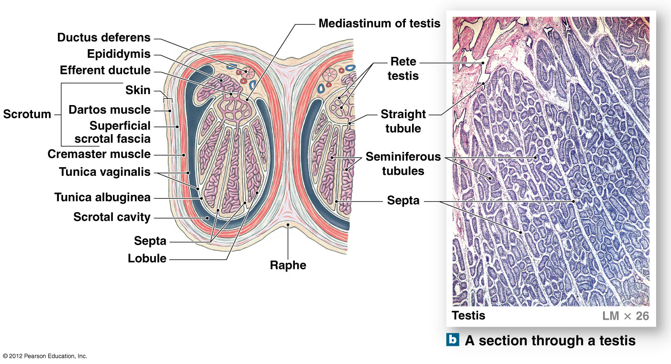
Histology of the Testes
Notes:
Lobules
Created by the septa, which subdivide the testes and contain the seminiferous tubules
Seminiferous tubules
Approximately 800 slender, tightly coiled tubes each ca. 80 cm (32 in.) in length
One testis contain nearly ½ mile of seminiferous tubules
Site of sperm production
Straight tubule
Comes off seminiferous tubule entering mediastinum of testis
Extensively interconnected
Rete testis
Formed by straight tubule appearing as a maze of passageways
Efferent ductile
Connect rete testis to epididymis
Martini Fundamentals of A&P 9e

Slide 25
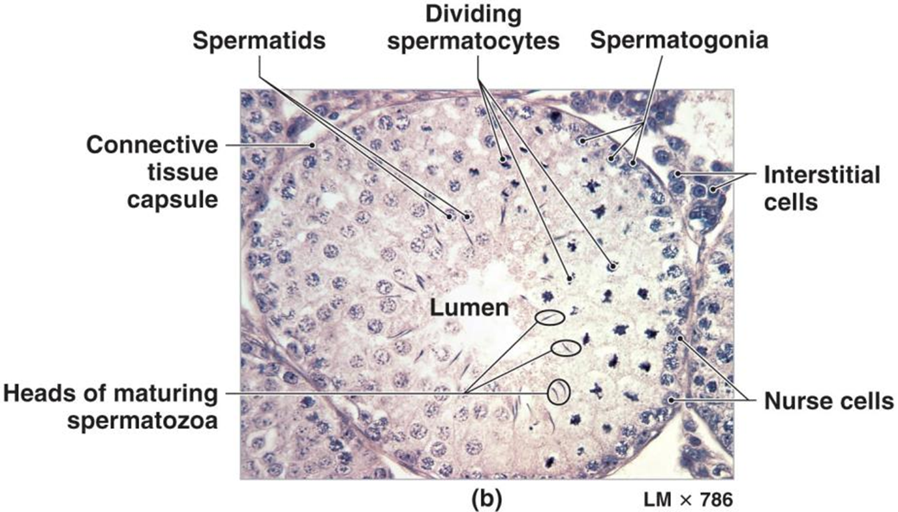
Sperm Formation Occurs in Seminiferous Tubules
Seminiferous tubules contain all stages of sperm development
  Spermatogonia
  Primary spermatocyte
  Secondary spermatocyte
  Spermatid
  Spermatozoa
Nurse cells
  Support spermatogenesis
  AKA: Sertoli or sustentacular
Leydig cells (AKA: interstitial)
  Secrete testosterone
(immobile)
Notes:
Martini Fundamentals of A&P 7e

Slide 26

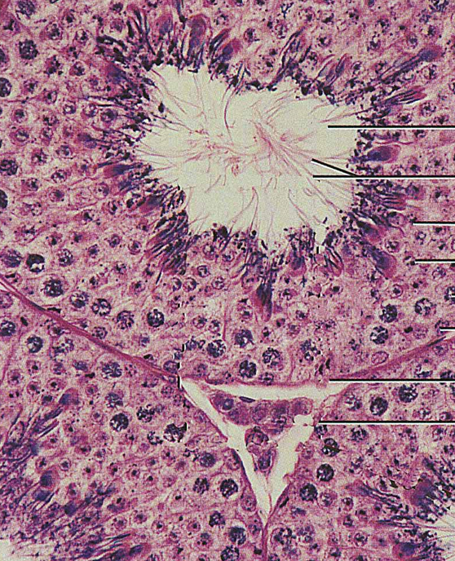
Spermatogenesis is the Formation of Sperm
Formation of sperm cells from spermatogonia.
Begins at puberty and continues up into and beyond 7th decade of life.
Notes:
Spermatogenesis
Begins at puberty continuing up into and beyond 7th decade of life
Continuous process
All stages of meiosis are observed within seminiferous tubules
Martini Fundamentals of A&P 7e

Slide 27
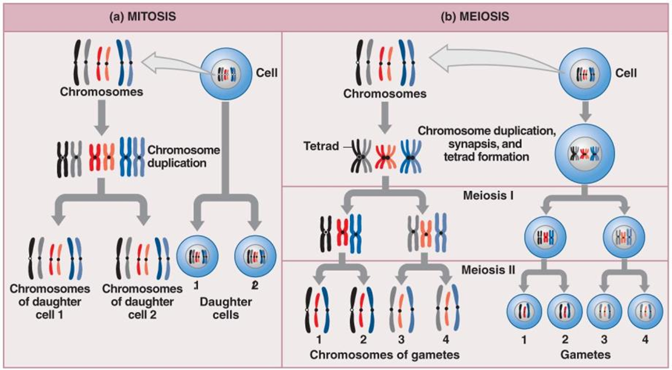
Spermatogenesis Involves:
Mitosis, Meiosis and Spermiogenesis
Video on spermatogenesis
Notes:
Mitosis
Part of somatic cell division
Produces two diploid daughter cells
Both have identical pairs of chromosomes
Meiosis
Specialized form of cell division only in production of gametes
Spermatozoa in males
Oocytes in females
Gametes contain 23 chromosomes, half the normal amount
Fusion of male and female gametes produces zygote with 46 chromosomes
Martini Fundamentals of A&P 9e
Janux. (2015, Jan 10). Human physiology – reproduction: Spermatogenesis. Retrieved from https://www.youtube.com/watch?v=krSMZDsjLuU

Slide 28
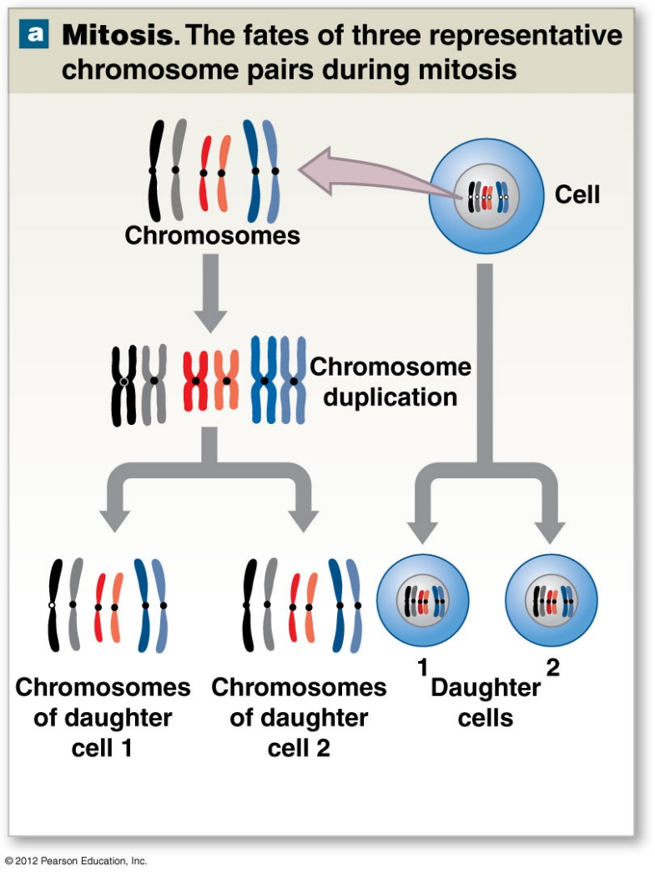
Spermatogenesis and Spermatogonia
Spermatogonia - diploid
  Produce 2 kinds of daughter cells.
  Type A
    Remain outside blood-testis barrier.
    Produce more daughter cells until death.
  Type B
    Differentiate into primary spermatocytes - diploid.
Notes:
Mitosis and spermatogonium
Each division of a diploid spermatogonium produces two daughter cells. One is a spermatogonium and remains in contact with basement membrane of tubule. The other a primary spermatocyte, which displaces toward lumen.
Martini Fundamentals of A&P 9e

Slide 29
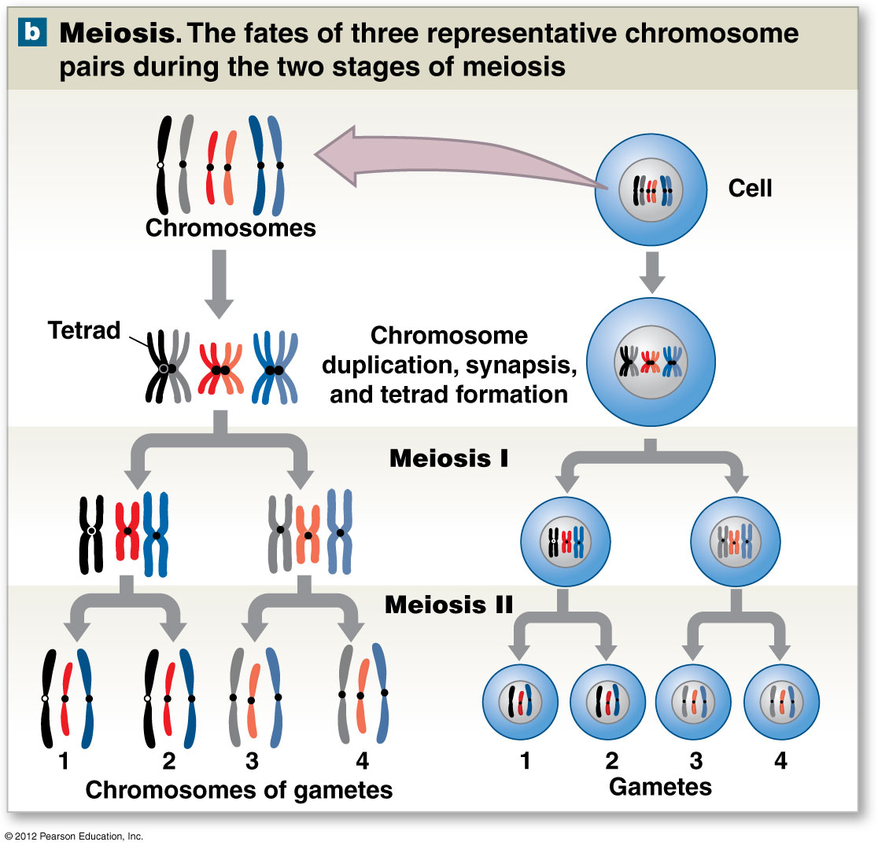
Spermatogenesis and Secondary Spermatocytes
Secondary spermatocytes formed.
  23 chromosomes - haploid
    Each is 2 chromatids joined by centromere.
    Moves through meiosis II.
4 spermatids formed.
  Each haploid and unique.
  50% X chromosome and 50% Y chromosome.
Notes:
Meiosis I
Prior to the start of meiosis I primary spermatocyte contains 46 individual chromosomes. At the end of meiosis I daughter cells are known as secondary spermatocytes each containing 23 chromosomes and a pair of duplicate
chromatids.
Meiosis II
Secondary spermatocytes soon enter meiosis II yielding four haploid spermatids, each containing 23
chromosomes. Each primary spermatocyte entering meiosis will render four spermatids.
Martini Fundamentals of A&P 9e

Slide 30
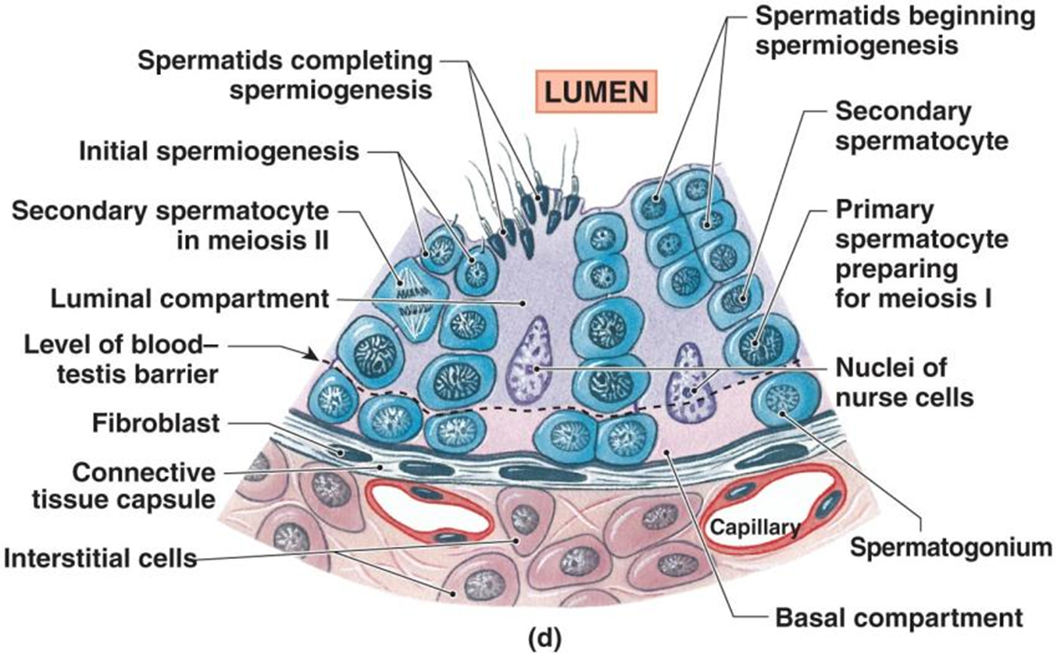
Spermiogenesis and Spermiation
Spermiogenesis
    Maturation of spermatids into sperm cells.
Spermiation
  Release of a sperm cell from nurse cell.
Notes:
Martini Fundamentals of A&P 7e

Slide 31
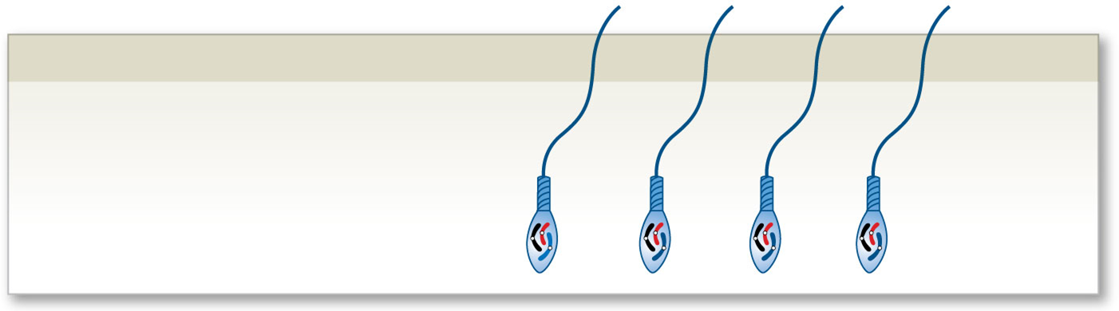
Spermiogenesis
Last step of spermatogenesis.
Each spermatid matures into single spermatozoon (sperm).
The physical maturation process
Spermatozoa
(haploid)
Notes:
31
Spermiogenesis
Is the last step of spermatogenesis where spermatid matures into spermatozoon (sperm) attached to cytoplasm of nurse cells.
Spermiation
In the process where spermatozoon detach from nurse cells and enter the lumen of the seminiferous tubule.
Spermatogonial division to spermiation takes approximately 9 weeks
Martini Fundamentals of A&P 9e

Slide 32
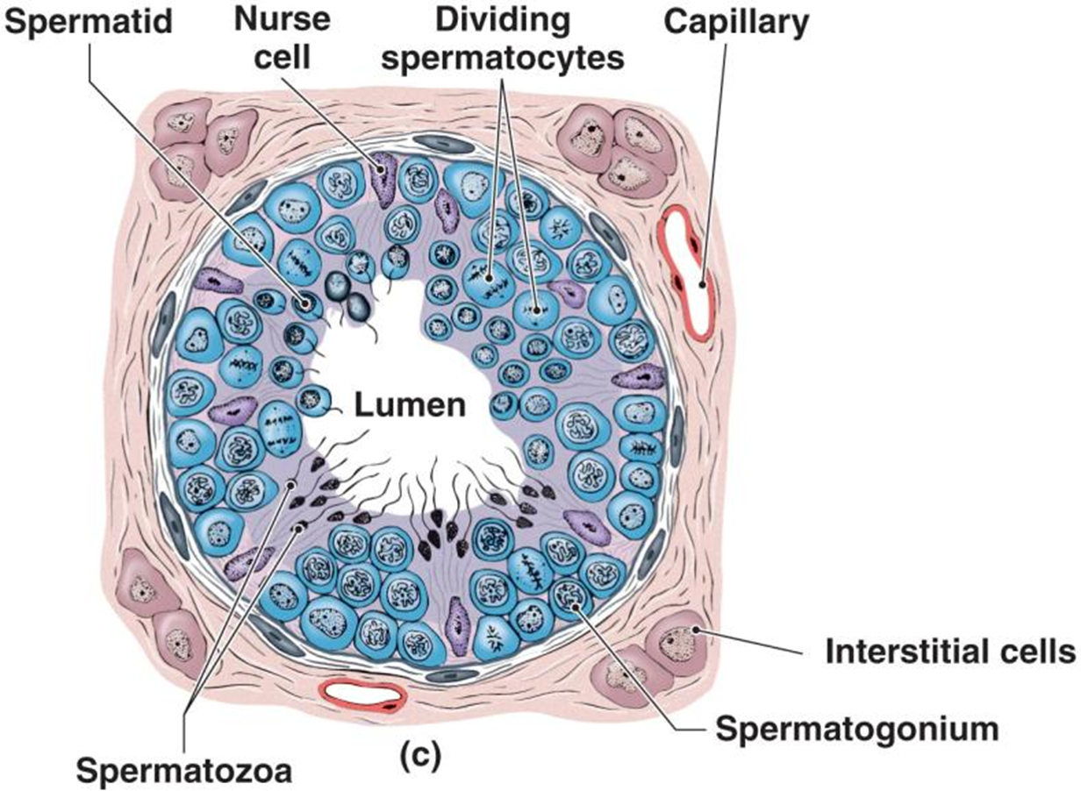
Supporting Nurse Cells of Sperm Formation
AKA: sustentacular or Sertoli cells.
  Maintain blood-testis barrier.
  Support mitosis and meiosis.
    FSH induced
  Support spermiogenesis.
    Nutrition, protection
  Secrete inhibin.
    Regulation of FSH and GnRH
  Secrete androgen-binding protein (ABP).
  Secrete Müllerian-inhibiting factor (MIF).
    Repression of development of female structures.
Notes:
Martini Fundamentals of A&P 7e

Slide 33
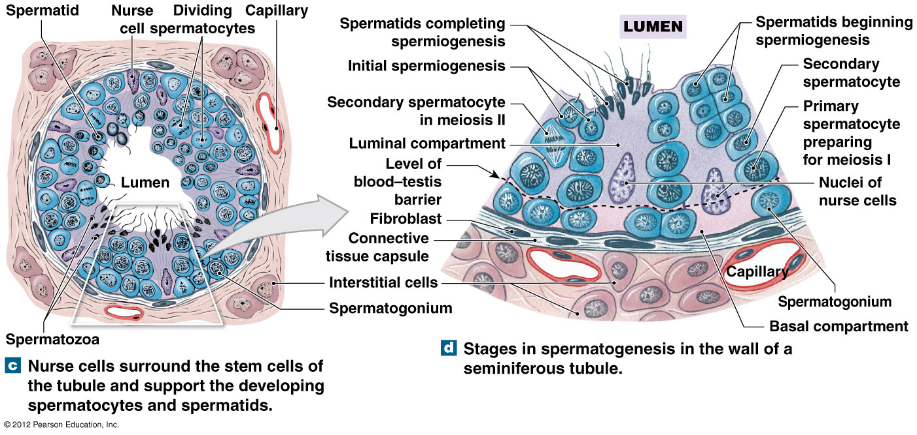
Spermatogenesis and Nurse Cells
Blood-testis barrier formed by tight junctions between and basement membrane under nurse cells.
Notes:
Martini Fundamentals of A&P 9e

Slide 34
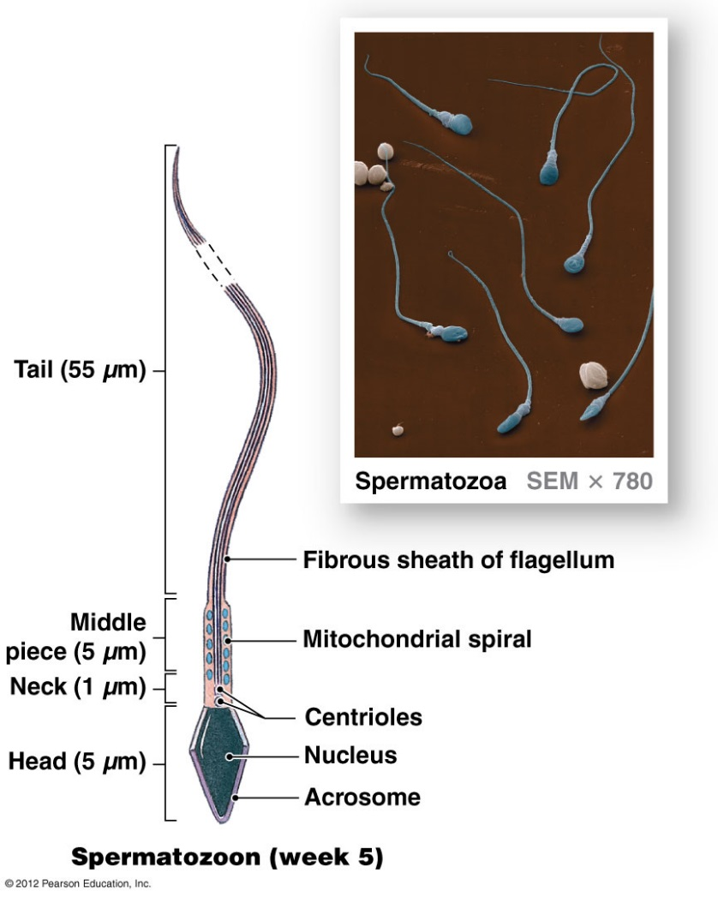
Anatomy of the Spermatozoon
Head
  Acrosome - hyaluronidase
  Nucleus - haploid set of chromosomes.
Neck
  Attaches head to middle piece.
  Contains centrioles.
Middle piece
  Contain mitochondria that produce ATP to move tail.
Tail
  Only flagellum in human body.
  Whiplike organelle that moves cell.
Notes:
Martini Fundamentals of A&P 9e

Slide 35
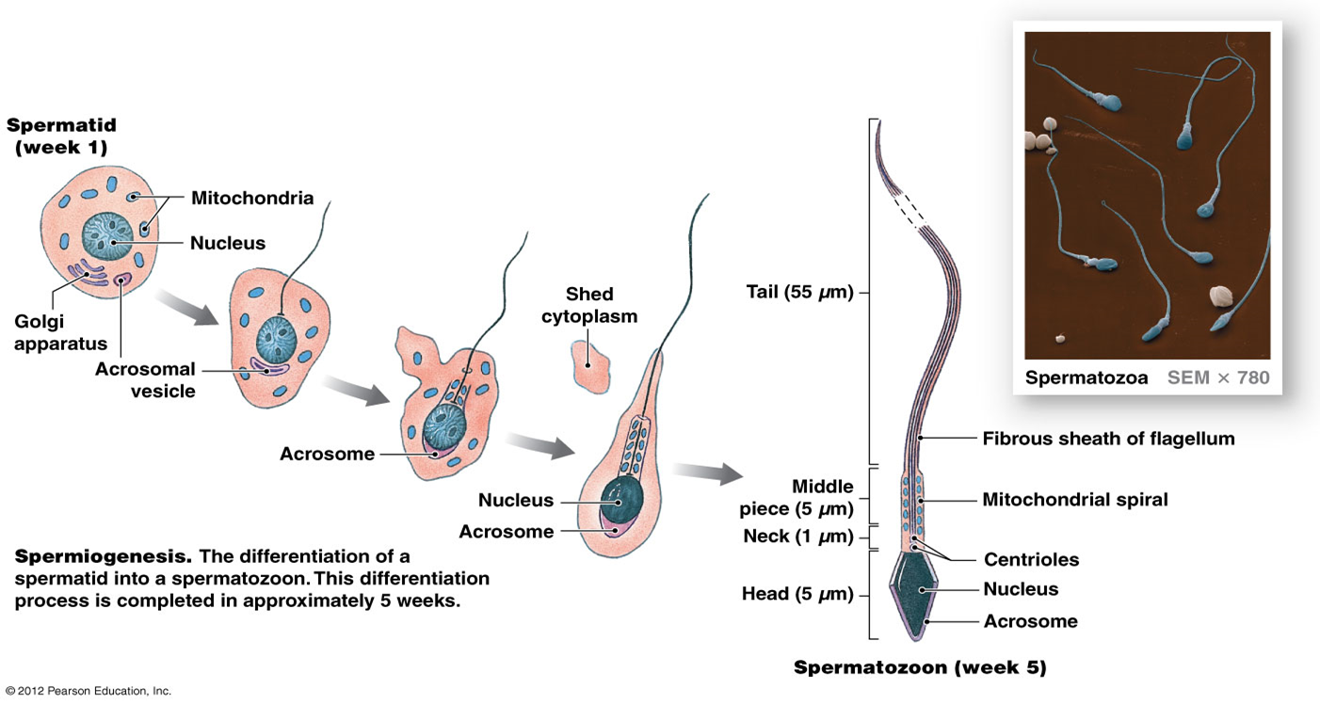
Transformation of spermatids into Spermatazoa
Spermiogenesis involves discarding excess cytoplasm and growing tails.
Notes:
Mature Spermatozoon
Lacks: endoplasmic reticulum, Golgi apparatus, lysosomes and peroxisomes
Inclusions and other intracellular structures
Loss of these organelles reduces sperm size and mass
Sperm must absorb nutrients (fructose) from surrounding fluid
~400,000,000 spermatozoa/day
85 days maturation time
50-130 million sperm per ml of semen
Average ejaculation 2-5 ml
Martini Fundamentals of A&P 9e

Slide 36
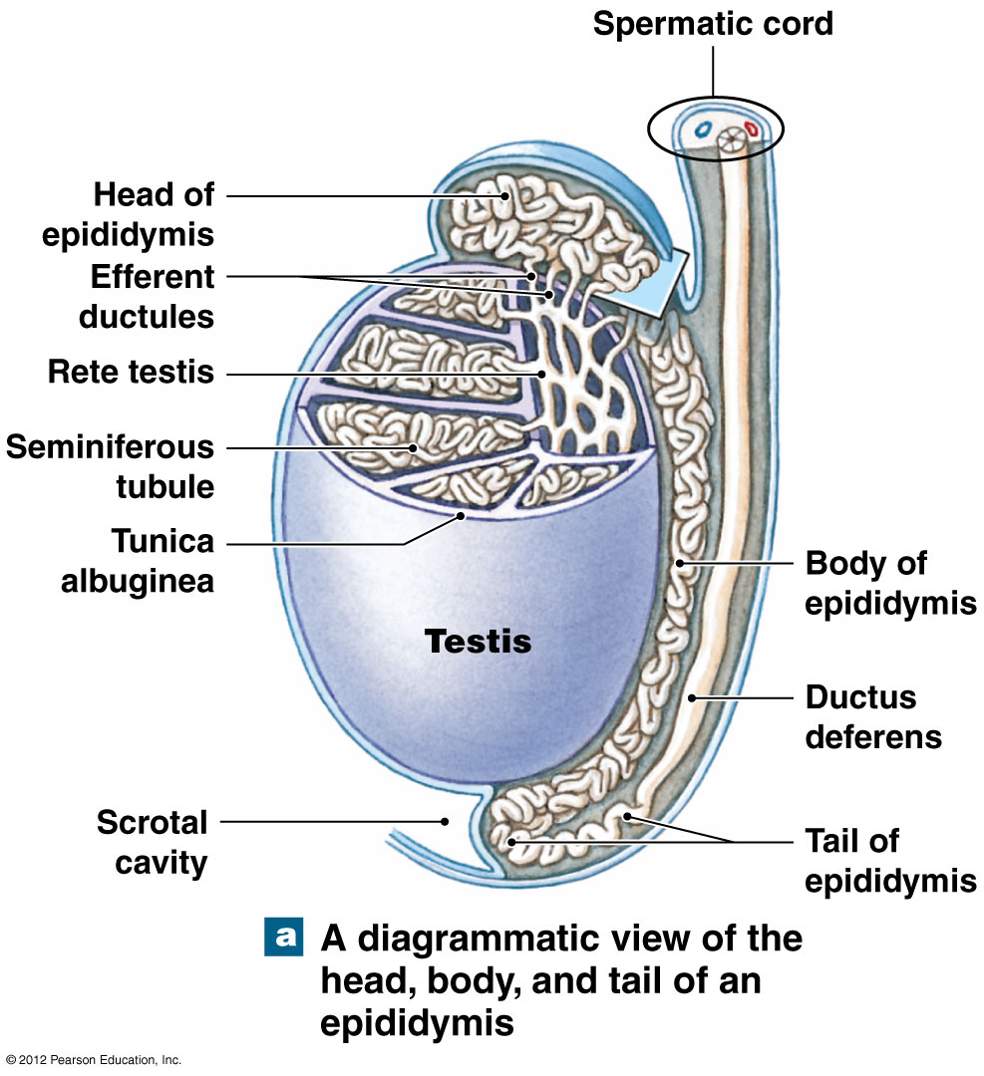
Epididymis: Site of Sperm Maturation
Comma-shaped organ.
Along posterior border of each testis.
Head, body and tail region.
Multiple efferent ducts to a single ductus epididymis of head region.
  20 foot tube if uncoiled.
Tail region continues as ductus deferens.
Pseudostratified ciliated columnar epithelium
Layer of smooth muscle.
Notes:
Martini Fundamentals of A&P 9e

Slide 37
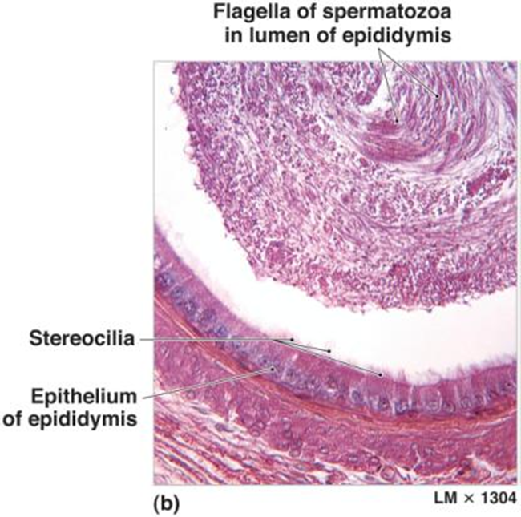
Function of the Epididymis and Spermatozoa
Monitors/adjusts fluid composition (stereocilia).
Recycles damaged spermatozoa.
Storage, protection, facilitation.
  Epithelial cells regulate environment.
  Maturation of spermatozoa
  Capacitation occurs when the glycoprotein coat of sperm Acrosome is removed in the female reproductive tract allowing the sperm to penetrate the oocyte.
Notes:
Martini Fundamentals of A&P 7e

Slide 38
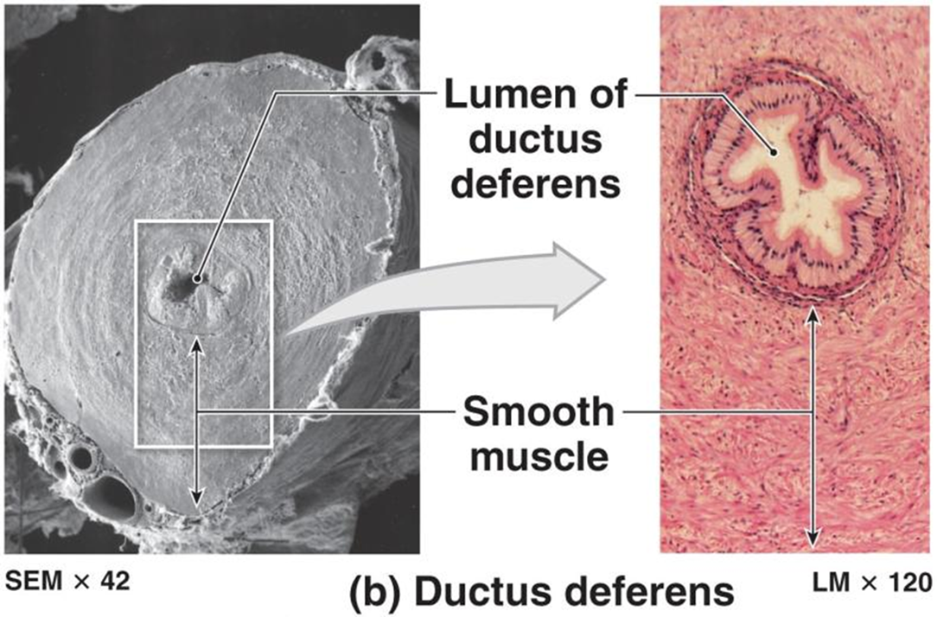
Ductus Deferens: Conveys sperm by peristaltic contractions
AKA: vas deferens
Muscular tube pathway of 40-45 cm (16-18 in.).
Pseudostratified columnar epithelium.
Covered with heavy coating of muscle.
Expanded portion known as ampulla.
Empties into prostatic urethra with seminal vesicle.
Convey sperm by peristaltic contractions.
Stored sperm remain viable for several months.
Notes:
Martini Fundamentals of A&P 7e

Slide 39
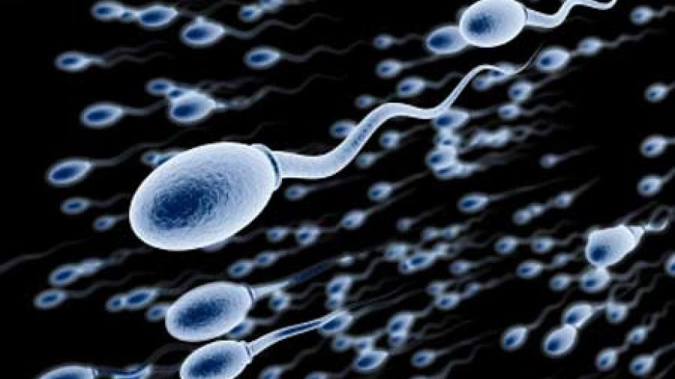
Semen
Ejaculate: 2-5 ml semen.
  Spermatozoa - 50-130 million per ml (60% normal).
  Seminal fluid
    60% from seminal glands.
    30% from prostate gland.
    5% from nurse cells and epididymis.
    < 5% from bulbourethral glands.
  Enzymes
    Protease - dissolves mucous.
    Seminalplasmin – antibiotic.
    Prostatic enzyme – fibrinogen, fibrin.
    Fibrinolysin - liquefies clot after 15-30 min.
Notes:
Retrieved from http://a57.foxnews.com/global.fncstatic.com/static/managed/img/legacy/2009/07/876/493/0_21_450_sperm_istock.jpg?ve=1&tl=1, 2016

Slide 40
https://www.youtube.com/watch?v=iZAQl9w_zSQ
https://www.youtube.com/watch?v=2JGqVQv7LEU

Slide 41
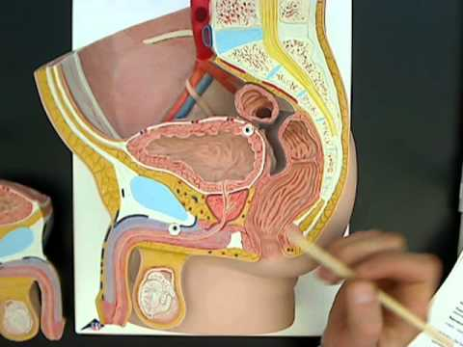
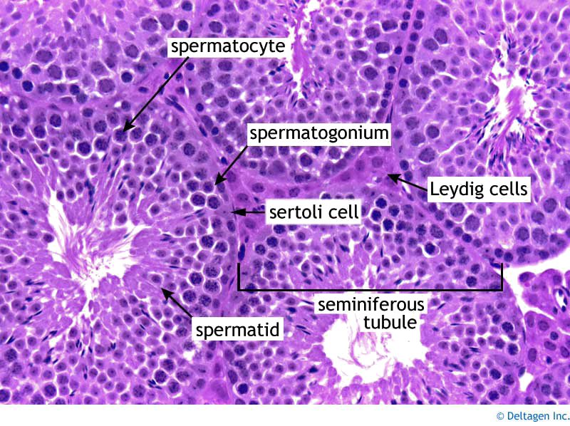
Activities
Study and review all models of male reproduction for structure identification.
Microscopic observation: histology of the penis and testis.
Answer all associated questions in Survival Guide.
Notes:
Model image retrieved from https://i.ytimg.com/vi/54984GsSSw4/hqdefault.jpg, 2016
Testis histology image retrieved from http://www.deltagen.com/target/histologyatlas/atlas_files/male_rep/testis_40X.jpg, 2016

Slide 42
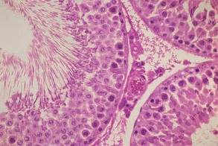

Slide 43
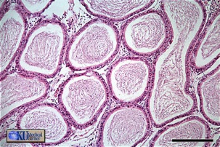

Slide 44
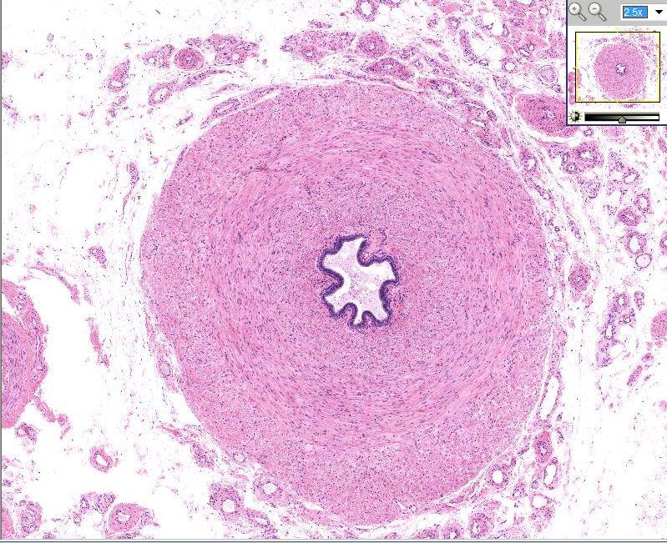
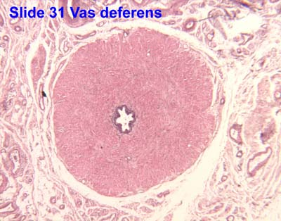

Slide 45
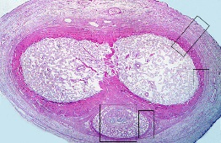

Slide 46
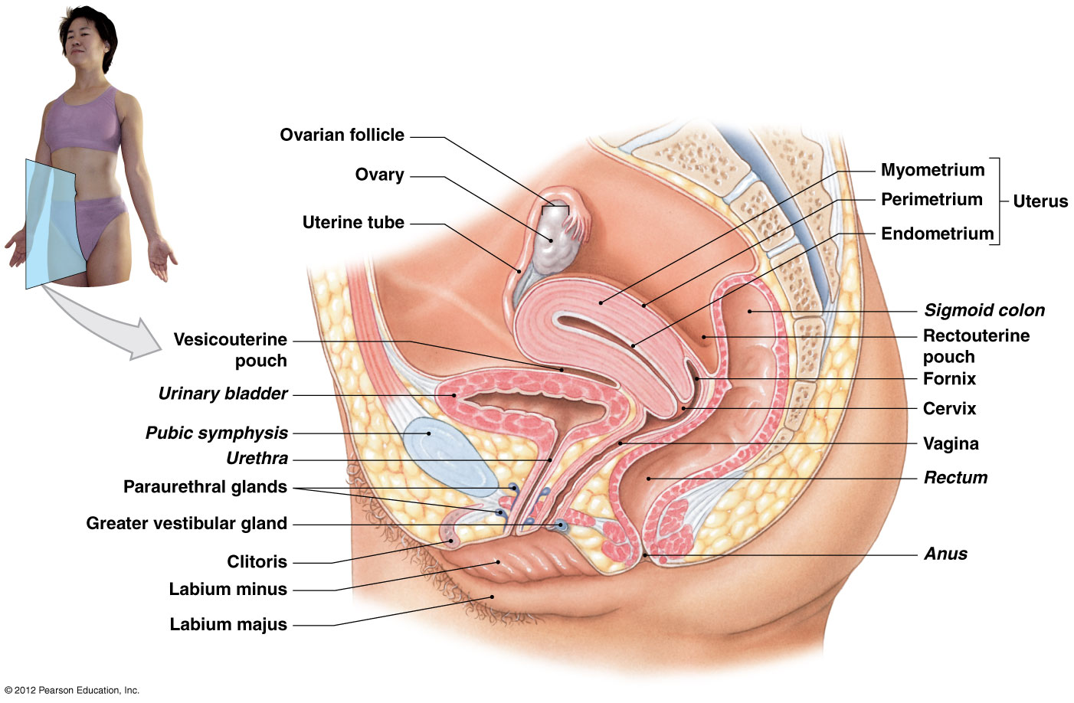
Female Reproductive System Consists of…..
Ovary (2)
Uterine tube (2)
Uterus
Vagina
Vulva
Notes:
The Female Reproductive System produces sex hormones and functional gametes, protects and supports developing embryo, and nourishes newborn infant.
Ovaries – produces secondary oocytes and hormones
Uterine tubes – transports ovulated oocyte or zygote
Uterus – location of fetal development
Vagina – passageway for elimination of menstrual fluids, receives penis during intercourse, and birth canal.
Vulva – components of external genitalia
Martini Fundamentals of A&P 9e

Slide 47
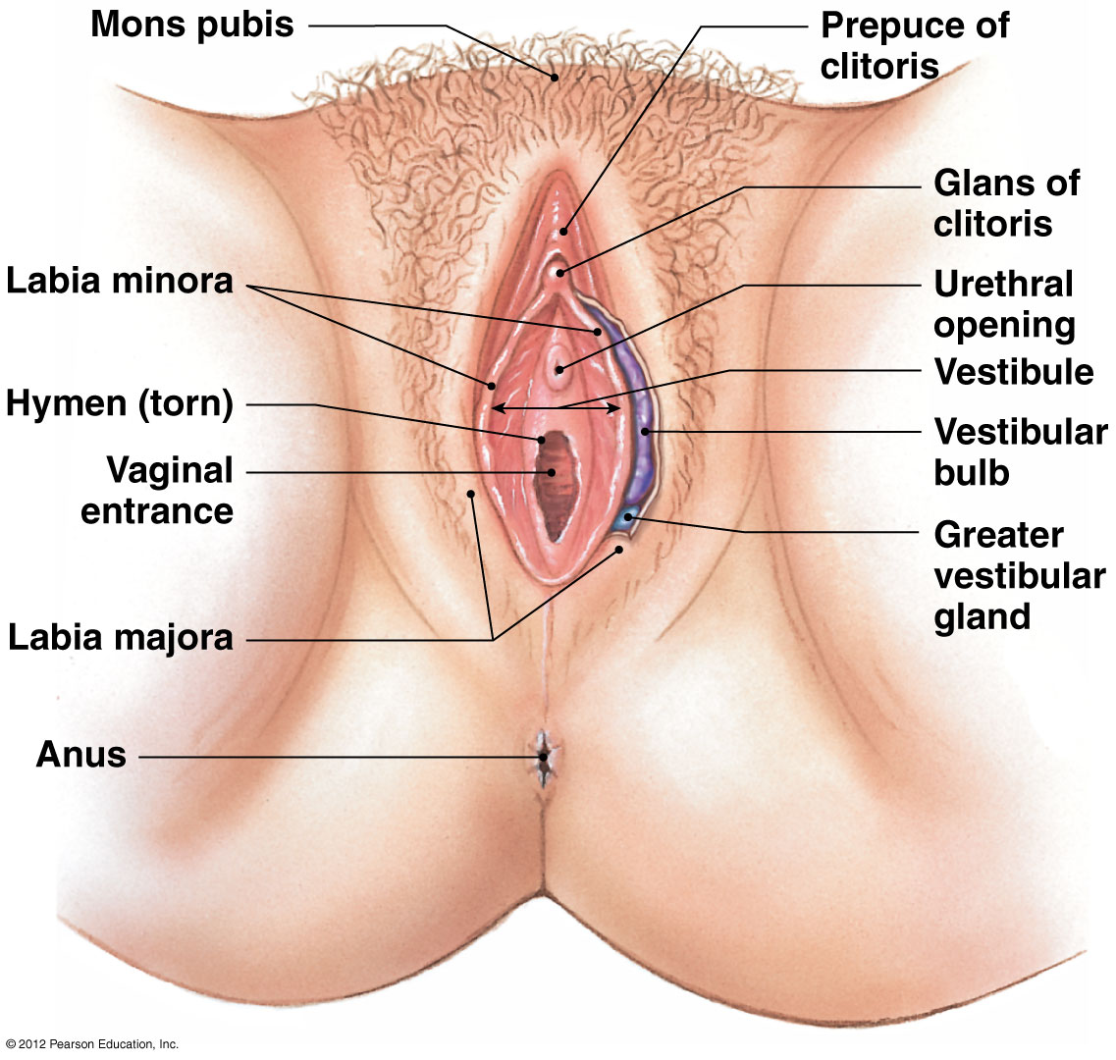
Vulva: External Genitalia - Homology
Embryonic origins
  Clitoris = penis (corpus cavernosa).
  Labia majora and minora = scrotum.
  Greater vestibular (Bartholin’s) glands = bulbo-urethral gland.
  Vestibular bulbs = corpus spongiosum.
  Perineum: the area between the anus and vulva or scrotum
Notes:
Martini Fundamentals of A&P 9e

Slide 48
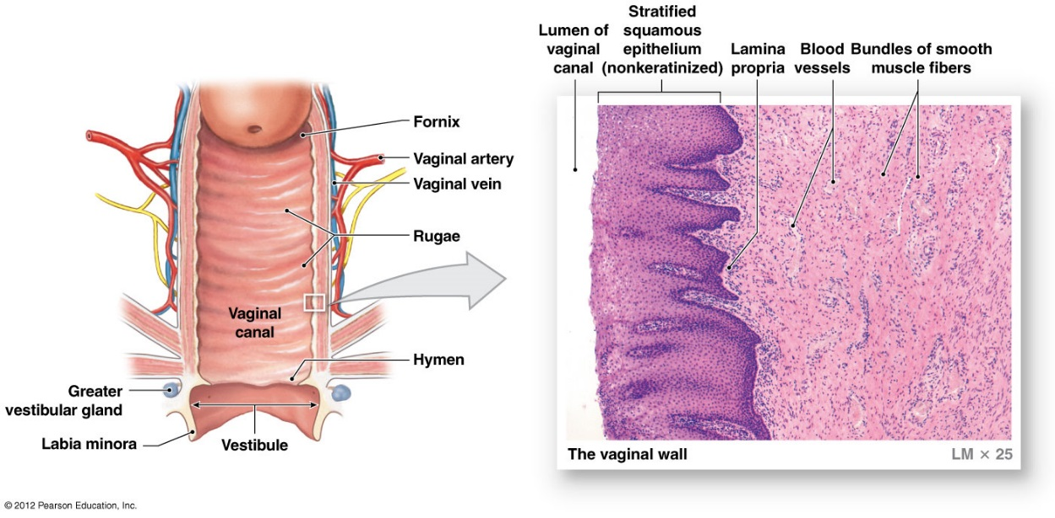
The Vagina and its Function
Elastic, muscular tube.
7.5-9 cm long.
Bacteria ensure low pH – acidic.
Innervation
  Hypogastric plexus (S2-S4).
  Pudenal nerve branches.
Functions
  Passageway (fluids)
  Receptacle of sperm
  Birth canal
Notes:
Martini Fundamentals of A&P 9e

Slide 49
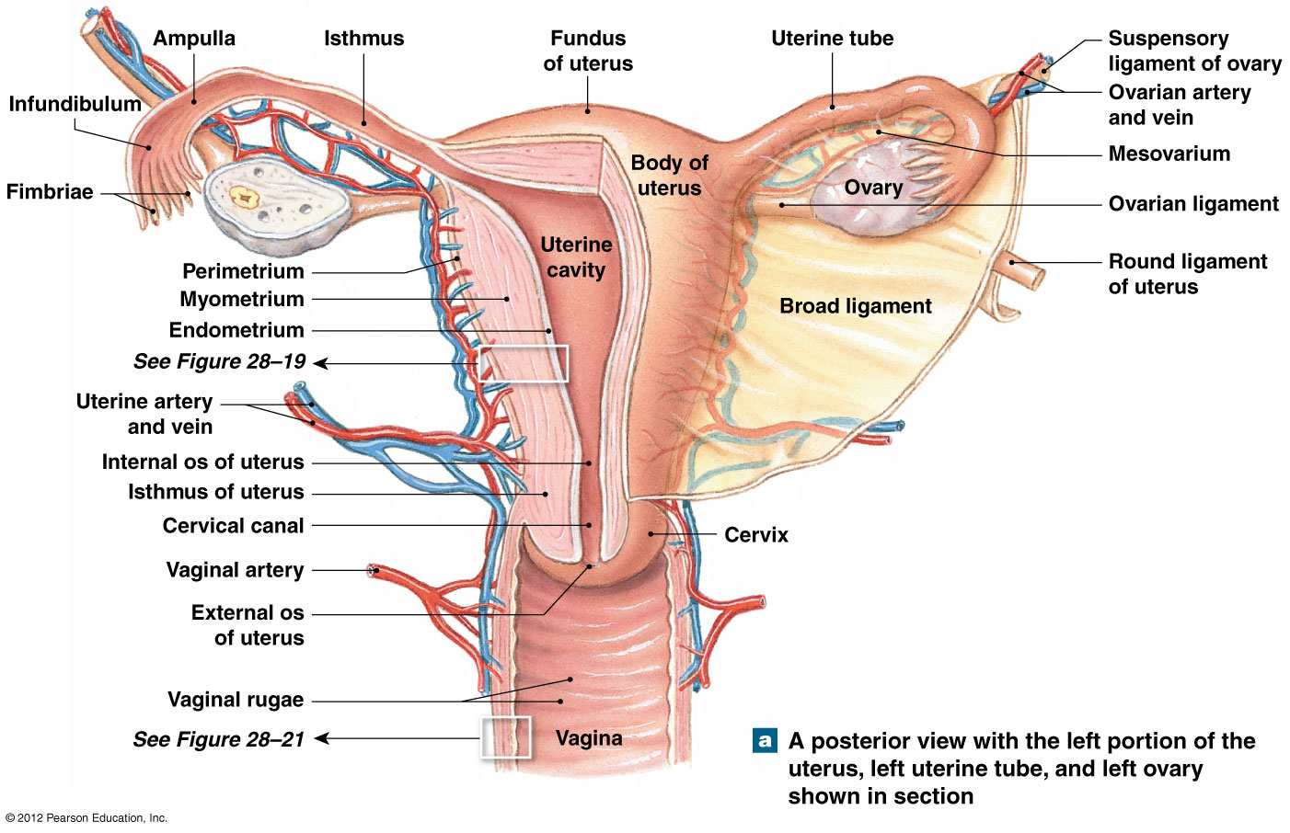
Internal Anatomy of the Uterus
Notes:
Martini Fundamentals of A&P 9e

Slide 50
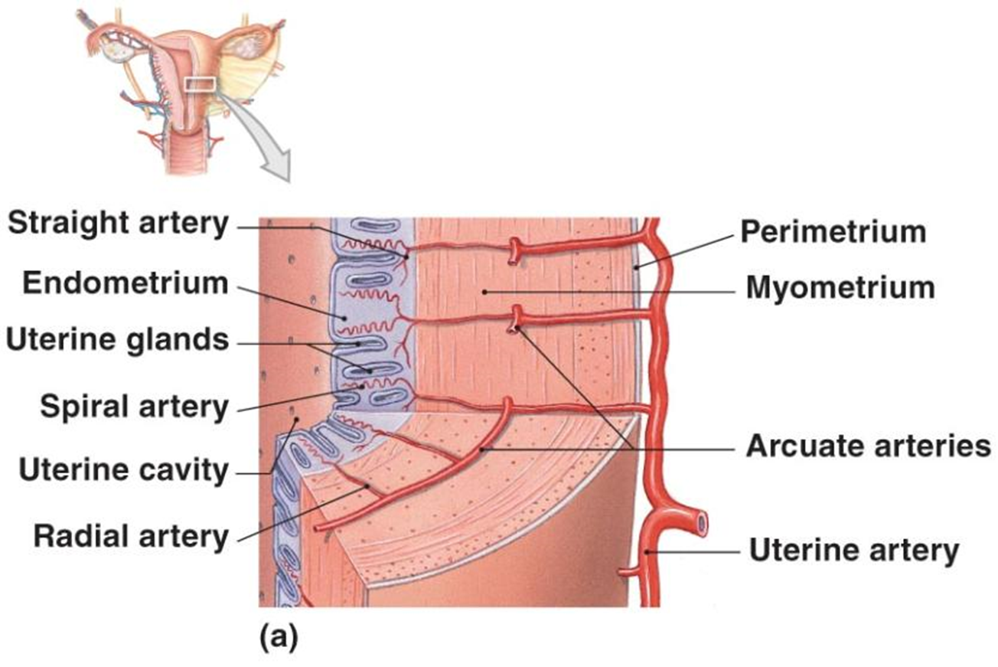
The Uterine Wall
Myometrium: muscular tissue (90%)
Endometrium: glandular tissue, blood vessels (10%)
Perimetrium: serosa
Notes:
Martini Fundamentals of A&P 7e

Slide 51


The Uterus
7.5 x 5 cm, 30-40 g.
Anteflexed (bent anteriorly at base).
Provides fetus (weeks 1-8) and embryo (week 9-birth).
  Mechanical protection
  Nutritional support
  Waste removal
Notes:
Martini Fundamentals of A&P 9e
Martini Fundamentals of A&P 7e

Slide 52

Histology of the Uterus
Notes:
Two Divisions of Endometrium
Functional zone – contains most of the uterine glands, contributes most of endometrial thickness, undergoes dramatic changes in thickness and structure during menstrual cycle
Basilar zone – attaches endometrium to myometrium and contains terminal branches of tubular endometrial glands
Martini Fundamentals of A&P 7e

Slide 53

Review of the Uterine/Menstrual Cycle
Notes:
Martini Fundamentals of A&P 9e

Slide 54

The Uterine Cycle: Begins with Menses
21-35 days
3 phases:
  Menses
  Proliferative
  Secretory
Begins with menstruation (menses)
Endometrial sloughing
35-50 mL of blood
Follicular phase
Luteal phase
Notes:
Martini Fundamentals of A&P 7e

Slide 55

The Uterine Cycle: Proliferative Phase
Restoration of functional epithelium.
Growth and vascularization.
Follicles enlarge.
Estrogen induced.
Glycogen-rich mucus.
Notes:
Martini Fundamentals of A&P 7e

Slide 56

The Uterine Cycle: Secretory Phase
14 days
Glands enlarge.
Arteries abundant.
Ovulation-corpus albicans.
Progestins and estrogens → corpus luteum.
Peaks 12 days after ovulation.
Notes:
Martini Fundamentals of A&P 7e

Slide 57

The Uterine Tubes
AKA: fallopian tubes, oviduct.
Narrow, 13 cm tube extends from ovary to uterus.
  Infundibulum
    Open, funnel-shaped portion near ovary.
  Fimbriae
    Moving finger-like processes.
  Ampulla
    Central region of tube.
  Isthmus
    Narrowest portion joins uterus.
Notes:
Epithelium lining tube is composed of ciliated columnar epithelial cells with scattered mucin-secreting cells and mucosa surrounded by concentric layers of smooth muscle.
Uterine Tube and Oocyte Transport
Ciliary movement and peristaltic contractions in walls of uterine tube
Few hours before ovulation, nerves from hypogastric plexus initiate beating pattern and peristalsis
From infundibulum to uterine cavity takes ~3-4 days
Martini Fundamentals of A&P 9e

Slide 58

Uterine Tubes (Fallopian)

Slide 59

The Ovarian Cycle and Follicular Stages
Stages of follicular development.
  Primordial
  Primary
  Secondary
  Graafian
  Ovulation
Corpus luteum
  An ovulation wound.
  Hormone secreting cells.
Corpus albicans
  Degenerated corpus luteum.
Corpus
Albicans
Notes:
Ovarian follicles are specialized structures in cortex of ovaries where both oocyte growth and meiosis I occur.
Cycle can be divided into a follicular phase (preovulatory phase) and a luteal phase (postovulatory phase)
Martini Fundamentals of A&P 7e

Slide 60


Histological View of Ovary
Primordial follicles
Primary follicle
Secondary follicle
Tertiary follicle
Notes:
Ovaries are small, almond-shaped organs near lateral walls of pelvic cavity
Three main functions:
Production of immature female gametes (oocytes)
Secretion of female sex hormones (estrogens, progestins)
Secretion of inhibin, involved in feedback control of pituitary FSH
Full cat ovary retrieved from https://embryology.med.unsw.edu.au/embryology/images/d/dc/Ovary-_histology_overview.jpg, 2015
Section of cat ovary retrieved from https://embryology.med.unsw.edu.au/embryology/images/f/fe/Ovary5x.gif, 2015

Slide 61

Primordial Follicle
Will mature and be released as a secondary oocyte or degenerate (atresia).
Notes:
Located in outer portion of ovarian cortex near tunica albuginea
Clusters are called egg nests
Each surrounded by single squamous layer of follicle cells forming primordial follicle
At puberty follicles are continuously activated
Will mature and be released as a secondary oocyte or degenerate (atresia)
Martini Fundamentals of A&P 9e

Slide 62

Formation of Primary Follicle
Activation of a primordial follicle into primary follicles.
Notes:
Activation of a primordial follicle into primary follicles
Enlarge, divide and form several layers of cells around primary oocyte = granulosa cells
Glycoprotein-rich region = zona pellucida
Granulosa cells enlarge and multiply forming layer of thecal cells
Thecal and granulosa cells collaborate to produce estrogens
Martini Fundamentals of A&P 9e

Slide 63

Formation of Secondary Follicle
Many primordial follicles develop into primary follicles, but only a few mature under the control of growth factor.
SECONDARY FOLLICLE – PRIMARY OOCYTE
Notes:
Many primordial follicles develop into primary follicles, but only a few mature
Under control of growth factor produced by oocyte
Wall of the follicle thickens and deeper cells begin to secrete follicular fluid or Liquor folliculi that accumulates I small pockets that expand and separate inner and outer layers of follicle
This stage defines the secondary follicle
Contains a slow growing primary oocyte
Martini Fundamentals of A&P 9e

Slide 64

Formation of Tertiary Follicle
Day 10 to 14 the chosen follicle becomes a tertiary or mature graafian follicle, ~15 mm in diameter.
Notes:
Day 10 to 14 the chosen follicle becomes a tertiary or mature graafian follicle ~15 mm in diameter
Oocyte projects into antrum that is surrounded by a mass of granulosa cells
Development of tertiary follicle ends, LH levels begin to rise prompting completion of meiosis I
Yields secondary oocyte and non-functional polar body
Enters meiosis II, but suspended in metaphase
Day 14 secondary oocyte and granulosa cells loose connection with follicular wall and drift free within antrum.
Granulosa cells associated with secondary oocyte form protective layer, corona radiata
Martini Fundamentals of A&P 9e

Slide 65



Slide 66



Slide 67

The Process of Oogenesis
  AKA: ovum production.
  Begins before birth.
  Accelerates at puberty.
  Ends at menopause.
https://youtu.be/-iF9dwVQUvc
Notes:
Mitosis
As a fetus, oogonia divide to produce millions by mitosis with most degenerating (atresia)
Meiosis occurs between 3rd -7th month (fetus) producing primary oocyte suspended in prophase of meiosis I
~2 million primary oocytes in primordial follicles at birth
At puberty: 400,000
Meiosis I
At puberty, FSH triggers ovarian cycle
Each month after ovarian cycle begins, some of the primary oocytes are stimulated and undergo further development
Meiosis I is then completed yielding a secondary oocyte and a polar body
Meiosis II
Each month ovarian cycle begins releasing one or more secondary oocytes suspended in metaphase of meiosis II and will be completed only if fertilization occurs
Polar body produced in meiosis I may or may not undergo meiosis II
In either case the polar body soon degenerates
Martini Fundamentals of A&P 7e
Sanghvi, S. (2014, Dec 18). Oogenesis Animation 2. Retrieved from https://www.youtube.com/watch?v=0-Q4V9tJ_18

Slide 68

Graafian Follicle and Ovulation
Ovulation marks end of follicular phase of ovarian cycle and beginning of luteal phase.
Notes:
Ovulation involves the tertiary follicle’s release of the secondary oocyte.
Distended follicular wall suddenly ruptures, ejecting follicular contents, which includes the secondary oocyte and corona radiata, into pelvic cavity.
Moved to uterine tube by contact with fimbriae.
Martini Fundamentals of A&P 9e

Slide 69

Formation of the Corpus Luteum
Endocrine structure that secretes progesterone preparing uterus for pregnancy (also estradiol).
Notes:
Empty tertiary follicle initially collapses, and ruptured vessels bleed into antrum.
Remaining granulosa cells invade area proliferating and creating the corpus luteum (endocrine structure).
Contains cholesterol enabling the production of progestins, primarily progesterone.
Progesterone stimulates the maturation of the uterine lining and secretions of the uterine glands in preparing uterus for pregnancy.
Martini Fundamentals of A&P 9e

Slide 70

Formation of Corpus Albicans
Disintegration, or involution, of corpus luteum marks end of ovarian cycle.
Notes:
~Day 12 after ovulation, degeneration of the corpus luteum begins unless fertilization occurs.
This is followed by a sharp fall in levels of estrogen and progesterone.
Fibroblast invade nonfunctional corpus luteum producing a know to pale scar tissue.
Disintegration, or involution, of corpus luteum marks end of ovarian cycle.
New cycle begins with activation of another group of primordial follicles.
Martini Fundamentals of A&P 9e

Slide 71

Regulation of Female Reproductive Cycle
Video on regulation of the female reproductive cycle
Notes:
Martini Fundamentals of A&P 9e
Alila medical media. (2014, May 4). Hormonal control of the menstrual cycle, animation. Retrieved from https://www.youtube.com/watch?v=pNe43KGZTl8&noredirect=1

Slide 72

Review of the Ovarian Cycle
Video on the ovarian cycle
Notes:
Martini Fundamentals of A&P 9e
Muno, J. (2012, Sep 6). Ovarian cycle. Retrieved from https://www.youtube.com/watch?v=I0RsB1dj55o

Slide 73

Review: Hormones of Female Reproductive Cycle
Video on the hormones of the reproductive cycle
Notes:
Hormonal Regulation of Female Reproductive Cycle
Follicular phase
Estrogen levels are low
GnRH pulse frequency 16–24/day
Tertiary follicles form, ↑ concentration of circulating estrogens
GnRH pulse frequency ↑ to 36/day
Estrogen levels exceed threshold for ~ 36 hours resulting in large release of LH
Surge in LH concentration triggers: completion of meiosis I, rupture of follicular wall → ovulation (~36 hrs. after LH surge)
Luteal phase
↑ LH levels trigger ovulation promoting progesterone secretion and formation of corpus luteum
Frequency of GnRH pulses stimulates LH more than FSH
LH maintains structure and secretory function of corpus luteum
Progesterone levels remain ↑ for one week
Corpus luteum begins to degenerate if fertilization does not occur
Progesterone and estrogen levels ↓
GnRH pulse frequency ↑ stimulating FSH secretion initiating a new ovarian cycle
Hormones and the Uterine Cycle
Corpus luteum degenerates leading to ↓ Progesterone and estrogen levels resulting in menses
Endometrial tissue sheds several days
↑ estrogen stimulates regeneration of functional zone
Proliferative phase continues until ↑ progesterone initiates secretory phase
↑estrogen and progesterone causes enlargement of endometrial glands and ↑ secretory activities
Martini Fundamentals of A&P
Darby, J. (2013, Mar 19). Positive and negative feedback before and after ovulation. Retrieved from https://www.youtube.com/watch?v=j7oo2YLOxMM

Slide 74


Slide 75

Menopause:
Cessation of Ovulation and Menstruation
Midlife change in hormone secretion accompanied by menopause.
Age related depletion of follicles means ↓ secretion of estrogen and progesterone.
May consider hormone replacement therapy (HRT).
Perimenopause
  Interval immediately preceding menopause.
  Ovarian and uterine cycles become irregular.
Notes:
Midlife change in hormone secretion accompanied by menopause
↓ in circulating concentrations of estrogens and progesterone, with a sharp and sustained ↑ production of GnRH, FSH and LH
Cessation of menstruation
Average age of 52
Age related depletion of follicles means less secretion of estrogen and progesterone
Atrophy of uterus, vagina and breasts
Skin becomes thinner, bone mass declines, and risks of cardiovascular disease increase
Hot flashes (sudden dilation of cutaneous arteries) occur several times a day
May consider hormone replacement therapy (HRT)
Low dose estrogen and progesterone therapy
Research indicates that estrogen replacement therapy exceeding 5 years increases risk of heart disease, breast cancer, Alzheimer’s disease, blood clots, and stroke
Only used after thorough discussion and assessment by a medical professional regarding potential risks and benefits
Short term therapy
Retrieved from http://www.34-menopause-symptoms.com/pics/34-meno-symptoms-img1.jpg, 2015

Slide 76

Anatomy of the Mammary Glands
Lactation
15-20 Lactiferous sinuses.
Controlled by placenta, hormones.
  Prolactin
    Prolactin promotes the synthesis of milk but many hormones also play a role including progesterone, estrogen and human placental lactogen.
  Oxytocin
    Causes contractions during labor and after birth milk letdown
Notes:
Secrete milk to nourish an infant (lactation)
Are specialized organs of integumentary system (modified sudoriferous glands)
Are controlled by hormones of reproductive system and the placenta
Lie in pectoral fat pads deep to skin of chest
Nipple on each breast contains ducts from mammary glands to surface
Areola is reddish-brown skin around each nipple
Martini Fundamentals of A&P 9e

Slide 77

Breasts
Axillary lymph nodes drain lymph vessels from the lateral quadrant of the breast. These nodes are clinically significant in breast cancer and metastasis from the breast to the axillary lymph nodes.
Breast cancer
  Mammary gland tumor.
  40,500 deaths/yr. in U.S.
  450 male deaths.
  12 % chance.

Slide 78


Histological Perspective:
Inactive and Active Mammary Glands
Notes:
Martini Fundamentals of A&P 9e

Slide 79
Meiosis Review & Genetics Homework
Mitosis .vs. Meiosis
https://www.youtube.com/watch?v=bRcjB11hDCU
Meiosis Review:
https://www.youtube.com/watch?v=nMEyeKQClqI
Homework:
10 points

Slide 80



Slide 82


Slide 83


Activities
Study and review all models of female reproduction for structure identification.
Microscopic observation: histology of the uterus and ovary.
Answer all associated questions in Survival Guide.
Notes:
Model image retrieved from http://www.zipanatomy.com/images/female-reproductive/Slide9.JPG, 2016
Ovary histology image retrieved from http://ocw.tufts.edu/data/4/221179/221181_xlarge.jpg, 2016

Slide 84

Clinical Correlation: Cervical Cancer
Women between 14-35 years old.
13,000 women Dx/yr. in U.S.
~4,000 women die/yr.
Human Papilloma Virus (HPV)
  35,000 women diagnosed/yr. in U.S.
  Gardasil
    Effective vaccine.
Notes:
Retrieved from http://intimatehealthhelp.net/wp-content/uploads/2012/08/cervical-cancer.jpg, 2015

Slide 85
Works Cited
Marieb, E. N. (2012). Essentials of human anatomy & physiology
(6th ed.). Boston: Pearson Education, Inc.
Marieb, E.N., Mitchell, S.J. & Smith, L.A. (2012). Human anatomy and physiology laboratory manual (10th ed.). Boston: Pearson Education, Inc.
Martini, F., Nath, J. & Bartholomew, E.F. (2012). Fundamentals of anatomy & physiology (9th ed.). Boston: Pearson Education, Inc.
McPhee, J. & Papadakis, M. (2012) Current medical diagnosis & treatment (51st ed.). New York: McGraw Hill.
Patton, T. & Thibodeau, G. (2013). Anatomy & physiology (8th ed.).
St. Louis:Mosby Elsevier.
Saladin, K. S. (2012). Anatomy & physiology: The unity of form and function (6th ed.). New York: McGraw Hill.
Tortora, G.J. & Derrickson, B.H. (2012). Principles of anatomy and physiology (13th ed.). Hoboken, NJ: Wiley

