Slide 1
BI 232 Laboratory Circulatory System: Blood Vessels and Blood Pressure
Notes:
Saladin A&P Unity of Form and Function 6e

Slide 2
Anatomy of Blood Vessels: Closed System of Tubes that Carries Blood
Arteries
Leaving the heart
Carry blood from heart to tissues.
Deliver to capillary beds for gas and nutrient exchange.
Veins
Returning to the heart
Carry blood from tissues back to heart.
Capillaries
Thin walled microscopic vessels.
Connect smallest arteries to smallest veins.
Notes:
Saladin A&P Unity of Form and Function 6e

Slide 3
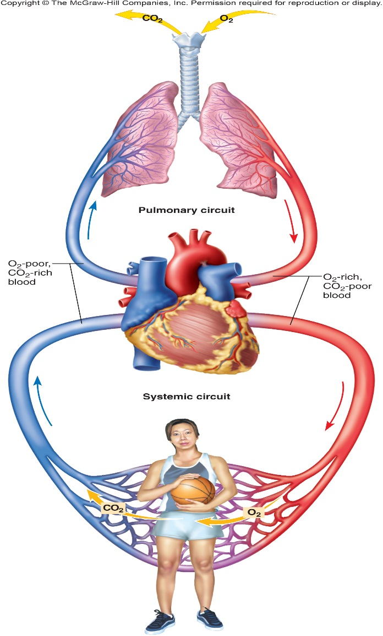
General Circulatory Patterns
Two main circuits:
Pulmonary circulation
Blood flows from R. heart → lungs → L. heart.
Pulmonary trunk and its branches.
Leave the right ventricle, return left atria
Contain deoxygenated blood.
Systemic Circulation
Blood flows from L. heart → rest of the body -> R. heart
Aorta and its branches.
Leave the left ventricle return right atria
Contain oxygenated blood.
Notes:
Saladin A&P Unity of Form and Function 6e

Slide 4
General Anatomy of Blood Vessels
Notes:
Saladin A&P Unity of Form and Function 6e

Slide 5
Artery and Vein Histology
Walls have 3 layers:
Deep to superficial
Tunica intima
Tunica media
Tunica externa
Notes:
Retrieved from http://droualb.faculty.mjc.edu/Lecture%20Notes/Unit%204/FG22_01.jpg, 2016

Slide 6
Tunica Intima
Innermost layer
Includes:
Endothelial lining
Simple squamous epithelium.
overlying basement membrane.
Sparse layer of loose CT.
Internal elastic membrane (arteries only)
Thick layer of elastic fibers in outer margin of tunica.
Notes:
Retrieved from http://www.vascularconcepts.com/img/patients/artery.jpg, 2016

Slide 7
Tunica Media
Middle layer.
Concentric sheets of smooth muscle in loose connective tissue.
Binds to inner and outer layers.
Notes:
Retrieved from http://www.josr-online.com/content/figures/1749-799X-5-18-1-l.jpg, 2016

Slide 8
Tunica Externa
AKA: tunica adventitia
Outer layer.
Contains connective tissue sheath.
Anchors vessel to adjacent tissues.
In arteries…
Contain collagen.
Elastic fibers.
In veins…
Contain elastic fibers.
Smooth muscle cells.
Notes:
Retrieved from http://www.lab.anhb.uwa.edu.au/mb140/corepages/vascular/Images/aty10he.jpg, 2016

Slide 9
Arteries vs. Veins
Arteries and veins run side-by-side (VAN)
Arteries
Have thicker walls (maintain shape histo)
Higher blood pressure.
Collapsed artery
Small, round/oval lumen.
Vein
Large, flat lumen.
Artery
Vein
Notes:
Retrieved from https://encrypted-tbn3.gstatic.com/images?q=tbn:ANd9GcQ3Sw1PAD3RzkfCkkByGxtycI5yWvKW5OhJUfeo2yjVmI-v32_ecg, 2016

Slide 10
Arteries - Carry Blood Away From the Heart
Arteries considered resistance vessels.
Strong, resilient, resist high blood pressure.
Carry oxygenated blood except for pulmonary artery.
Have thick elastic muscle walls.
Valves are absent.
Blood flow under high pressure.
Notes:
Retrieved from http://image.slidesharecdn.com/ch21lecturepresentation-130818142951-phpapp01/95/169-ch-21lecturepresentation-30-638.jpg?cb=1376838347, 2016

Slide 11
Artery Types: Conducting or Elastic Arteries
Are the largest arteries
Tunica media
Many elastic fibers, few muscle cells.
Elasticity evens out pulse force .
Examples (leaving heart & aorta) :
Pulmonary trunk
Aorta
Common carotid arteries
Subclavian arteries
Common iliac arteries
Notes:
Saladin A&P Unity of Form and Function 6e

Slide 12
The Blood Supply For Vessels: Vasa Vasorum
Latin: “the vessels of the vessels”
Found in large veins and arteries (aorta and its branches, vena cava).
Serves as blood supply and nourishment for tunica adventitia and outer parts of tunica media.
Notes:
Retrieved from http://antranik.org/wp-content/uploads/2011/12/elastic-artery-tunica-externa-media-intima-vasa-vasorum-elastin-lumen.jpg?951378, 2016

Slide 13
Artery Types: Muscular Arteries
AKA: medium-sized or distributing
Make up majority of arteries.
Tunica media has many muscle cells.
Examples:
External carotid arteries
Brachial arteries
Femoral arteries
Notes:
Retrieved from http://faculty.scf.edu/kerstenb/2086/lecture%20powerpoints/MN%20Chapter%2021_files/slide0005_image013.jpg, 2016

Slide 14
Arterioles
Smallest branches of arteries.
Delivering blood to capillaries.
Have little or no tunica externa.
Have thin or incomplete tunica media.
Metarterioles
Short vessels connecting arterioles to capillaries.
Precapillary sphincter -↓ or shuts off blood flow.
Notes:
Martini Fundamentals of A&P 9e

Slide 15
Exchange Vessels: Capillaries
Capillaries are considered exchange vessels.
Smallest vessels.
Structure
Simple squamous epithelium tube.
Lumen side has a thin basal lamina.
No tunica media or externa.
Location of exchange between blood and interstitial fluid.
Gasses and chemicals diffuse across walls.
Continuous & Fenestrated (leaky filtration pores)
Notes:
Retrieved from http://www.vetmed.vt.edu/education/curriculum/vm8054/labs/Lab12b/IMAGES/CAPILLARY%20COMPARISON%20COMPOSITE.jpg, 2016

Slide 16
3 Types of Capillaries
Continuous capillaries
Basal lamina, intercellular clefts.
E.g. Skeletal, smooth muscle, connective tissue.
Fenestrated capillaries
Filtration pores (fenestrations).
E.g. Kidneys, small intestine, choroid plexuses.
Sinusoids (discontinuous capillaries)
Irregular blood filled spaces.
E.g. Liver, bone marrow, spleen, anterior pituitary.
Notes:
Saladin A&P Unity of Form and Function 6e

Slide 17
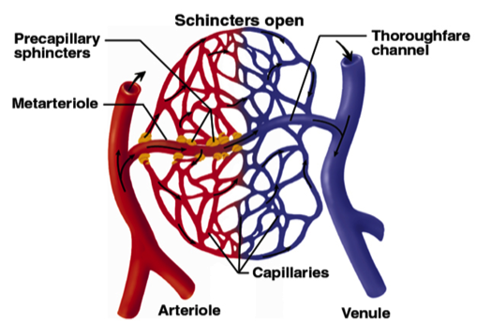
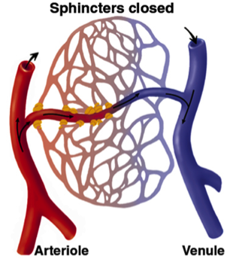
Capillary Beds are Organized Networks of Capillaries
Notes:
Saladin A&P Unity of Form and Function 6e

Slide 18
Veins Carry Blood From the Body To the Heart
Veins considered capacitance vessels.
Are larger in diameter than arteries.
Have thinner non-elastic walls.
Carry deoxygenated blood except for pulmonary veins.
Blood flows under low pressure.
Contain valves
Folds of tunica intima.
Prevent back flow.
Notes:
Retrieved from http://previews.123rf.com/images/hfsimaging/hfsimaging1201/hfsimaging120100006/11943435-Cross-section-of-artery-and-vein-Stock-Vector-blood-vein-vessels.jpg, 2016

Slide 19
Veins Types: Venules
Venules
Smallest veins.
Carry blood away from capillaries.
Notes:
Retrieved from https://encrypted-tbn2.gstatic.com/images?q=tbn:ANd9GcTCNqCd3viA9U2tMTD0RY8RpTJ3Lx1HJb5L04mWfNrhYNA_qGeVEg, 2016

Slide 20
Vein Types: Medium-Sized
Medium-sized veins
Thin tunica media.
Few smooth muscle cells.
Tunica externa
Longitudinal bundles of elastic fibers.
Examples:
Radial
Ulnar
Small/great saphenous
Medium vein with valve
Notes:
Retrieved from http://courseweb.edteched.uottawa.ca/medicine-histology/English/Cardiovascular/Lg_Images/fig19mmvalve.jpg, 2016

Slide 21
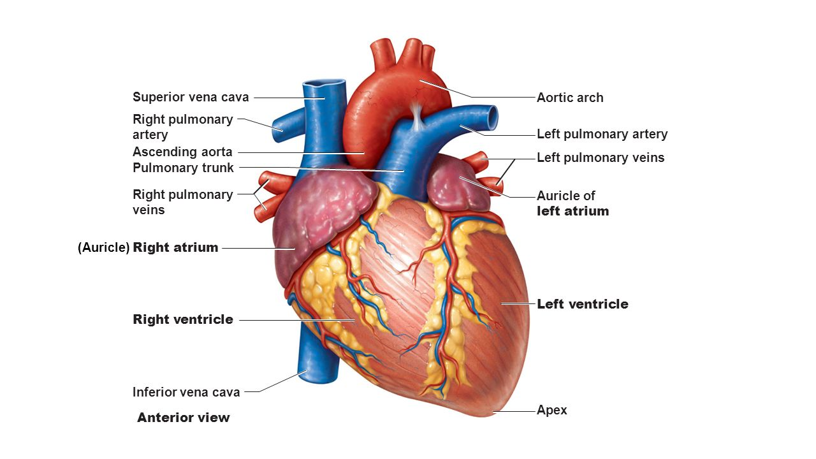
Vein Type: Large veins
Large veins
Have all 3 tunica layers.
Thick tunica externa.
Thin tunica media.
Examples:
Inferior and superior vena cava
Pulmonary
Internal jugular
Notes:
Retrieved from http://images.slideplayer.com/27/9020436/slides/slide_4.jpg, 2016

Slide 22
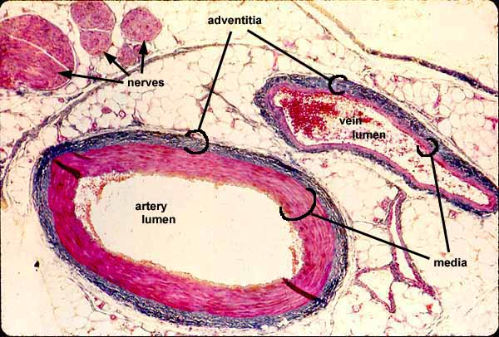
Activities
Vessel histology
View under the microscope and draw the following vessels (pg. 180-181):
Arteries
Capillaries
Veins
Notes:
Retrieved from http://www.siumed.edu/~dking2/crr/images/CR020b.jpg, 2016

Slide 23
Arteries: Ascending Aorta
Aortic Arch
Ascending Aorta
Left Coronary Artery
Right Coronary Artery
Notes:
Martini Fundamentals of A&P 9e

Slide 24
Arteries: Aortic Arch
Brachiocephalic trunk
Right common carotid artery
Right subclavian artery
Left common carotid artery
Left subclavian artery
Notes:
Saladin A&P Unity of Form and Function 6e

Slide 25
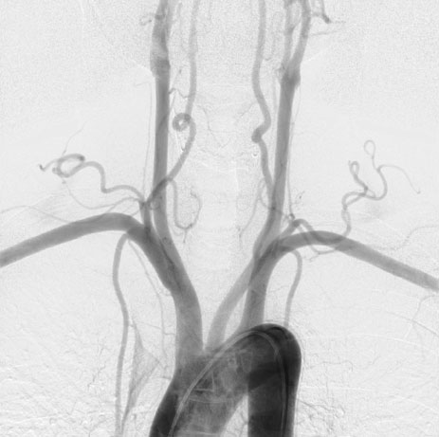
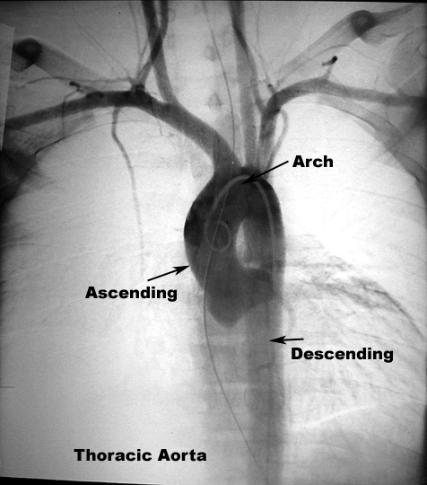
Arteries: Aortic Arch
R. Common Carotid
L. Common Carotid
R. Subclavian
Vertebral
L. Subclavian
Brachiocephalic Trunk
Notes:
Retrieved from http://img.medscape.com/pi/emed/ckb/radiology/336139-423295-1027tn.jpg, 2016

Slide 26
Arteries: Head and Neck
Notes:
Saladin A&P Unity of Form and Function 6e

Slide 27
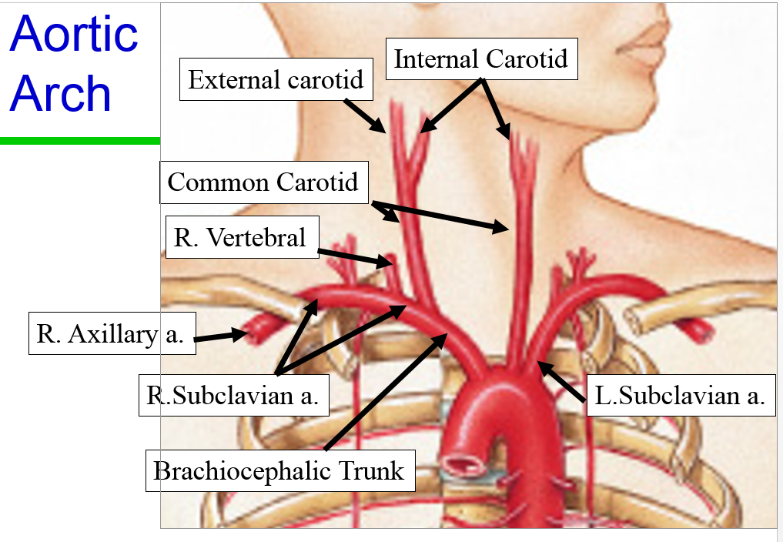
L.Vertebral

Slide 28
Arteries: Head and Neck
LR Common carotid arteries
LR External carotid (face)
Facial
Temporal
Maxillary
Occipital
LR Internal carotid (brain)
LR Vertebral
Notes:
Retrieved from http://websupport1.citytech.cuny.edu/faculty/ibarjis/Teaching/Anatomy%20and%20Physiology/lecture21/Slides/a-p-powerpoint21_files/slide0191_image098.jpg, 2016

Slide 29
Cerebral Vasculature
LR Vertebral arteries
Basilar
Circle of Willis
Basilar
LR Internal carotids
Posterior communicating
Anterior communicating
Branches
Middle cerebral – formed by
LR internal carotids.
Anterior cerebral
Posterior cerebral
Anterior communicating
Anterior cerebral
Internal Carotid (cut)
Middle cerebral
Posterior communicating
Basilar
Posterior cerebral
R. Vertebral
L. Vertebral
Notes:
Martini Fundamentals of A&P 9e

Slide 30
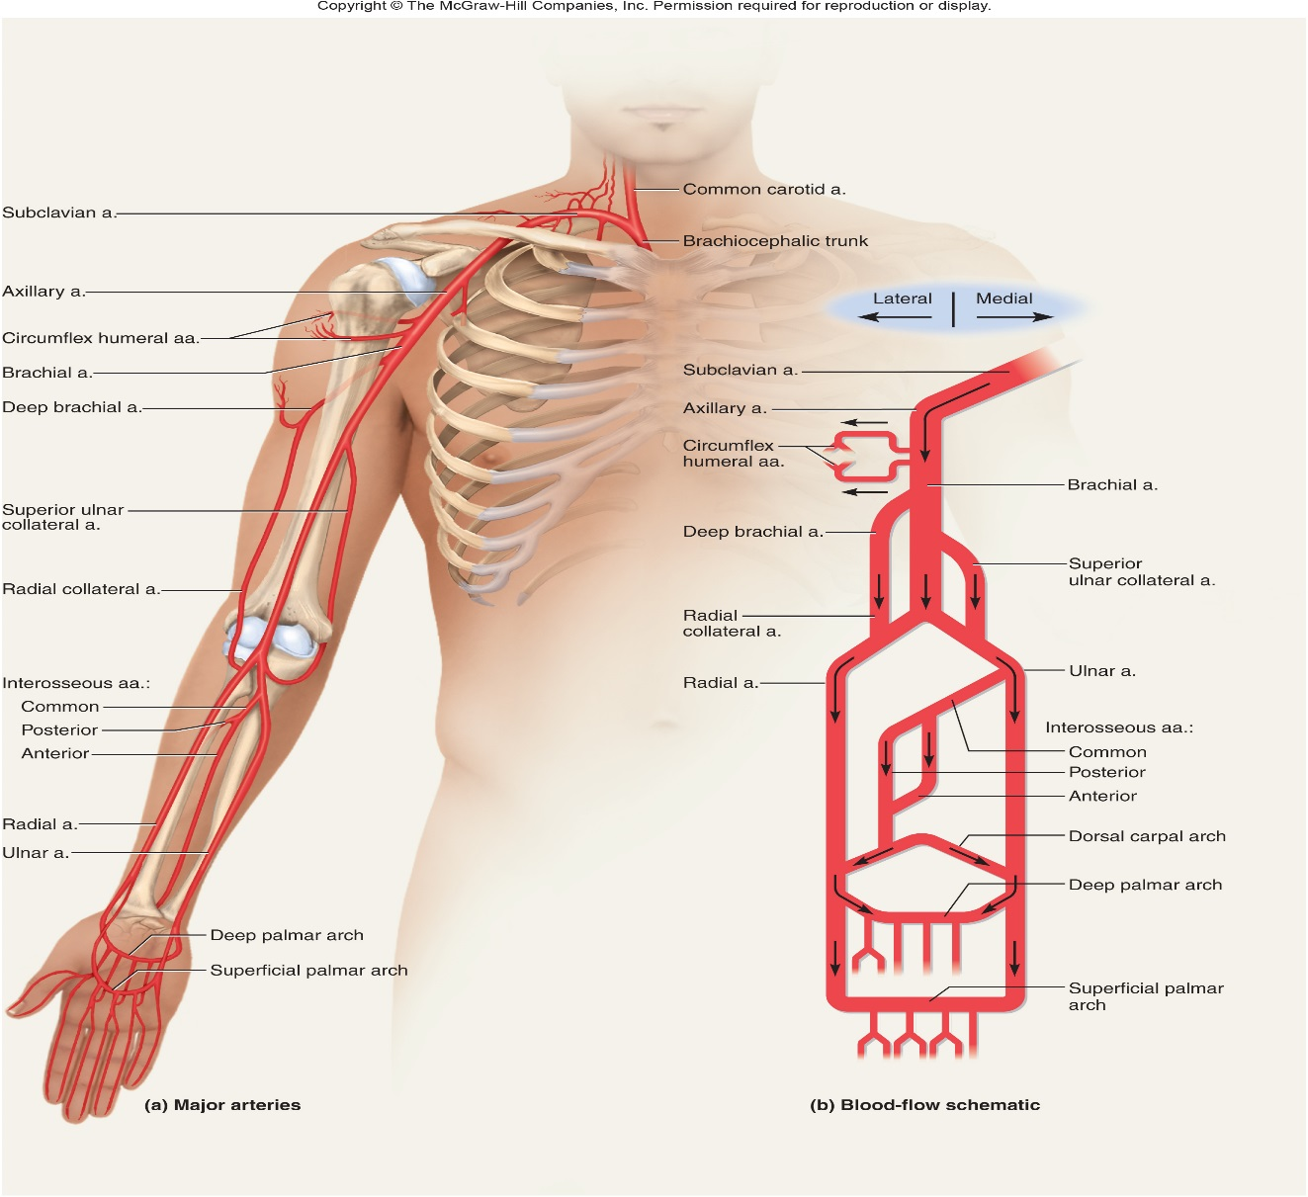
Arteries: Upper Extremities
Axillary Artery from Subclavian
Brachial artery
Radial
Palmar arch arteries
Digital arteries
Ulnar
Palmar arch arteries
Digital arteries
Notes:
Saladin A&P Unity of Form and Function 6e

Slide 31
Descending Aorta
Thoracic aorta
Above the diaphragm.
Intercostal arteries between ribs.
Abdominal aorta
Below diaphragm.
Notes:
Retrieved from http://intranet.tdmu.edu.ua/data/kafedra/internal/anatomy/classes_stud/en/nurse/1/bsn/ptn/1/17.%20ARTERIAL%20SYSTEM%20SYSTEMIC%20AND%20PULMONARY%20ARTERIES.files/image033.jpg, 2014

Slide 32
Abdominal Aorta Arteries
Abdominal aorta
Celiac trunk
Common hepatic artery
Left gastric artery
Splenic artery
Superior mesenteric artery
Renal arteries
Gonadal arteries
Inferior mesenteric artery
Notes:
Saladin A&P Unity of Form and Function 6e

Slide 34
Arteries: Lower Extremities
Anterior
LR Common iliac arteries
Internal iliac arteries
External iliac arteries
Femoral artery
Popliteal artery
Anterior tibial artery
Notes:
Saladin A&P Unity of Form and Function 6e

Slide 35
Arteries: Lower Extremities
Posterior from Popliteal artery
Posterior tibial artery
Fibular (peroneal) artery
Posterior tibial and fibular arteries
Anastomose in foot forming
Dorsal pedal artery
Medial and lateral plantar arteries
Digital arteries
Notes:
Saladin A&P Unity of Form and Function 6e

Slide 36
Veins: Head and Neck
Fascial vein
Drain into superior vena cava.
Temporal vein
Internal Jugular
Occipital vein
Brachiocephalic
Right
Left
Vertebral vein
External Jugular
Superior Vena Cava
Subclavian vein
Notes:
Martini Fundamentals of A&P 9e

Slide 38
Veins: Head and Neck
Superior Sagittal sinus
Inferior Sagittal sinus
Internal Jugular
Vertebral Vein
External Jugular
Drain into superior vena cava
Notes:
Martini Fundamentals of A&P 9e

Slide 39
Veins: Upper Extremities Drain into Superior Vena Cava via Subclavian and Brachiocephalic
Palmar arch veins
Radial vein
Ulnar vein
Brachial veins
Basilic vein
Cephalic vein
Median cubital vein
Axillary
Subclavian
Brachiocephalic
Notes:
Saladin A&P Unity of Form and Function 6e

Slide 41
Veins: Upper Extremities Drain into Superior Vena Cava
Subclavian
Brachiocephalic veins
Union of internal jugular and subclavian veins.
Superior vena cava
Notes:
Saladin A&P Unity of Form and Function 6e

Slide 42
Veins: Lower Extremities Drain into Inferior Vena cava
Anterior tibial vein
Great saphenous vein
Small saphenous vein
Posterior tibial vein
Popliteal vein
Femoral vein
Deep femoral vein
External iliac vein
Notes:
Saladin A&P Unity of Form and Function 6e

Slide 43
Thoracic Veins: Drain into Superior Vena Cava
Intercostal veins
Drain the intercostal muscles.
Azygos and hemiazygos veins
Drain blood from the thoracic region.
Notes:
Saladin A&P Unity of Form and Function 6e

Slide 44
Veins: Abdominopelvic Region Drains into Inferior Vena Cava
Inferior vena cava
Hepatic veins (.vs. hepatic portal veins)
Renal veins
Gonadal veins
Right takes blood to IVC.
Left takes blood to left renal vein.
Common iliac vein
Internal & External iliac veins
What’s missing?
Notes:
Saladin A&P Unity of Form and Function 6e

Slide 46
Hepatic Portal Circulation
Veins flowing into liver before return to heart.
From digestive organs and spleen.
Blood travels to capillaries of liver.
Processed by liver and sent to hepatic vein.
Then to the inferior Vena Cava.
Notes:
Saladin A&P Unity of Form and Function 6e

Slide 47
Blood Pressure (BP)
Importance of BP maintenance.
Health of the heart.
Proper functioning of various organs.
Defined as:
Force exerted by blood on blood vessel walls.
A function of…
Pumping action of the heart.
Resistance to flow of blood moving through vessels.
Notes:
Retrieved from http://www.tuscany-diet.net/wp-content/uploads/2013/02/Blood-pressure-and-healthy-life.jpg,2014

Slide 48
Blood Pressure (BP)
Systolic pressure
Maximum pressure exerted on BV walls.
Diastolic pressure
Minimum pressure exerted on BV walls.
Measured in units of millimeters of mercury (mmHg)
Pressure in a BV is 95mm Hg =
Force exerted by blood will cause a column of mercury to rise 95mm.
Notes:
Retrieved from http://images.medicinenet.com/images/dtarticleplayer/low-blood-pressure-s2-what-is-low-blood-pressure.jpg, 2014

Slide 49
Pulse
Rhythmic expansion and recoil of arteries.
Found in various locations.
Diminish in smaller arteries.
Absent in capillaries and veins.
Taking blood pressure demonstration video
Notes:
fpbnursing. (2010, September). Blood Pressure Skill Demonstration [video file]. Retrieved from http://www.youtube.com/watch?v=j-326lCJ7wY
Retrieved from http://o.quizlet.com/i/tjjCN5rSSmRbqG7beV9fJw_m.jpg, 2014

Slide 50
Normal Blood Pressure
For adults 18 and older who…
No hypertension meds.
Not experiencing short-term serious illness.
No history of diabetes, kidney disease, etc.
Systolic BP < 119
Diastolic BP < 79
Notes:
Retrieved from http://www.cruisecontroldiet.com/wp-content/uploads/2013/02/highbp.jpg, 2014

Slide 51
Pre-Hypertension and Hypertension
Guidelines established by the American Heart Association:
Untreated pre-hypertension is high risk for becoming hypertensive.
Higher category will classify blood pressure level for systolic and diastolic readings falling in different categories.
Type | Systolic Pressure | Diastolic Pressure
Prehypertension | 120 to 139 | 80 to 89
Stage 1 hypertension | 140 to 159 | 90 to 99
Stage 2 hypertension | 160 or higher | 100 or higher

Slide 52
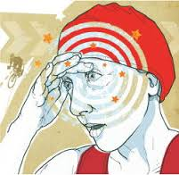
Hypotension is Subnormal Arterial Pressure
As defined by the American Autonomic Society and American Academy of Neurology…
Physical finding of a systolic blood pressure decrease of at least 20 mm Hg or a diastolic blood pressure decrease of at least 10 mm Hg within three minutes of standing.
Inadequate pressure to effectively perfuse tissues.
General medical consensus: ≤90/60
Usually a mean arterial pressure (MAP) < 60 mmHg.
MAP= diastolic + 1/3(systolic-diastolic)
Example: BP= 120/70
MAP= 70 + 1/3(120-70)= 86.6
People who are chronically hypertensive may experience hypotension..
MAP < 40 mmHg, even if the absolute value is still over 60.
Notes:
Retrieved from https://encrypted-tbn3.gstatic.com/images?q=tbn:ANd9GcQDjKdkow3vNaLjHrSj1dhurcZ2wJGeddunzJYBjyuCsgSzqGUo, 2014

Slide 53
Orthostatic Hypotension: Testing
Have the patient lie down for 5 minutes.
Measure blood pressure and pulse rate.
Have the patient stand.
Repeat blood pressure and pulse rate measurements after standing 1 and 3 minutes.

Slide 54
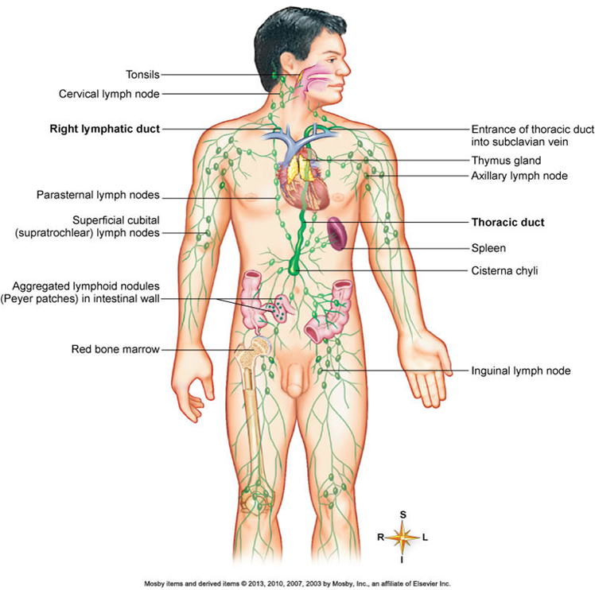
Lymphatic System: Body’s Defense Mechanism Against Foreign Invaders
Most interstitial fluid reabsorbed into capillaries.
Lymphatic ducts picks up remaining interstitial fluid.
Pathogens are filtered out through lymph nodes.
Contain lymphocytes and macrophages responding to pathogens.
Lymph
Clear fluid in lymphatic vessels.
Subclavian veins
Return lymph into heart.
Notes:
Patton & Thibodeau A&P 8e

Slide 55
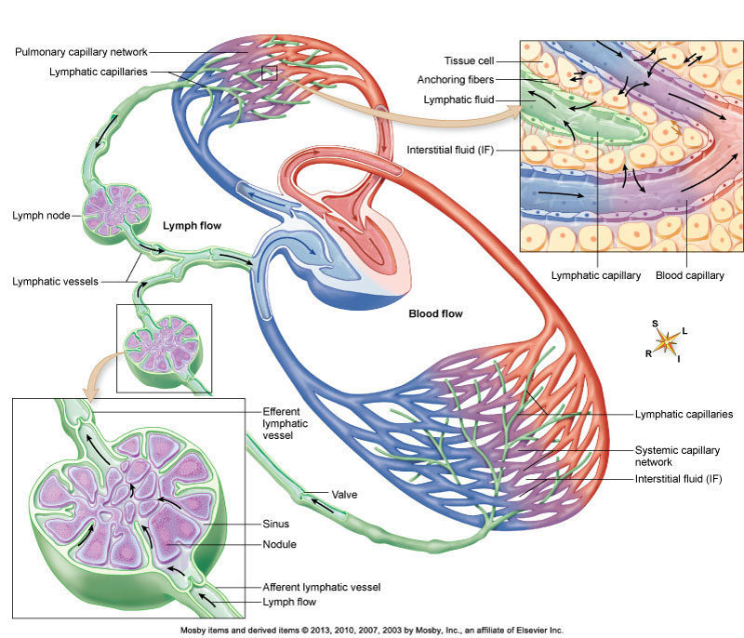
Lymphatic System: Three Major Functions
Drains excess fluid from tissues to blood.
Transports lipids and lipid soluble vitamins reabsorbed in GI tract to bloodstream.
Facilitating immune response.
Notes:
Patton & Thibodeau A&P 8e

Slide 56
Lymphatic Vessels Provide Transportation of Lymph
Same 3 layer structure as blood vessels.
Begin at dead end.
Thinner with no basement membrane.
Larger diameter and overlaps to create one-way valve
Compensate for low pressure through valves, muscular compression, and respiratory pumps.

Slide 57
Lymphatic Anatomy: Pathway
lymphatic capillaries → collecting lymphatic vessels → lymph nodes → more collecting vessels → six lymphatic trunks → two final collecting ducts → subclavian veins.
Notes:
Retrieved from http://www.unm.edu/~jimmy/lymph_flow.jpg, 2016

Slide 58
Lymphatic Organs: Thymus
Two lobed organ located between lungs in front of aorta.
Most often active in childhood.
Has both a lymphatic and endocrine function.
Secretes hormones critical for maturation of T-cells

Slide 59
Lymphatic Organs: Spleen Largest Mass of Lymphatic Tissue
Located in hypochondriac region of abdomen.
Composed of a capsule and extending trabeculae.
Two kinds of tissue in spleen.
White pulp
Composed mostly of lymphocytes and macrophages.
Red pulp
Composed of blood-filled sinuses and splenic cords.
Primary functions:
Reservoir for blood.
Place for destroying old red blood cells.
Filter for the blood.
Creation of blood cells during fetal development.
Notes:
Patton & Thibodeau A&P 8e

Slide 60
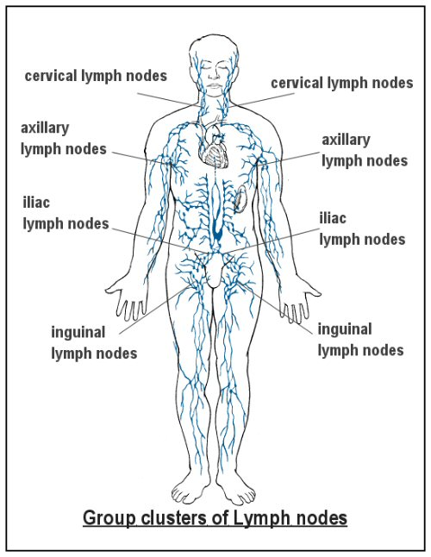
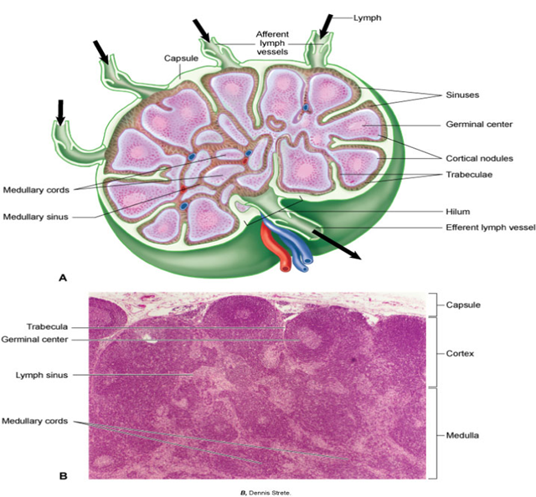
Lymphatic Tissues: Lymph Nodes
Bean-shaped structures positioned at regular intervals along lymphatic vessel routes
~600 total in lymphatic system.
Designed to filter the lymph fluid.
Most prolific and important organ in lymphatic system.
Embedded in connective tissue throughout body.
Most concentrated in cervical, axillary, abdominal, pelvic and thoracic regions.
Notes:
Histology image retrieved from Patton & Thibodeau A&P 8e
Lymph node image retrieved from http://penile-cancer.ca/images/lymph-group-clusters.jpg, 2016

Slide 61
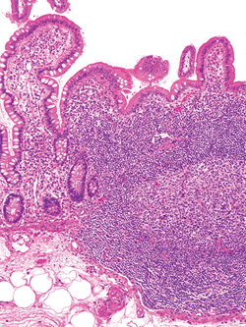
Lymphatic Tissue: Lymphatic Nodules
Masses of lymphatic tissue that lack the capsule.
Found in mucous membranes of the gastrointestinal (GALT), urinary, reproductive tracts, and respiratory airways.
Macrophages, in addition to B cells and plasma cells.
Gut-associated lymphoid tissue (GALT)

Slide 62
Lymphatic Tissues: Tonsils
Lymphatic nodules located at entrance to pharynx that are placed to deal with ingested and inhaled foreign particles and pathogens.
Palatine, lingual, and pharyngeal tonsils (located in associated area).
Notes:
Patton & Thibodeau A&P 8e

Slide 63
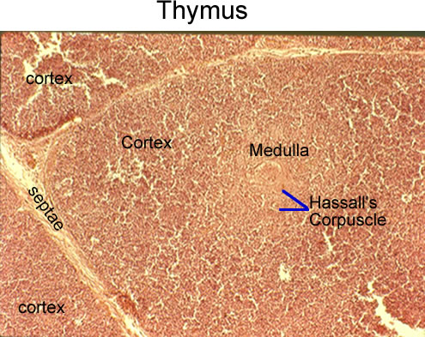
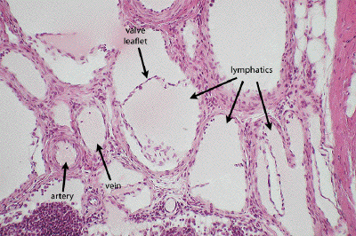
Activities
Lymphatic histology
View under the microscope and draw the following vessels (pg. 190):
Spleen
Lymph node
Thymus
Lymph vessel
Notes:
Vessel image retrieved from http://www.dartmouth.edu/~anatomy/Histo/lab_3/cardiovascular/DMS120/38.gif, 2016
Thymus image retrieved from http://iws.collin.edu/mweis/BIOL%202402/Lab/lab%20exercise%20reviews/endocrine/histo_endocrine/web_ready/histo_labeled_endocrine_%20thymus.jpg, 2016

Slide 64
Works Cited
Marieb, E. N. (2012). Essentials of human anatomy & physiology
(6th ed.). Boston: Pearson Education, Inc.
Marieb, E.N., Mitchell, S.J. & Smith, L.A. (2012). Human anatomy and physiology laboratory manual (10th ed.). Boston: Pearson Education, Inc.
Martini, F., Nath, J. & Bartholomew, E.F. (2012). Fundamentals of anatomy & physiology (9th ed.). Boston: Pearson Education, Inc.
McPhee, J. & Papadakis, M. (2012) Current medical diagnosis & treatment (51st ed.). New York: McGraw Hill.
Patton, T. & Thibodeau, G. (2013). Anatomy & physiology (8th ed.).
St. Louis:Mosby Elsevier.
Saladin, K. S. (2012). Anatomy & physiology: The unity of form and function (6th ed.). New York: McGraw Hill.
Tortora, G.J. & Derrickson, B.H. (2012). Principles of anatomy and physiology (13th ed.). Hoboken, NJ: Wiley

