Slide 1
BI 232 Laboratory Circulatory System: Blood
Notes:
Saladin A&P Unity of Form and Function 6e

Slide 2
Functions of the Circulatory System
Circulatory system
Consists of heart, vessels and blood.
Cardiovascular system
Only heart and vessels.
Hematology
Study of blood and blood disorders.
Fundamental purpose of blood:
Transportation of substances from place to place throughout body.
Includes protection and regulatory functions.
Notes:
Retrieved from http://cdn.builtlean.com/wp-content/uploads/2012/02/physical-fitness-3.jpg, 2014

Slide 3
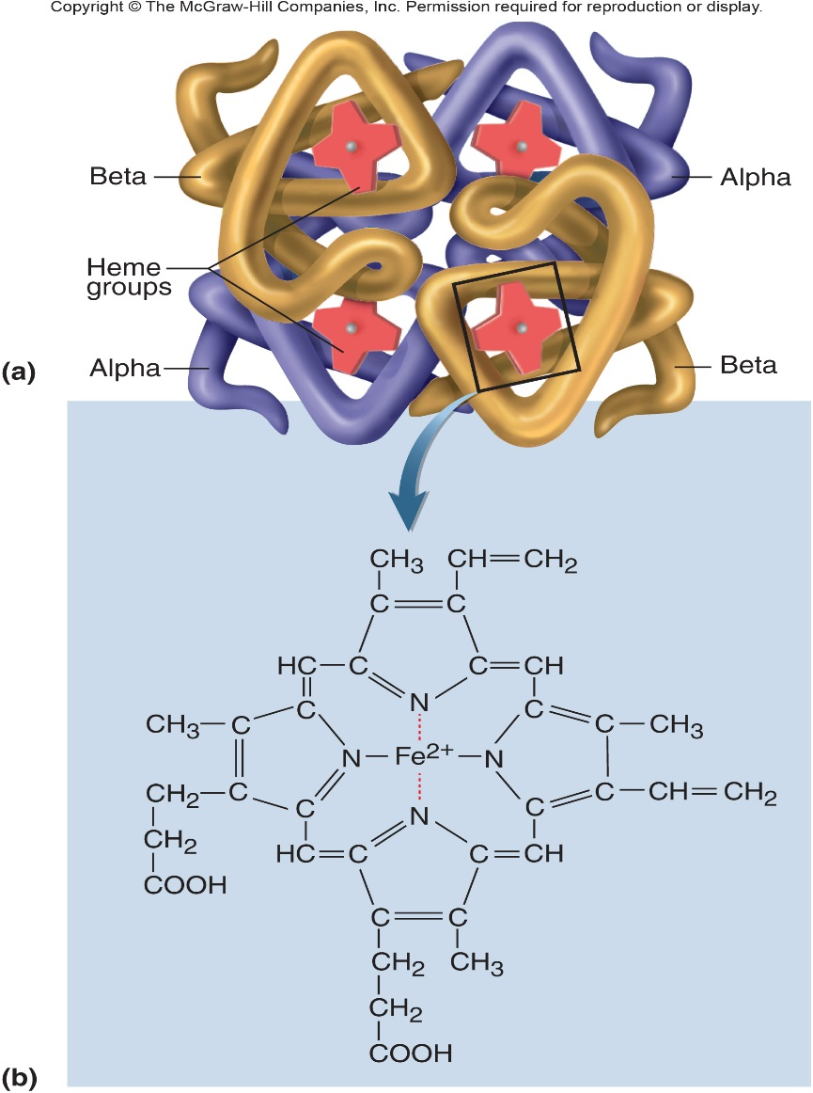
Functions of the Circulatory System
Transportation
O₂, CO₂, metabolic wastes, nutrients, heat, hormones and stem cells.
Depending on function or need will pick-up, deliver and/or be removed.
Protection
From disease and loss of blood.
Destruction of microorganisms and cancer cells by WBCs.
Antibodies/blood proteins neutralize toxins and destroy pathogens.
Platelets initiate blood clotting.
Regulation of
pH through buffers.
Body temperature.
Fluid distributions via capillaries.
Notes:
Saladin A&P Unity of Form and Function 6e

Slide 4
General Properties of Blood
Adults have 4-6 L of blood
Plasma – clear extracellular fluid.
Formed elements – blood cells and platelets.
More viscous than water, so flows more slowly.
Temperature of 100.4 degrees F.
pH 7.4 (7.35-7.45)
8 % of total body weight.
Notes:
Retrieved from http://www.pitch.com/imager/the-new-face-of-dui-justice/b/original/2574024/0c99/Blood_drop_guy.jpg, 2014

Slide 5
Components of Blood: Blood is highly specialized connective tissue.
Hematocrit
Blood test measuring percentage of volume of whole blood that is made up of red blood cells.
Depends on number of RBCs and their size.
55% plasma
45% cells (formed elements)
99% RBCs
< 1% WBCs and platelets
Notes:
Saladin A&P Unity of Form and Function 6e

Slide 6
Plasma and Plasma Proteins
Plasma is a mixture
Water (>90%)
Proteins – albumin, globulins, fibrinogen (7%)
Enzymes, nutrients, wastes, hormones, electrolytes, and gases (2% total).
If allowed to clot & clot removed (fibrin), what remains is called serum.
All plasma proteins formed by liver except globulins (antibodies).
Antibodies produced by plasma cells descended from B lymphocytes.
Notes:
Retrieved from http://www.plastech.biz/images/news/5449/aden560.jpg, 2014

Slide 7
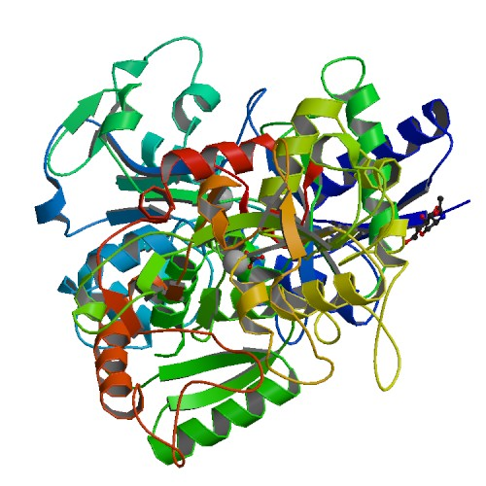
Plasma and Plasma Proteins
3 major categories of plasma proteins:
Albumins
Most abundant plasma protein.
Contributes to viscosity and osmolarity.
Influences blood pressure, flow and fluid balance.
Globulins (antibodies)
Provide immune system defenses.
Alpha, beta and gamma globulins.
Fibrinogen
Precursor of fibrin threads that help form blood clots.
Notes:
Retrieved from http://biowiki.edu-wiki.org/_media/rcsb_image/1h76.jpg, 2014

Slide 8
Nonprotein Components of Plasma
Plasma contains nitrogenous compounds.
Amino acids from dietary protein or tissue breakdown.
Nitrogenous wastes (urea) are toxic end products of protein catabolism.
Normally removed from the blood by kidneys.
Nutrients (glucose, amino acids, vitamins, fats, minerals, etc.).
Some O₂ and CO₂ are transported in plasma.
Many electrolytes are found in plasma.
Sodium makes up 90% of plasma cations.
More of blood’s osmolarity than any other solute.
Notes:
Retrieved from https://medicalanalysis.files.wordpress.com/2012/06/162831_1815315749490_8079103_n.jpg, 2014

Slide 9
Formed Elements (cells) of Blood
Erythrocytes (red blood cells, RBCs)
Leukocytes (white blood cells, WBCs)
Granular leukocytes
Neutrophils
Eosinophils
Basophils
Agranular leukocytes
Lymphocytes (T cells, B cells, natural killer cells)
Monocytes
Platelets (special cell fragments)
Notes:
Saladin A&P Unity of Form and Function 6e

Slide 10
Cells of the Blood
Notes:
Retrieved from http://img.webmd.com/dtmcms/live/webmd/consumer_assets/site_images/articles/image_article_collections/anatomy_pages/blood.jpg, 2016

Slide 11
Hemopoiesis: Formation of Blood’s Cellular Components
All derived from hematopoietic stem cells - hemocytoblasts in the red bone marrow
Notes:
Saladin A&P Unity of Form and Function 6e

Slide 12
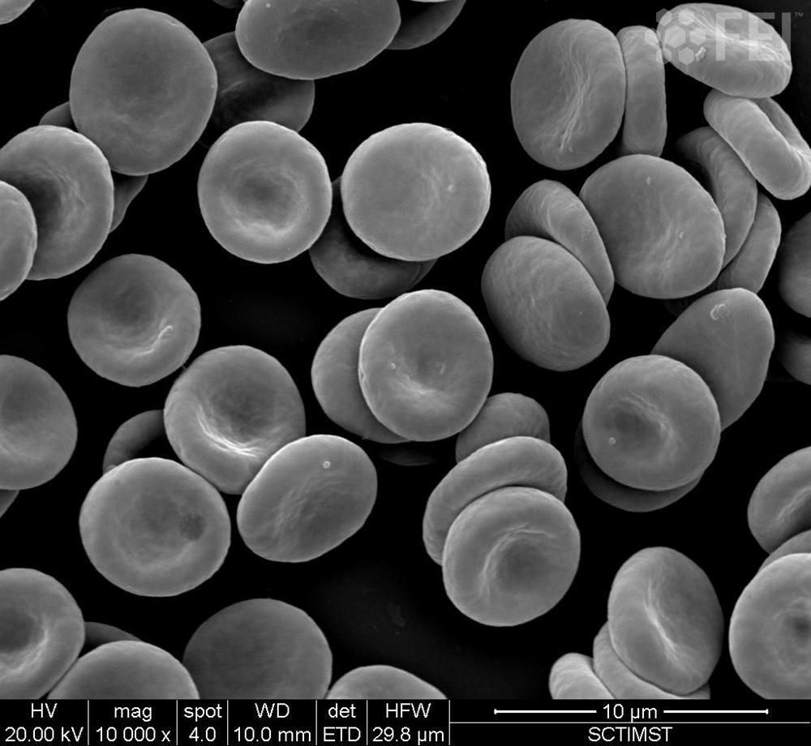
Erythrocyte (RBC)
Flattened biconcave discs lacking nuclei and most organelles.
Cytoplasm is filled primarily with hemoglobin.
Function = transport of o₂
Blood: ♂ 42-52% RBC’s and ♀ 37-48% RBC’s
Notes:
Retrieved from http://www.fei.com/uploadedimages/FEISite/Content/Image_Gallery/Images/2014_Image_Contest/IM_20140327_Kv_86_RBC.jpg, 2015

Slide 13
Hemoglobin Structure
Hemoglobin – Heme + Globin
GLOBIN - Consists of 4 protein chains called globin (2 alpha and 2 beta).
HEME - Each protein chain conjugated with heme group binding O₂ to ferrous iron (Fe⁺²).
ONE Hemoglobin molecule can carry four O₂.
Fetal hemoglobin has gamma instead of beta chains.
Notes:
Saladin A&P Unity of Form and Function 6e

Slide 14
Erythrocyte (RBC)
Fate of an RBC
Life span about 120 days, cell wall become brittle & broken down by liver or spleen.
Globin - protein are broken down to amino acids and reabsorbed for general use.
Heme metabolized to bilirubin in liver and secreted as part of bile.
Iron portion recycled to make more hemoglobin.
Notes:
Retrieved from http://www.fei.com/uploadedimages/FEISite/Content/Image_Gallery/Images/2014_Image_Contest/IM_20140327_Kv_86_RBC.jpg, 2015

Slide 15
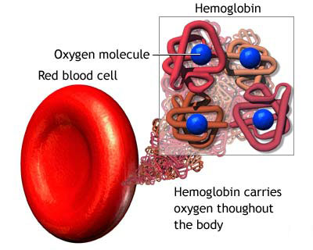
Erythrocytes and Hemoglobin
RBC count and hemoglobin
RBC concentration indicates the amount of O₂ blood can carry
Hematocrit (packed cell volume)
% of blood composed of red blood cells.
♂ 42-52% red cells and ♀ 37-48% red cells. (-4)
Hemoglobin concentration of whole blood.
♂ 13-18g/dL and ♀ 12-16g/dL RBC count . (-2)
♂ 4.6-6.2 million/μL and ♀ 4.2-5.4 million/μL.
Values lower in women.
Androgens stimulate RBC production.
Due to periodic menstrual losses.
Notes:
Retrieved from http://mokaspetridish.files.wordpress.com/2009/12/hemoglobin.jpg

Slide 16
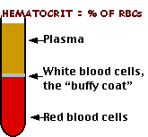
Hemoglobin Concentrations
Normal hemoglobin concentration (Hb)
Females = 12-16 g/dL
Males = 13-18 g/dL
Hematocrit
% of volume of whole blood contributed by cells.
3x hemoglobin concentration = hematocrit.
Normal hematocrit
Females: 37-48%
Males: 42-52%
Gender differences in Hb
Testosterone stimulates synthesis of erythropoietin triggering erythropoiesis.
Lower values in women of reproductive age may also reflect blood losses due to menstruation.
Notes:
Retrieved from http://www.drstandley.com/images/labvalues/hematocrit.gif, 2015

Slide 18
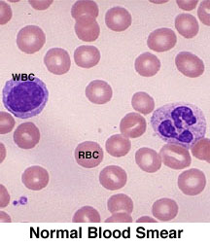
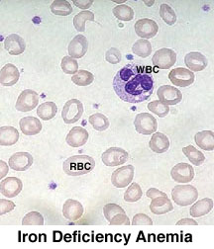
Iron Deficient RBC
When RBC is small and pale: body doesn’t have enough iron to build healthy RBCs with resulting cells being smaller and paler causing fatigue, shortness of breath etc.
Notes:
Normal blood smear retrieved from http://www.pathologyoutlines.com/images/marrow/259.jpg, 2016
Iron deficiency anemia retrieved from https://s-media-cache-ak0.pinimg.com/236x/58/59/aa/5859aaa40d3c310e2fe43308179017a3.jpg, 2016

Slide 19
Sickle Cell Anemia
Normal RBC
Sickling of RBC
Caused by abnormal hemoglobin, called hemoglobin S, resulting in distorted sickle shaped RBC cell wall. Inherited disease.
Notes:
Martini Fundamentals of A&P 9e

Slide 20
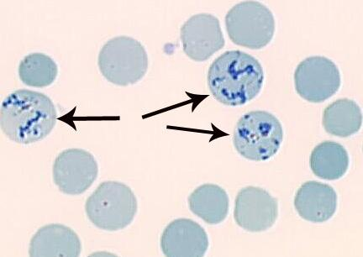
Reticulocyte is an Immature Red Blood Cell
Count: 1-2% of RBC
RBC precursor.
Increased when RBC turnover is high.
Still contains nuclear fragments.
Notes:
Retrieved from http://www.siamhealth.net/public_html/images/hemato/reticulo.jpg, 2015

Slide 24
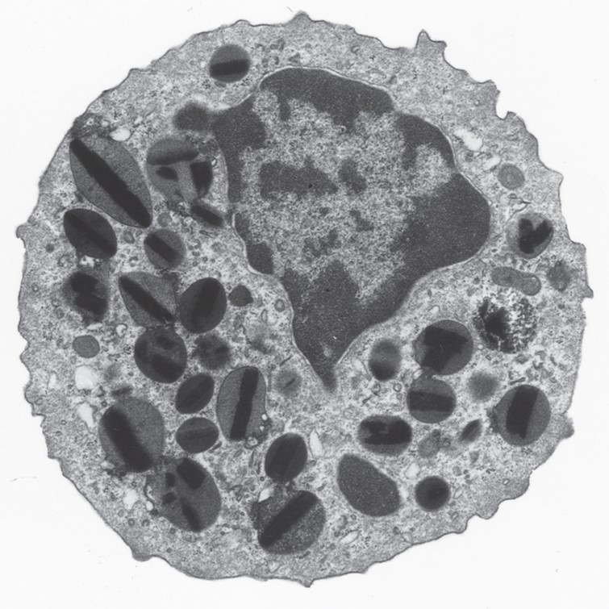
Leukocytes
AKA: white blood cells (WBCs)
Less numerous than RBCs.
5000 to 10,000 cells per drop of blood.
1 WBC for every 700 RBC.
Retain organelles throughout life.
Must synthesize protein s in order to carry out function.
Packaged into lysosomes and other organelles.
Appear as conspicuous nonspecific granules.
Distinguish one WBC from the other.
Only 2% of total WBC population is in circulating blood at any given time.
Others found in lymphatic fluid, skin, lungs, lymph nodes and spleen.
Notes:
Saladin A&P Unity of Form and Function 6e

Slide 25
Leukocyte Groups
Granular leukocytes named due to granules in the cytoplasm.
Agranular leukocytes lack granules.
Notes:
Martini Fundamentals of A&P 9e

Slide 26
Leukocyte Types
All leukocytes (WBCs)
Have a nucleus and no hemoglobin.
Granular or agranular classification
Based on presence of cytoplasmic granules made visible by staining.
Granulocytes (w/granules)
Neutrophils
Eosinophils
Basophils
Agranulocytes (w/out granules)
Monocytes
Lymphocytes
Notes:
Saladin A&P Unity of Form and Function 6e

Slide 27
Neutrophils
Granulocyte
AKA: Polymorphonuclear leukocytes or polys
Nuclei
Consist of 2 to 5 lobes connected by thin strands.
Diameter is 10-12 microns
Count: 60 to 70%
Fastest response of all WBC to bacteria.
Direct actions against bacteria.
Lysozymes which destroy/digest bacteria.
Defensin proteins that act like antibiotics.
Puncture holes in bacterial cell walls destroying them.
Secrete bactericidal oxidizing agents.
↑ during bacterial infections
Notes:
Saladin A&P Unity of Form and Function 6e

Slide 28
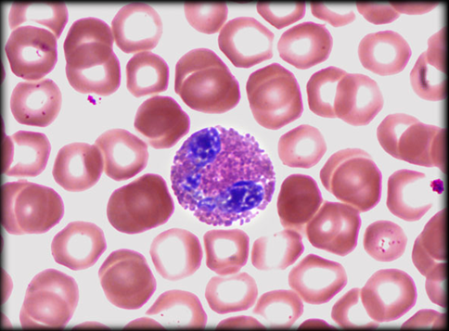
Eosinophils
Granulocyte
Nucleus with 2 or 3 lobes connected by a thin strand.
Large, uniform-sized granules stain orange-red with acidic dyes.
Do not obscure the nucleus.
Diameter is 10 to 12 microns.
Count: 2 to 4%
Leave capillaries to enter tissue fluid.
Release histaminase.
Slows down inflammation caused by basophils.
Attack parasitic worms.
Phagocytize antibody-antigen complexes.
↑ during parasitic infection and allergies.
Notes:
Saladin A&P Unity of Form and Function 6e

Slide 29
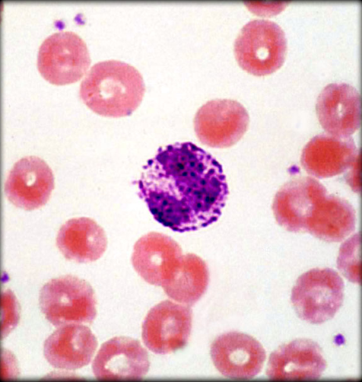
Basophils
Granulocyte
Large, dark purple, variable-sized granules stain with basic dyes.
Obscure the nucleus.
Irregular, s-shaped, bilobed nuclei.
Diameter is 8 to 10 microns
Count: < 1%
Involved in inflammatory and allergy reactions.
Release heparin, histamine and serotonin.
Heighten inflammatory response.
Account for hypersensitivity (allergic) reaction.
↑ during chicken pox, diabetes, autoimmune disorders, hypersensitivities (allergies).
Notes:
Saladin A&P Unity of Form and Function 6e

Slide 30
Lymphocytes
Agranulocyte
Dark, oval to round nucleus.
Cytoplasm sky blue in color.
Amount varies from rim of blue to normal amount.
Small cells 6 - 9 microns in diameter.
Large cells 10 - 14 microns in diameter.
Increase in number during viral infections.
Count: 20 to 25%
Notes:
Saladin A&P Unity of Form and Function 6e

Slide 31
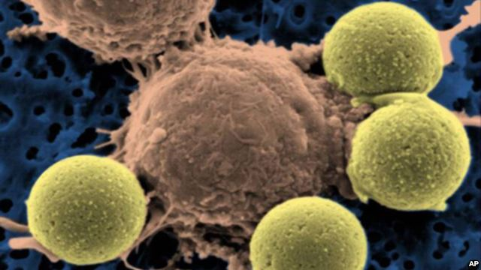
Lymphocyte Functions
B Lymphocytes
Destroy bacteria and their toxins.
Turn into plasma cells that produces antibodies.
Provide immunological memory.
T Lymphocytes
– cell mediated immunity
Attack viruses, fungi, transplanted organs, cancer cells and some bacteria.
Present antigens to other immune cells.
Natural killer cells
Attack many different microbes and some tumor cells.
Destroy foreign invaders by direct attack.
↑ during diverse infections and immune responses
Notes:
Retrieved form http://gdb.voanews.com/03B12E6C-D816-41DD-999C-204A0A2ABCFE_w640_r1_s.jpg, 2014

Slide 32
B-Cells and T-Cells
Unable to distinguish between these with Wright's stain.
B cells
Become plasma cells which make antibodies.
T cells
Mature in thymus and provide cell-mediated immunity.
Notes:
Plasma cells provide antibody-mediated immunity and T cells move close to and destroy some types of bacteria or virus-infected cells
T cells also attack tumors and transplanted tissues
Natural killer cells attack bacteria, transplanted cells and cancer cells
Retrieved from http://askabiologist.asu.edu/sites/default/files/resources/activities/body_depot/viral_attack/b_t_comparison.gif, 2015

Slide 33
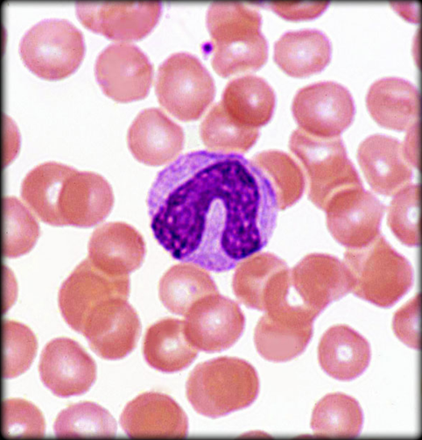
Monocyte
Agranulocyte
Nucleus is kidney or horse-shoe shaped.
Largest WBC in circulating blood.
Briefly in blood long before migrating to tissues.
Differentiate into macrophages.
Wandering group gathers at sites of infection.
Diameter is 12 - 20 microns.
Count: 3 to 8%
Take longer to get to site of infection, but arrive in larger numbers.
Become wandering macrophages, once they leave the capillaries.
Destroy microbes and clean up dead tissue following an infection.
↑ during viral infections and inflammation.
Notes:
Saladin A&P Unity of Form and Function 6e

Slide 34
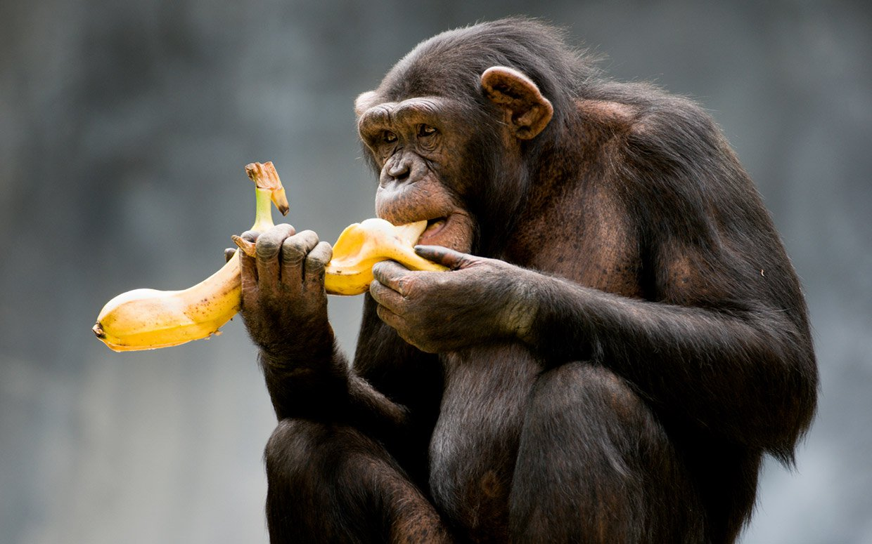
Preponderance of White Blood Cells (WBC)
WBCs from most to least abundant:
Neutrophils
Lymphocytes
Monocytes
Eosinophils
Basophils
Easy way to remember:
Never
Let
Monkeys
Eat
Bananas
Notes:
Retrieved from http://static.communitytable.parade.com/wp-content/uploads/2014/01/banana-not-good-for-monkeys-ftr.jpg, 2016

Slide 35
Leukopenia and Leukemia
Leukopenia
↓ in number of circulating leukocytes.
Can be caused by radiation therapy, chemotherapy and some drugs.
Leukocytosis
↑ in number of WBCs
response to infection, inflammation
Neutrophilia, lymphocytosis, monocytosis, eosinophilia, basophilia
Leukemia
Cancer of bone marrow
Abnormal WBC’s and non-functional crowd out normal
Myelogenous, Lymphocytic, Monocytic
Notes:
Retrieved from https://theycallmebetty.files.wordpress.com/2013/11/leukemia.jpg, 2015

Slide 37
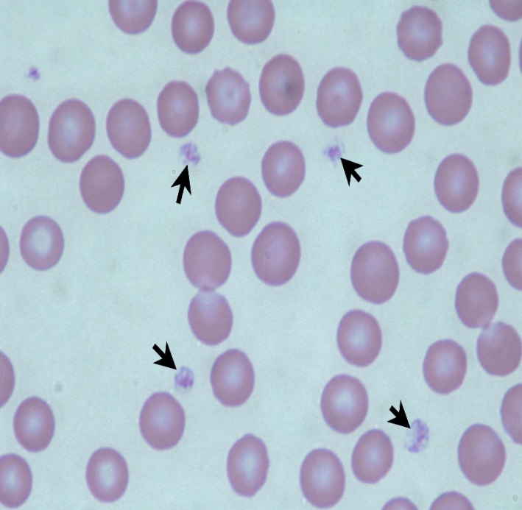
Platelets Mediate Blood Clotting
AKA: thrombocyte
Disc-shaped, 2 - 4 micron cell fragment with no nucleus.
Count: 150,000-400,000/drop of blood.
Other blood cell counts
5 million red and 5-10,000 white blood cells
Functions
Secrete clotting factors, growth factors for endothelial repair.
Vasoconstrictors in broken vessels.
Form temporary platelet plugs.
Dissolve old blood clots.
Attract WBCs to sites of inflammation.
Notes:
Retrieved from http://www.vetmed.wsu.edu/van308/images/DSCN7746ed.jpg, 2014

Slide 38
Thrombopoiesis: Platelet Production
Hemocytoblast
Develops receptors for thrombopoietin from liver or kidney.
Becomes megakaryoblast.
Megakaryoblast
Repeatedly replicates its DNA without dividing.
Forms gigantic cell called megakaryocyte (100 μm in diameter).
Remains in bone marrow.
Infoldings of megakaryocyte cytoplasm.
Splits off cell fragments entering bloodstream as platelets.
Live for 10 days.
Some stored in spleen and released as needed.

Slide 39
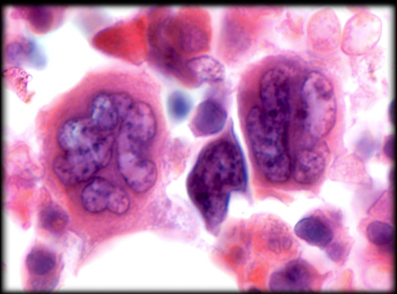
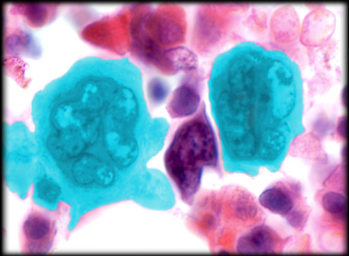
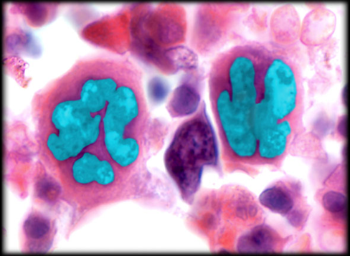
Megakaryocyte
Megakaryocyte
Nucleus of Megakaryocyte
Notes:
Saladin A&P Unity of Form and Function 6e

Slide 40
Clinical Correlation: Normal Lab Values for Complete Blood Count (CBC)
Blood test used to evaluate overall health and detect wide range of disorders
Including anemia, infection and leukemia.
Components and features of blood measured:
Red blood cells (carry oxygen)
White blood cells (fight infection)
Hemoglobin (oxygen-carrying protein in RBCs)
Hematocrit (proportion of RBCs to fluid component (plasma) in blood)
Platelets (blood clotting)
Abnormal increases or decreases in cell counts indicate an underlying medical condition requiring further evaluation.
Notes:
Retrieved from https://s-media-cache-ak0.pinimg.com/736x/f5/46/35/f54635a1e3a43c38ad9333eae59feef7.jpg, 2016

Slide 41
Activities
Making a blood smear using Wright’s stain.
Before beginning this activity, please read page 154:
OR-OSHA blood –borne pathogens standard
Blood cells can also be observed using prepared slides.
Count of 100 WBCs
Hemoglobin concentrations
Notes:
Retrieved from http://2.bp.blogspot.com/_aLnunV6-RSU/Sjr00Omhi4I/AAAAAAAAAqg/Me5HokuIv2c/s200/manwbc.jpg, 2016

Slide 42
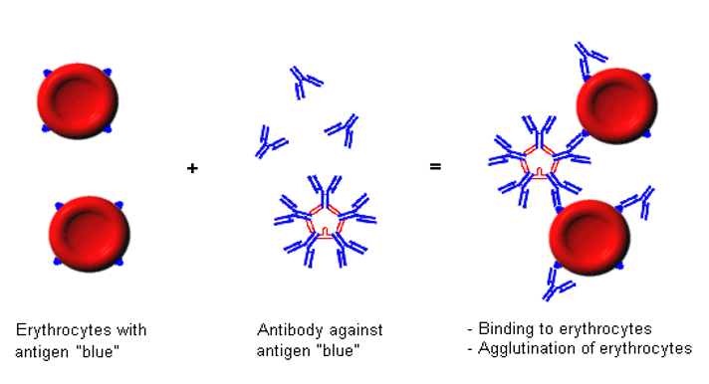
Antigen/Antibody & Blood Type
Antigen – shape on the cell that allows recognition of self and detection of foreign cells
Antibody – protein that recognized and binds antigens
Blood Type depends on the presence of antigens on the RBC
Plasma contains antibodies

Slide 43
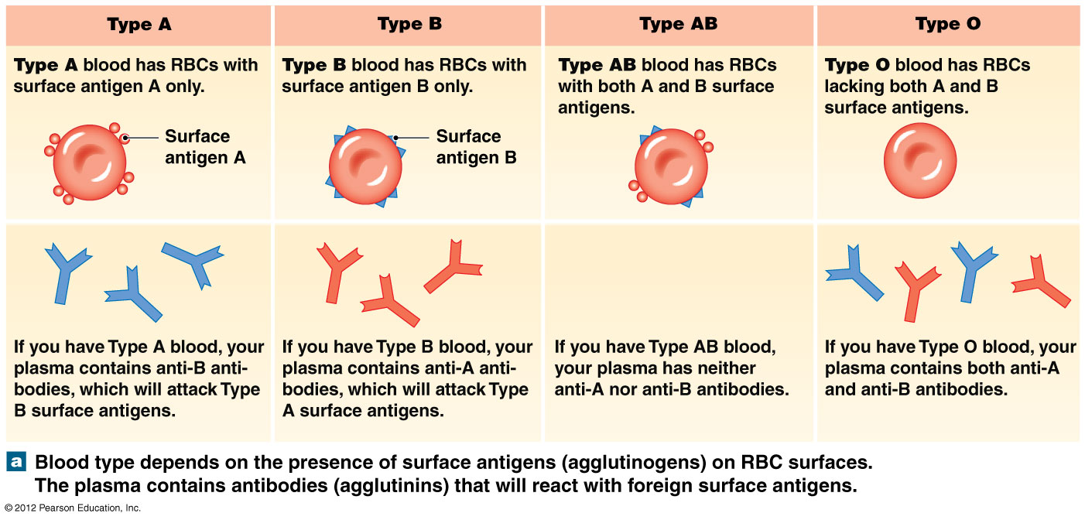
ABO Blood Types
RBC surfaces are marked by genetically determined glycoproteins (surface antigens or agglutinogens).
Glycoprotein (surface antigens) determines blood type.
Plasma contains antibodies (agglutinins) to A or B antigens not found on blood cells.
Notes:
Martini Fundamentals of A&P 9e

Slide 45
Type A
Display only surface antigen A.
Plasma contains Type B antibodies.
Notes:
Martini Fundamentals of A&P 7e

Slide 46
Type B
Display only surface antigen B.
Plasma contains type A antibodies.
Notes:
Martini Fundamentals of A&P 7e

Slide 47
Type AB
Display both A and B surface antigens.
Plasma contains no antibodies.
Notes:
Martini Fundamentals of A&P 7e

Slide 48
Type O
Display no surface antigens.
Plasma contains Type A and B antibodies.
Notes:
Martini Fundamentals of A&P 7e

Slide 49
Rh Blood Groups – Rh Antigen
People with Rh agglutinogens on RBC surface are Rh⁺.
Normal plasma contains no anti-Rh antibodies.
Antibodies develop only in Rh¯ blood type and only with exposure to antigen.
Transfusion of positive blood.
During pregnancy with positive blood type fetus.
Transfusion reaction upon 2nd exposure to antigen.
Results in hemolysis of the RBCs in donated blood.
Notes:
Retrieved from https://rhincompatibility.files.wordpress.com/2012/05/rh-antigen.jpg, 2015

Slide 50
Rh¯ Mother with Rh⁺ Babies
FIRST Rh+ baby in Rh- mother
Rh¯ mother can make anti-Rh antibodies if she encounters the Rh antigen with an Rh+ baby
Placental tearing during birth results mixing of maternal and fetal blood.
Mixing of maternal Rh¯ and fetal Rh⁺ blood will stimulate antibody formation in mother.
SECOND Rh+ baby
Maternal Anti-Rh antibodies can cross the placenta and attack the fetal RBCs
Erythroblastosis fetalis
First Rh⁺ baby will be normal.
Second will be at risk due to presence of mother’s Rh antibodies.
Prevention
Injections of anti-Rh factor antibodies (RhoGam) coat Rh⁺ fetal RBCs and prevent Rh¯ mother from producing anti-Rh antibodies.

Slide 51
Erythroblastosis Fetalis
https://youtu.be/ksC7JxLOrv4?list=PL5Sj-Bsdex3SXn_8S-iYpHWlXCyoNWfXO

Slide 52
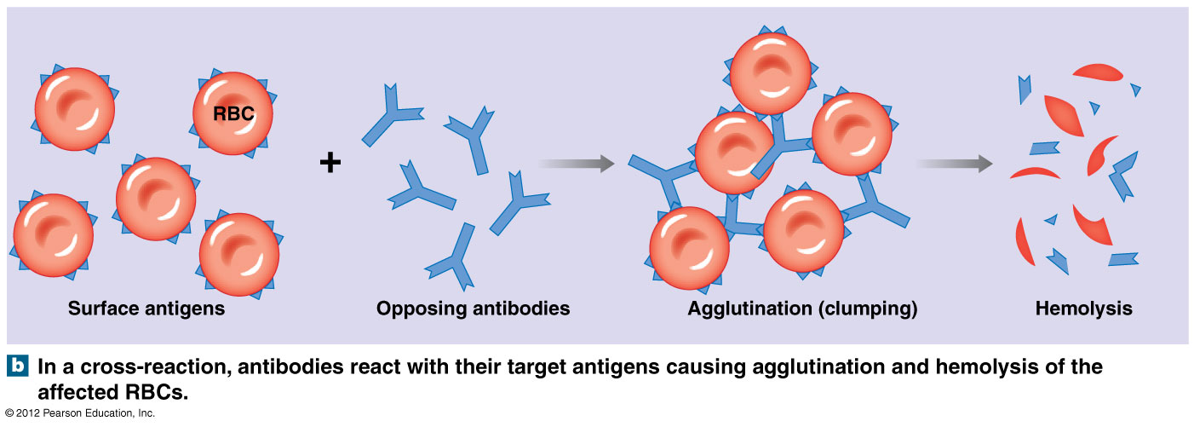
Blood Transfusions and Cross-Reactions
Only RBC’s are donated in a transfusion
Transfusion reactions
Recipients plasma (opposing antibodies) interacts with donors RBCs
Causes agglutination (clumping).
Hemolysis (destruction of RBC leading to release of hemoglobin from RBC into plasma).
Notes:
Martini Fundamentals of A&P 9e

Slide 53
Blood Transfusions: Universal Donor and Recipient
Universal donor (CELLS)
Type O-negative blood
No surface antigens (A, B, or Rh) on cells
Called "universal donor" type because of its compatibility with any blood type.
Universal recipient/acceptor (PLASMA)
Type AB-positive blood
No antibodies in plasma
Called "universal recipient" type because any blood of any type can be received.
Precautions
It is now known that even type O negative blood may have antibodies that cause serious reactions during a transfusion.
Although "universal donor and recipient" types are used to classify in emergency, to prevent cross-reactions blood type tests are always performed.
Notes:
Retrieved from https://i.ytimg.com/vi/Qf6IovJTAXU/hqdefault.jpg, 2016

Slide 54
Activities
ABO and Rh blood typing
ABO & Rh antigens
Blood transfusions
Notes:
Saladin A&P Unity of Form and Function 6e

Slide 55
Genetics of ABO Blood Types
ABO blood types are inherited and determined by genes on chromosome 9
Do not change as a result of environmental influences during life
ABO type results from inheritance of 1 of 3 alleles (A, B, or O) from each parent.
Possible outcomes are demonstrated at the right.
A and B alleles are dominant over O.
AO genotype will have an A phenotype.
OO genotypes will have an O phenotype (inherited a recessive O allele from both parents).
A and B alleles are codominant.
A is inherited from parent 1 and B from parent 2.
Results in AB phenotype.
Parent Alleles | A | B | O
A | AA (A) | AB (AB) | AO (A)
B | AB (AB) | BB (B) | BO (B)
O | AO (A) | BO (B) | OO (O)
Black – offspring genotype
Red – offspring phenotype
Notes:
Retrieved from http://anthro.palomar.edu/blood/ABO_system.htm, 2016

Slide 56
Coagulation and Coagulation Time
AKA: clotting
Process where blood changes from liquid to gel resulting in a clot formation
Generates potential for achieving hemostasis
Cessation of blood loss from a damaged vessel followed by repair.
Involves activation, adhesion, and aggregation of platelets coupled with deposition and maturation of fibrin.
Normal clotting time is between 2 and 6 min.
Disorders of coagulation can result in bleeding (hemorrhage or bruising) or obstructive clotting (thrombosis).
Notes:
Saladin A&P Unity of Form and Function 6e

Slide 57
Activities
Genetics and ABO blood types
Coagulation time
Notes:
Retrieved from http://static1.squarespace.com/static/5240dde2e4b00424461203e1/t/5261e068e4b04c04f40bd6e0/1382146710837/codominant.jpg, 2016

Slide 58
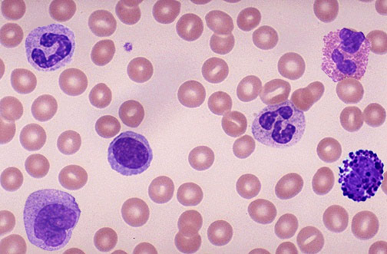

Slide 62
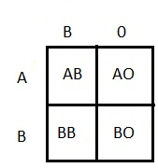
Mom blood type AB,
Dad blood type B, Genotype BO
What are the possible blood types (phenotypes) for their child?

Slide 63
Could a blood type A mother and a blood type O father have a type O child?

Slide 64
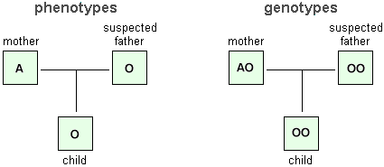
Could a blood type A mother and a blood type B father have a type O child?

Slide 65
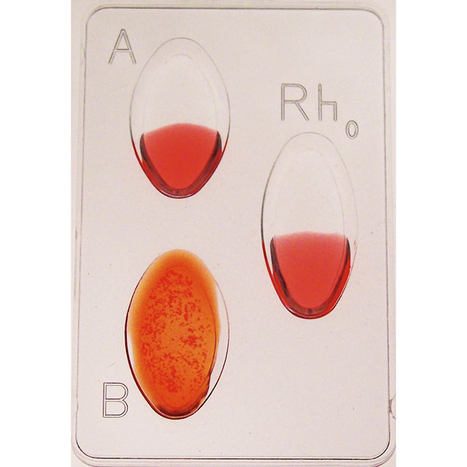
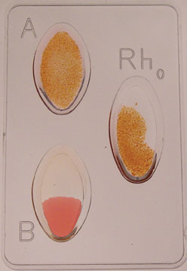

Slide 66
Gather All Materials FIRST!
Hb Cuvette
2 slides
Blood typing tray
2 drops anti-sera in each well (A B Rh)
3 Tooth pics
Band-Aid (open before)
Alcohol swab
Lancet

Slide 67
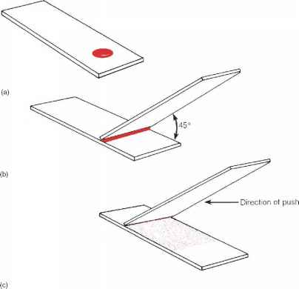
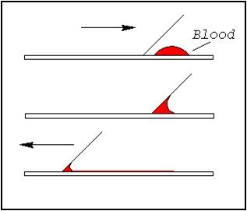
Wright’s Stain
PRACTICE with 2 slides FIRST! – smooth and even!
1 drop of blood at end of bottom slide
DRAG with a second slide at 45 degrees
Start in middle & slide back to blood
Touch blood – forms line via capillary action
Slide forward smooth and even – creates a “feathered edge”
Allow blood to dry on bottom slide
At sink bottom slide:
10 drops Wrights onto feathered end 3 minutes
10 drops buffer 1 minute
Rinse slide off with ionized water
Allow to dry standing on edge

Slide 69
References
Marieb, E. (2012). Essentials of human anatomy & physiology (6th ed.). Boston: Pearson Education, Inc.
Marieb, E., Mitchell, S. & Smith, L. (2012). Human anatomy and physiology laboratory manual (10th ed.). Boston: Pearson Education, Inc.
Martini, F. (2006). Fundamentals of anatomy & physiology (7th ed.). San Francisco: Pearson Education, Inc.
Martini, F., Nath, J. & Bartholomew, E. (2012). Fundamentals of anatomy & physiology (9th ed.). Boston: Pearson Education, Inc.
McPhee, J. & Papadakis, M. (2012) Current medical diagnosis & treatment (51st ed.). New York: McGraw Hill.
Patton, T. & Thibodeau, G. (2013). Anatomy & physiology (8th ed.).
St. Louis: Mosby Elsevier.
Saladin, K. (2012). Anatomy & physiology: The unity of form and function (6th ed.). New York: McGraw Hill.
Tortora, G. & Derrickson, B. (2012). Principles of anatomy and physiology (13th ed.). Hoboken: Wiley

