Slide 1
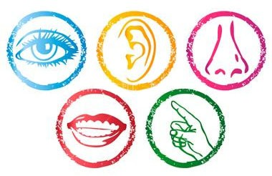
BI 232 Laboratory Special Senses: Olfaction-Gustation and Hearing-Equilibrium
Notes:
Retrieved from http://www.gardenbuildingsdirect.co.uk/blog/wp-content/uploads/5-Senses-380x246.jpg, 2016

Slide 2
Chemical Senses and Chemoreceptors: Smell and Taste
Specific chemical compounds are detected by sense organs and interpreted in designated region of brain.
Receptor cells are categorized as chemoreceptors.
Olfaction (smell)
Gustation (taste) – taste buds.
Collaborative senses
If sense of smell is compromised, as will be taste.
Notes:
Retrieved from http://www.brainfacts.org/~/media/Brainfacts/Article%20Multimedia/Sensing%20Thinking%20and%20Behaving/Senses%20and%20Perception/Taste/TasteSmell.ashx, 2016

Slide 3
Olfaction: Sense of Smell
Notes:
Retrieved from http://www.whatayear.org/images/12_13_Smell_Receptor.jpg, 2016

Slide 4
Olfactory Epithelial Cells
Olfactory receptor cells
Sensory receptors for smell found in olfactory epithelium(olfactory mucosa).
Extremely sensitive and easily fatigue.
Distinguish as many as 10,000 odors.
Epithelium overs 5cm² of superior concha and nasal septum.
Supporting cells
Provide support, nutrition, and protection of receptor cells in olfactory epithelium.
Bowman's glands secretions allow old odors to be constantly washed away.
Basal cells
Stem cells capable of division and differentiation into supporting or olfactory cells.
Rest on basal lamina of olfactory epithelium.
Constant division leads to replacement of olfactory epithelium every 2–4 weeks.

Slide 5
Olfactory Epithelial Cells
Olfactory receptor cells
Bipolar neurons with 20 cilia called olfactory hairs.
Axons pass through cribriform plate.
Survive 60 days.
Supporting cells.
Basal cells divide.
Notes:
Retrieved from http://www.leffingwell.com/olf2.gif, 2016

Slide 6
Physiology of Olfaction
Odorants must be volatile.
Odorants bind to receptors.
Na⁺ channels open.
Depolarization occurs.
Nerve impulse triggered.
Adaptation and odor thresholds.
Decreasing sensitivity.
Rapid due to sympathetic inhibition.
Low threshold – methyl mercaptan (methanethiol) added to natural gas as warning.
Notes:
Saladin A&P Unity of Form and Function 6e

Slide 7
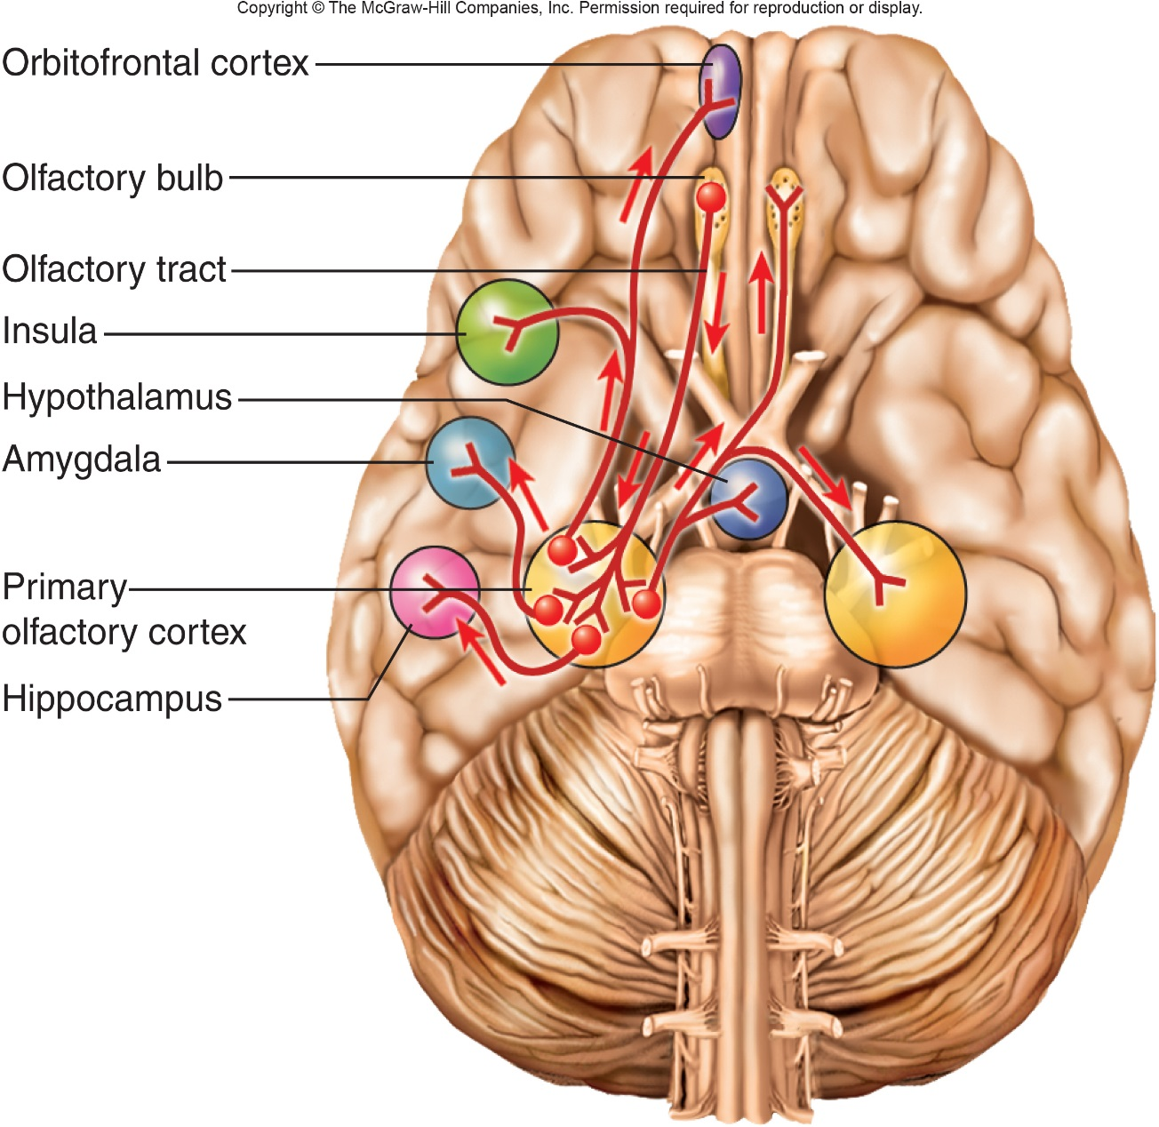
Olfactory Pathway
Axons from olfactory receptors form olfactory nerves (CN I), synapse in olfactory bulb.
Second-order neurons within olfactory bulb.
Pathways lead to the amygdala and hypothalamus.
Amygdala – emotional response.
Hypothalamus – physiological response.
Other pathways lead to frontal lobe where odor is identified.
Notes:
Saladin A&P Unity of Form and Function 6e

Slide 8
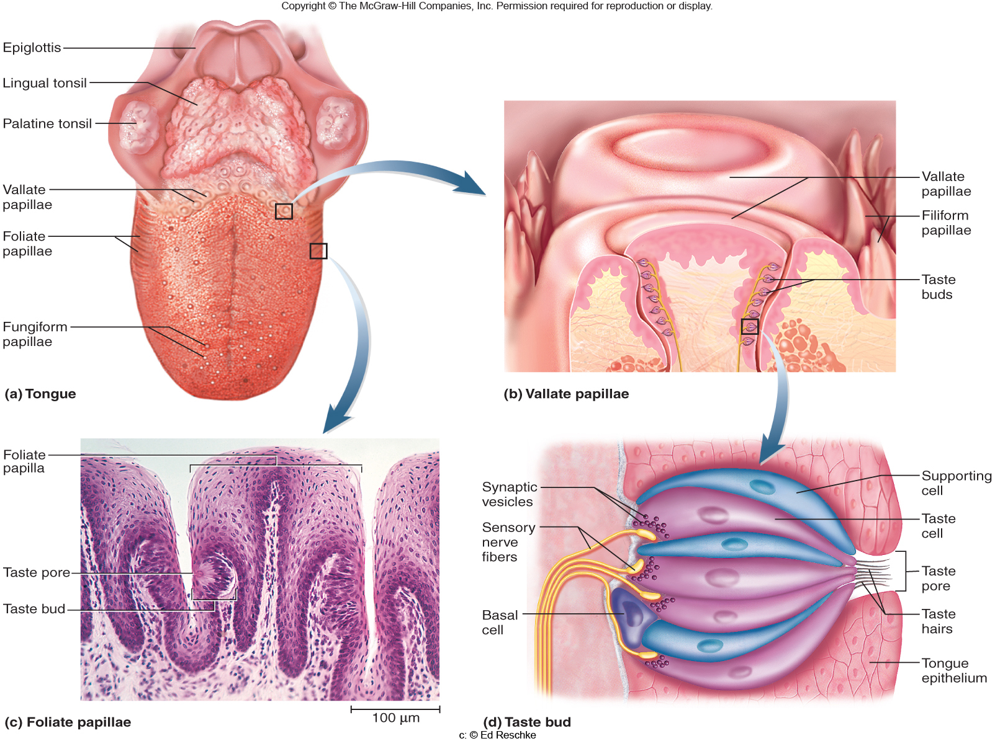
Gustation: Sense of Taste
Sensation of taste results from action of chemicals on the taste buds.
Notes:
Saladin A&P Unity of Form and Function 6e

Slide 9
Taste Buds and Structure
9
Associated with lingual papillae.
Fungiform
Large, mushroom shaped.
Anterior 2/3rd of tongue.
Contain approximately 5 taste buds.
Vallate (circumvallate)
Huge, dome-shaped.
Form row near back of tongue.
Contain approximately 100 taste buds.
Foliate
Leaf-like
Lateral edges of posterior tongue.
Filiform (no taste buds/texture)
Threadlike
Scattered among fungiform papillae.
Notes:
Retrieved from http://wahoo.nsm.umass.edu/histology/sites/wahoo.nsm.umass.edu.histology/files/imagecache/full/tongueedit.jpg, 2014

Slide 10
Histology of a Taste Bud: Contain Spindle-Shaped Cells
Gustatory cells
Contain taste receptors.
Epithelial cell in a taste bud that activates sensory fibers CN: VII, IX, or X.
Extend microvilli into the surrounding fluids through a taste pore.
Basal cells
Produce daughter cells that mature in stages.
Taste pore
Minute opening of taste bud where gustatory hairs of gustatory cells project.
Support cells
Similar in appearance to taste , but lack sensory microvilli.
Notes:
Retrieved from http://www.austincc.edu/apreview/NursingPics/PNSafferentpt2Pics/Picture32.jpg, 2016

Slide 11
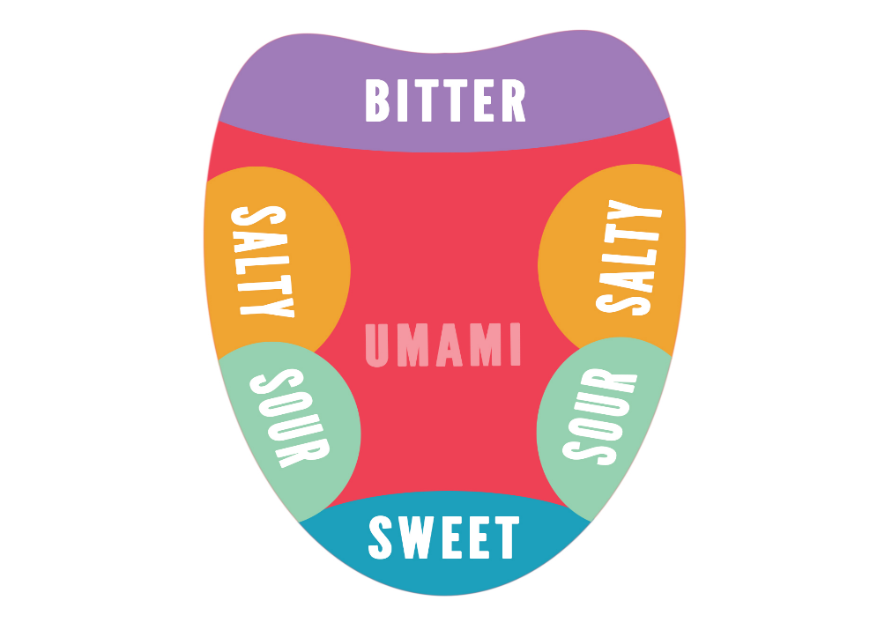
Physiology of Taste
To be tasted, molecules must dissolve in saliva.
5 primary sensations: salty, sweet, sour, bitter and umami (savory).
Influenced by food texture, aroma, temperature, and appearance.
Analytical sense
Sweet tastes concentrated on tip of tongue.
Salty and sour on lateral margins of tongue
Bitter at posterior aspect of tongue.
All tastes can be detected throughout the tongue surface.
Notes:
Retrieved form https://userscontent2.emaze.com/images/18709275-5ca2-4422-971e-db70126568e8/bd38ddc5-d305-472e-a790-3aaa574511b2.png, 2016

Slide 12
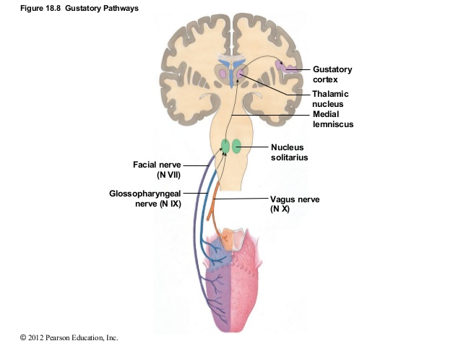
Projection Pathways for Taste
Innervation of the taste buds.
Facial nerve (VII) for the anterior 2/3rd of tongue.
Glossopharyngeal nerve (IX) for the posterior 1/3rd .
Vagus nerve (X) for palate, pharynx and epiglottis.
All fibers project to solitary nucleus in medulla.
Cells project to hypothalamus and amygdala.
Activate autonomic reflexes such as salivation, gagging and vomiting.
Cells project to thalamus and then postcentral gyrus of cerebrum.
Conscious sense of taste.
Cells project to association area and frontal lobe for identification of taste.
Notes:
Retrieved from http://image.slidesharecdn.com/ch18lecturepresentation-140918213614-phpapp02/95/ch-18lecturepresentation-20-638.jpg?cb=1411076301, 2016

Slide 13
Activities
Perform the following activities:
Histology of a taste bud.
Olfactory stimulation and taste.
Olfactory adaptation.
Stimulating taste buds.
Plotting taste bud distribution.
Notes:
Retrieved from http://www.siumed.edu/~dking2/erg/images/GI054b.jpg, 2016

Slide 14
Sense of Hearing and Equilibrium
Notes:
Retrieved from http://www.jsonger.net/wp-content/uploads/2010/11/hearingbalance.jpg, 2016

Slide 15
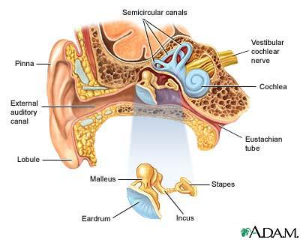
External/Outer Ear
Function – collect sounds.
Structures
Auricle or pinna
Elastic cartilage covered with skin.
External acoustic canal (external auditory canal)
Curved 1” tube of cartilage and bone leading into temporal bone.
Ceruminous glands produce cerumen (ear wax).
Tympanic membrane (eardrum)
Epidermis, collagen and elastic fibers, simple cuboidal epithelium.
Perforated eardrum (hole is present)
Pain, ringing, hearing loss, dizziness.
Caused by explosion, scuba diving, or ear infection.
Notes:
Retrieved from http://graphics8.nytimes.com/images/2007/08/01/health/adam/1092.jpg, 2016

Slide 16
Middle Ear Cavity
Notes:
Saladin A&P Unity of Form and Function 6e

Slide 17
Structures of Middle Ear Cavity
Air filled cavity in the temporal bone.
Separated from external ear by eardrum and from internal ear by oval and round window.
3 ear ossicles connected by synovial joints.
Malleus
Incus
Stapes
Malleus attached to eardrum, incus and stapes attached by foot plate to membrane of oval window.
Stapedius and tensor tympani muscles attach to ossicles.
Auditory tube (Eustachian tube)
Leads to nasopharynx.
Helps to equalize pressure on both sides of eardrum.
Connection to mastoid bone – mastoiditis.
Notes:
Tortora Principles of A&P 13e

Slide 18
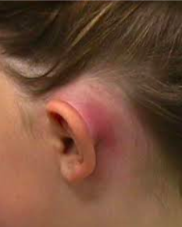
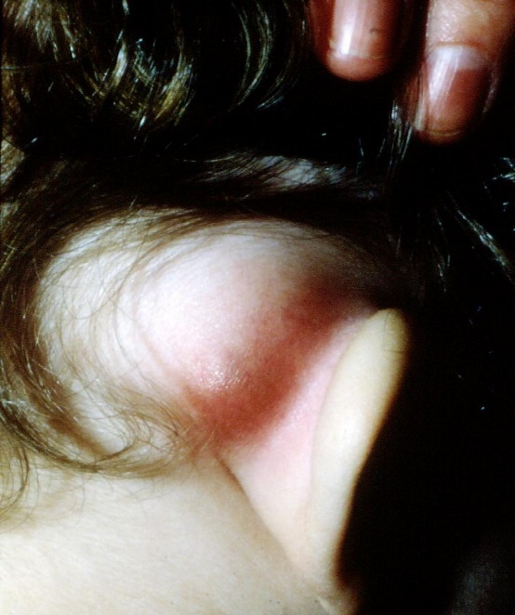

Slide 19
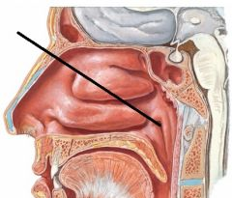

Slide 20
Inner Ear
Notes:
Saladin A&P Unity of Form and Function 6e

Slide 21
Structures of Inner Ear
Bony labyrinth
Set of tube-like cavities in temporal bone.
Semicircular canals, vestibule and cochlea lined with periosteum.
Filled with perilymph (similar to CSF).
Surrounds and protects membranous labyrinth.
Notes:
Retrieved from https://s3.amazonaws.com/thumbnails.illustrationsource.com/huge.101.506854.JPG, 2016

Slide 22
Structures of Inner Ear
Membranous labyrinth
Set of membranous tubes containing sensory receptors for hearing and balance.
Filled with endolymph.
Similar to ICF.
Utricle, saccule, 3 ampulla, 3 semicircular ducts and cochlea.
Notes:
Retrieved from https://s3.amazonaws.com/thumbnails.illustrationsource.com/huge.101.506854.JPG, 2016

Slide 23
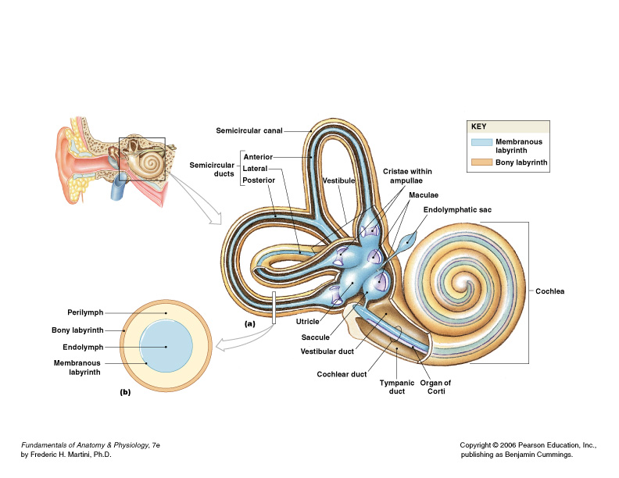
Vestibular Complex
Semicircular canals - boney labyrinth that encloses semicircular ducts.
Anterior, lateral, and posterior.
Perilymph fills canals - endolymph within ducts.
Notes:
Retrieved from http://images.slideplayer.com/14/4301471/slides/slide_12.jpg, 2016

Slide 24
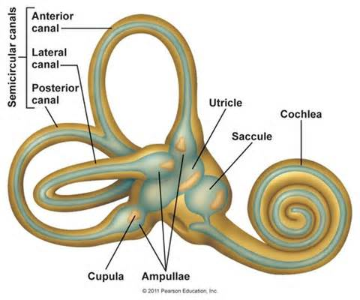
Vestibular Complex
Vestibular apparatus
Semicircular ducts (anterior, lateral, posterior)
Three ring-shaped tubes filled with endolymph.
Detect angular acceleration of head.
Ampulla – dilated sac at one end of each duct.
Contain
Crista ampullaris – mound of hair cells and support cell.
Cupula - gelatinous cap extending for crista to roof of ampulla.
Utricle (posterior) – other end each duct opens into this structure, contains macula
Saccule – anterior to utricle and also contains macula
Macula – contains hair cells embedded in gelatinous otolithic membrane weighted with calcium-carbonate crystals called otoliths, which detect tilt of head.
Notes:
Retrieved from http://fitlifefusion.com/wp-content/uploads/2015/05/vestibular.jpeg, 2016

Slide 25
Ampulla: Crista Ampullaris and Cupula Dynamic Equilibrium
Notes:
Saladin A&P Unity of Form and Function 6e

Slide 26
Roman Ampulla

Slide 27
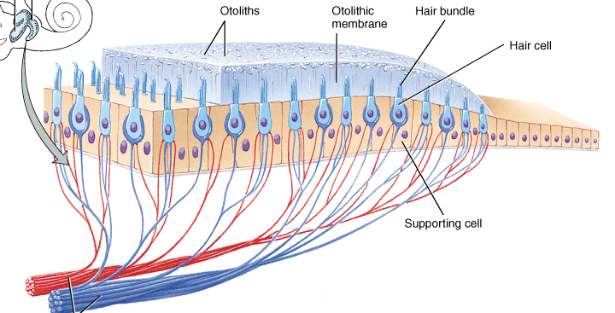
Otolithic Organs: Saccule and Utricle
Thickened regions called macula within the saccule and utricle of the vestibular apparatus.
Cell types in the macula region.
Hair cells with stereocilia (microvilli) and one cilia (kinocilium).
Supporting cells that secrete gelatinous layer.
Gelatinous otolithic membrane contains calcium carbonate crystals called otoliths that move when you tip your head.
Notes:
Tortora Principles of A&P 13e

Slide 29
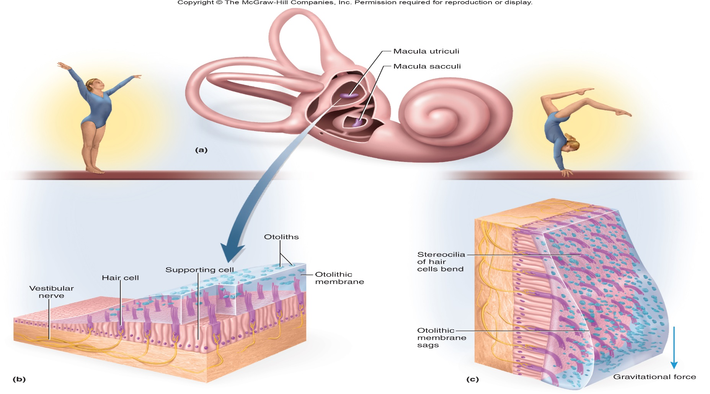
Otolithic Organs: Saccule and Utricle Maculae Static Equilibrium
Macula – movement of stereocilia or kinocilium results in the release of neurotransmitter onto the vestibular branches of the vestibulocochler nerve.
Notes:
Saladin A&P Unity of Form and Function 6e

Slide 30
Physiology of Equilibrium (Balance)
Dynamic equilibrium
Maintain body position (head) during sudden movement of any type.
Rotation, deceleration or acceleration.
Crista receptors within ampulla of semicircular ducts.
Static equilibrium
Maintain the position of the body (head) relative to the force of gravity.
Macula receptors within saccule and utricle.
Notes:
Retrieved from http://reflectionsyoga.com/wp-content/uploads/2015/02/balancing-act-elephant.jpg, 2016

Slide 31
Cochlea

Slide 32
The Organ of Hearing: Cochlea
Notes:
Saladin A&P Unity of Form and Function 6e

Slide 33
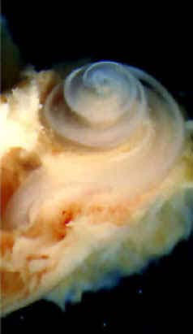
Structures of the Cochlea
Cochlea has 3 fluid filled chambers separated by membranes:
Scala vestibuli (vestibular duct) – superior chamber filled with perilymph.
Scala tympani (tympanic duct) – inferior chamber filled with perilymph.
Scala media (cochlear duct) – middle chamber filled with endolymph.
Separated from scala vestibuli above by vestibular membrane (thin) and from scala tympani below by basilar membrane (thick).
Notes:
Retrieved from http://scienceblogs.com/chaoticutopia/wp-content/blogs.dir/393/files/2012/04/i-7397979794ecb6b40e8882d34c930bf0-cochlea.jpg, 2016

Slide 34
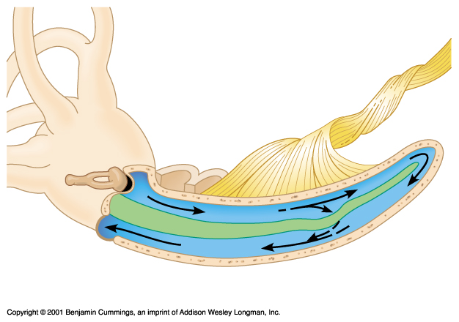
Cochlea Uncoiled
vestibular duct
oval window
helicotrema
round window
tympanic duct
Cochlear duct containing the Organ of Corti
Stapes pushes on fluid of vestibular duct at oval window
At helicotrema, vibration moves into tympanic duct
Fluid vibration dissipated at round window which bulges
The central structure is vibrated (cochlear duct)

Slide 35
Cochlea
Vestibulocochlear nerve sends impulses to the auditory cortex of the temporal lobe of brain and interpreted as sound

Slide 36
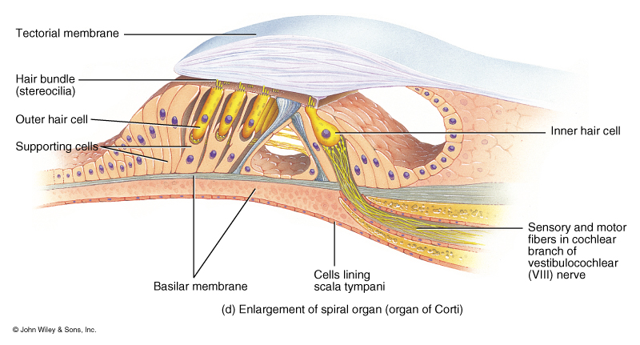
Structures of the Cochlea
Spiral organ (acoustic organ or Organ of Corti) – found within scala media.
Tectorial membrane – gelatinous structure that rests atop the stereocilia of the spiral organ.
Basilar membrane – support spiral organ and aids in translation of sound vibrations into electrical impulses.
Inner hair cells (IHCs) – arrange in a row on medial aspect of basilar membrane.
Outer hair cells (OHCs) – three rows arranged across from inner hair cells.
Notes:
Tortora Principles of A&P 13e

Slide 37
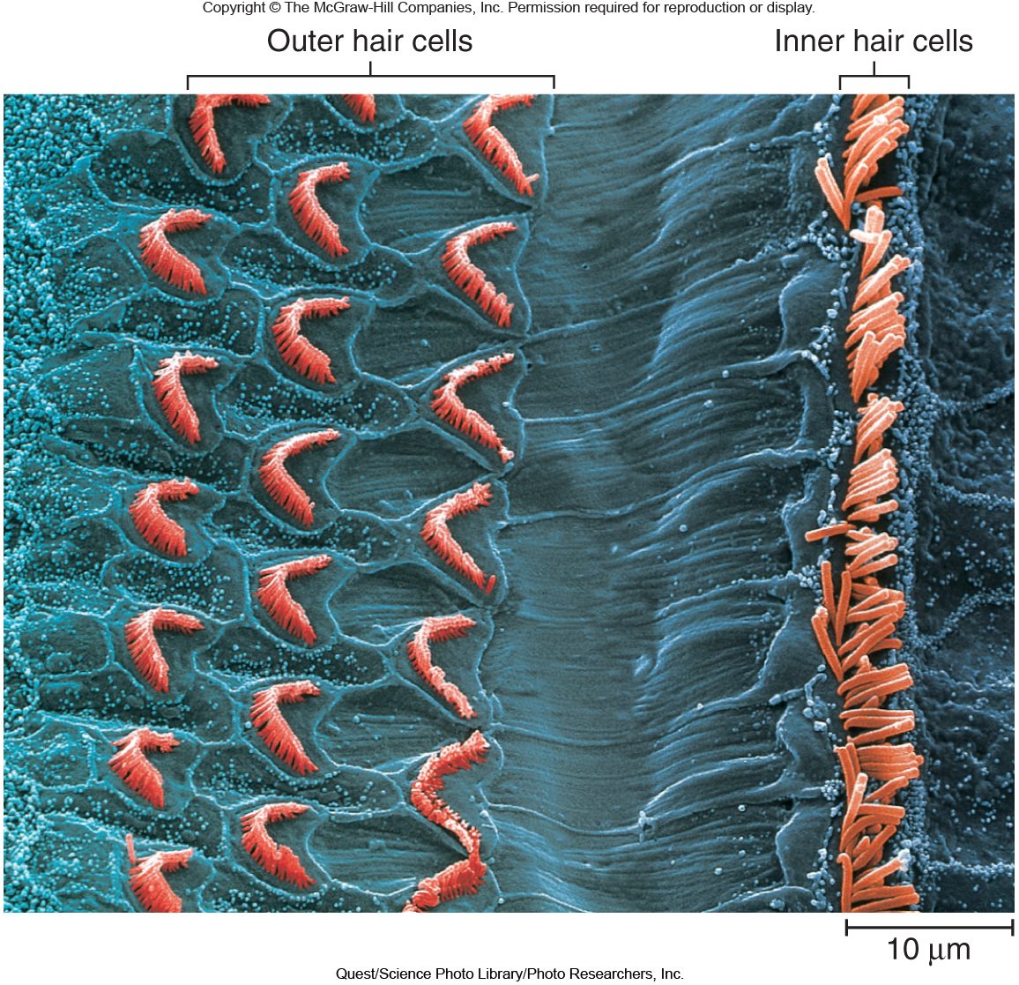
Anatomy of the Spiral Organ
Thick epithelium of sensory and supporting cells and associated membranes.
Converts vibrations into nerve impulses.
16,000 hair cells have 30-100 stereocilia (microvilli).
Stereocilia of hair cells are attached to gelatinous tectorial membrane.
Microvilli make contact with tectorial membrane (gelatinous membrane that overlaps the spiral organ of Corti).
Basal sides of inner hair cells synapse with 1st order sensory neurons whose cell body is in spiral ganglion.
Hearing comes from inner hair cells.
Outer adjust cochlear responses to different frequencies increasing precision.
Notes:
Saladin A&P Unity of Form and Function 6e

Slide 38
Tubular Structures of the Cochlea
Stapes pushes on fluid of scala vestibuli at oval window.
At helicotrema (where scala tympani and vestibuli meet).
Vibration moves into scala tympani.
Fluid vibration dissipated at round window which bulges.
The central structure is vibrated (cochlear duct).
Notes:
Saladin A&P Unity of Form and Function 6e

Slide 39
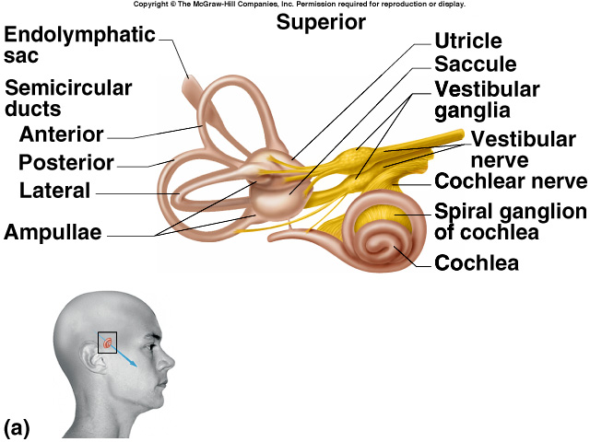
Innervation of Internal Ear
Vestibular ganglia is visible in vestibular nerve.
Spiral ganglia is buried in modiolus of cochlea.
Notes:
Tortora Principles of A&P 13e

Slide 40
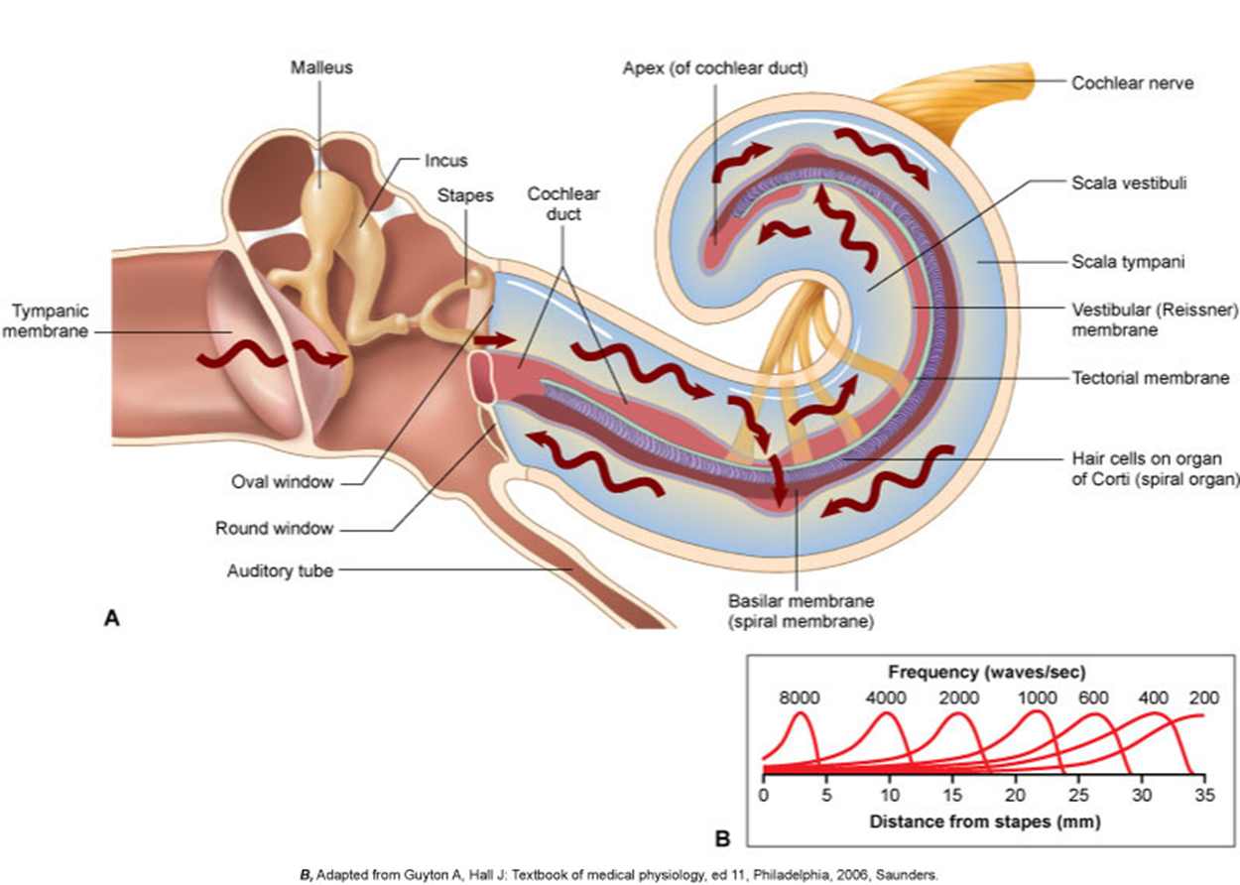
Physiology of Hearing
Auricle collects sound waves.
Eardrum vibrates
Slow vibration in response to low-pitched sounds.
Rapid vibration in response to high-pitched sounds.
Ossicles vibrate since malleus attached to eardrum.
Stapes pushes on oval window producing fluid pressure waves in scala vestibuli and tympani.
Oval window vibration 20X more vigorous than eardrum.
Pressure fluctuations inside cochlear duct move the hair cells against the tectorial membrane.
Microvilli are bent producing receptor potentials.
Notes:
Patton A&P 8e

Slide 42
Activities
Perform the following activities:
Histology of the spiral organ (organ of Corti)
Examine ear with an otoscope
Weber test (hearing)
Rinne test (hearing)
Barany’s test (equilibrium)
Rhomberg test (equilibrium)
Review all models
Notes:
Retrieved from http://www.siumed.edu/~dking2/ssb/images/EE001b.jpg, 2016

Slide 43
Deciphering Types of Hearing Loss
Conductive hearing loss
Associated with impaired transmission of sound waves through external ear canal OR bones of the middle ear.
Caused by damage to any mechanical components of ear
E.g. Accumulation of cerumen, disruption of tympanic membrane, fusion of one or more middle ear ossicles.
Sensorineural hearing loss
Due to a defect in neural pathways, which may be at the level of the cochlea, auditory nerve, or in the cerebral cortex .
E.g. Infections–especially intrauterine (rubella), drug toxicity (aminoglycosides), and tumors (acoustic neuroma).
Mixed hearing loss
Due to a combination of mechanical and neural defects.
E.g. Down syndrome, cystic fibrosis, cerebral palsy.

Slide 44
Understanding Weber and Rinne Tests
Weber test – determines if hearing loss is present in one ear, but does not distinguish conductive and sensorineural deafness.
Interpreting the test:
Normally, the sound is heard in the center of the head or equally in both ears.
Sound localizes toward the poor ear with conductive loss.
Sound localizes toward the good ear with sensorineural hearing loss.
Rinne test – valuates an individual’s ability to hear sounds conducted by air or bone.
Interpreting the test:
Normally, someone will hear the vibration in the air (in front of the ear) after they stop hearing it on the bone.
If patient hears vibration on bone after they no longer hear it in the air, conductive hearing loss.
Used together, these test can distinguish between the two types of hearing loss.

Slide 46
References
Marieb, E. N. (2012). Essentials of human anatomy & physiology
(6th ed.). Boston: Pearson Education, Inc.
Marieb, E.N., Mitchell, S.J. & Smith, L.A. (2012). Human anatomy and physiology laboratory manual (10th ed.). Boston: Pearson Education, Inc.
Martini, F., Nath, J. & Bartholomew, E.F. (2012). Fundamentals of anatomy & physiology (9th ed.). Boston: Pearson Education, Inc.
McPhee, J. & Papadakis, M. (2012) Current medical diagnosis & treatment (51st ed.). New York: McGraw Hill.
Patton, T. & Thibodeau, G. (2013). Anatomy & physiology (8th ed.).
St. Louis:Mosby Elsevier.
Saladin, K. S. (2012). Anatomy & physiology: The unity of form and function (6th ed.). New York: McGraw Hill.
Tortora, G.J. & Derrickson, B.H. (2012). Principles of anatomy and physiology (13th ed.). Hoboken, NJ: Wiley

