Slide 1
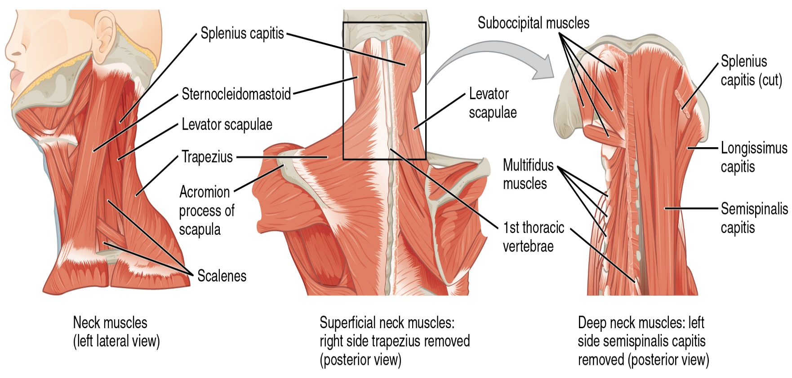
Lab 8: Muscles Group I
Joint movements
Histology: structure of skeletal muscle
Origin, insertion, and action
Muscles of the head, neck, trunk, and shoulder

Slide 2
Joint Movements Defined
Flexion – decrease in angle between articulating bones
Extension – increase in angle between articulating bones
Hyperextension – extension past the anatomical position
Adduction (ad = to) – movement towards longitudinal axis of body
Abduction (ab = from) - movement away from longitudinal axis of body
Circumduction – angular movement incorporating flexion, abduction, extension, and adduction
Rotation – action of rotating around an axis or center
Head rotates to left or right, limb rotates internally (medial) or externally (lateral)
‹#›

Slide 3
Joint Movements Defined
Pronation of hand (palm down) – rotation of radius over ulna medially.
Supination of hand (palm up) – rotation of radius over ulna laterally.
Inversion (sole in) – twisting movement of foot turning sole of foot in.
Eversion (sole out) – twisting movement of foot turning sole of foot out.
Dorsiflexion – flexion of ankle joint and elevation of sole (dig heel in).
Plantar flexion – extension of ankle joint and elevates heel (stand on tiptoe).
‹#›

Slide 4
Flexion, Extension, Hyperextension
‹#›

Slide 5
Flexion, Hyperextension, Lateral Flexion, Rotation
‹#›

Slide 6
Rotation: Medial (internal), Lateral (external)
‹#›

Slide 7
ABduction and ADDuction
‹#›

Slide 8
Circumduction
‹#›

Slide 9
Supination and Pronation
‹#›

Slide 10
Dorsiflexion and Plantar Flexion INversion and Eversion
Movements Specific to the Foot
‹#›

Slide 11
Movements Specific to the Hand
‹#›

Slide 12
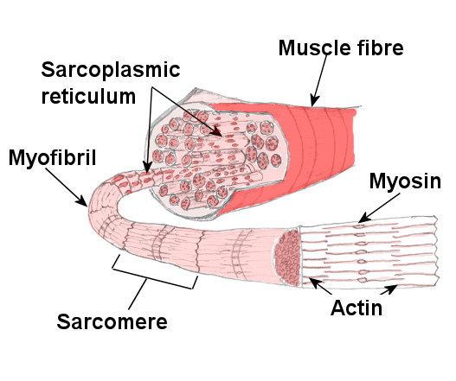
‹#›

Slide 13
Structure of skeletal muscle cells
Plasma membrane of a muscle fiber is called the sarcolemma and its cytoplasm is called sarcoplasm.
Sarcoplasm is occupied mainly by long protein cords called myofibrils.
‹#›

Slide 14
Structure of skeletal muscle
Smooth endoplasmic reticulum is called sarcoplasmic reticulum (SR).
SR forms dilated sacs called terminal cisternae.
Enfolding of sarcolemma form transverse (T) tubules.
T tubule and 2 terminal cisternae form a triad.
‹#›

Slide 15
Structure of skeletal muscle
Myofibrils are bundles of parallel protein microfilaments called myofilaments.
Thick filaments: made up of myosin.
Thin filaments: primarily composed of fibrous (F) actin.
‹#›

Slide 16
Structure of skeletal muscle
Each F actin is like a bead necklace.
With another protein called tropomyosin which blocks the active sites of six or seven G actins.
Each tropomyosin has a calcium-binding protein called troponin bound to it.
‹#›

Slide 17
Structure of skeletal muscle
Sarcomere
Structural and functional contractile unit of the muscle fiber.
Z discs form the boundaries for a single sarcomere in the striation pattern.
‹#›

Slide 18
‹#›

Slide 19
Structure of skeletal muscle
A band: dark bands where thick and thin filaments overlap.
H bands are a lighter band within the A band where no overlapping occurs.
M line: protein that links the myosin together.
‹#›

Slide 20
Structure of skeletal muscle
Z disc provides anchorage for the thin filaments.
Each light I band is bisected by the dark narrow Z disc (Z line).
A muscle shortens because its individual sarcomeres shorten and pull z discs closer to each other.
‹#›

Slide 21
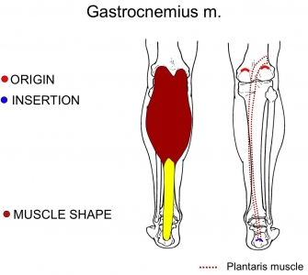
Origin, Insertion, and Action of Muscle
Origin
Fixed end attaches to a bone, cartilage, or connective tissue.
Insertion
Movable end attaching to another structure.
Action
Movement caused by shortening of muscle.
‹#›

Slide 22
frontalis
Epicranial Aponeurosis
Frontal belly
Action: Elevates eyebrows and wrinkles skin of forehead
Origin: Epicranial aponeurosis
Insertion: skin of eyebrow and bridge of nose
‹#›

Slide 23
Occipitalis
Occipital belly
Action: Pulls scalp posteriorly; wrinkles skin on posterior surface of neck
Origin: Superior nuchal line on occipital bone and temporal bone
Insertion: Epicranial aponeurosis (Galea aponeurotica)
‹#›

Slide 24
Orbicularis Oculi
Action: Closes eyelids; acts during squinting and blinking
Origin: Medial aspect of bony orbit
Insertion: skin around eyelids
‹#›

Slide 25
Temporalis
Action: Elevates and retracts mandible to close jaw
Origin: Temporal bone
Insertion: coronoid process of mandible
‹#›

Slide 26
Masseter
Action: Elevates mandible to close jaw; protrudes mandible
Origin: Zygomatic arch
Insertion: angle and ramus of mandible
‹#›

Slide 27
Orbicularis Oris
Action: Encircles mouth, closes and purses lips as in speaking, kissing and whistling
Origin: modiolus of mouth (corners of mouth)
Insertion: Submucosa and dermis of lips
‹#›

Slide 28
Zygomaticus Major
Action: Elevates corner of mouth
Origin: Zygomatic bone
Insertion: Angle of mouth
‹#›

Slide 29
Risorius
Action: Draws corner of mouth laterally
Origin: fascia of masseter
Insertion: corner of mouth
‹#›

Slide 30
Omohyoid
Action: Depresses and retracts hyoid bone
Superior belly
Origin: Clavicle and first rib
Insertion: hyoid bone
Inferior belly
Origin: superior margin of scapula
Insertion: clavicle and first rib
‹#›

Slide 31
Sternohyoid
Action: Depresses larynx and hyoid bone during swallowing.
Origin: Manubrium
Insertion: Hyoid bone
‹#›

Slide 32
Mylohyoid
Action: Elevates hyoid bone and floor of mouth during swallowing and speaking
Origin: Mylohyoid line
Insertion: Hyoid bone
‹#›

Slide 33
Digastric Anterior Belly
Action: Elevates hyoid bone and base of tongue, depresses mandible
Origin: inferior margin of mandible
Insertion: Hyoid bone
‹#›

Slide 34
Digastric Posterior Belly
Action: Moves hyoid bone back
Origin: mastoid process
Insertion: Hyoid bone
‹#›

Slide 35
Sternocleidomastoid
Action: Ipsilateral lateral flexion of neck and contralateral rotation head.
Origin: Manubrium and medial third of clavicle
Insertion: Mastoid process
‹#›

Slide 36
Trapezius
Action: Extends and laterally flexes neck. elevate, retracts and depresses scapula.
Origin: Posterior surface of occipital bone; superior nuchal line; spinous processes of thoracic vertebrae.
Insertion: Lateral third of clavicle; acromion; spine of scapula
‹#›

Slide 37
Latissimus Dorsi
Action: Adduction and medial rotation of arm
Origin: Spinous processes of vertebrae T6-T12; thoracolumbar fascia; iliac crest; inferior three ribs
Insertion: Intertubercular groove of humerus
‹#›

Slide 38
Levator Scapula
Action: Elevates scapula
Origin: Transverse processes of superior four cervical vertebrae
Insertion: medial border of scapula near superior angle
‹#›

Slide 39
Rhomboid Major
Action: Adducts (retracts) scapula and performs downward rotation
Origin: Spinous processes of vertebrae T1-T5.
Insertion: Medial border of scapula
‹#›

Slide 40
Rhomboid Minor
Action: Adducts scapula and fixes scapula during arm movements
Origin: Ligamentum nuchae; spinous processes of vertebrae C7 and T1
Insertion: Medial border of scapula
‹#›

Slide 41
Serratus Anterior
Action: Holds scapula to chest wall, rotates scapula, fixes scapula during abduction of arm etc.
Origin: External surfaces of ribs 1-8
Insertion: Medial border of scapula
‹#›

Slide 42
‹#›

Slide 43
Erector spinae
Action: Extension of the vertebral column
Origin: Sacrum, iliac crest, spinous processes of lumbar vertebrae and T 11,12
Insertion: angles of ribs, spinous and transverse processes of vertebrae
‹#›

Slide 44
External Intercostal
Action: Elevates rib cage during inspiration
Origin: Inferior border of superior rib
Insertion: Superior border of inferior rib
‹#›

Slide 45
Internal Intercostal
Action: Depresses rib cage during forced expiration
Origin: Superior border of inferior rib
Insertion: Inferior border of superior rib
‹#›

Slide 46
Pectoralis Major
Action: Flexes, adducts, and medially rotates humerus, draws body upward in climbing
Origin: Medial half of clavicle; sternum; costal cartilages of ribs 1-6
Insertion: intertubercular groove on humerus
‹#›

Slide 47
Pectoralis Minor
Action: Draws scapula down and forward and elevates ribs
Origin: External surfaces of ribs 3-5
Insertion: Coracoid process of scapula
‹#›

Slide 48
‹#›

Slide 49
External Abdominal Oblique
Action: Compresses abdomen, contralaterally rotates and flexes vertebral column
Origin: External surfaces of inferior 8 ribs.
Insertion: Linea alba; pubic crest; pubic tubercle; iliac crest
‹#›

Slide 50
Internal Abdominal Oblique
Action: Compresses abdomen, ipsilaterally rotates and flexes vertebral column
Origin: Thoracolumbar fascia; iliac crest; inguinal ligament
Insertion: Linea alba; pubic crest; inferior three or four ribs
‹#›

Slide 51
Rectus Abdominis
Action: Tenses abdominal wall and flexes vertebral column
Origin: Pubic crest; pubic symphysis
Insertion: Xiphoid process, costal cartilages of ribs 5-7
‹#›

Slide 52
Transverse Abdominis
Action: Compresses abdomen
Origin: Thoracolumbar fascia; inguinal ligament; costal cartilages of inferior six ribs; iliac crest
Insertion: linea alba; pubic crest
‹#›

Slide 53
‹#›

Slide 54
Deltoid
Action:
Anterior fibers: medial rotation and flexion of arm
Middle fibers: abduction of arm
Posterior fibers: lateral rotation and extension of arm
‹#›

Slide 55
Deltoid
Origin: Lateral third of clavicle; acromion process; spine of scapula
Insertion: Deltoid tuberosity of humerus
‹#›

Slide 56
Supraspinatus
Action: Abduction of arm
Origin: supraspinous fossa of scapula
Insertion: Greater tubercle of humerus
‹#›

Slide 57
Infraspinatus
Action: Lateral rotation of arm. Prevents head of humerus from sliding upward
Origin: Infraspinous fossa of scapula
Insertion: Greater tubercle of humerus
‹#›

Slide 58
Teres minor
Action: Lateral rotation of arm and prevents head of humerus from sliding upward as arm is abducted
Origin: Lateral border of scapula
Insertion: Greater tubercle of humerus
‹#›

Slide 59
Teres major
Action: Extension, adduction and medial rotation of arm and prevents head of humerus from sliding upward as arm is abducted
Origin: Scapula, near inferior angle
Insertion: medial lip of intertubercular groove of the humerus
‹#›

Slide 60
Subscapularis
Action: Adduction and medial rotation of arm.
Origin: Subscapular fossa of scapula
Insertion: lesser tubercle of humerus
‹#›

Slide 61
Biceps brachii
Action: Flexion and supination of forearm; flexion of arm
Origin:
Long head: supraglenoid tubercle
Short head: coracoid process of scapula
Insertion: radial tuberosity
‹#›

Slide 62
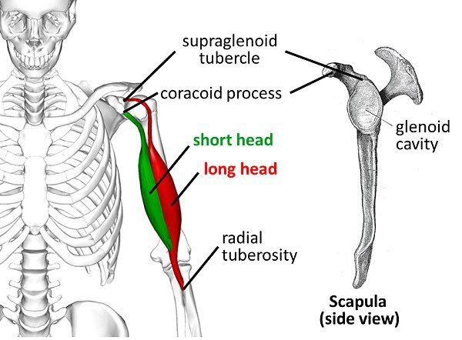

Slide 63
Triceps brachii
Action: Extension of forearm; long head extends and adducts arm
Origin: Long head: infraglenoid tubercle
Lateral head: posterior surface of humerus
Medial head: posterior surface inferior to lateral head
Insertion: Olecranon process of ulna
‹#›

Slide 64
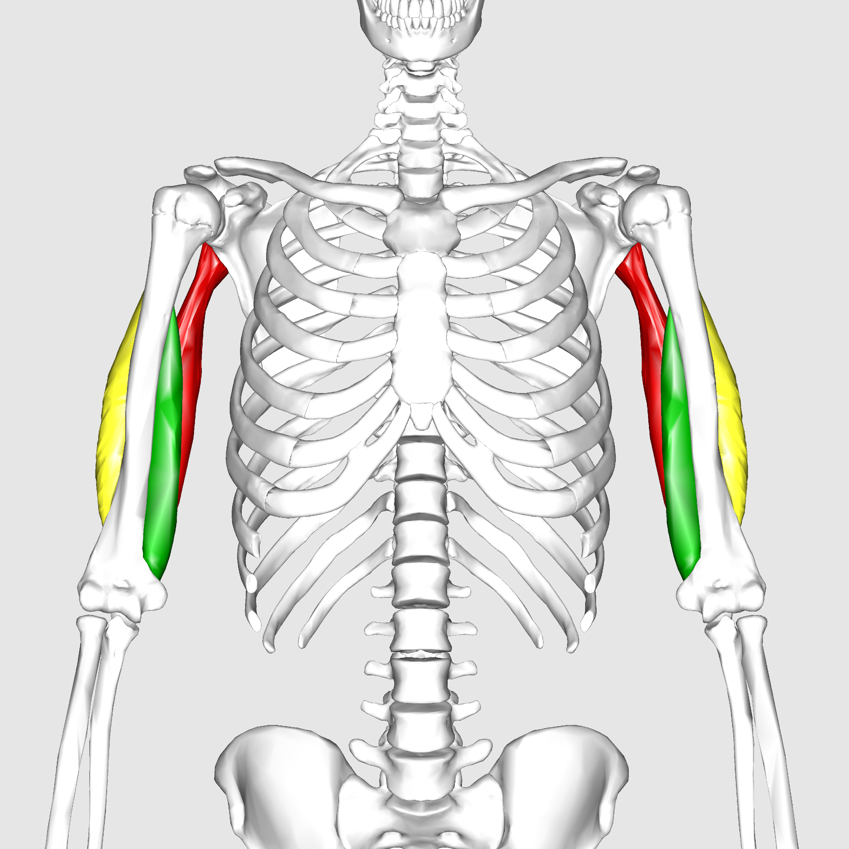
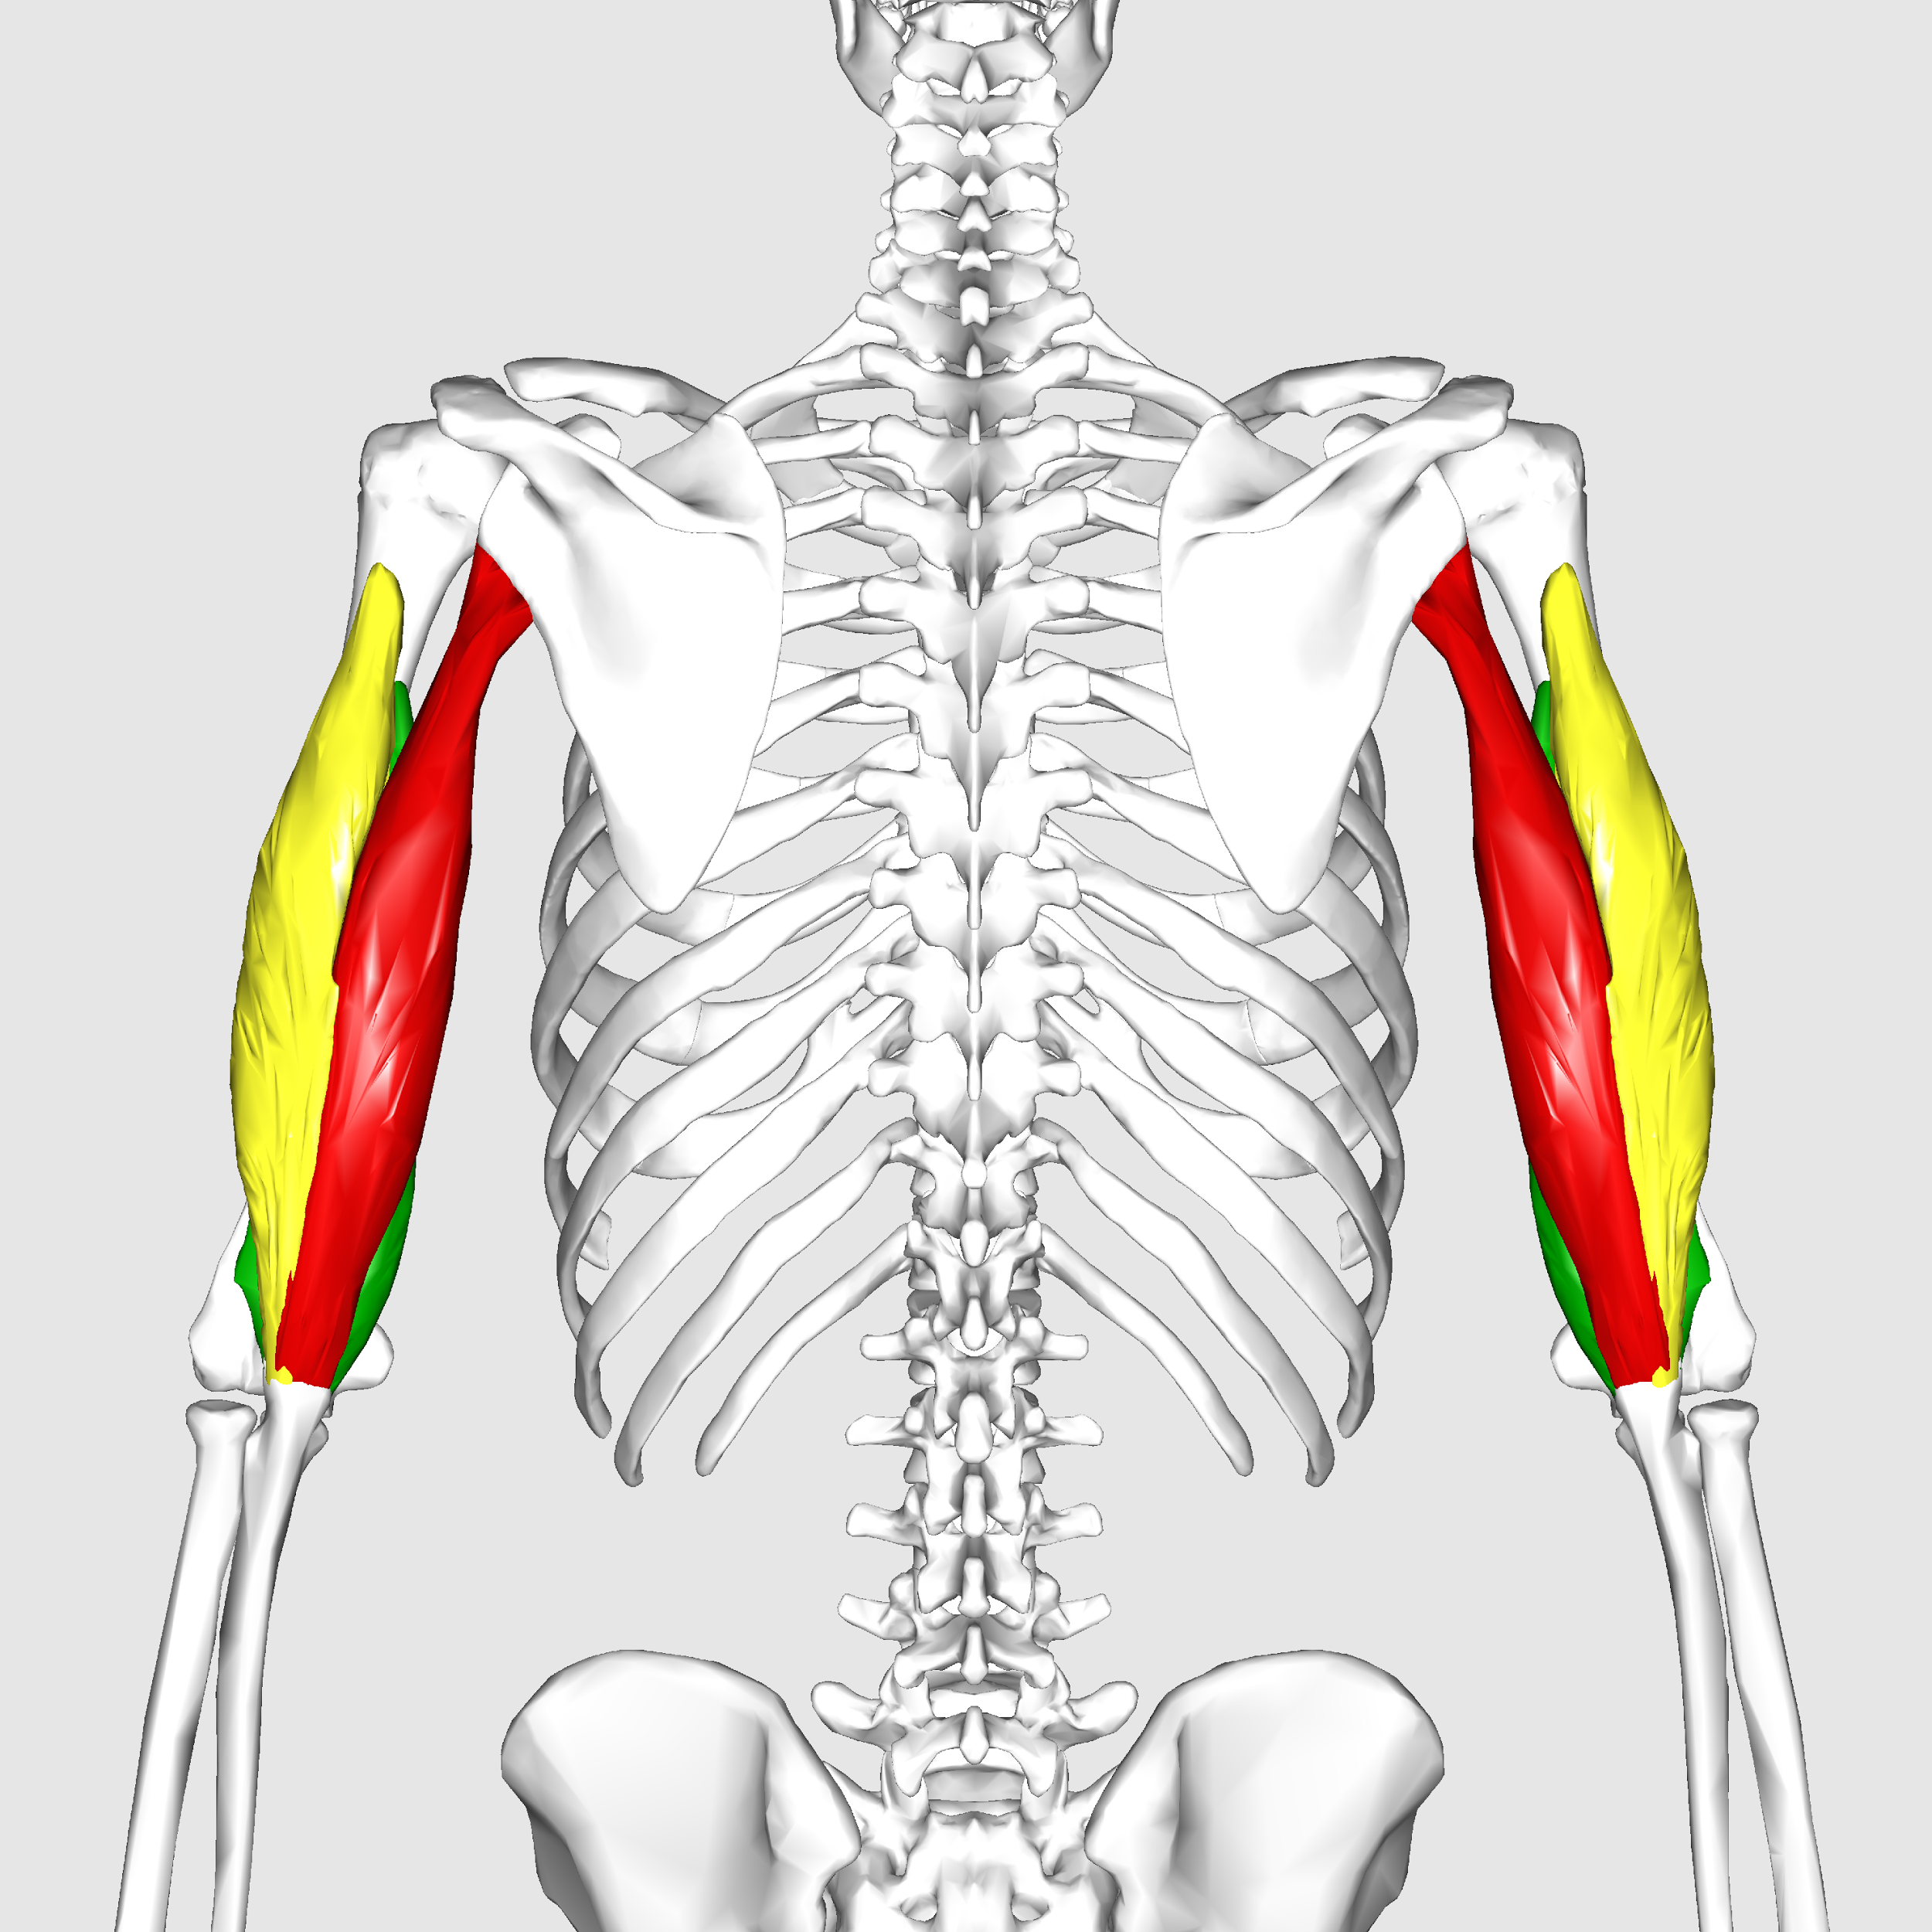

Slide 65
‹#›

Slide 66
Coracobrachialis
Action: Flexion and medial rotation of arm
Origin: Coracoid process of scapula
Insertion: Medial surface of humerus
‹#›

Slide 67
Brachialis
Action: Flexion of forearm
Origin: Anterior surface of humerus
Insertion: Coronoid process of ulna
‹#›

Slide 68
‹#›

Slide 69
‹#›

Slide 70
‹#›

Slide 71
References
Marieb, E. N. (2012). Essentials of human anatomy & physiology
(6th ed.). Boston: Pearson Education, Inc.
Marieb, E.N., Mitchell, S.J. & Smith, L.A. (2012). Human anatomy and physiology laboratory manual (10th ed.). Boston: Pearson Education, Inc.
Martini, F., Nath, J. & Bartholomew, E.F. (2012). Fundamentals of anatomy & physiology (9th ed.). Boston: Pearson Education, Inc.
McPhee, J. & Papadakis, M. (2012) Current medical diagnosis & treatment (51st ed.). New York: McGraw Hill.
Patton, T. & Thibodeau, G. (2013). Anatomy & physiology (8th ed.).
St. Louis:Mosby Elsevier.
Saladin, K. S. (2012). Anatomy & physiology: The unity of form and function (6th ed.). New York: McGraw Hill.
Tortora, G.J. & Derrickson, B.H. (2012). Principles of anatomy and (13th ed.). Hoboken, NJ: Wiley
‹#›

