Slide 1
Lab 7
Appendicular Skeleton
Shoulder (pectoral) girdle
Upper extremities
Pelvic girdle
Lower extremities

Slide 2
Shoulder Girdle and Upper Extremity
Shoulder (pectoral) girdle consists of a ring of bone formed by the two clavicles and scapulae.
Completed anteriorly by manubrium (sternum) and incomplete posteriorly.
‹#›

Slide 3
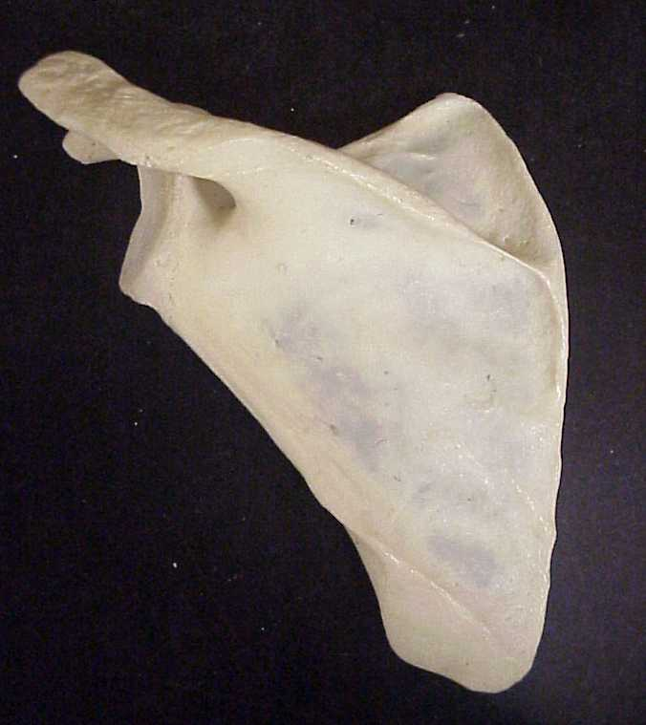
Scapula: Posterior View Spine
‹#›

Slide 4
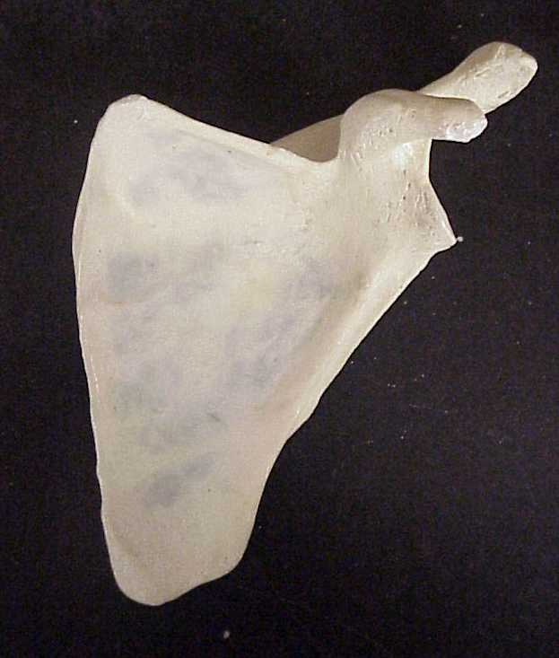
Scapula: Anterior View Borders
Superior Boarder
Medial Boarder (vertebral)
Lateral Boarder (axillary)
‹#›

Slide 5
Scapula: Posterior View Angles
Superior Angle
Inferior Angle
Lateral Angle
‹#›

Slide 6
Scapula: Posterior View Acromion or Acromial Process
‹#›

Slide 7
Scapula: Anterior View Coracoid Process
‹#›

Slide 8
Scapula: Posterior View Supraspinous Fossa
‹#›

Slide 9
Scapula: Posterior View Infraspinous Fossa
‹#›

Slide 10
Scapula: Anterior View Subscapular Fossa
‹#›

Slide 11
Scapula: Lateral View (Fig A) Glenoid Fossa or Cavity
Figure A
Figure B
‹#›

Slide 12
Scapula: Anterior View Scapular Notch
‹#›

Slide 13
Clavicle
‹#›

Slide 14
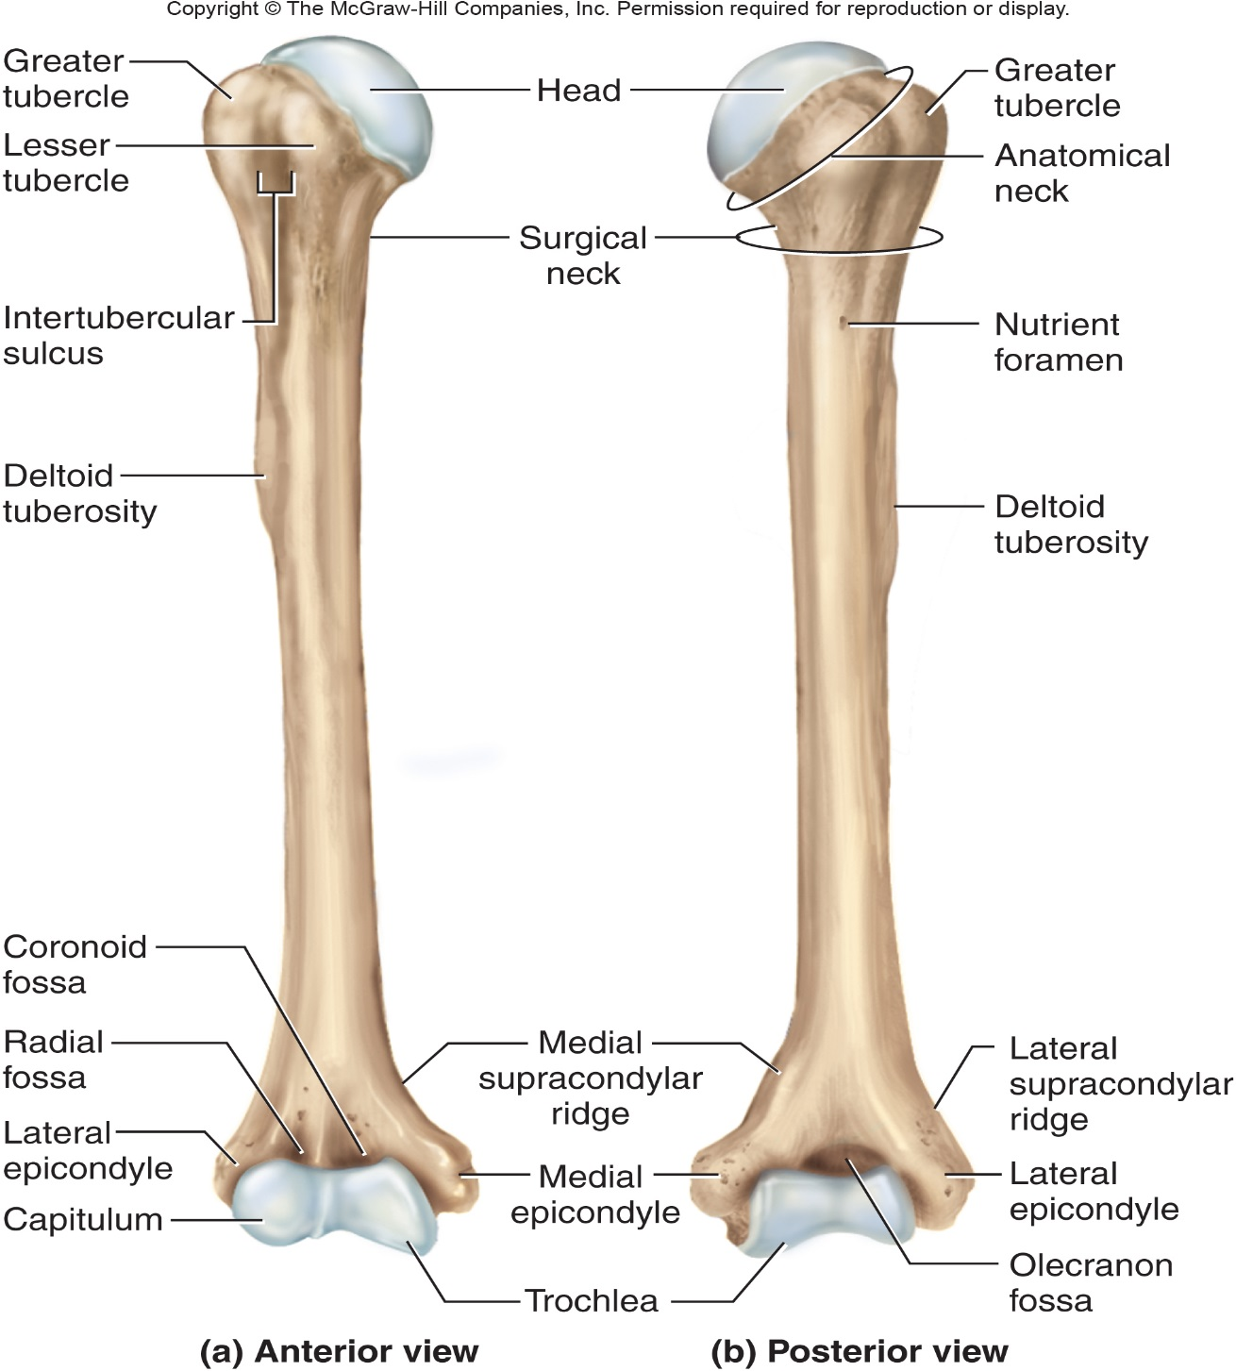
Humerus
‹#›

Slide 15
Humerus: Proximal End
Greater tubercle
Lesser tubercle
Head: above the epiphyseal line
Anatomical Neck
Surgical neck
Intertubercular groove
Anterior Medial Posterior
‹#›

Slide 16
Humerus: Deltoid Tuberosity
‹#›

Slide 17
Humerus: Distal End Trochlea
Anterior
Posterior
Anterior
Posterior
‹#›

Slide 18
Humerus: Distal End Capitulum
Anterior
Posterior
Anterior
Posterior
‹#›

Slide 19
Humerus: Distal End Olecranon Fossa
Anterior
Posterior
Anterior
Posterior
‹#›

Slide 20
Humerus: Distal End Medial Epicondyle
Anterior
Posterior
Anterior
Posterior
‹#›

Slide 21
Humerus: Distal End Lateral Epicondyle
Anterior
Posterior
Anterior
Posterior
‹#›

Slide 22
Humerus: Distal End Radial Fossa
Anterior
Posterior
Anterior
Posterior
‹#›

Slide 23
Humerus: Distal End Coronoid Fossa
Anterior
Posterior
Anterior
Posterior
‹#›

Slide 24
Humerus: Distal End/Anterior
Medial Supracondylar Ridge
Lateral Supracondylar Ridge
Coronoid Fossa
Radial fossa
Lateral Epicondyle
Medial Epicondyle
Capitulum
Trochlea
‹#›

Slide 25
Humerus: Distal End/Posterior
Olecranon Fossa
Medial Epicondyle
Lateral Epicondyle
Trochlea
‹#›

Slide 26
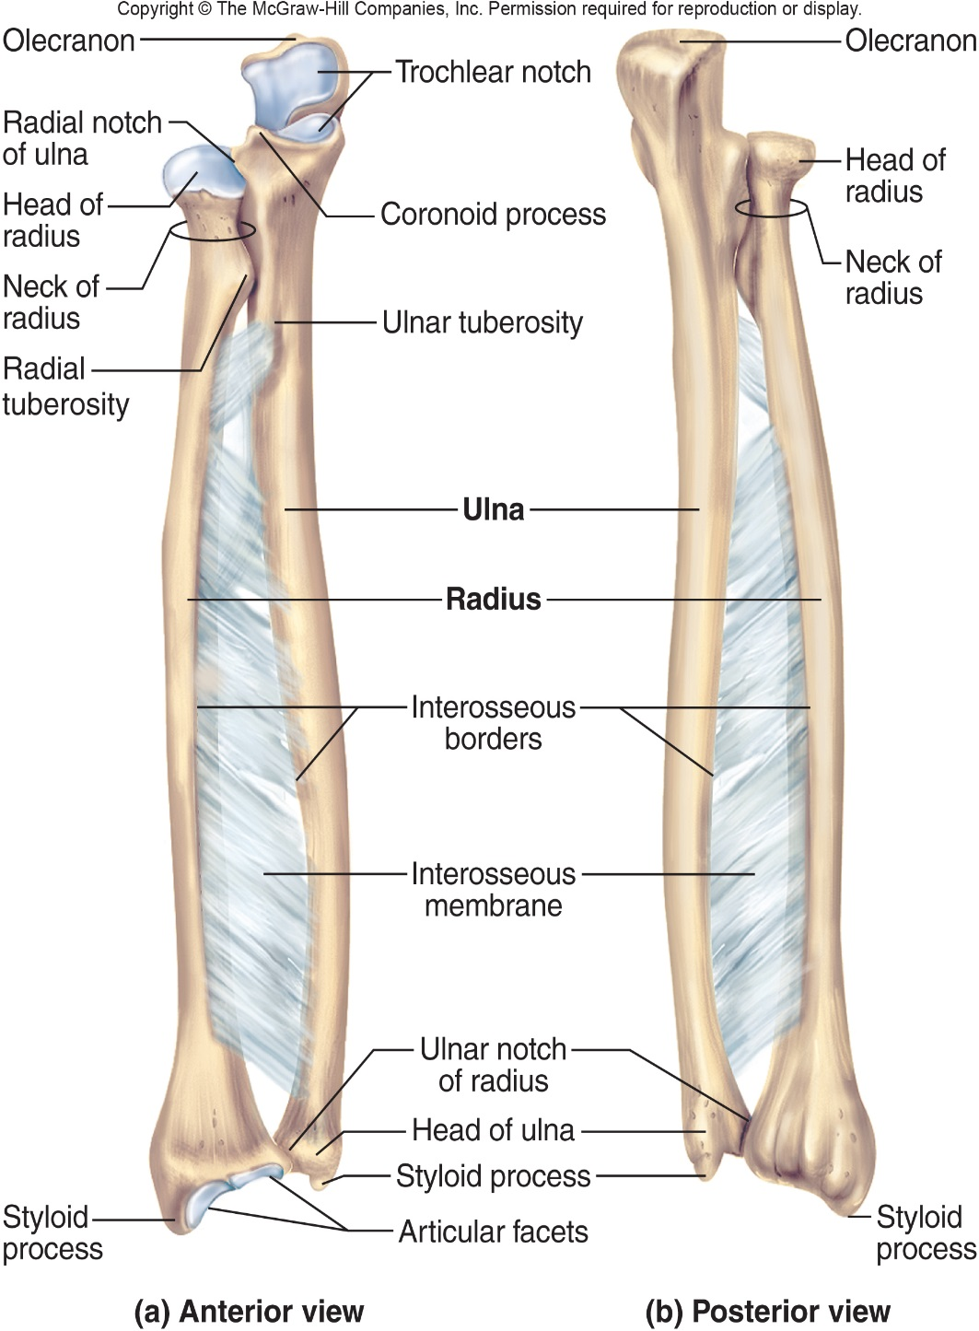
Radius
“Rotates”
Lateral bone of forearm
‹#›

Slide 27
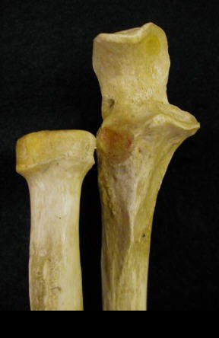
Radius: Head
Radius
Ulna
‹#›

Slide 28
Radius: Radial Tuberosity
Ulna
Radius
‹#›

Slide 29
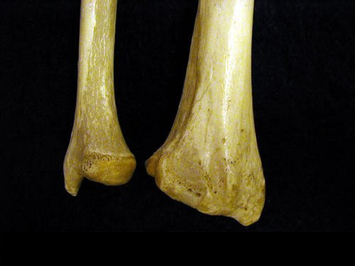
Radius: Ulnar Notch of the Radius
Ulna
Radius
‹#›

Slide 30
Radius: Interosseous Ridge
Ulna
Radius
‹#›

Slide 31
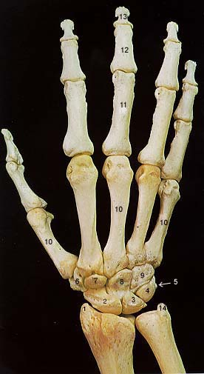
Radius: Styloid Process
Ulna
Radius
‹#›

Slide 32
Radius
Distal
Anterior
Proximal
Radial
Tuberosity
Radial
Head
Ulnar Notch
Interosseous ridge
Styloid process
Posterior
‹#›

Slide 33
Ulna: Distal End Head
Radius
Ulna
‹#›

Slide 34
Ulna: Distal End Styloid Process
Radius
Ulna
‹#›

Slide 35
Ulna: Posterior View Olecranon or Olecranon Process
‹#›

Slide 36
Ulna: Anterior View Coronoid Process
Ulna
Radius
‹#›

Slide 37
Ulna: Trochlear Notch
‹#›

Slide 38
Ulna: Anterior View Radial Notch of the Ulna
Ulna
Radius
‹#›

Slide 39
Ulna: Interosseous Ridge
‹#›

Slide 40
Ulna: Ulnar Tuberosity
‹#›

Slide 41
Ulna
Supinator Crest
Olecranon
Lateral
Interosseous ridge
Trochlear
Notch
Styloid
Process
Head
Coranoid Process
Anterior
‹#›

Slide 42
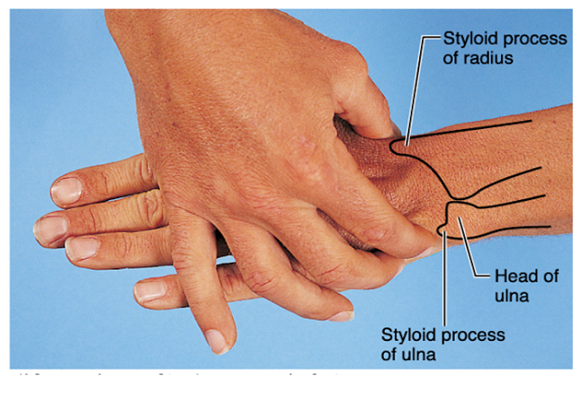

Slide 44
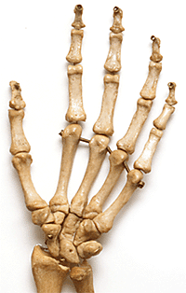
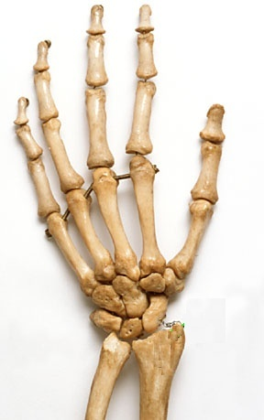
Carpals Form the Wrist
Distal Row
Proximal Row
Palm View
Dorsal View
‹#›

Slide 45
Wrist Carpals: Scaphoid
Dorsal View
Palm View
‹#›

Slide 46
Wrist Carpals: Lunate
Palm View
Dorsal View
‹#›

Slide 47
Wrist Carpals: Triquetrum
Palm View
Dorsal View
‹#›

Slide 48
Wrist Carpals: Pisiform
Palm View
‹#›

Slide 49
Wrist Carpals: Trapezium
Dorsal View
Palm View
‹#›

Slide 50
Wrist Carpals: Trapezoid
Dorsal View
Palm View
‹#›

Slide 51
Wrist Carpals: Capitate
Dorsal View
Palm View
‹#›

Slide 52
Wrist Carpals: Hamate
Dorsal View
Palm View
‹#›

Slide 53
Palm of Hand: Metacarpals 1 - 5
2
3
4
1
Palm View
5
‹#›

Slide 54
Distal Phalanges
Phalanges form fingers.
Numbered lateral to medial beginning with pollicis.
Total of 14
Proximal, middle, and distal
Exception: pollicis consists only of proximal and distal phalanges.
‹#›

Slide 55
Middle Phalanges
‹#›

Slide 56
Proximal Phalanges
‹#›

Slide 57
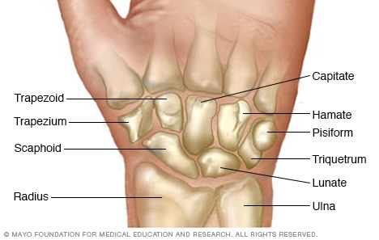

Slide 58
Pelvic Girdle and Lower Extremity
Hip extends from superior margin of coxal (os coxae or hipbone) bone to hip joint.
Contains pelvic girdle – ring of bone formed by coxal bones.
Articulate at pubic symphysis anteriorly and sacrum posteriorly.
‹#›

Slide 59
Pelvic Girdle: Hipbones Os Coxae
Ilium
Pubic Bone
Ishium
‹#›

Slide 60
Ilium: Iliac Crest
Anterior view Posterior View
‹#›

Slide 61
Ilium: Anterior View Anterior Superior Iliac Spine
‹#›

Slide 62
Ilium: Anterior View Anterior Inferior Iliac Spine
‹#›

Slide 63
Ilium: Posterior View Posterior Superior Iliac Spine
‹#›

Slide 64
Ilium: Posterior View Posterior Inferior Iliac Spine
‹#›

Slide 65
Ilium: Posterior View Greater Sciatic Notch
‹#›

Slide 66
Ilium: Anterior View Iliac Fossa
‹#›

Slide 67
Ilium: Lateral View Body of the Ilium
‹#›

Slide 68
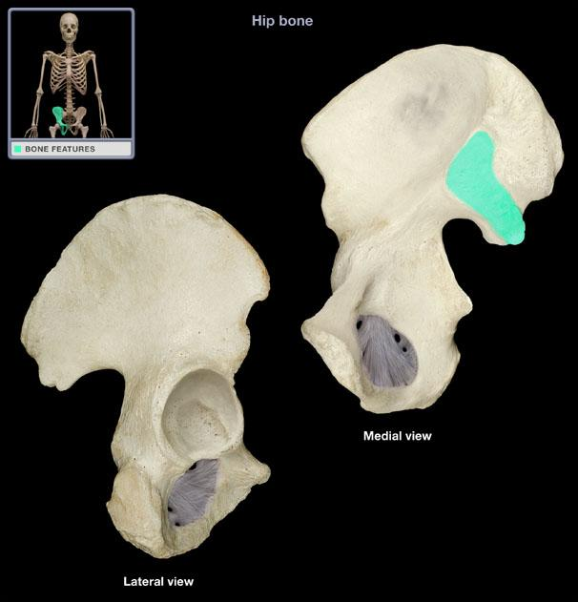
Ilium: Medial View Auricular Surface (articulates with sacrum)
‹#›

Slide 69
Ilium: Anterior View Sacroiliac Joint
‹#›

Slide 70
Ilium: Medial View Arcuate Line
‹#›

Slide 71
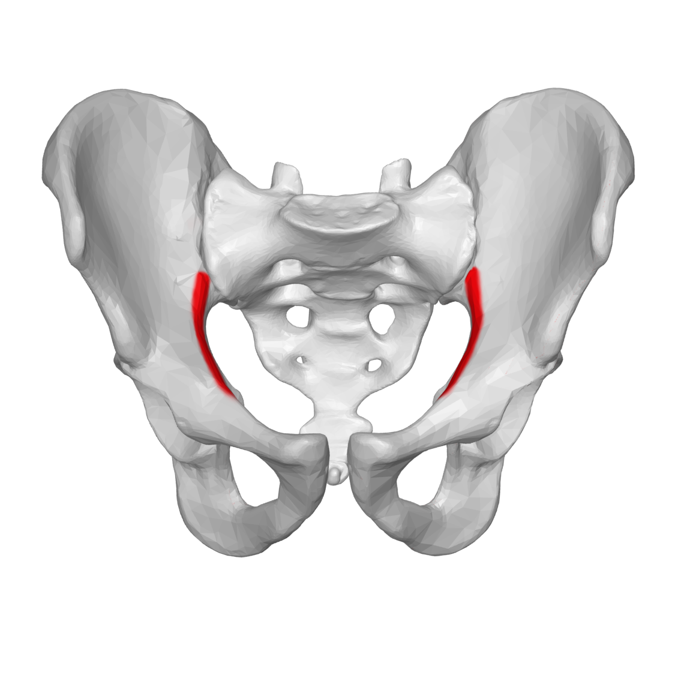

Slide 72
Ischium: Posterior View Ischial Tuberosity
‹#›

Slide 73
Ischium: Posterior and Lateral Views Ischial Spine
‹#›

Slide 74
Ischium: Lateral View Body of the Ischium
‹#›

Slide 75
Ischium: Anterior View Ischial Ramus
‹#›

Slide 76
Ischium: Lateral View Lesser Sciatic Notch
‹#›

Slide 77
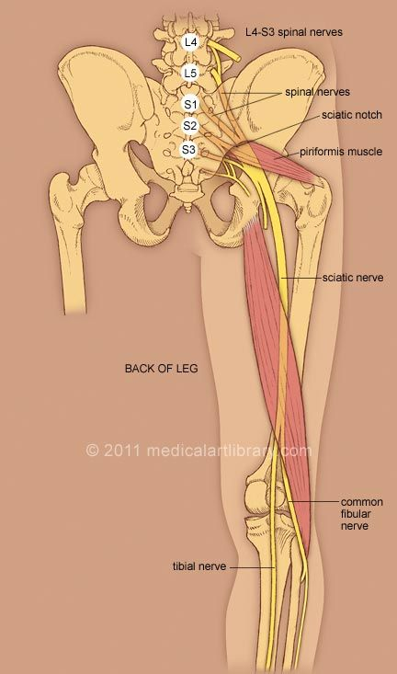
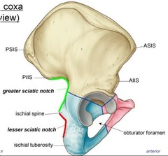

Slide 78
Pubic Bone: Anterior View Pubic Crest
‹#›

Slide 79
Pubic Bone: Anterior View Body of the Pubis
‹#›

Slide 80
Pubic Bone: Anterior View Pubic Symphysis (Fibrocartilage)
‹#›

Slide 81
Pubic Bone: Lateral View Superior Ramus
‹#›

Slide 82
Pubic Bone: Lateral View Inferior Ramus
‹#›

Slide 83
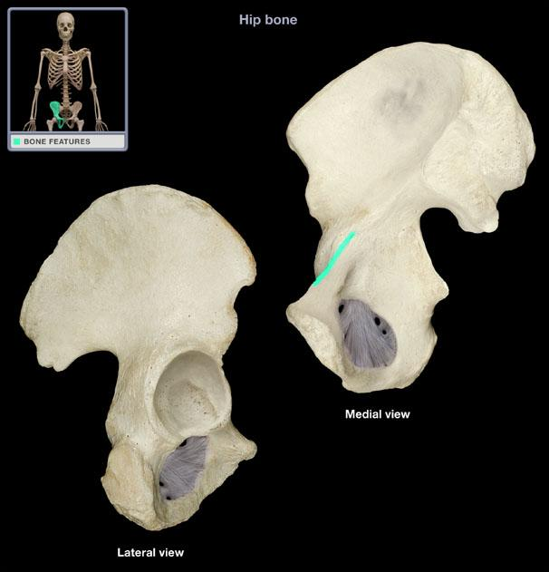
Pubic Bone: Medial View Pectineal line
‹#›

Slide 84
Pubic Bone: Anterior View Pubic Tubercle
‹#›

Slide 85
Pubic Bones: Anterior View Pubic Arch and Angle
Arch formed by the inferior rami of pubic bones.
Angle where they converge is the subpubic angle (pubic angle).
‹#›

Slide 86
Other regions: Obturator Foramen
‹#›

Slide 87
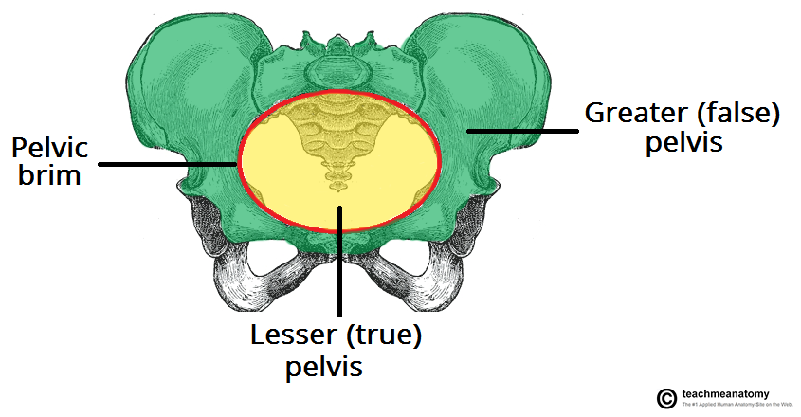
Other Regions: Pelvic Brim, Greater and Lesser Pelvis
‹#›

Slide 88
Other Regions: Acetabulum
‹#›

Slide 89
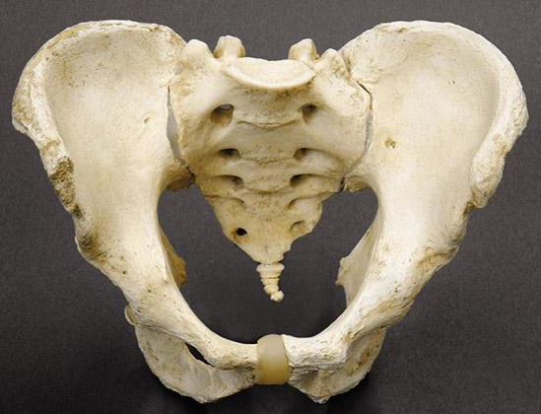
Male Pelvis
Vertical iliac bones
Subpubic arch <90°
Deep iliac fossa
Heart shaped pelvic brim (inlet)
<90°
‹#›

Slide 90
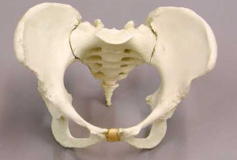
Female Pelvis
Less vertical iliac bones
Subpubic arch >90°
Round shaped pelvic brim (inlet)
>90°
‹#›

Slide 91
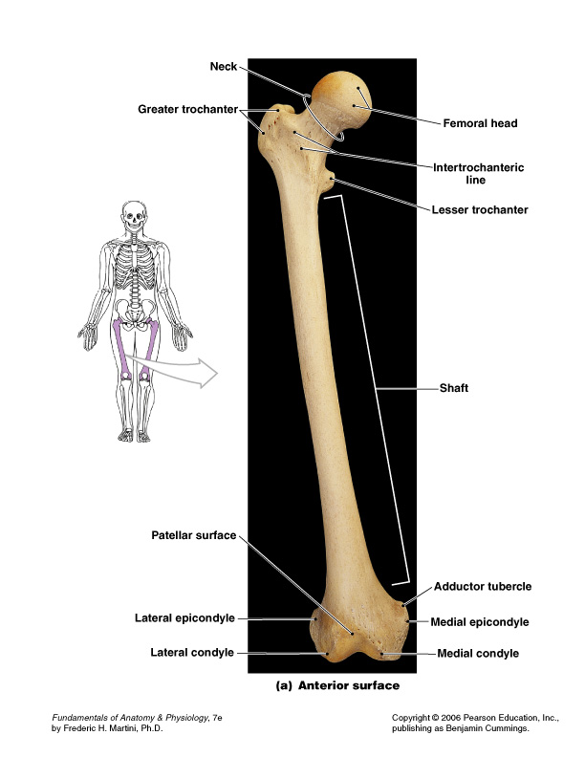
Femur: Anterior View
‹#›

Slide 92
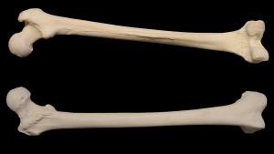
Femur: Anterior and Posterior Views Head of Femur
Posterior view
Anterior view
‹#›

Slide 93
Femur: Anterior and Posterior Views Greater Trochanter
Posterior view
Anterior view
‹#›

Slide 94
Femur: Anterior and Posterior Views Lesser Trochanter
Posterior view
Anterior view
‹#›

Slide 95
Femur: Anterior and Posterior Views Neck of Femur
Posterior view
Anterior view
‹#›

Slide 96
Femur: Anterior and Posterior Views Intertrochanteric Crest and Line
Intertrochanteric crest
Posterior view
Intertrochanteric line
Anterior view
‹#›

Slide 97
Femur: Posterior View Linea Aspera
Posterior view
‹#›

Slide 98
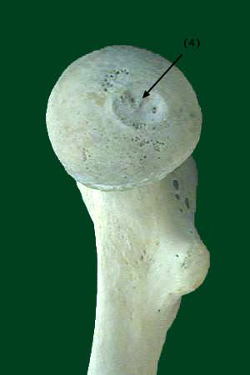
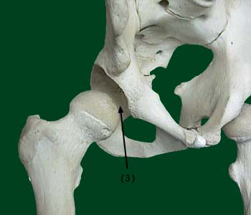
Head of Femur: Fovea Capitus
‹#›

Slide 99
Posterior Femur: Medial Condyle
Posterior view
Anterior view
‹#›

Slide 100
Posterior Femur: Lateral Condyle
Posterior view
Anterior view
‹#›

Slide 101
Femur: Proximal to Medial Epicondyle Adductor Tubercle
Posterior view
Anterior view
‹#›

Slide 102
Femur: Medial Epicondyle
Posterior view
Anterior view
‹#›

Slide 103
Femur: Lateral Epicondyle
Posterior view
Anterior view
‹#›

Slide 104
Anterior Femur: Patellar Surface
Anterior view
‹#›

Slide 105
Posterior Femur: Intercondylar Notch or Fossa
Posterior view
‹#›

Slide 106
Tibia: Anterior View Medial Bone of Leg
‹#›

Slide 107
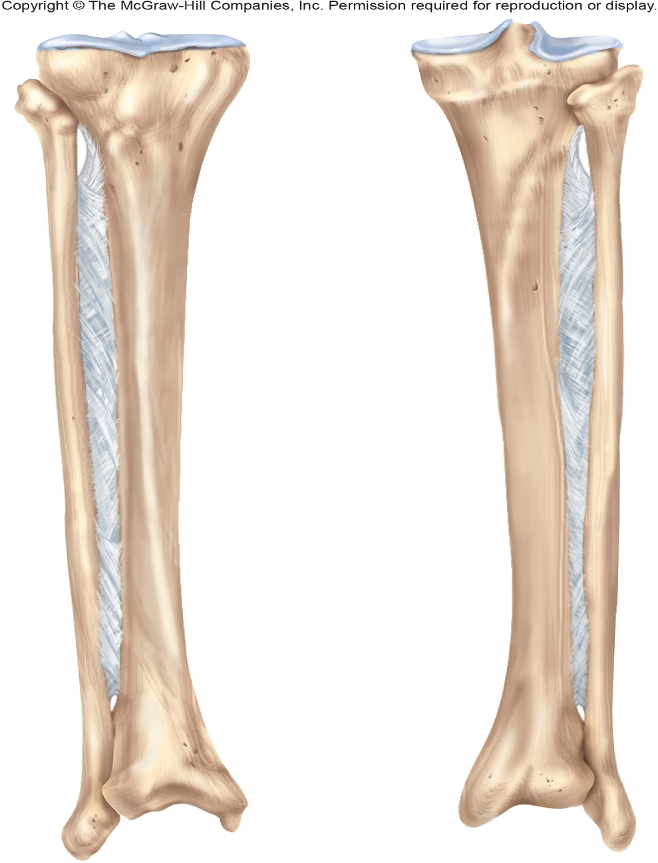
Tibia: Medial Condyle
Anterior View
Posterior View
‹#›

Slide 108
Tibia: Lateral Condyle
Anterior View
Posterior View
‹#›

Slide 109
Tibia: Intercondylar Eminence
Anterior View
Posterior View
‹#›

Slide 110
Tibia: Tibial Tuberosity
Anterior View
Posterior View
‹#›

Slide 111
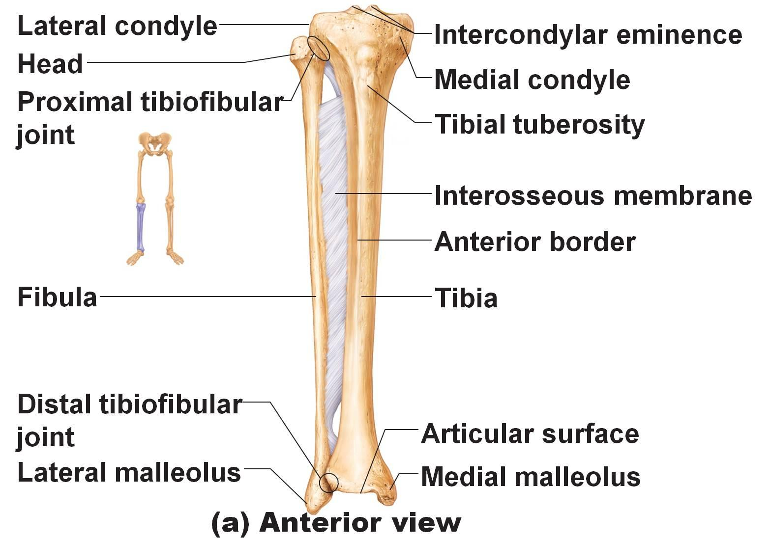
Tibia: Anterior View Fibular Surface of the Tibia
Articular facet on inferolateral aspect of lateral condyle.
Head of fibula articulates here with tibia.
‹#›

Slide 112
Tibia: Medial Malleolus
Anterior View
Posterior View
‹#›

Slide 113
Tibia: Anterior Crest
Anterior View
Posterior View
‹#›

Slide 114
Tibia: Posterior View Fibular Notch
Depression on lateral surface of distal tibia.
Where malleolus of fibula articulates.
Fibular Notch
‹#›

Slide 115
Fibula: Anterior View Lateral Bone of Leg
‹#›

Slide 116
Fibula: Head with Styloid Process (Apex)
Styloid Process
Head
Anterior View
Posterior View
‹#›

Slide 117
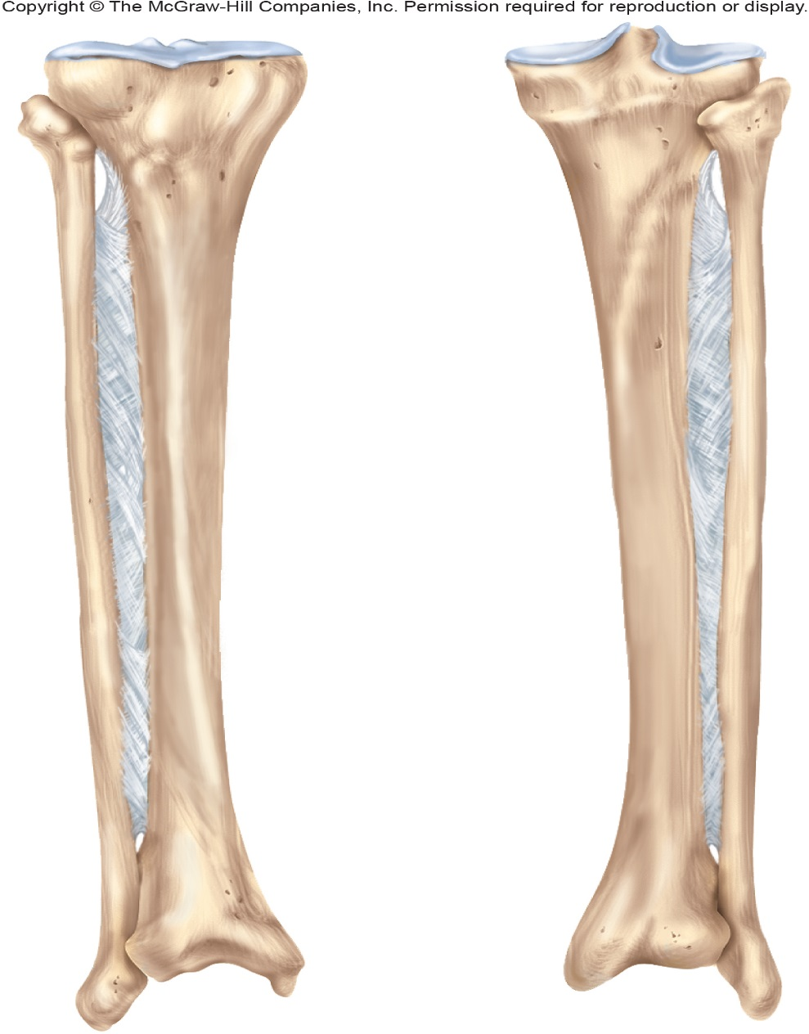
Fibula: Distal Lateral Malleolus
Anterior View
Posterior View
‹#›

Slide 118
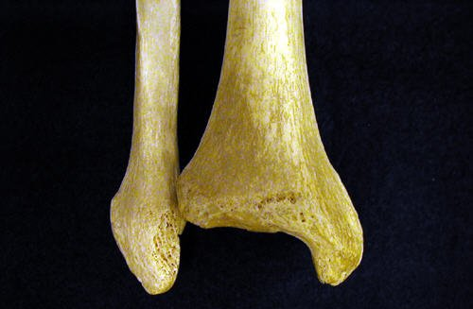
Fibula: Distal Medial Surface Fibular Articular Surface for Talus
‹#›

Slide 119
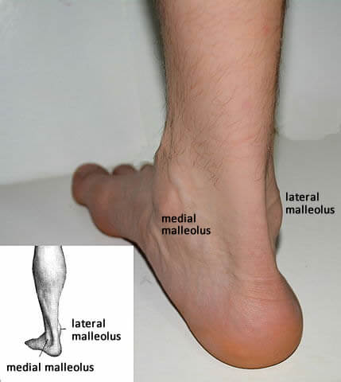

Slide 120
Patella: Medial Facet (articular surface) Articulates with Medial Condyle of Femur
Anterior View
Posterior View
‹#›

Slide 121
Patella: Lateral Facet (articular surface) Articulates with Lateral Condyle of Femur
Anterior View
Posterior View
‹#›

Slide 122
Ankle and Foot
‹#›

Slide 123
Tarsal: Talus
Superior View
Medial View
‹#›

Slide 124
Tarsal: Calcaneus
Superior View
Medial View
‹#›

Slide 125
Tarsal: Navicular
Superior View
Medial View
‹#›

Slide 126
Tarsal: Cuboid
Superior View
‹#›

Slide 127
Tarsal: Cuneiforms
Lateral
Intermediate
Medial
Referenced numerically or by name.
1
2
3
‹#›

Slide 128
Foot: Metatarsals 1-5
5
4
3
2
1
‹#›

Slide 129
Foot: Phalanges Proximal, Middle, and Distal
‹#›

Slide 130
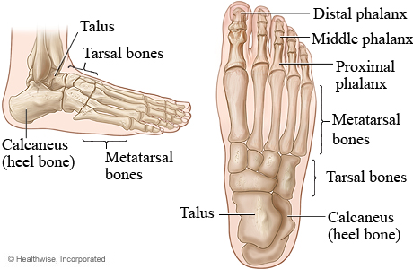

Slide 131
Supportive Structure of Knee Joint
Anterior Cruciate Ligament (ACL)
Posterior Cruciate Ligament (PCL)
Medial Meniscus
Lateral Meniscus
Quadriceps Tendon
Patellar Ligament
‹#›

Slide 132
Knee: Extracapsular Ligaments Medial and Lateral Collateral
AKA: Tibial and Fibular Collateral Ligaments
‹#›

Slide 133
Knee: Intracapsular Ligaments Anterior and Posterior Cruciate
‹#›

Slide 134
Knee: Meniscus Medial and Lateral Menisci
‹#›

Slide 135
Knee: Extracapsular Quadriceps Tendon & Patellar Ligament
‹#›

Slide 136
‹#›

Slide 137
References
Marieb, E. N. (2012). Essentials of human anatomy & physiology
(6th ed.). Boston: Pearson Education, Inc.
Marieb, E.N., Mitchell, S.J. & Smith, L.A. (2012). Human anatomy and physiology laboratory manual (10th ed.). Boston: Pearson Education, Inc.
Martini, F., Nath, J. & Bartholomew, E.F. (2012). Fundamentals of anatomy & physiology (9th ed.). Boston: Pearson Education, Inc.
McPhee, J. & Papadakis, M. (2012) Current medical diagnosis & treatment (51st ed.). New York: McGraw Hill.
Patton, T. & Thibodeau, G. (2013). Anatomy & physiology (8th ed.).
St. Louis:Mosby Elsevier.
Saladin, K. S. (2012). Anatomy & physiology: The unity of form and function (6th ed.). New York: McGraw Hill.
Tortora, G.J. & Derrickson, B.H. (2012). Principles of anatomy and physiology (13th ed.). Hoboken, NJ: Wiley
‹#›

