Slide 1
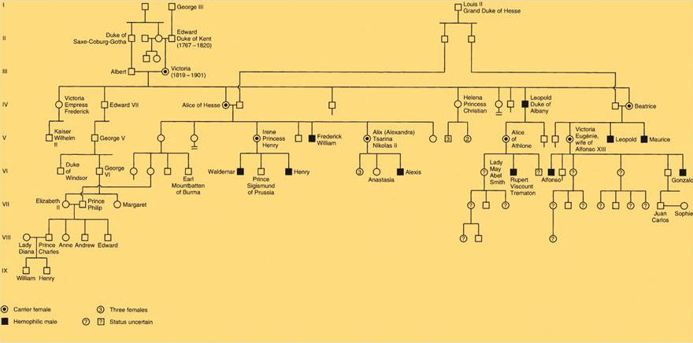
Pedigrees
Geneticists use charts called pedigrees to display family relationships and to follow which relatives have specific phenotypes and, sometimes genotypes.
They help keep tract of relationships and traits.
Important for helping families identify the risk of transmitting an inherited illness
Queen Victoria’s Pedigree

Slide 2
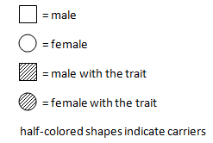
Pedigree Key
Dominant or Recessive
Autosomal or X-linked

Slide 3
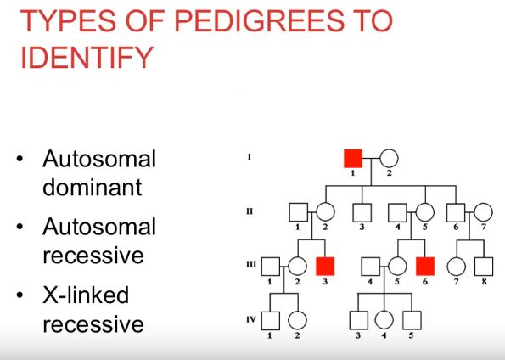

Slide 4
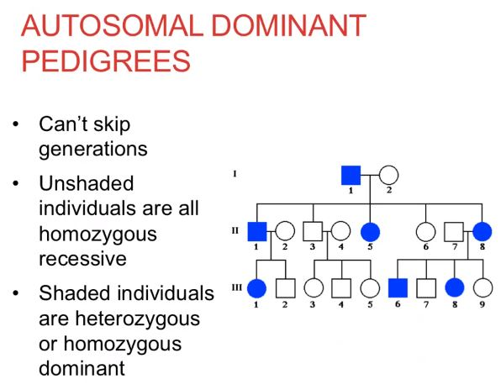
Affected parents can have unaffected children

Slide 5
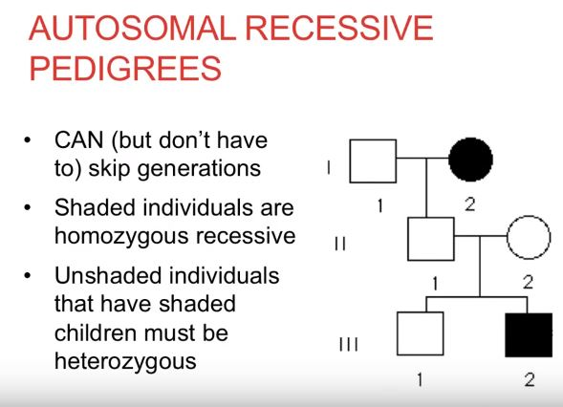
Unaffected parents can have affected children

Slide 6
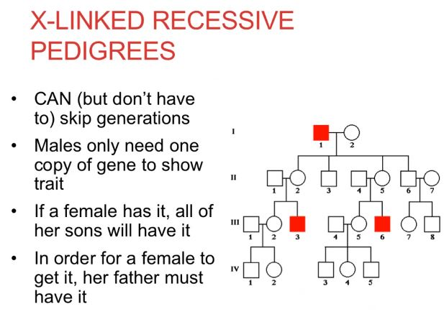

Slide 7
X Linked Dominant
All daughters of affected father will be affected
Cannot transfer father to son

Slide 8
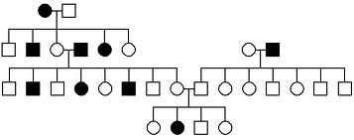
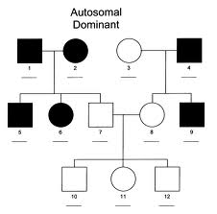
Pedigree Examples
Albinism: autosomal recessive
Autosomal dominance

Slide 9
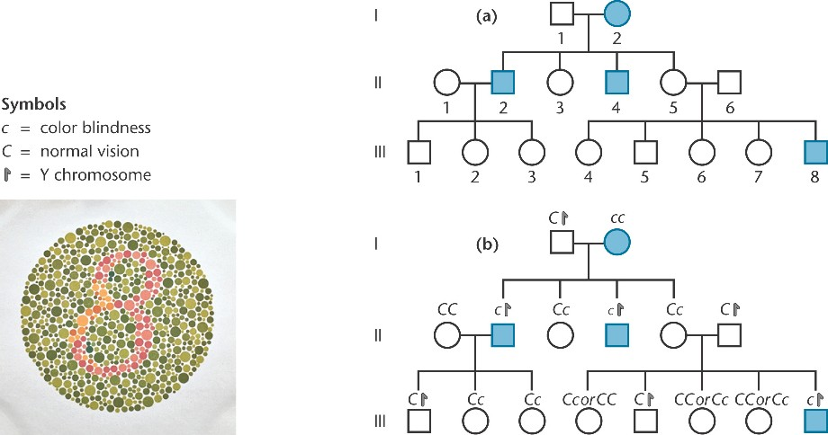
Red-Green Color Blindness
X linked recessive

