Slide 1
BI 233 Laboratory Urinalysis
Notes:
Saladin A&P: The Unity of Form and Function 6e

Slide 2
Three Basics Processes of Urine Formation
Filtration
Blood pressure forces water/solutes across capillaries.
Small enough solutes pass through.
Filtrate – fluid pushed out consisting of everything except blood cells and large proteins.
Reabsorption
Removal of water and solutes (glucose, amino acids and various ions) from filtrate.
Returned to blood by passing from renal tubules to peritubular capillaries or vasa recta.
Secretion
Backup process for filtration.
Unwanted substances are removed from blood and enter renal tubule.
Metabolic wastes, drugs and excess ions (H⁺, K⁺).
Most occurs in DCT and collecting ducts.
Notes:
Retrieved from https://physproject-2011.wikispaces.com/file/view/12-18-2010_4%3B51%3B47_PM.JPG/189139043/720x208/12-18-2010_4%3B51%3B47_PM.JPG, 2016

Slide 3
Goal of Urine Production
Maintain homeostasis by...
Regulating volume and composition of blood.
Excretion of metabolic waste products.
Notes:
Retrieved from http://img.youtube.com/vi/Wa5MrT3yY-I/0.jpg, 2016

Slide 4
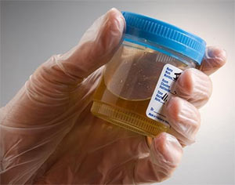
Composition and Urinalysis
Chemical composition: 95% water, 5% solutes
Normal
Urea, NaCl, KCl, creatinine, uric acid, phosphates, sulfates, traces of calcium, magnesium, and sometimes bicarbonate, urochrome, and a trace of bilirubin
Abnormal
Glucose, free hemoglobin, albumin, ketones, bile pigments
Normal volume for average adult = 1 - 2 L/day (0.7-1.4ml/min)
Polyuria = ˃ 2 L/day (diabetes mellitus)
Oliguria = ˂ 500 mL/day (diabetes insipidus)
Anuria = 0 to 100 mL/day
Notes:
Anuria:
Low output from kidney disease, dehydration, circulatory shock, prostate enlargement
Low urine output of less than 400 mL/day, the body cannot maintain a safe, low concentration of waste in the plasma
Retrieved from http://www.premiermedicalhv.com/wp-content/uploads/2012/06/pu.jpg, 2016

Slide 5
Composition of Normal Urine
Notes:
Martini Fundamentals of A&P 9e

Slide 6
Universal precautions
You will be examining the physical and chemical characteristics of your own urine sample.
Work with your urine only.
Wear gloves, safety eyewear, and a mask.
Clean spills with 10% bleach solution.
Anything that comes into contact with urine goes into an autoclave bag.
Notes:
Retrieved from http://image.slidesharecdn.com/universal-safetyhealth-precautions-140118210432-phpapp01/95/universal-safety-precautions-3-638.jpg?cb=1390079164, 2016

Slide 7
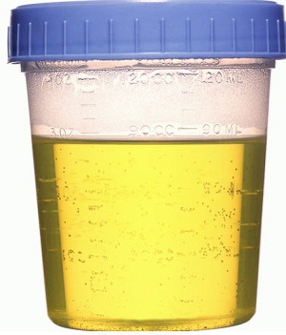
Physical Characteristics of Urine: Color, Transparency, and Odor
Normal: clear, pale to deep yellow due to urochrome.
Breakdown product of hemoglobin related to bile pigments.
Concentrated urine has a deeper yellow/amber color.
Abnormal: red or red-brown color
Food dye, eating fresh beets, certain drugs, presence hemoglobin or myoglobin.
Sample containing many red blood cells would be cloudy as well as red.
Turbidity or cloudiness may be caused by excessive cellular material or protein in urine.
Odor
Fresh urine – slightly aromatic.
Standing urine – develops an ammonia odor.
Some drugs and vegetables – asparagus alter usual odor.
Elevated ketones – fruity or acetone-like.
Notes:
Retrieved from https://store.donanimhaber.com/7b/2e/cd/7b2ecde598f552cf9385c490b0a627bd.jpg, 2016

Slide 8
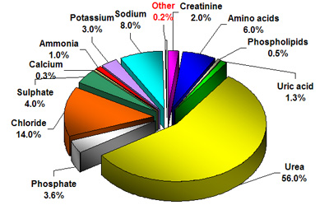
Chemical Composition of Urine
95% water and 5% solutes.
Nitrogenous wastes – include urea, uric acid, and creatinine.
Other normal solutes include…
Sodium, potassium, phosphate, and sulfate ions.
Calcium, magnesium, and bicarbonate ions.
Abnormally high concentrations of any urinary constituents may indicate pathology.
Notes:
Retrieved from http://www.chromedia.org/dchro/gfx/ZokxzhcIC.jpeg, 2016

Slide 9
Chemical Analysis: Role of Nitrogenous Wastes
Urea
End product of protein breakdown.
Proteins → Amino acids →NH₂ removed → Ammonia → Urea
Uric acid
Nucleic acid catabolism.
Metabolite of purine breakdown.
Hyperuricemia can cause kidney stones or lead to an inflammatory joint condition called gout
Creatinine
Associated with muscle metabolism.
Creatine phosphate catabolism.
Can only be eliminated when dissolved in urine.
Removal involves unavoidable water loss.
Notes:
Saladin A&P Unity of Form and Function 6e

Slide 10
Physical Characteristics of Urine: Specific Gravity
Measures density of urine compared to water.
Ranges from 1.001 to 1.035 (accuracy lab: 1.040, ten oh one, ten thirty five)
1.001 is dilute. (1.000=water)
1.035 is concentrated.
Dependent on solute concentration.
> 1.035
Contaminated or contains very high levels of glucose.
Low water intake.
Notes:
Specific gravity image retrieved from http://3.bp.blogspot.com/-iy4E3s8MXxM/TbtS6VXaEwI/AAAAAAAAACo/fnW7DuRlyPM/s1600/Specific+Gravity+blogge2.jpg, 2016
Specific gravity instrument image retrieved from http://www.phartoonz.com/wp-content/uploads/2010/10/urinometer_urine_specific_gravity.jpg, 2016

Slide 11
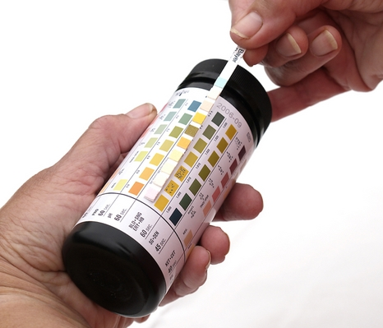
Urinalysis: Dipstick Method
A test using a small, chemically treated strip that is dipped into a urine sample.
Chemical reaction changes color on strip
Ten different pads on the test strip…
Leukocytes
Nitrite
Urobilinogen
Protein
pH
Blood
Specific gravity
Ketones
Bilirubin
Glucose
Notes:
Retrieved from http://www.newkidscenter.com/images/10407828/image001.jpg, 2016

Slide 12
Dipstick Urinalysis Interpretation: Leukocytes
Indicates infection or inflammation.
Normal: negative
Abnormal:
Pyuria: Leukocytes in urine.
Cystitis: Bladder infection.
Pyelonephritis: Kidney infection.
Notes:
Retrieved from http://learn.parallax.com/sites/default/files/content/Reference/Urinalysis/Multistix-Urinalysis-Color-Key.png, 2016.

Slide 13
Dipstick Urinalysis Interpretation: Nitrite
May indicate bacterial infection with gram-negative rods (E. coli)
When present, bacteria convert nitrates to nitrites.
Normal: negative
Notes:
Retrieved from http://learn.parallax.com/sites/default/files/content/Reference/Urinalysis/Multistix-Urinalysis-Color-Key.png, 2016.

Slide 14
Dipstick Urinalysis Interpretation: Urobilinogen
Produced in intestine from bilirubin (heme breakdown)
Gives feces brown color.
Normal: small amount.
Abnormal:
Absence: renal disease or biliary obstruction.
Increase: any condition causing increase in production or retention of bilirubin.
Production – hemolytic anemia
Retention - Hepatitis, cirrhosis or biliary disease.
Notes:
Retrieved from http://learn.parallax.com/sites/default/files/content/Reference/Urinalysis/Multistix-Urinalysis-Color-Key.png, 2016.

Slide 15
Dipstick Urinalysis Interpretation: Protein
Usually proteins are too large to pass through glomerulus.
Normal: negative
Trace amounts normal in pregnancy or after eating a lot of protein.
Abnormal:
Proteinuria – usually represents an abnormality in glomerular filtration barrier.
Albuminuria – albumin in urine.
Notes:
Retrieved from http://learn.parallax.com/sites/default/files/content/Reference/Urinalysis/Multistix-Urinalysis-Color-Key.png, 2016.

Slide 16
Dipstick Urinalysis Interpretation: pH
Recorded though seldom of diagnostic value.
Normal: 4.5 to 8.2 (average is 6.0).
Abnormal: diet can alter pH.
Acidic: high protein diet, ketoacidosis.
Alkaline: vegetarian diet, UTI.
Notes:
Retrieved from http://learn.parallax.com/sites/default/files/content/Reference/Urinalysis/Multistix-Urinalysis-Color-Key.png, 2016.

Slide 17
Dipstick Urinalysis Interpretation: Blood
General indicates pathology because RBC are too large to pass through glomerulus.
Normal: negative
Abnormal:
Hematuria: blood in urine.
Possible causes: kidney stone, infection, tumor.
Caution: very common finding in women because of menstruation (artifact).
Notes:
Retrieved from http://learn.parallax.com/sites/default/files/content/Reference/Urinalysis/Multistix-Urinalysis-Color-Key.png, 2016.

Slide 18
Dipstick Urinalysis Interpretation: Specific Gravity
Dependent on solute concentration.
Normal: 1.001 to 1.035.
1.001 is dilute.
1.035 is concentrated.
Abnormal: > 1.035
Contaminated or contains very high levels of glucose.
Low water intake.
Notes:
Retrieved from http://learn.parallax.com/sites/default/files/content/Reference/Urinalysis/Multistix-Urinalysis-Color-Key.png, 2016.

Slide 19
Dipstick Urinalysis Interpretation: Ketones
Intermediate products of fat metabolism
Urine testing only detects acetoacetic acid.
Other ketones: acetone or beta-hydroxybuteric acid.
Normal: negative or trace amounts
Abnormal:
Ketonuria: ketones in urine.
High Ketonuria and glucose may indicate diabetes mellitus.
Notes:
Retrieved from http://learn.parallax.com/sites/default/files/content/Reference/Urinalysis/Multistix-Urinalysis-Color-Key.png, 2016.

Slide 20
Dipstick Urinalysis Interpretation: Bilirubin
Presence of bilirubin indicates:
Increase production or retention of bilirubin
Production – hemolytic anemia
Retention – Liver disease - hepatitis, cirrhosis or biliary disease.
Normal: small amounts
Abnormal:
Bilirubinuria: excessive appearance of bilirubin in urine.
Yellow foam forms when sample is shaken.
Notes:
Retrieved from http://learn.parallax.com/sites/default/files/content/Reference/Urinalysis/Multistix-Urinalysis-Color-Key.png, 2016.

Slide 21
Dipstick Urinalysis Interpretation: Glucose
Presence of glucose indicates: filtered load of glucose exceeds maximal tubular reabsorptive capacity for glucose.
Normal: negative
Abnormal:
Glycosuria: glucose in urine.
Can occur temporarily after eating a high carb meal or during stress.
Notes:
Retrieved from http://learn.parallax.com/sites/default/files/content/Reference/Urinalysis/Multistix-Urinalysis-Color-Key.png, 2016.

Slide 22
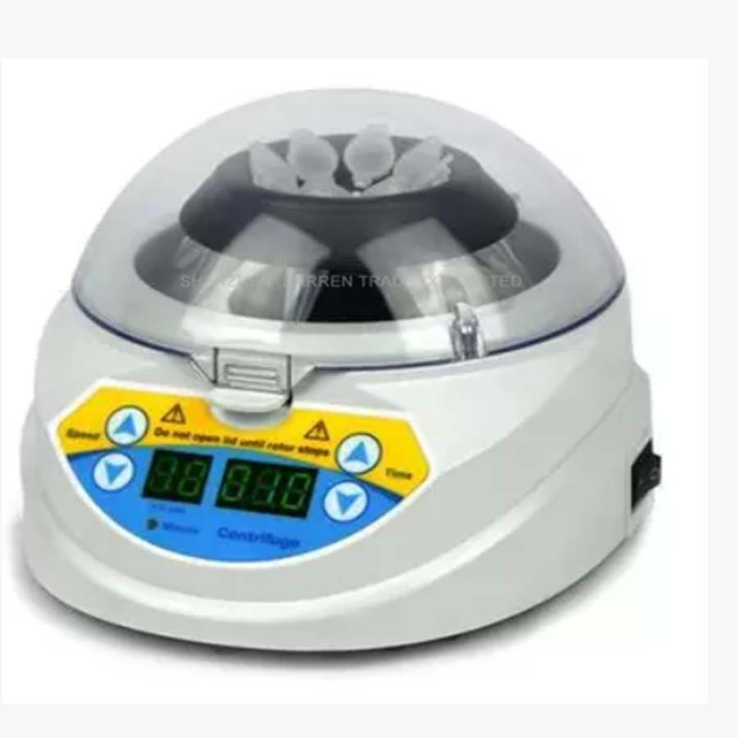
Urine sediments
Centrifuging a urine sample allows for sediment (solid components) to then be examined microscopically.
Some solids are normally found in urine
Notes:
Retrieved from http://g01.a.alicdn.com/kf/HTB1.cR9KVXXXXbvXVXXq6xXFXXXB/Free-ship-by-DHL-Mini-10K-font-b-Centrifug-b-font-for-Handled-Mini-font-b.jpg, 2016

Slide 23
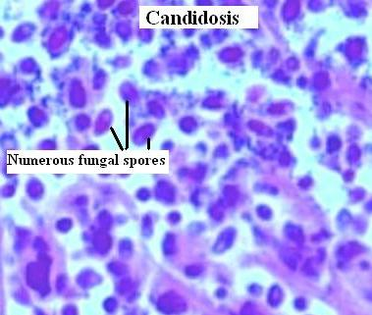
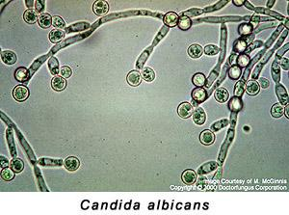
Commonly Found Organisms in Urine
Some organisms commonly found in urine:
Yeast (aka candidiasis) Candida albicans- causes vaginal yeast infections
Trichomonas vaginalis- common protozoan infection
Notes:
Yeast image retrieved from http://www.histopathology-india.net/candida.JPG, 2016
Trichomonas vaginalis retrieved from http://www.medthical.com/uploads/2/3/7/3/23733606/6284560_orig.jpg, 2016
Candida albicans retrieved from http://www.optimalhealthnetwork.com/v/vspfiles/images/ohnresp/candida.jpg, 2016

Slide 24
Sediments
Cells: small numbers of epithelial cells that are shed from various regions of the urinary tract.
Cells of urethra: squamous epithelial cells
Cells of the bladder or ureter: transitional epithelial cells
Large numbers of WBCs and any amount of RBCs are abnormal usually indicate disease.
Notes:
Retrieved from http://cal.vet.upenn.edu/projects/clinlab/diabetes/images/tugur1lb.jpg, 2016

Slide 25
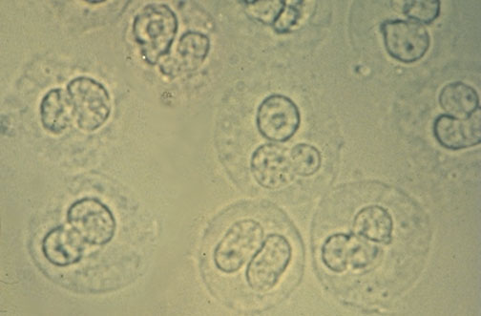
Microscopic Examination: WBC’s
Normal:
Men: <2 WBCs per hi power field
Women: <5
Pyuria = WBC’s in urine.
Presence of inflammatory process along course of urinary tract.
Large numbers of WBCs and any amount of RBCs are abnormal usually indicate disease.
Notes:
Retrieved from http://www.uatest.com/images/URIN064.jpg, 2016

Slide 26
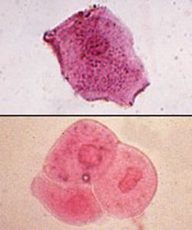
Microscopic Examination: Epithelial Cells
Transitional epithelial cells originate from the renal pelvis, ureters, bladder and/or urethra.
Bladder cancer: large sheets of transitional epithelial cells can be seen.
Excessive large number of squamous cells: suggest contamination, poor specimen collection.
Squamous epithelial cell
Transitional epithelial cell
Notes:
Retrieved from http://www.sridianti.com/wp-content/uploads/2013/07/Sel-Epitel-dalam-Urin.jpg, 2016

Slide 27
Microscopic Examination of Casts
Hardened cell fragments formed in DCT’s and collecting ducts of kidneys.
Form when cells clump together.
Can only be seen with microscopic examination.
Notes:
Retrieved from http://image.slidesharecdn.com/cpc-4-4-1-ren-gn-pathlec-view-091013211218-phpapp02/95/pathology-of-glomerulonephritis-37-728.jpg?cb=1255468487, 2016

Slide 28
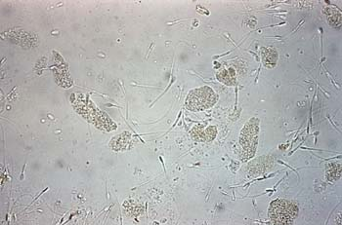
Cellular and Hyaline Casts
White blood cell casts: usually indicates pyelonephritis (kidney infection).
Other causes: interstitial nephritis (inflammation of tubules and spaces between tubules and glomeruli)
Red blood cell casts: usually Indicates glomerulonephritis.
With leakage of RBC's from glomeruli or severe tubular damage.
Hyaline casts: composed primarily of a mucoprotein secreted tubule cells.
Tamm-Horsfall protein
Appear transparent
Causes: low flow rate, high salt concentration, and low pH.
All favor protein denaturation and precipitation of the Tamm-Horsfall protein.
Notes:
Retrieved from http://vet.uga.edu/ivcvm/courses/vpat5215/urinary/nephritis/images/F07126.jpg, 2016

Slide 29
Crystal Cast Histology
Notes:
Retrieved from http://4.bp.blogspot.com/-zh9_IWlNk_I/T4Mz9F9IArI/AAAAAAAABBQ/IP5xJuH3o6s/s1600/kidney+stone+Crystal+Shapes.jpg, 2016

Slide 30
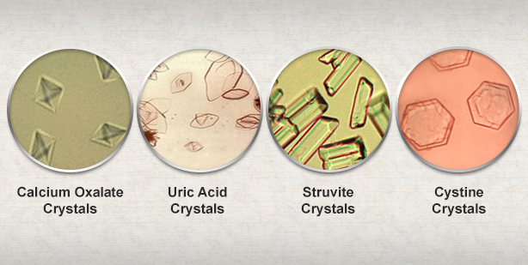
Crystal Casts
Calcium oxalate crystals: occur in urine of any pH.
Causes: Dietary asparagus and ethylene glycol (antifreeze) intoxication.
Uric acid crystals: High uric acid in blood.
By-product of purine digestion/high protein diet.
Causes: Associated with gout (arthritis).
Struvite crystals: formation favored in alkaline urine.
Causes: urinary tract infections (UTI) with urease producing bacteria (e.g. Proteus vulgaris)
Bacteria promote struvite crystals by raising urine pH and increasing free ammonia.
Notes:
Retrieved from http://www.americanhealthcare.co/wp-content/uploads/2015/05/Crystals.png, 2016

Slide 31
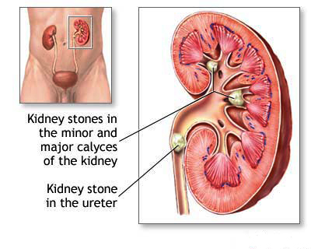
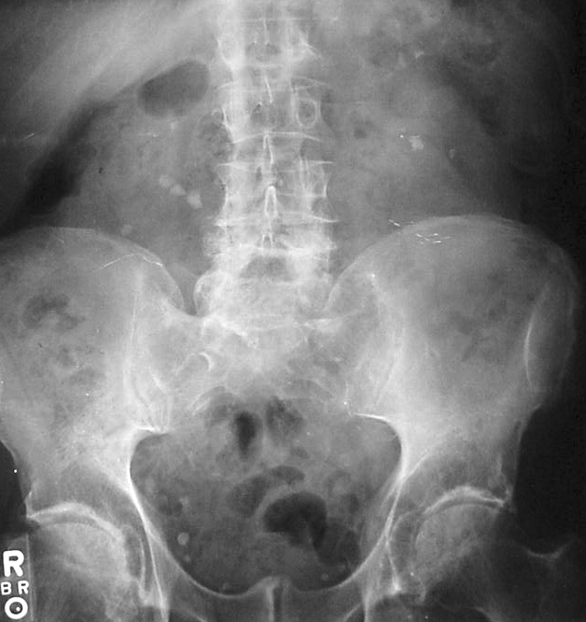
Renal Calculi
AKA: Kidney stones
Causes: mineral, amino acid, or oxidative product deposition in kidneys.
Stones are masses of crystals that fuse and can block ureter.
Notes:
Kidney stone image retrieved from http://www.homoeotricks.com/wp-content/uploads/kidneystone3.jpg, 2016
Abdominal X-Ray image retrieved from https://upload.wikimedia.org/wikipedia/commons/6/66/Kidney_stones_abdominal_X-ray.jpg, 2016

Slide 32
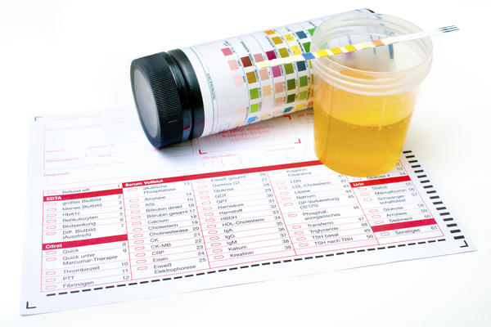
Activities
Perform lab activities and complete all questions (pgs.233-241).
Remember to follow universal precautions.
Effects of fluid intake on urine production and specific gravity (pgs. 233-236).
Microscopic analysis (pg. 236).
Dipstick analysis (pg. 236).
Urinalysis (pg. 241).
Notes:
Retrieved from https://edc2.healthtap.com/ht-staging/user_answer/reference_image/56294/large/476451399.jpeg?1416070930, 2016

Slide 33
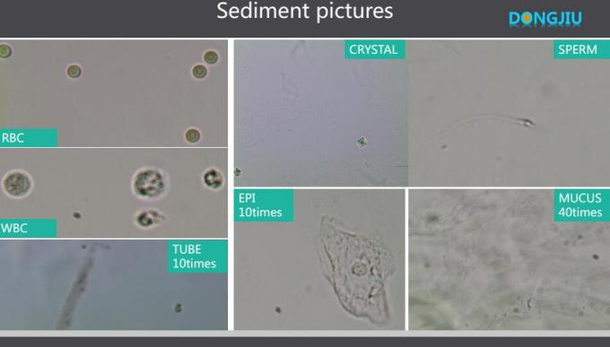

Slide 34
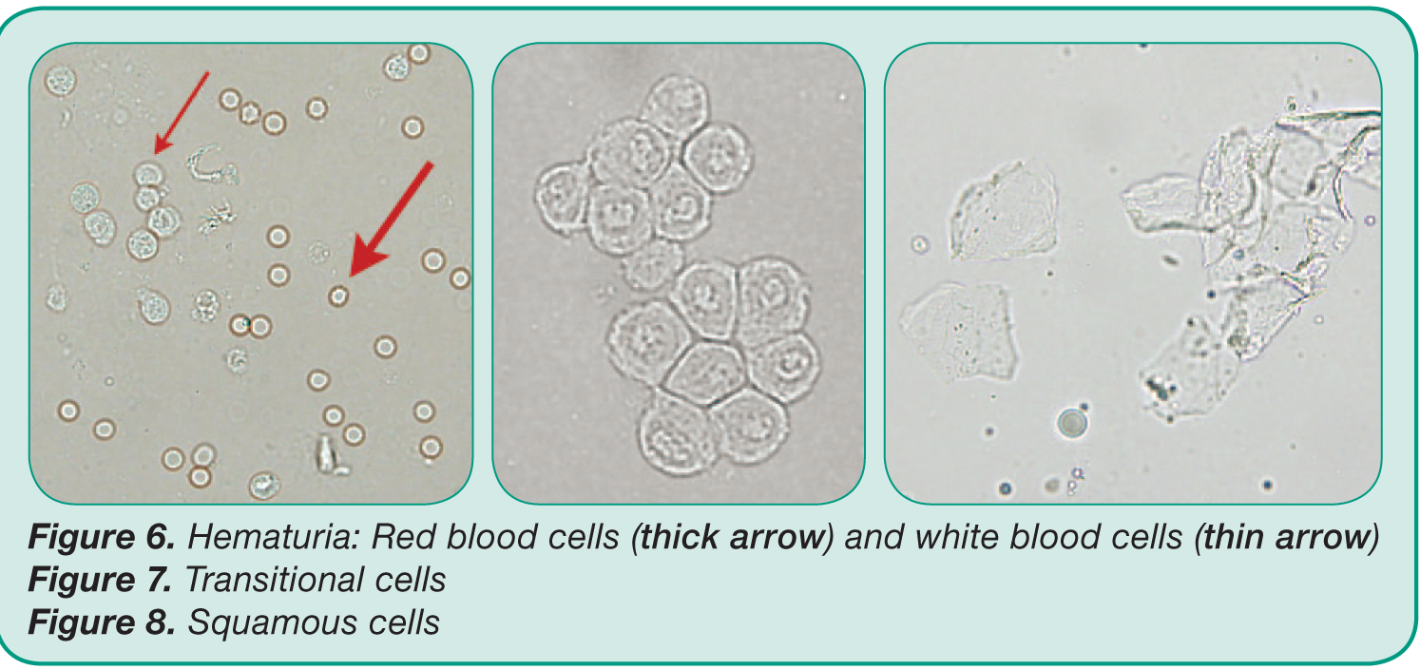

Slide 35
Urinalysis Lab
Everybody urinate
THEN, Students 1, 2 & 3 – drink fluid (timer record time)
Everybody test their urine (time 0)
specific gravity – pipette 2 drops
Dipstick - wet
sediment – spin, dump, one drop urine sed + one drop stain
Students 1, 2 & 3 empty bladder at time 30, 60 and 90 minutes & record
Urine Output – measure volume – graduated cylinders back of room
Urine Concentration – measure specific gravity
While you wait, do questions in survival guide
Written test
Disposal – Disinfectant, Autoclave, Metal Bucket (see key on tables)

Slide 36
References
Marieb, E. N. (2012). Essentials of human anatomy & physiology
(6th ed.). Boston: Pearson Education, Inc.
Marieb, E.N., Mitchell, S.J. & Smith, L.A. (2012). Human anatomy and physiology laboratory manual (10th ed.). Boston: Pearson Education, Inc.
Martini, F., Nath, J. & Bartholomew, E.F. (2012). Fundamentals of anatomy & physiology (9th ed.). Boston: Pearson Education, Inc.
McPhee, J. & Papadakis, M. (2012) Current medical diagnosis & treatment (51st ed.). New York: McGraw Hill.
Patton, T. & Thibodeau, G. (2013). Anatomy & physiology (8th ed.).
St. Louis:Mosby Elsevier.
Saladin, K. S. (2012). Anatomy & physiology: The unity of form and function (6th ed.). New York: McGraw Hill.
Tortora, G.J. & Derrickson, B.H. (2012). Principles of anatomy and physiology (13th ed.). Hoboken, NJ: Wiley

