Slide 1
BI 233 Laboratory Digestive Enzymes
Notes:
Patton A&P 8e

Slide 2
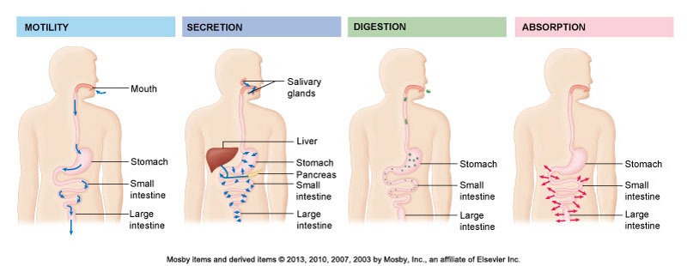
Overview of Digestive Function
Primary function of digestive system…
Brings essential nutrients into internal environment making available to each cell of body.
Extension of external environment with actual entry being at absorptive level of internal environment.
Notes:
Patton A&P 8e

Slide 3
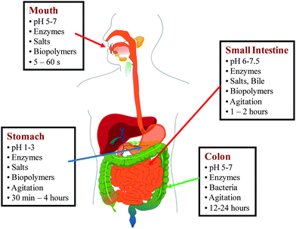
Actions of Digestive (GI) Tract
Ingestion
Occurs when material enters via mouth.
Digestion
Break down of complex nutrients into simple nutrients.
Motility of GI wall
Physically breaks down large chunks of food material and moves food along tract.
Secretion
Release of water acids, buffers, enzymes and salts by epithelium of GI tract and glandular organs facilitating chemical digestion.
Absorption
Movement of organic substrates, electrolytes, vitamins and water across digestive epithelium.
Elimination
Excretion of materials not absorbed.
Notes:
Retrieved from http://pubs.rsc.org/services/images/RSCpubs.ePlatform.Service.FreeContent.ImageService.svc/ImageService/Articleimage/2010/FO/c0fo00111b/c0fo00111b-f1.gif, 2016

Slide 7
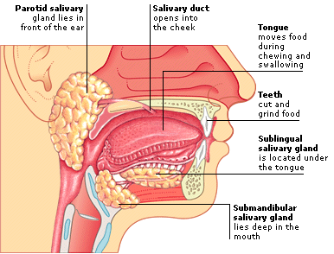
Digestion in the Mouth
Mechanical digestion (mastication or chewing)
Breaks into pieces.
Mixes with saliva so it forms a bolus.
Chemical digestion
Amylase – saliva – parotid, sublingual, submandibular
Begins starch (polysaccharide=carbs) digestion at pH of 6.5 or 7.0 found in mouth.
When bolus and enzyme hit the pH 2.5 gastric juices hydrolysis ceases.
Lingual lipase
Secreted by serous salivary glands in tongue.
Begins breakdown of triglycerides (=fats) into fatty acids and glycerol.
Notes:
Retrieved from http://img.ehowcdn.com/og-image-tag/ehow/images/a07/n2/u7/chewing-mastication-diets-800x800.jpg, 2014

Slide 8
Carbohydrates Starch, Dextrin, Sugars, Fiber, Wheat, Corn & Potato Starch, Pasta

Slide 10
Saliva
Secreted by salivary glands.
Mucus lubricates food and, coupled with water, facilitates mixing.
Amylase
Enzyme that initiates digestion of starches.
Small amount of salivary lipase released.
Sodium bicarbonate ↑pH (basic) for most effective amylase function.
Notes:
Patton A&P 8e

Slide 11
Digestion of Carbohydrates
Mouth
Salivary amylase
Esophagus and stomach
No digestion
Duodenum
Pancreatic amylase
Brush border enzymes – Small Intestine
Act on disaccharides producing monosaccharides.
Lactose (lactase) → glucose + galactose
Maltose (maltase) → glucose + glucose
Sucrose (sucrase) → glucose + fructose
Notes:
Patton A&P 8e

Slide 12
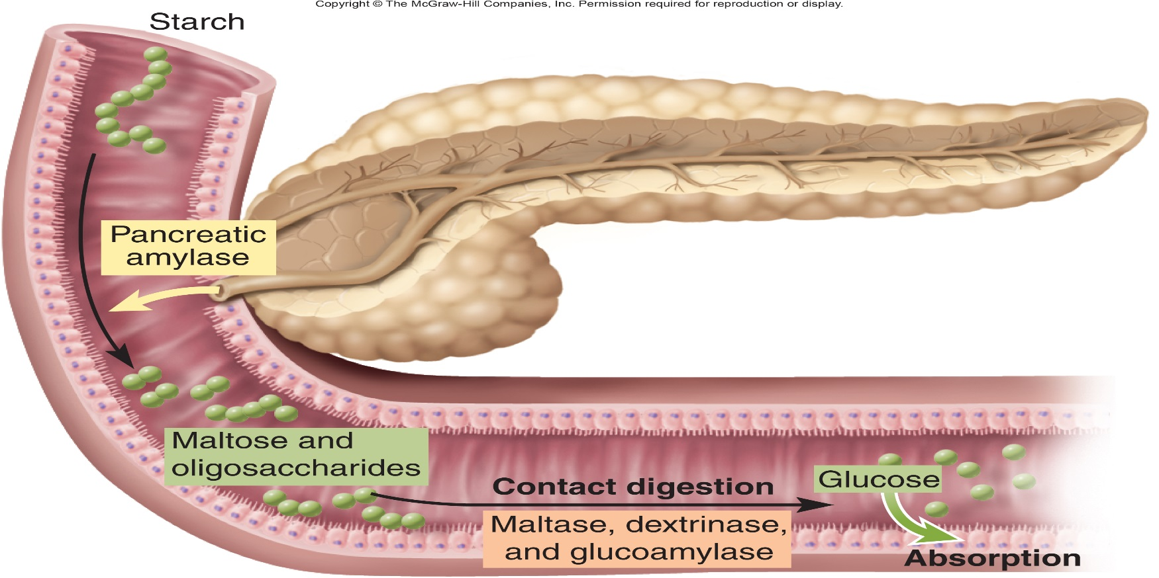
Carbohydrate Digestion in Small Intestine
Salivary amylase stops working in acidic stomach (pH < 4.5).
50% of dietary starch digested before it reaches small intestine.
Pancreatic amylase completes first step in 10 minutes.
Brush border enzymes act upon maltose, sucrose, lactose and fructose.
Notes:
Saladin A&P Unity of Form and Function 6e

Slide 13
Carbohydrate Digestion Review
Notes:
Retrieved from http://chemwiki.ucdavis.edu/@api/deki/files/25813/=37c9abefb172b2bf45f1be8f837a6f6f.jpg?revision=1, 2016

Slide 15
Clinical Correlation: Lactose Intolerance
Mucosal cells of small intestine fail to produce lactase.
Essential for digestion of lactose sugar in milk.
Undigested lactose retains fluid in the feces.
Bacterial fermentation produces gases.
Symptoms
Diarrhea, gas, bloating and abdominal cramps.
Dietary supplements are helpful.
Notes:
Retrieved from https://www.msu.edu/course/isb/202/tsao/images/lactose%20intol%20cow50.jpg, 2016

Slide 16
Protein Digestion Proteins = chains of Amino Acids (20/9) – Peptide Bonds

Slide 17
Proteins – Polypeptides – Peptides – Amino Acids

Slide 18
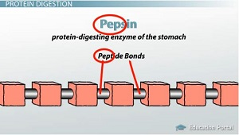
Digestion of Proteins
Stomach
HCl acid denatures or unfolds proteins.
Proteases catalyze hydrolysis of proteins into intermediate proteins then amino acids.
Pepsin in gastric juice turns proteins into peptides.
Pancreas
Trypsin
Digestive enzyme that split peptide bonds between different amino acids.
Breaks down proteins into peptides and amino acids.
Brush border enzymes (small intestine)
Aminopeptidase or dipeptidase split off amino acid at amino end of molecule or split dipeptide.
Notes:
Retrieved from http://study.com/cimages/multimages/16/pepsin-breaks-peptide-bonds.jpg, 2016

Slide 19
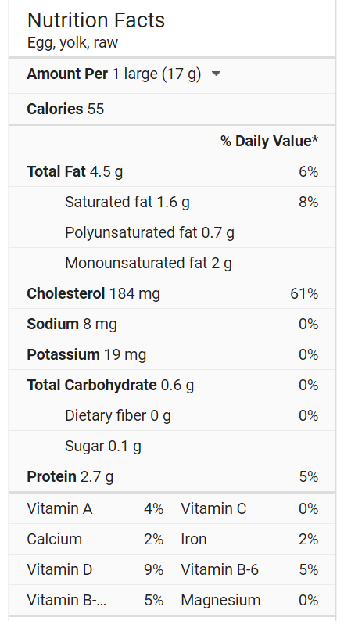

Slide 20
Denature Protein shape of a protein determines functionality – heat & acid will denature

Slide 21
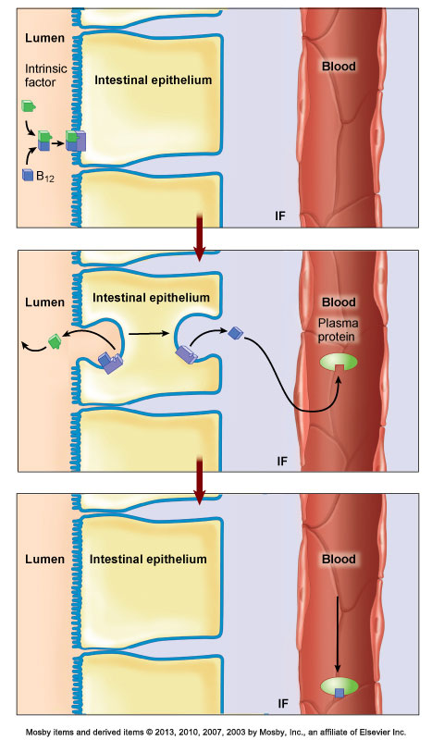
Gastric Enzymes and Intrinsic Factor
Pepsin (chief cell) protein digestion.
Secreted as pepsinogen (an inactive zymogen).
HCl (parietal cells ) converts it to pepsin (active form).
Pepsin then activates more pepsinogen.
Gastrin (G cells in stomach, duodenum, pancreas)
stimulates secretion HCl by the parietal cells
aids in gastric motility
Gastric lipase (chief cell)
fat digestion.
Lipase digests butterfat of milk in infant.
Intrinsic factor (parietal cells )
Essential for absorption of B₁₂ by small intestine.
Necessary for RBC production (pernicious anemia)
Notes:
Patton A&P 8e

Slide 22
Digestion of Proteins Begins in the Stomach
Notes:
Saladin A&P Unity of Form and Function 6e

Slide 23
In duodenum: Trypsin catalyzes hydrolysis of peptide bonds, breaking down proteins into smaller peptides & activates other enzymes
Notes:
Saladin A&P Unity of Form and Function 6e

Slide 24
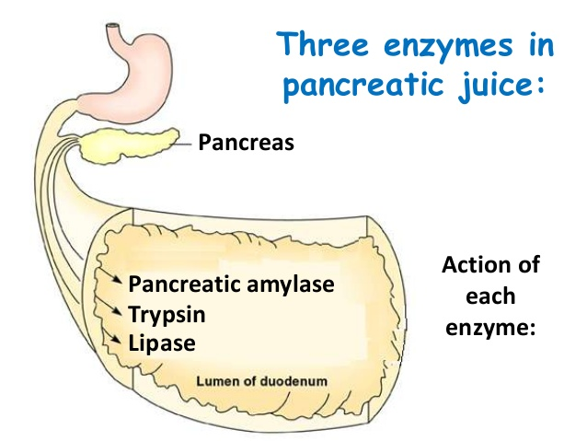
Composition and Functions of Pancreatic Juice
1 .5 quarts/day at pH of 7.1 to 8.2.
Contains water, enzymes and sodium bicarbonate.
Digestive enzymes
Pancreatic amylase, pancreatic lipase, proteases.
Trypsinogen - activated by enterokinase (a brush border enzyme).
Chymotrypsinogen - activated by trypsin.
Procarboxypeptidase - activated by trypsin.
Proelastase - activated by trypsin.
Trypsin inhibitor - combines with any trypsin produced inside pancreas.
Ribonuclease - to digest nucleic acids.
Deoxyribonuclease
Notes:
Retrieved from http://image.slidesharecdn.com/digestion-131209012039-phpapp02/95/digestion-62-638.jpg?cb=1386552149, 2016

Slide 25
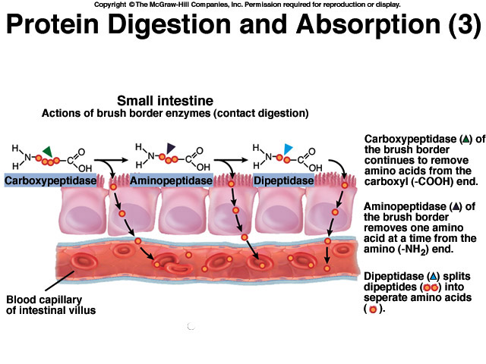
Brush border enzymes finish the task producing amino acids
Notes:
Tortora Principles of A&P 13eTortora Principles of A&P 13e

Slide 26
Protein Digestion Review
Notes:
Saladin A&P Unity of Form and Function 6e
\

Slide 27
Digestion of Lipids
Mouth
Lingual lipase
Small intestine
Emulsification by bile.
Breakdown of fat globules in duodenum into tiny droplet – NOT DIGESTION
Provides a larger surface area on which pancreatic lipase can act to digest fats.
Pancreatic lipase splits into fatty acids and monoglycerides.
No enzymes in brush border.
Notes:
Saladin A&P Unity of Form and Function 6e

Slide 28
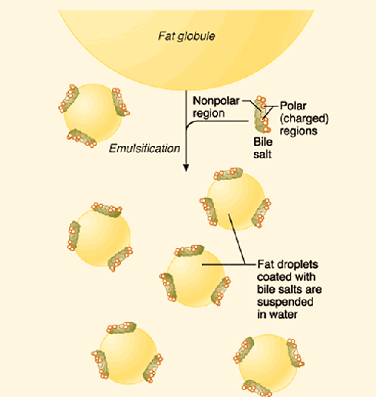
Bile and Intestinal Juice
Bile is secreted by liver, stored and concentrated in gall bladder.
Lecithin and bile salts emulsify fats encasing them to form micelles.
Bicarbonate ↑ pH for optimum enzyme function.
Cholesterol, products of detoxification, and bile pigments (bilirubin) are excreted by liver and eliminated in feces.
Intestinal juice
Secreted by cell of intestinal exocrine cells.
Mucus and H₂O lubricate and aid in continued mixing of chime.
Bicarbonate ↑ pH for optimum enzyme function.
Notes:
Retrieved from http://www.namrata.co/wp-content/uploads/2013/11/Role-of-bile-salts-in-emulsification.png, 2016

Slide 29
Bile Salt Emulsification (Fats are hydrophobic)

Slide 30
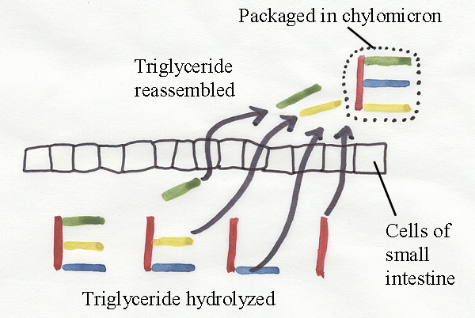
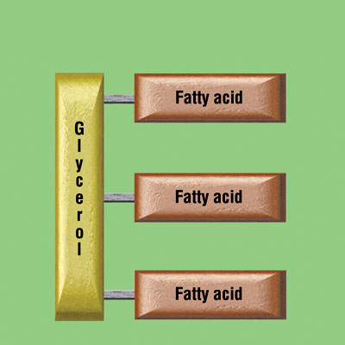
FAT Hydrolysis - Triglyceride, Monoglyceride, Fatty Acids

Slide 31
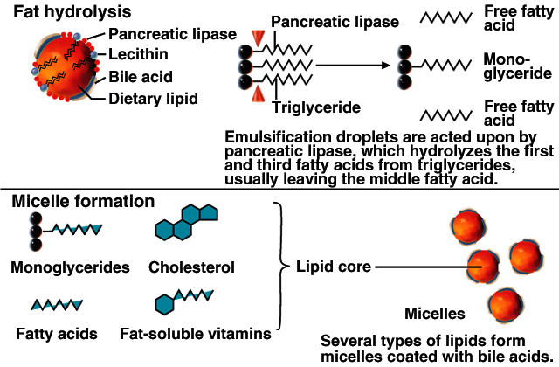
Fat Digestion Review
Notes:
Tortora Principles of A&P 13e

Slide 32
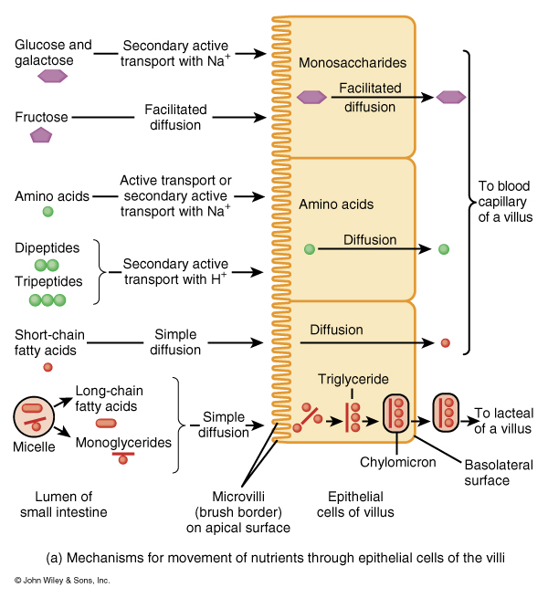
Absorption in Small Intestine
Notes:
Tortora Principles of A&P 13e

Slide 33
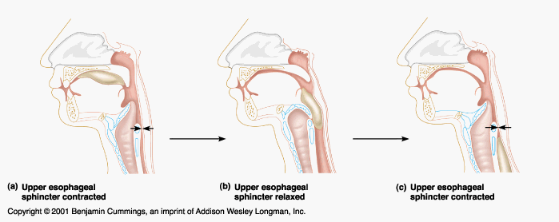
Deglutination: Process of Swallowing
Complex process requiring coordinated and rapid movements.
Upper sphincter relaxes when larynx is lifted.
Peristalsis pushes food down.
Circular fibers behind bolus .
Longitudinal fibers in front of bolus shorten the distance of travel.
Travel time is 4-8 seconds for solids and 1 sec for liquids.
Lower sphincter relaxes as food approaches.
Notes:
Retrieved from http://legacy.owensboro.kctcs.edu/gcaplan/anat2/notes/Image510.gif, 2016

Slide 34
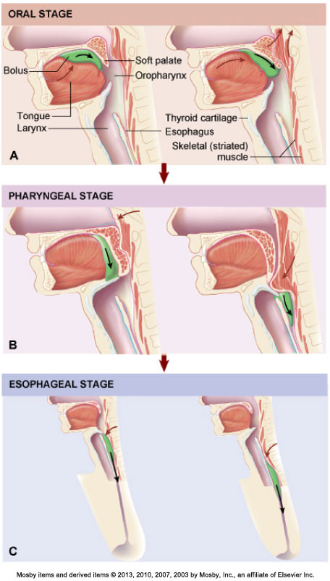
Stages of Deglutination
Oral
Mouth to oropharynx.
Voluntary
Formation of food bolus via manipulation on tongue to oropharynx.
Pharyngeal
Oropharynx to esophagus.
Involuntary movement.
Propel bolus from pharynx to esophagus.
Esophageal
Esophagus to stomach.
Involuntary
Contraction and gravity move bolus down esophagus to stomach.
Notes:
Patton A&P 8e

Slide 35
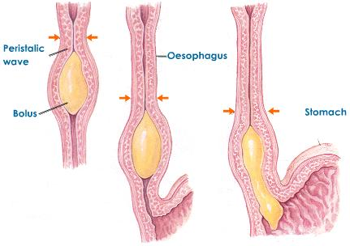
Two main types of motility produced by smooth muscle of GI tract.
Occur simultaneously of in alternating fashion.
Peristalsis
Wavelike ripple of muscle layer of a hollow organ.
Progressive motility that produces forward movement.
Segmentation
Mixing movement.
Digestive reflexes cause forward-and-backward movement with single segment.
Mixes food and digestive juices.
Brings digested food in contact with intestinal mucosa facilitating absorption.
Notes:
Retrieved from http://images.tutorvista.com/content/animal-nutrition/peristalsis.jpeg, 2016

Slide 36
Segmentation and Peristalsis

Slide 37
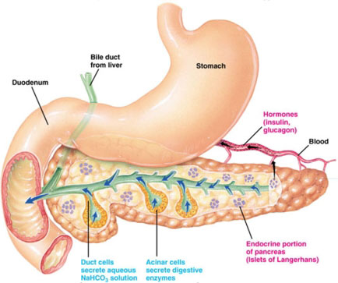
Activities
Following the instructions in the Survival Guide, perform the following experiments relating to digestive enzymes: (Clean All Test Tubes!)
Carbohydrate – page 217-219
Starch digestion with amylase
Lugol’s IKI test
Benedict’s solution test
Protein – page 220-221
Protein digestion with pepsin
Lipids – page 221-223
Emulsification of fats with bile salts
Fat digestion with lipase
Peristalsis – page 224
Notes:
Retrieved from http://pharmatips.doyouknow.in/images/2013.10/Human-Anatomy-Physiology-Of-Pancreas-220831410347652.png, 2016

Slide 38
Works Cited
Marieb, E. N. (2012). Essentials of human anatomy & physiology
(6th ed.). Boston: Pearson Education, Inc.
Marieb, E.N., Mitchell, S.J. & Smith, L.A. (2012). Human anatomy and physiology laboratory manual (10th ed.). Boston: Pearson Education, Inc.
Martini, F., Nath, J. & Bartholomew, E.F. (2012). Fundamentals of anatomy & physiology (9th ed.). Boston: Pearson Education, Inc.
McPhee, J. & Papadakis, M. (2012) Current medical diagnosis & treatment (51st ed.). New York: McGraw Hill.
Patton, T. & Thibodeau, G. (2013). Anatomy & physiology (8th ed.).
St. Louis:Mosby Elsevier.
Saladin, K. S. (2012). Anatomy & physiology: The unity of form and function (6th ed.). New York: McGraw Hill.
Tortora, G.J. & Derrickson, B.H. (2012). Principles of anatomy and physiology (13th ed.). Hoboken, NJ: Wiley

