Slide 1
BI 233 Laboratory Respiratory Physiology
Notes:
Retrieved from http://www.aireurbano.com/wp-content/uploads/2014/05/Respiratory-system-cells.JPG, 2016

Slide 2
Respiratory Terminology
Pulmonary ventilation
Process by which O₂ enters and CO₂ exits alveoli (breathing).
Respiration
Process by which O₂ and CO₂ diffuse in and out of the blood (gas exchange)
Occurs in 2 areas of the body.
External respiration – gas exchange across respiratory membrane of lungs (alveoli) into the blood.
Internal respiration – gas exchange between the blood and the interstitial fluid, tissues and cells
Cellular respiration
Series of metabolic processes where living cells produce energy through oxidation of organic substances.

Slide 3
Cellular Respiration

Slide 4
Pulmonary Ventilation: Respiratory Cycle
Ventilation is breathing with a respiratory cycle including:.
Inspiration
Air moves into lungs when pressure inside lungs is less than atmospheric pressure.
Expiration
Air moves out of the lungs when pressure inside lungs is greater than atmospheric pressure.
1 ATM or 760mm Hg
Notes:
Patton A&P 8e

Slide 5
Mechanics of Breathing
Notes:
Saladin A&P The Unity of Form and Function 6e

Slide 6
Pneumothorax
Pleural cavities are sealed cavities not open to the outside.
Presence of air in pleural cavity.
Loss of negative intrapleural pressure allows lungs to recoil and collapse.
Collapse of lung (or part of lung) is called atelectasis.
Injuries to the chest wall that let air enter the intrapleural space.
Mechanism of injury.
Collapsed lung on same side as injury.
Surface tension and recoil of elastic fibers causes the lung to collapse.
Notes:
Retrieved from https://www.med-ed.virginia.edu/courses/rad/chest/images/x-rays/tensionpnewitharrows.jpg, 2016

Slide 7
Spirometry
Is a common test used to assess how well your lungs work by measuring how much air you inhale, how much you exhale and how quickly you exhale.
It is used to diagnose asthma, chronic obstructive pulmonary disease (COPD) and other conditions that affect breathing

Slide 8
Pulmonary Volumes (how much)
Exchange of O₂ and CO₂ dependent on normal volumes of air moving in and out, and remaining volumes.
Respiratory volumes
Tidal volume (TV)
Air exhaled after a normal inspiration (quiet breathing).
Inspiratory reserve volume (IRV)
Air in excess of tidal inspiration that can be inhaled with maximum effort.
Normal = 3.3L
Expiratory reserve volume (ERV)
Air in excess of tidal expiration that can be exhaled with maximum effort.
Normal = between 1.0 and 1.2L
Residual volume (RV)
Air remaining in lungs after maximum expiration, keeps alveoli inflated.
Normal = 1.1-1.2L

Slide 9
Pulmonary Capacities
Vital capacity (VC)
Amount of air that an be exhaled with maximum effort after maximum inspiration.
Influenced by size of thoracic cavity and posture.
Assess strength of thoracic muscles and pulmonary function.
VC = IRV + TV + ERV
Inspiratory capacity (IC)
Maximum amount of air that can be inhaled after a normal (tidal) expiration.
Functional residual capacity (FRC)
Amount of air in lungs after a normal respiration (tidal).
Total lung capacity (TLC)
Maximum amount of air lungs can hold.
Sum of all four lung volumes.
TLC = TV + IRV + ERV + RV

Slide 10
Pulmonary Volumes and Capacities
Notes:
Saladin A&P The Unity of Form and Function 6e

Slide 11
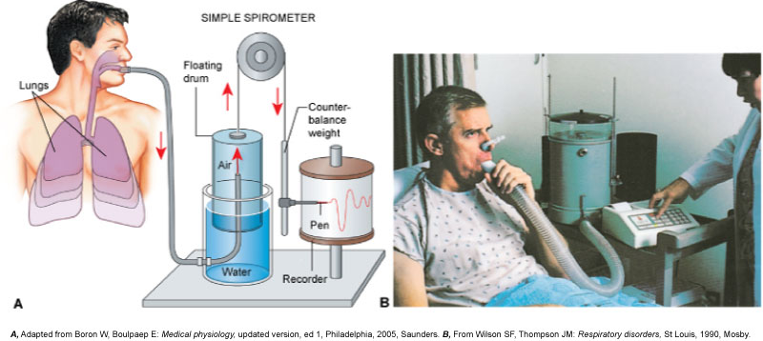
Pulmonary Volumes, Capacities and Air Flow
Wet Spirometers - measure volumes of gas that lungs exhale, can obtain ERV, TV and VC function of time. Can calculate the IRV using the following formula: IRV= VC-(ERV+TV)
Notes:
Patton A&P 8e

Slide 12
Affects on Respiratory Volumes and Capacities
Age
↓ lung compliance, respiratory muscles weaken.
Exercise
Maintains strength of respiratory muscles.
Body size
Proportional, big body has large lungs.
Restrictive disorders
↓ compliance and vital capacity (volume).
Obstructive disorders
Interfere with airflow, expiration requires more effort or less complete.
Notes:
Retrieved from http://martinfrost.ws/htmlfiles/oct2006/copd_01.jpg, 2016

Slide 13
FEV: Most Important Measurement of Lung Function
Forced expiratory volume (FEV) – volume of gas expired over time – (typically 1 sec=FEV1)
AKA: forced vital capacity (FVC)
Maximum volume of gas expired/second during forced expiration (% of VC).
Exhaled from full inhalation as forcefully and rapidly as possible.
Amount of air exhaled may be measured during first (FEV1), second (FEV2), and/or third seconds (FEV3) of forced breath.
Healthy adult - 75 to 85% in 1 sec.
FEV used to…
Diagnose obstructive lung diseases (asthma and COPD).
Individuals with asthma or COPD have lower FEV1 result than a healthy person.
Indicate effectiveness of medications prescribed for lung disease.
Monitor disease status.
Decreases in FEV1 value may indicate condition is worsening.

Slide 14
Pulmonary Airflow
Notes:
Patton A&P 8e

Slide 15
Respiratory Diseases
Obstructive Lung Disease – (Outflow)
Not getting air out
Large over inflated lungs because air can’t get out
Asthma (airways spasm and close)
Chronic bronchitis
Emphysema (lungs loose their elasticity)
Restrictive Lung Disease – (Intake)
No problem expiring air there is just less air
Lungs can not expand (an intake problem)
Fibrosis (tissue gets stiff)
Muscular diseases (muscular dystrophy, ALS)
obesity

Slide 17
FEV1 Forced Expiratory Volume = volume of air exhaled under forced conditions in the first one second
FEV1 /VC Percent Forced Vital Capacity = the ratio of FEV₁ to VC. In healthy adults this should be approximately 70–85% (declining with age).
In obstructive lung disease, (asthma, COPD, chronic bronchitis, emphysema) the FEV1 is reduced because of increased airway resistance to expiratory flow. Thus, the FEV1/FVC ratio will be reduced.
In restrictive lung disease, (fibrosis) the FEV1 and VC are equally reduced. Thus, the FEV1/VC ratio should be approximately normal.

Slide 18
Obstructive Respiratory Disorders
Notes:
Patton A&P 8e

Slide 19
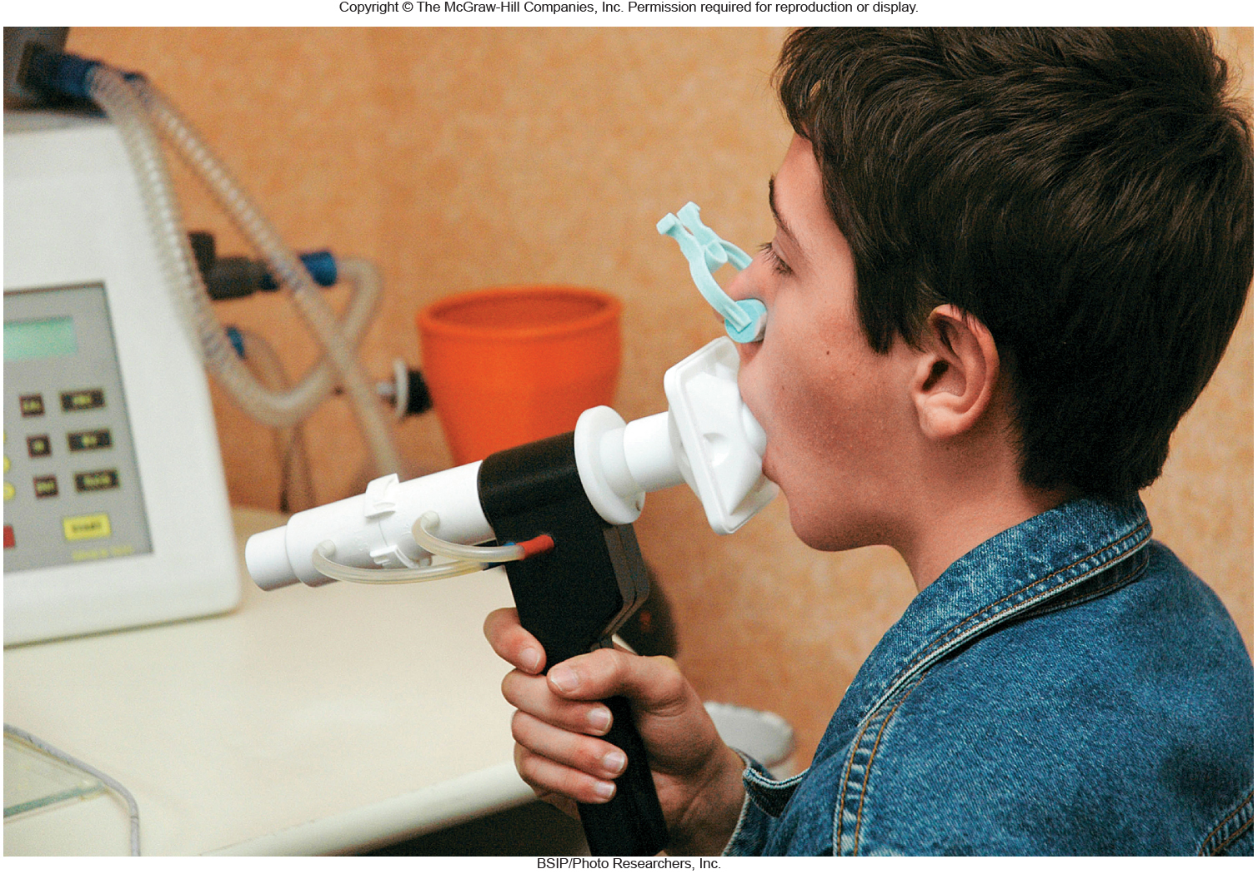
Activities
Spirometry exercise – pg. 203-205
Notes:
Saladin A&P The Unity of Form and Function 6e

Slide 20
What happens if we can’t expire CO2?
Hypercapnia (too much CO2)
If CO2 accumulates in the bloodstream the blood becomes acidic a condition called respiratory acidosis.
Hypocapnia (too little CO2)
If there is not enough CO2 in the bloodstream then blood becomes alkaline a condition call respiratory alkalosis.

Slide 21
Gas Exchange and Transport
Lungs decrease acid y incresing respiration or increase acid by decreasing respiration
Kidneys decrease acid by urinating H+ and putting base into blood
Notes:
Patton A&P 8e

Slide 22
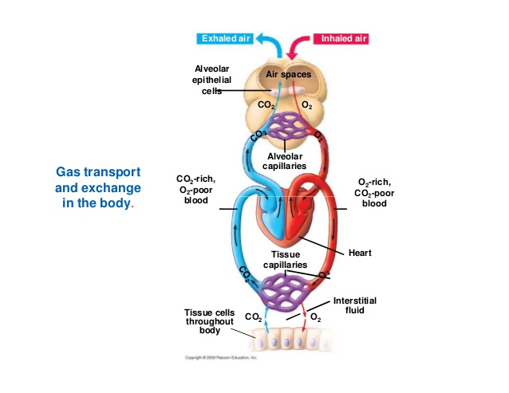
Gas Exchange and Transport: CO₂
CO₂ is carried in blood 3 ways:
Small percentage CO₂ dissolves into plasma (7%).
Hemoglobin can bind to some CO₂ (23%).
Most interacts with plasma H₂O to convert to carbonic acid (H₂CO₃) (70%).
Brain translates an increase in CO₂ as not breathing enough.
Carbon dioxide in tissues.
PCO₂ = 45 mmHg
Enters blood and combines with water to form carbonic acid.
Carbonic acid splits into hydrogen ion (H⁺) and bicarbonate (HCO₃¯).
HCO₃¯ + H⁺ forms H₂CO₃
H₂CO₃ splits to form H₂O and CO₂
CO₂ diffuses from blood into alveoli.
Notes:
Retrieved from http://image.slidesharecdn.com/chapter22-gasexchangecompatibilitymode-141214134225-conversion-gate01/95/chapter-22-gas-exchange-compatibility-mode-24-638.jpg?cb=1418564837, 2016

Slide 23
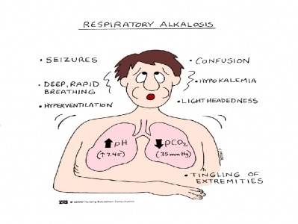
Effects of Hydrogen Ions
Respiratory alkalosis (pH > 7.45)
Hypocapnia (PCO₂) < 37 mmHg.
Caused by hyperventilation
Corrected by hypoventilation, pushes reaction to the right. CO₂ + H₂O → H₂CO₃ → HCO₃⁻ + H⁺
↑ H⁺, lowers pH to normal.
Respiratory acidosis (pH < 7.35)
Caused by failure of pulmonary ventilation - hypoventilation.
Hypercapnia (PCO₂) > 43 mmHg
CO₂ easily crosses blood-brain barrier, in CSF the CO₂ reacts with water and releases H⁺, central chemoreceptors strongly stimulate inspiratory center.
Corrected by hyperventilation, pushes reaction to the left by “blowing off ” CO₂ (expired). CO₂+ H₂O ← H₂CO₃ ← HCO₃⁻ + H⁺
Notes:
Retrieved from http://studydroid.com/imageCards/05/g4/card-5771775-back.jpg, 2016

Slide 24
Buffers
Any mechanism that resists changes in pH by converting a strong acid or base to a weak one.
A chemical buffer is a substance that binds H+ and removes it from solution as its concentration begins to rise, or releases H+ into solution as its concentration falls

Slide 25
Gas Exchange and Transport
Lungs decrease acid by increasing respiration or increase acid by decreasing respiration
Kidneys decrease acid by urinating H+ and putting base into blood
Notes:
Patton A&P 8e

Slide 26
Do Buffer Activity in lab manual
Follow the instructions in your manual

Slide 27
Activity: Effect of pCO2 on respiratory Rate
1. Observe lab partner for one minute and record their respiratory rate (# of breaths per min)
2. Next have partner take slow, deep breaths for two minutes and record respiratory rate for one minute
Was there an increase or decrease in the respiratory rate?
3. Next have partner breathe in and out of a paper bag (covering their nose and mouth with the bag) for two minutes and then record respiratory rate for one minute.
Was there an increase or decrease in the respiratory rate?

Slide 28
Activity: Effect of CO2 on the pH of a solution
Since we can’t measure the effects of ventilatory rate on blood pH directly in the lab because it requires an analysis of arterial blood we will use water and test the pH while resting, exercising and after exercising.
Follow the instructions in your lab manual and then answer the questions.

Slide 29
Oxygen Imbalances: Hypoxia
Hypoxemic hypoxia - usually due to inadequate pulmonary gas exchange
High altitudes, drowning, aspiration, respiratory arrest, degenerative lung diseases, CO poisoning.
Ischemic hypoxia - inadequate circulation. Shock
Anemic hypoxia - anemia
Histotoxic hypoxia - metabolic poison (cyanide).
Cyanosis - blueness of skin.
Primary effect of hypoxia is tissue necrosis, organs with high metabolic demands affected first.
Notes:
Retrieved from https://upload.wikimedia.org/wikipedia/commons/d/dc/Cynosis.JPG, 2016

Slide 30
Activity: Pulse Oximeter
Check your oxygen saturation levels and record on chart

Slide 31
Works Cited
Marieb, E. N. (2012). Essentials of human anatomy & physiology
(6th ed.). Boston: Pearson Education, Inc.
Marieb, E.N., Mitchell, S.J. & Smith, L.A. (2012). Human anatomy and physiology laboratory manual (10th ed.). Boston: Pearson Education, Inc.
Martini, F., Nath, J. & Bartholomew, E.F. (2012). Fundamentals of anatomy & physiology (9th ed.). Boston: Pearson Education, Inc.
McPhee, J. & Papadakis, M. (2012) Current medical diagnosis & treatment (51st ed.). New York: McGraw Hill.
Patton, T. & Thibodeau, G. (2013). Anatomy & physiology (8th ed.).
St. Louis:Mosby Elsevier.
Saladin, K. S. (2012). Anatomy & physiology: The unity of form and function (6th ed.). New York: McGraw Hill.
Tortora, G.J. & Derrickson, B.H. (2012). Principles of anatomy and physiology (13th ed.). Hoboken, NJ: Wiley

